Slide 1
The Demon-Haunted World
Carl Sagan

Slide 2
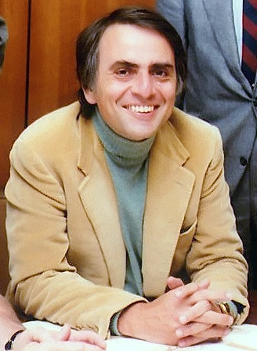
Carl Sagan
1934-1996
Astronomer cosmologist Astrophysicist
Cosmos: A Personal Voyage
Pulitzer Prize and the Hugo Award
myelodysplastic syndrome

Slide 3
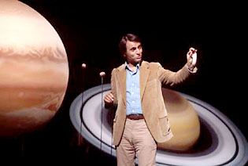

Slide 4
25 chapters
Valid VS pseudo
Author aims to explain the scientific method to laypeople, and to encourage people to learn critical and skeptical thinking

Slide 5
Dragon in the garage
https://www.youtube.com/watch?v=frI5y6tNsZg

Slide 6
Demons
Ancient world
Natural
“Work of a personal benign demon” - Socrates
Diotima of Mantineia describes them as intermediate between god and man
Plato believed demons had a high role of greater power
“God, in his love of mankind, placed over us the demons, who are a superior race.... Taking care of us and giving us peace and reverence and order and justice never failing, made the tribes of men happy and united.”
Didn’t believe demons to be evil, believing that Eros (keeper of sexual passion) was a demon
Dreams
Aristotle

Slide 7
Demons
Pagan Religion
St. Paul talked about wickedness in high places, referring to demons, in Ephesians 6:14
Demons were a symbol of human evil
St. Augustine
Believed demons were imortal but had passions similar to men
Characterizes them as evil
Antiquity-medieval times
Maimonides denied them
Macrobius described them as phantoms

Slide 8
Incubi and Succubi
Demons that come down and commit acts of rape
Offspring are considered witches
Many women in convent report incubi
Dreams
Ludovico Sinistrari believed they could go through walls

Slide 9
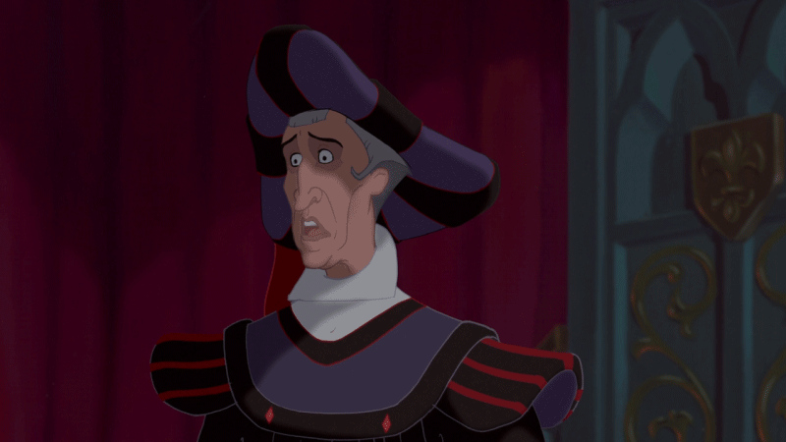
Witches
“It has come to Our ears that members of both sexes do not avoid to have intercourse with evil angels, incubi, and succubi, and that by their sorceries, and by their incantations, charms, and conjurations, they suffocate, extinguish, and cause to perish the births of women.”
-Pope Innocent VIII, Bull of 1484
Mainly persecuted women
Kramer and Sprenger appointed by Pope to write about witchcraft
Malleus Maleficarum
“Unparalleled cruelty”

Slide 10
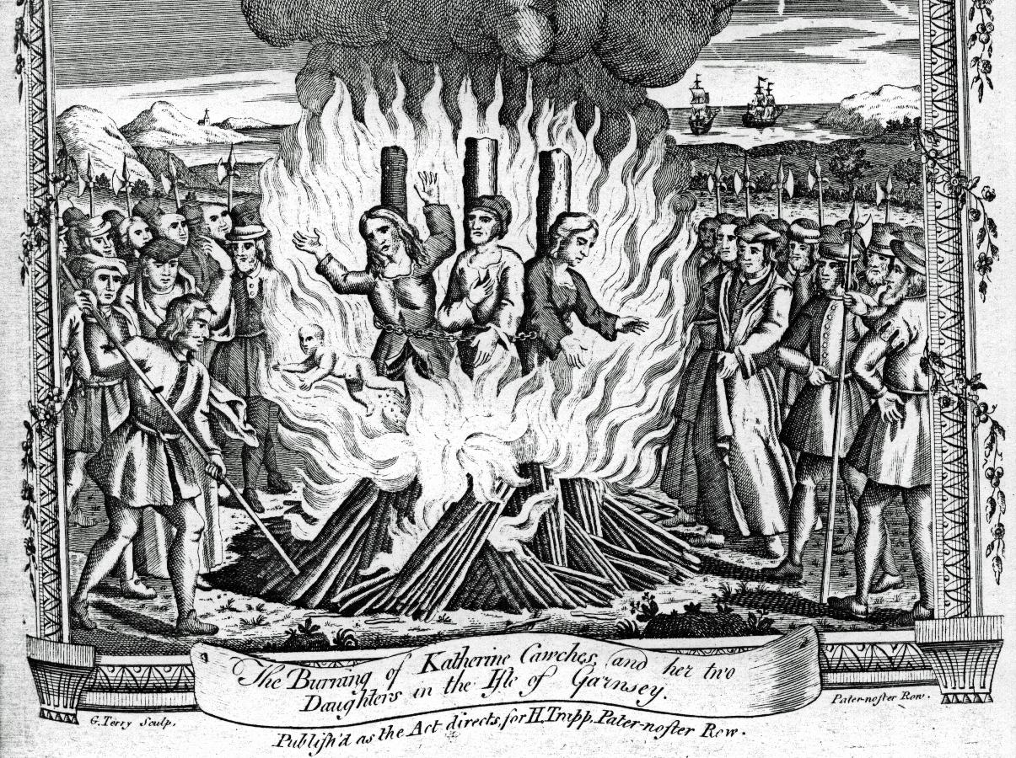
So you’ve been accused of being a witch… now what?
Once you’re accused, you’re guilty
Often tortured to show validity of accusation
To “release demons from the victim’s body” but often killed the accused
ZERO rights once accused and cannot confront accuser
Very expensive, with all costs endured by accused or family
Even their burning and torturer
Legally and morally sanctioned
Confessions under torture only convinced people more of the guilt of all accused
Each accused also accused others, making numbers grow rapidly
No defense worked, since you could attribute an alibi to a demon impersonator
“Humane attention” was being executed and burned privately
Anyone who tried to say witch-burning was wrong was also burned

Slide 11
Ancient Demons and Modern UFO
“If we reckon the skepticism that Gibbon says characterizes his time to have declined in ours, and even if a little of the rampant gullibility he attributes to late classical times is left over in ours, should we not expect something like demon to find a niche in the popular culture of the present?”
-Carl Sagan

Slide 12
In defense of Aliens...
Some believers of UFOs claim that ancient stories of demons and witches were aliens.
If this were the case…
Why are there no UFO reports prior to 1947?
Why doesn't any religion use a flying saucer/spaceship as their icon?
Why haven't the alien experiments been completed with centuries of tests?

Slide 13
Religion and UFOs
Several christian sects believe that God came to Earth in a UFO (the “Raelians”).
Some abductees describing their captors as “angels” or “emissaries of God”
Other Believers suggest that UFOs are omens of “end-times”
I have become thoroughly convinced that UFOs are real...They are operated by alien beings of great intelligence and power...I believe these beings are not only extraterrestrial but supernatural in origin. To be blunt, I think they are demons...part of a Satanic plot.
-Hal Lindsey, fundamentalist Christian author

Slide 14
Alien Appearance
Across all reported alien encounters, alien appearance rarely differs.
UFO believer Richard Boylan describes the known types of aliens:
“You’ve got three-and-a-half foot to four-foot types...five to six-foot types...three finger, and five finger types...large almond eyes slanted upward, outward, or horizontally.”
“Despite this apparent variety of extraterrestrials, the UFO abduction syndrome portrays, it seems to me a banal Universe.”

Slide 15
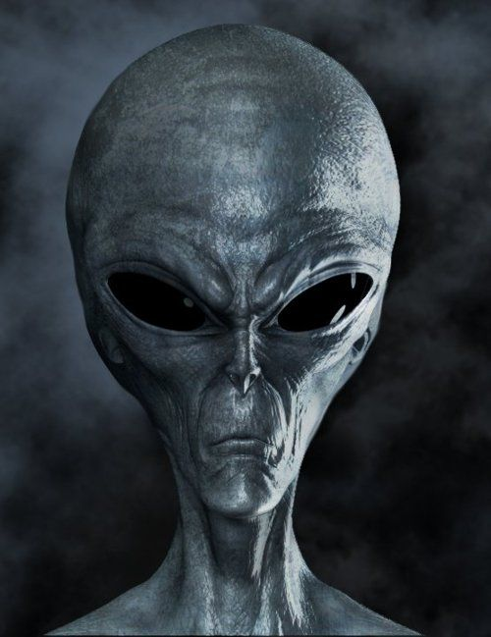
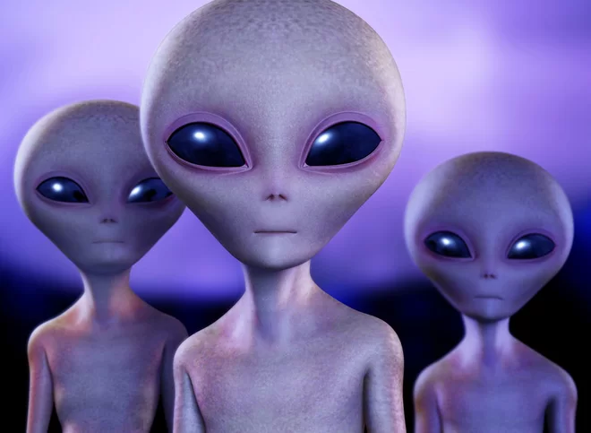
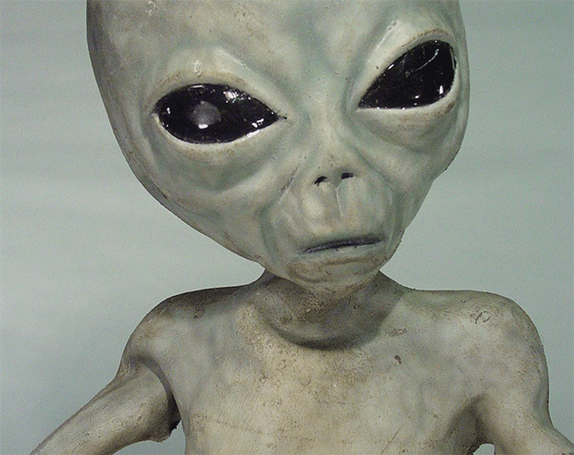
What is described

Slide 16
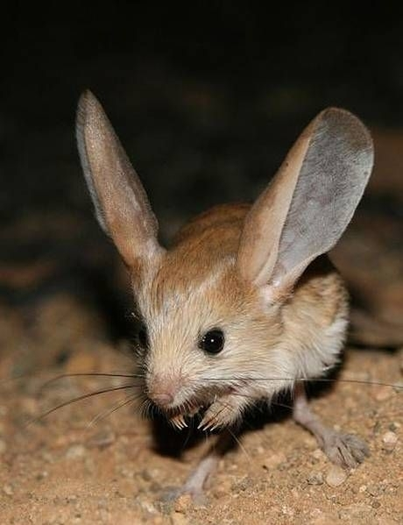
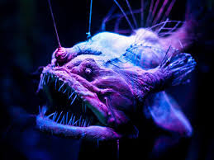
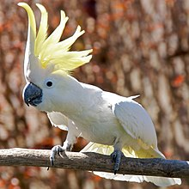
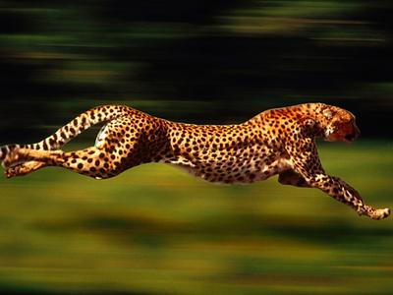
What you would expect

Slide 17
Works Cited
Main article:
Sagan, Carl. “The Demon Haunted World.” The Demon Haunted World, pp. 116–133.
Alien pictures:
“Spiritual Unite.” Spiritual Unite, www.spiritualunite.com/articles/real-aliens-on-earth-species-races-known/.
Animal pictures:
“Amazing Animals.” Mcgeesites, mcgeesites.wikispaces.com/Amazing+Animals.

