Slide 1
Psychiatrist Claims Alien Abduction
By: Claire, Raymond, Alex, and Matt

Slide 2
Patients’ Stories
- Floating into ship
Probing and experiments of sexual nature
The Aliens
Lecture on taking care of Earth
Repeated abductions

Slide 3
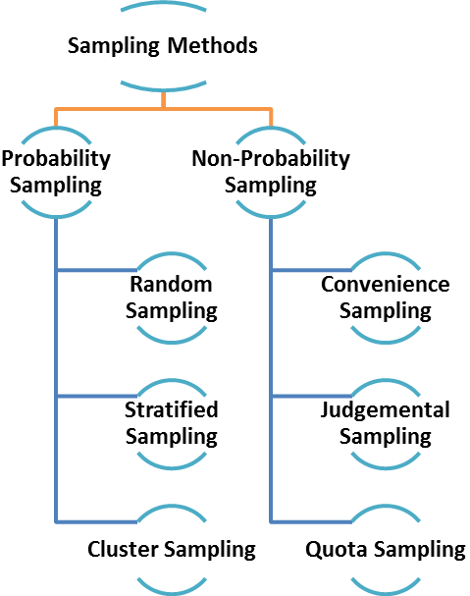
Experiment & Testing
Lack control & negative groups
Suspicious sampling
Hypnosis & subjective feedbacks
Logic fallacy: slippery slope
Double-blind
Memories are not reliable
Correlation

Slide 4
Critics to Mack’s claim
-He misused the technique of hypnosis
-He endangered the emotional health
-He did not use the scientific method to do the experiment
-He billed the insurance companies of at least some patients subjects

Slide 5
Critics to Mack himself and his book
-He himself believes supernatural power
-There is no logic in the book and he uses difficult phrases to make his readers misunderstand
-Also, why is this such an American phenomenon?

Slide 6
Test Using Scientific Method
Observation
Form 2+ Hypotheses
Design Experiment
Report your results for critical review by others
Notes:
Waking up paralyzed with a sense of a strange person or presence or something else in the room.
Experiencing a period of time of an hour or more, in which you were apparently lost, but you could not remember why, or where you had been.
Seeing unusual lights or balls of light in a room without knowing what was causing them, or where they came from.
Finding puzzling scars on your body and neither you nor anyone else remembering how you received them or where you got them.
Feeling that you were actually flying through the air although you didn't know why or how.

Slide 7
Test Using Scientific Method
Observation
People wake up feeling paralyzed, see weird lights, feel like they had been flying, have weird scars
Form 2+ Hypotheses
This is a normal human phenomenon.
These humans have been abducted by aliens.
Design Experiment
Take 10 random people off the street. Ask them the five questions. During hypnosis, do not use leading questions. Have a person in room to monitor whether leading questions are used. Record reactions/responses of subjects.
Report your results for critical review by others
Have accredited psychiatrists review test.

