Slide 1


Wake Forest University
February 22, 2019
WFU Analysis Seminar: Nonlinear Analysis
John A. Gemmer
gemmerj@wfu.edu

Slide 2


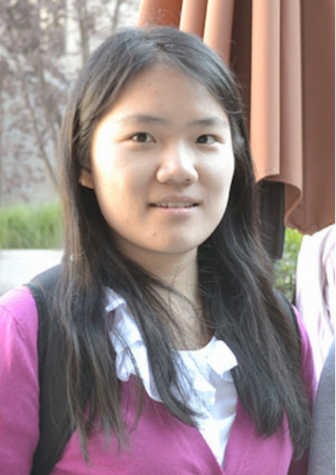




Collaborators
Max Rezek
Jessica Zanetell
Yuxin Chen
Alexandria Volkening
Shankar
Bjorn Sandstede
Mary Silber

Slide 3
Outline
Lecture 1 (2/22/19) Survey of Nonlinear Analysis:
Intro to nonlinear methods
Intro to some modern problems in calculus of variations
Intro to Gamma convergence
Lecture 2 (3/01/19) Pattern Formation in Hyperbolic Sheets:
Intro to non-Euclidean model of thin elastic sheets
Existence and regularity of (some) solutions to Monge-Ampere equation
Lecture 3 (3/08/19) Large Deviations in SDES:
Intro to Friedlin-Wentzell functional
Tipping events in piecewise-smooth SDEs.

Slide 4
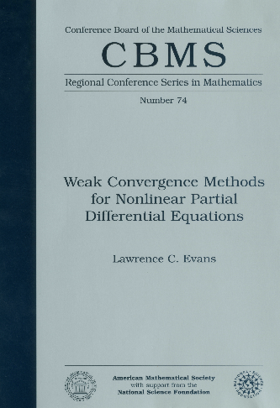

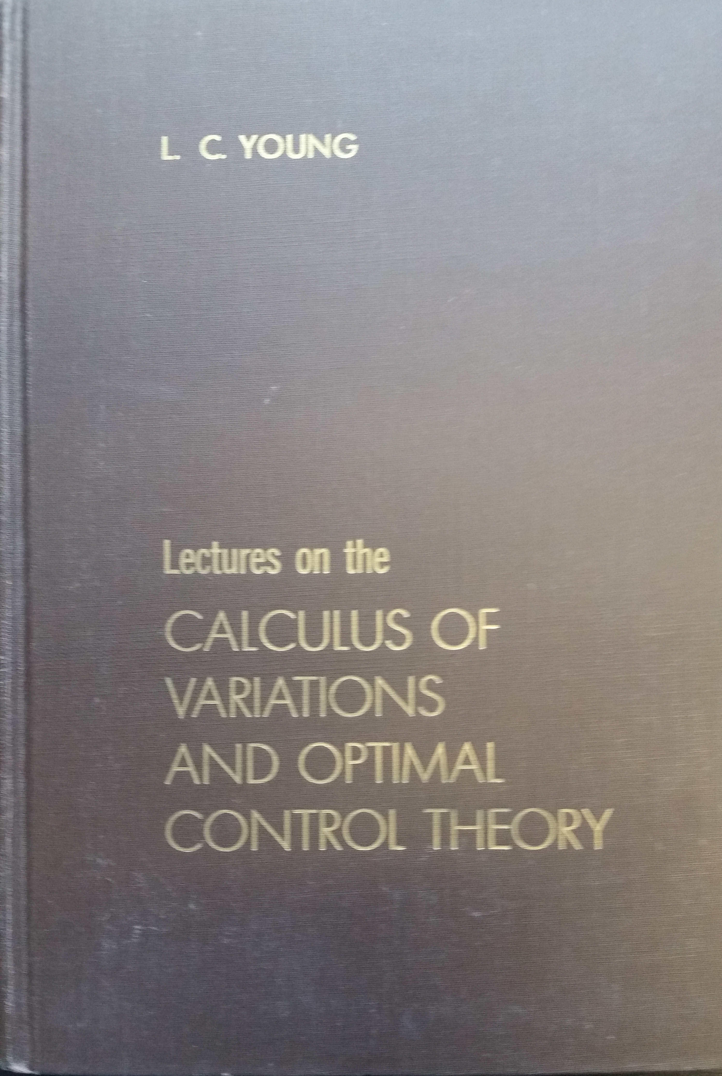
Books!
Evans, L. C. (1990). Weak convergence methods for nonlinear partial differential equations (No. 74). American Mathematical Soc..
Braides, A. (2002). Gamma-convergence for Beginners (Vol. 22). Clarendon Press.
Young, L. C. (2000). Lecture on the calculus of variations and optimal control theory (Vol. 304). American Mathematical Soc..

Slide 5






Big Picture
Solve the following equation:
Idea: Solve approximate problem
Goal: Prove the following
Problem:
Weak Compactness

Slide 6

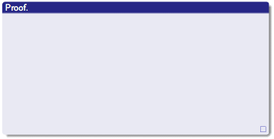
Why Care?

Slide 7





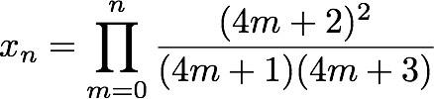

The World’s First Nonlinear Problem
Your “mathematical reality” is , solve the following equation:
Approximation Schemes:

Slide 8







Solution to Square Root Problem
is an equivalence class of approximations schemes! That is, it is an equivalence class of Cauchy sequences.
Equivalence relation:

Slide 9
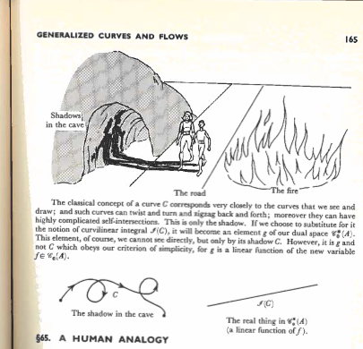
We All Live in a Cave

Slide 10

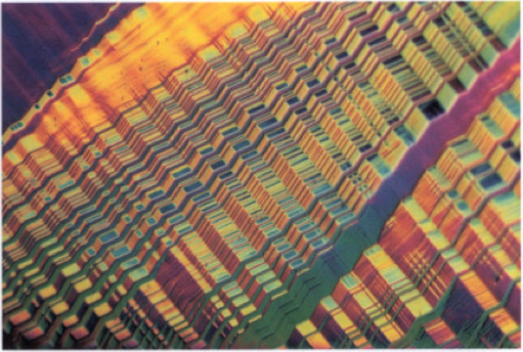
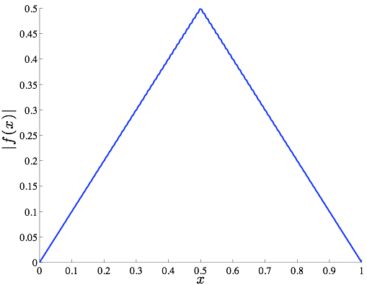
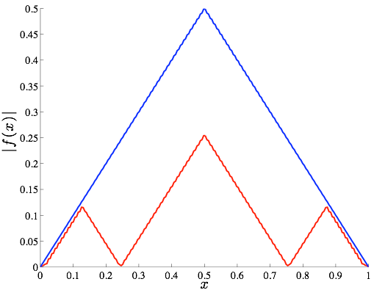
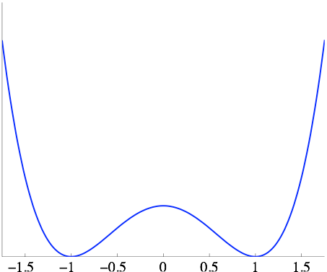
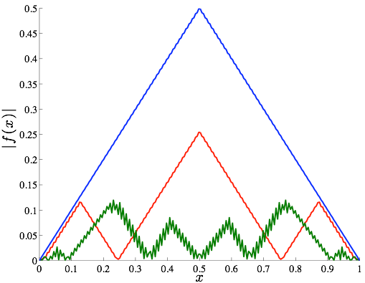
Calculus of Variations Example 1
Goal: Find f that minimizes the functional E.
State 1
State 2
Infinite number of minimizers!

Slide 11


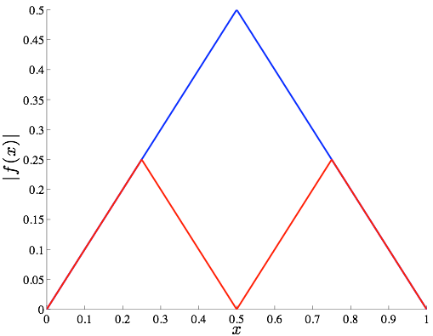
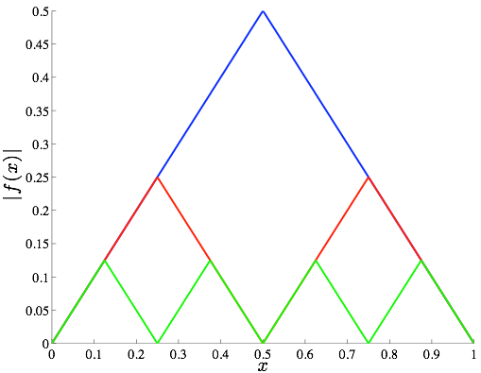
Calculus of Variations Example 2
Vanishes when
Vanishes when
There is no minimum for this problem!
Minimizing Sequence
Minimizing Sequence
Minimizing Sequence

Slide 12

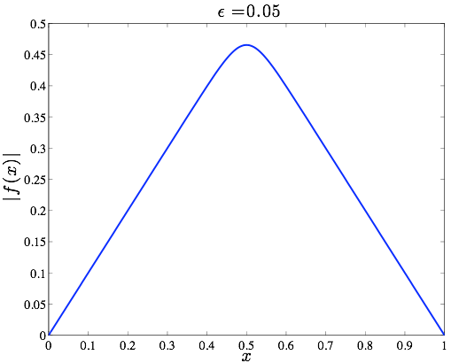
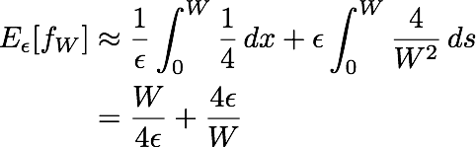

Calculus of Variations Example 3
Good guess:
Optimize over W:
Limiting Energy

Slide 13
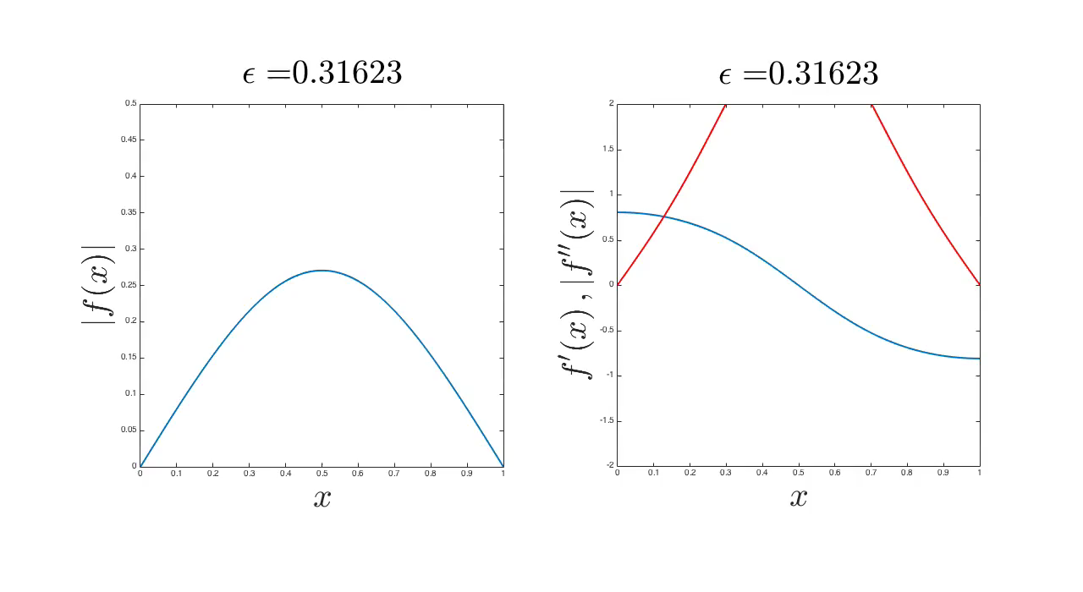
Calculus of Variations Example 3
Energy concentrates on tip of triangle (Defect).

Slide 14

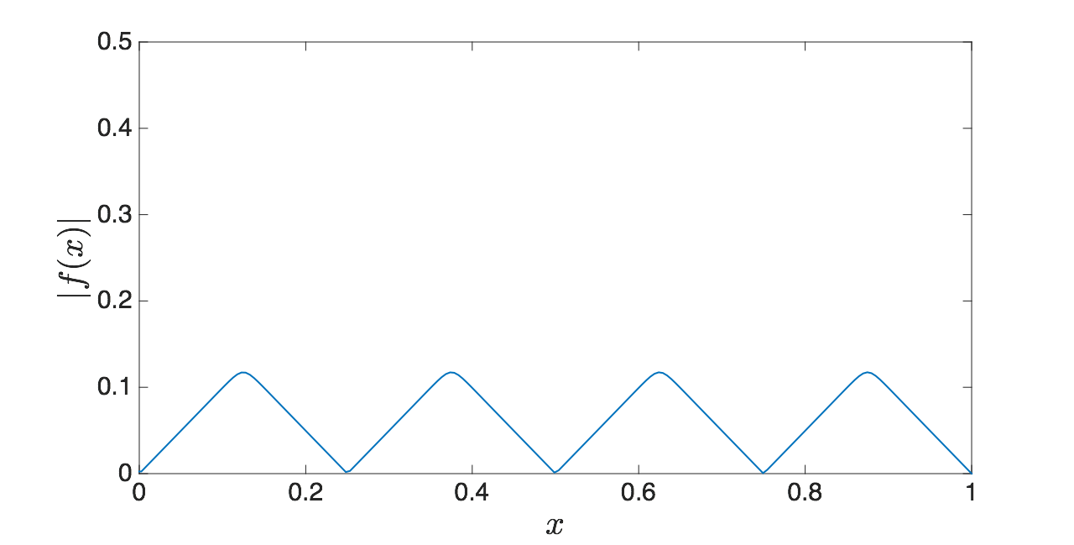

Calculus of Variations Example 4
Defects

Slide 15
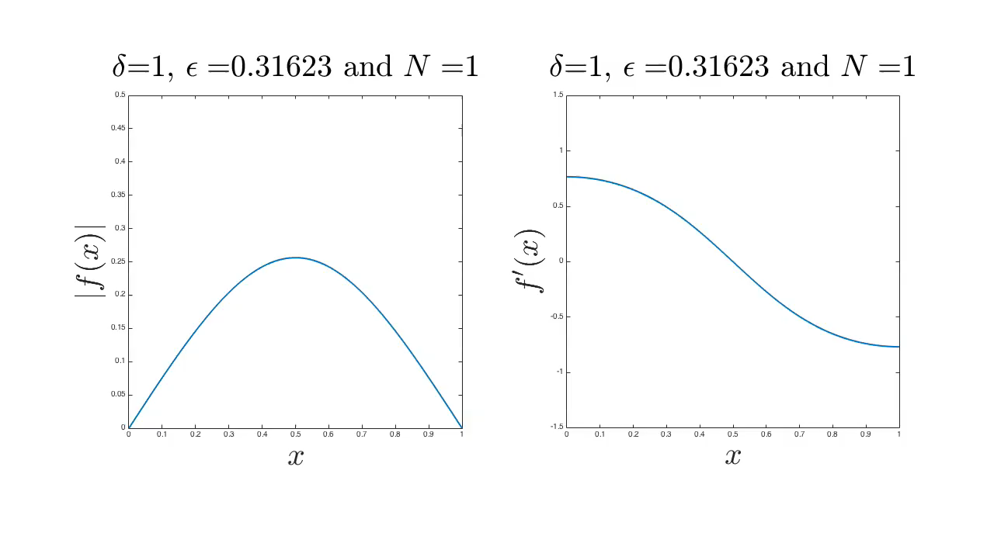
Calculus of Variations Example 4
Energy concentrates on defects.

Slide 16



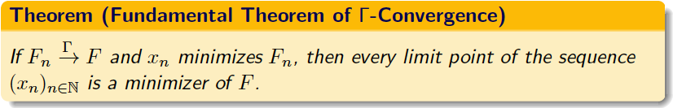
Gamma-Limits
Definition: Let F_n:X->R . We say F_n G-converges to F:X-> R and write G-lim_{n}=F if
Asymptotic Lower Bound: For every x\inX , and every adfadsfa in X:
Recovery Sequence: For every x\inX , there exists some adfadsfa such that in X and:

Slide 17


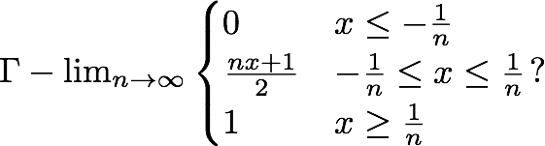
Examples:

Slide 18
Calculus of Variations Example 3
Good guess:
Optimize over W:
Limiting Energy

Slide 19
Observations
Competition between different terms energy scales drives pattern formation.
“Simple” differential equations give the correct pattern.
Knowing how the patterns partition energy (scaling laws), the problem reduces to solving a discrete optimization problem.
Big Picture:
In an indirect manner we have developed rigorous asymptotic approximations to solutions to a fourth order nonlinear differential equation.
We have also developed a simple robust discrete numerical algorithm for solving the equation.
This technique is similar to the viscosity method for regularizing shocks in hyperbolic systems.

Slide 20


Why Care?

Slide 21

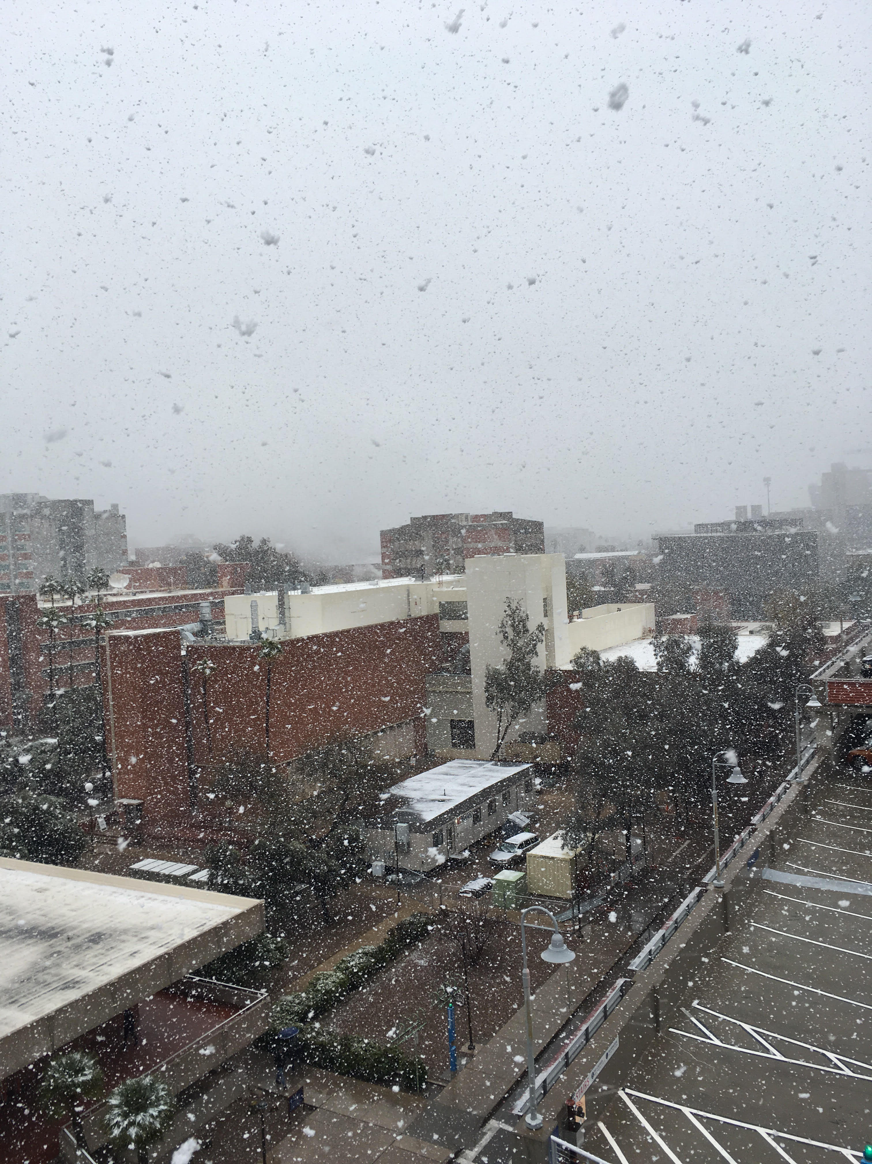
Live Update on Rare Events
Snowing in
Tucson!

