Slide 1
PHY 337/637 Analytical Mechanics
12:30-1:45 PM TR in Olin103
(Aug. 28-Oct. 17, 2023)
Lecture notes for Lecture 1 -- Chaps. 1 & 2 of Cline
Introduction, Motivation, and Review
Course structure and plan
Brief review of Newtonian mechanics
What is “analytical mechanics” and why should we study it?

Slide 2
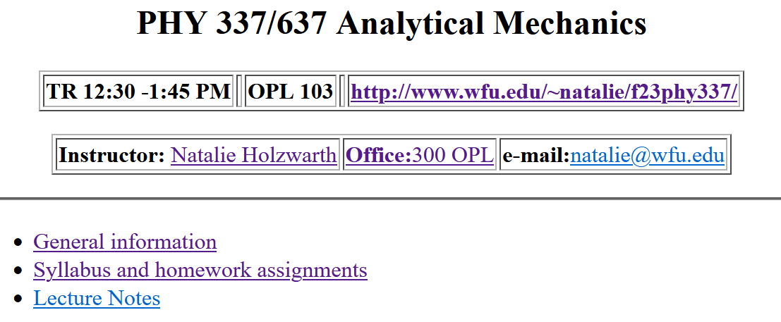
Course website -- https://users.wfu.edu/natalie/f23phy337/

Slide 3
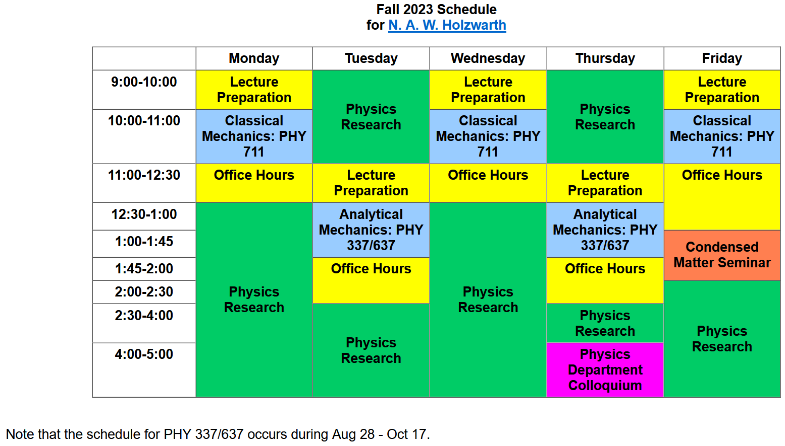
Note – Colloquium starts this week.

Slide 4
Physics Colloquium Series
Welcome to Fall 2023
Introductions, Presentations, and Announcements
4 PM in Olin 101
(Pre-Colloquium Reception in Olin Lobby at 3:30 PM)
August 31, 2023

Slide 6
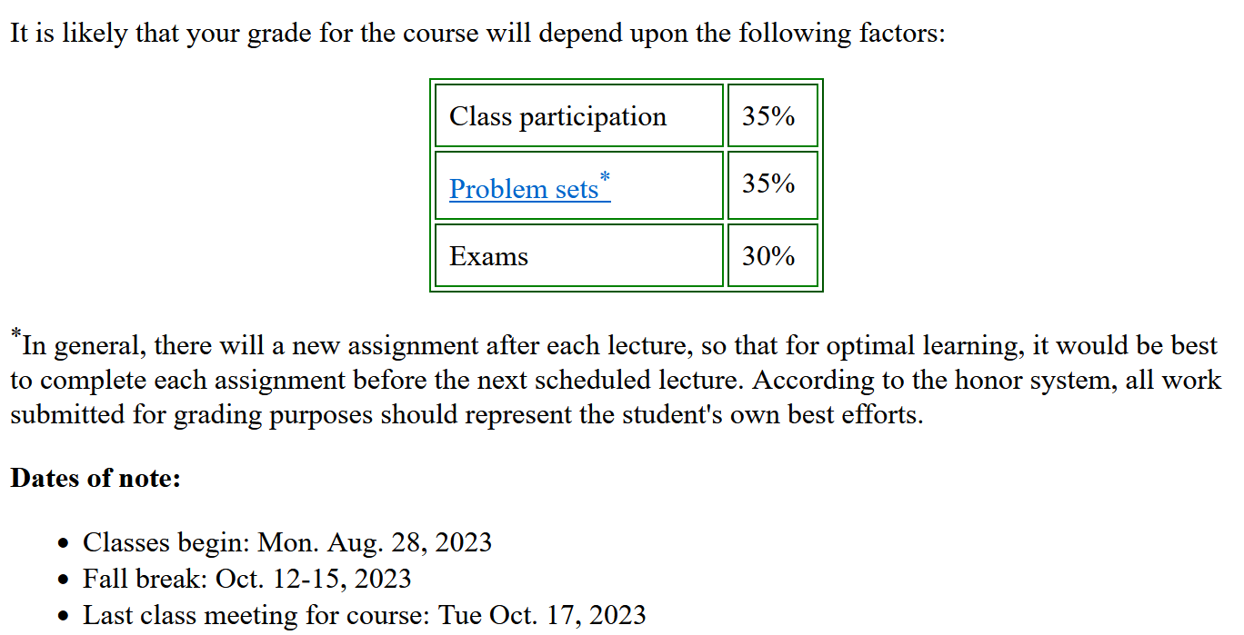
On-line textbook: Variational Principles in Classical Mechanics by Professor Douglas Cline from the University of Rochester

Slide 7
Participation in weekly tutorial sessions, discussing example problems from each chapter from the textbook covered in class, concepts and theories, and possibly material associated with homework problems.
Graduate student in charge of tutorials –
Arezoo Nemeny namea22@wfu.edu

Slide 8
Chapter 2 of textbook

Slide 9
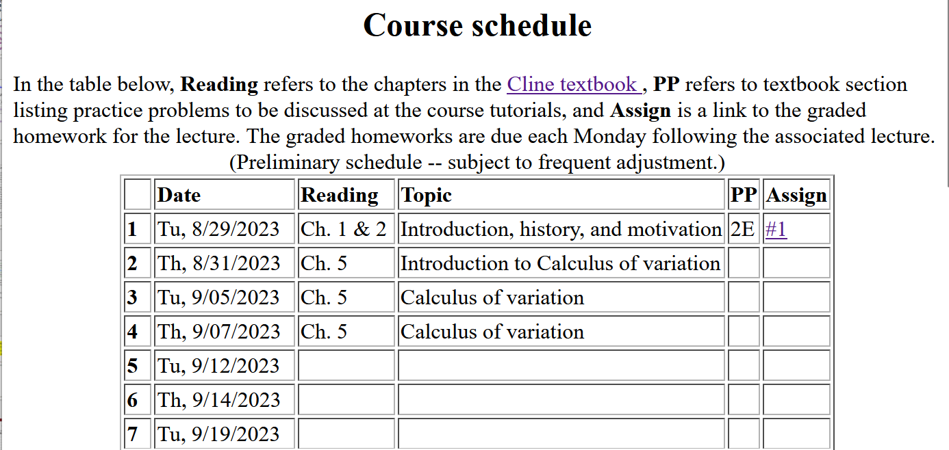
Topics to be covered –
Calculus of variation (necessary mathematical tool)
Lagrangian mechanics
Hamiltonian mechanics
Rigid body motion

Slide 10
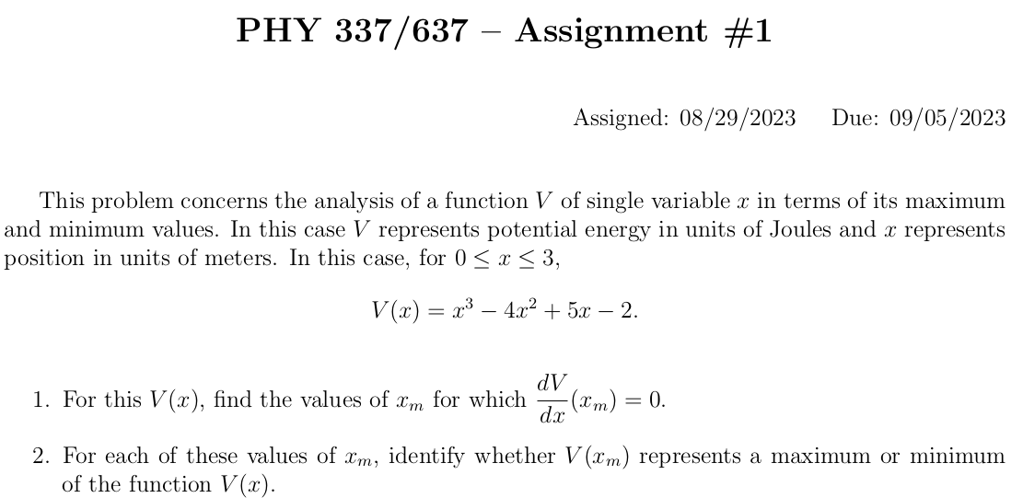

Slide 11
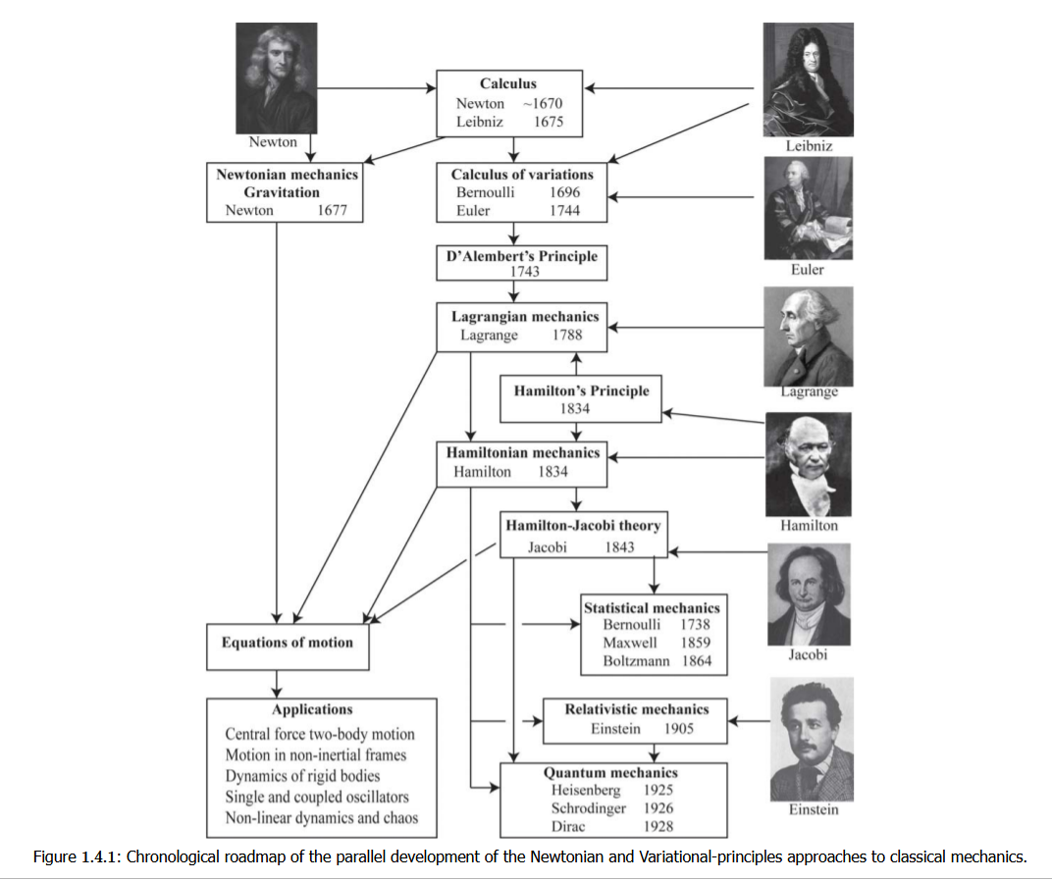
Some of the contributors to basic physics principles

Slide 12
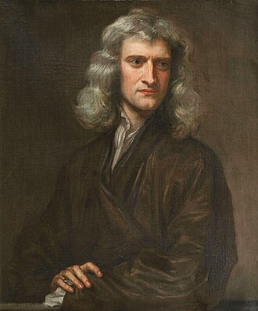
According to Wikipedia –
Sir Isaac Newton (1642-1726)
English mathematician, physicist, astronomer, alchemist, theologian, and author who was described in his time as a natural philosopher. He was a key figure in the Scientific Revolution and the Enlightenment that followed.

Slide 13
Whatever you learn in this course – Newton’s laws are still true.
Except when stated otherwise, we will focus on the physics of a single point particle of mass m.

Slide 16
➔Related notions of energy
Is this always true?

Slide 17
Some details --
Note that not all forces are “conservative”.

Slide 18
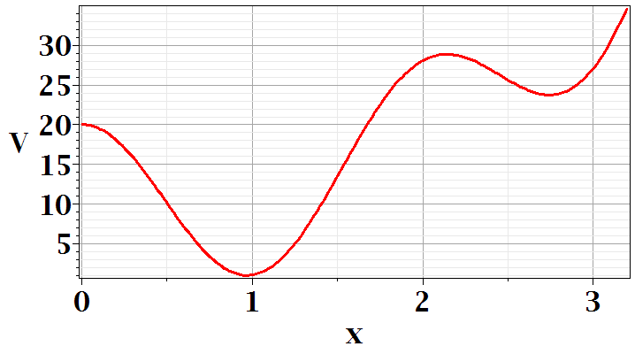
Consider a potential function V(x) with the following shape:
local minimum
global minimum
Why might this be interesting/important?

Slide 19
Minimization of a simple function
local minimum
global minimum

Slide 20
We have already seen that the search for minimum (or maximum) values of function is
Mathematically well-defined
Analytic and numerical methods are well-developed
Often physically significant
The calculus of variation is based on finding minimum values – in a different way. This will be discussed in Lecture 2 and in Chapter 5 of your textbook.

