Slide 1
PHY 337/637 Analytical Mechanics
12:30-1:45 PM TR in Olin 103
Notes for Lecture 12
Review
Calculus of variation methodology
Lagrangian formalism
Hamiltonian formalism
Notes:
Here we will review many of the main points covered in this class.

Slide 3
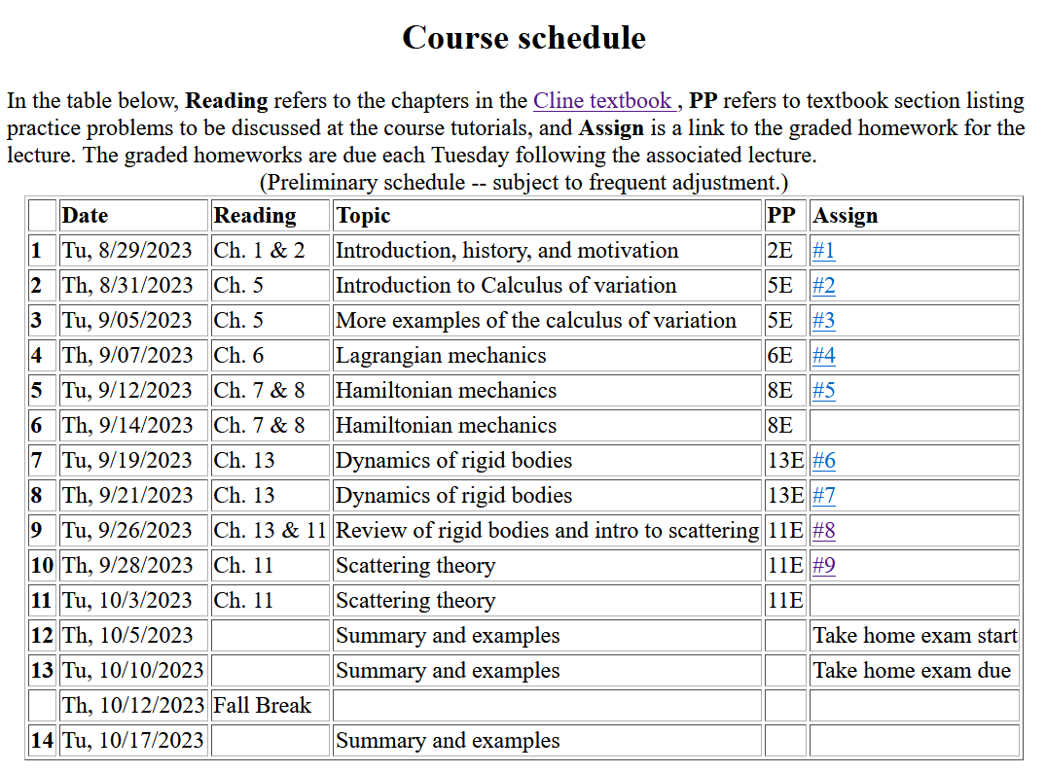
Notes:
This is the schedule posted on the webpage.

Slide 4
Review of the concept of the calculus of variation
Based on the notion of minimization, but applied to an integral form
Optimization performed to find a function – such as y(x).
Uses –
Various optimization problems in a variety of applications
Optimizing the “action integral” (Hamilton’s principle)
Richard Feynman applied it to develop an alternative approach to quantum mechanics called path integrals

Slide 5
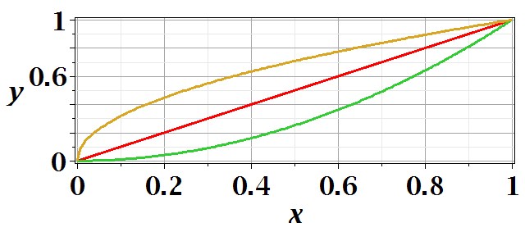
Functional minimization of an integral relationship

Slide 6
Difference between minimization of a function V(x) and the minimization in the calculus of variation.
Minimization of a function – V(x)
➔Know V(x) ➔Find x₀ such that V(x₀) is a minimum.
Calculus of variation

Slide 8
After some derivations, we find
Note that this is a
“total” derivative

Slide 10
Euler-Lagrange equation
Alternate Euler-Lagrange equation

Slide 11
No problem
Solvable problem

Slide 13
Application to particle dynamics
Hamilton’s principle states that the dynamical trajectory of a system is given by the path that extremizes the action integral
Simple example: vertical trajectory of particle of mass m subject to constant downward acceleration a=-g.

Slide 14
Potential energy
Kinetic energy

Slide 16
Extension of these ideas to multiple coordinates due to multiple dimensions and/or multiple particles.
1 particle with 1 degree of freedom
many particles with multiple degrees of freedom
➔
1 particle+3 Cartesian dimensions
N particles+3 Cartesian dimensions

Slide 17
Do you remember this example?
With fondness
Without fondness
With different notation

Slide 18
Here we can see some possible benefits of this approach --
Constant in time
Constant in time

Slide 19
Introducing the Hamiltonian --
Lagrangian picture
Switching variables – Legendre transformation

Slide 20
Hamiltonian picture – continued

Slide 21
Recipe for constructing the Hamiltonian and analyzing the equations of motion

Slide 22
Questions for discussion
Given that we need to start with the Lagrangian, do we really need the Hamiltonian
Given that for all of the examples we have discussed, we get the same answers from analysis with Newton’s laws and Lagrangian and Hamiltonian formalism, how does one pick the appropriate approach?

