Slide 1
PHY 337/637 Analytical Mechanics
12:30-1:45 PM TR in Olin 103
Notes for Lecture 14
Course review
Calculus of variation methodology
Lagrangian formalism
Hamiltonian formalism
Dynamics of rigid bodies
Scattering theory
Exams returned at the end of class

Slide 2
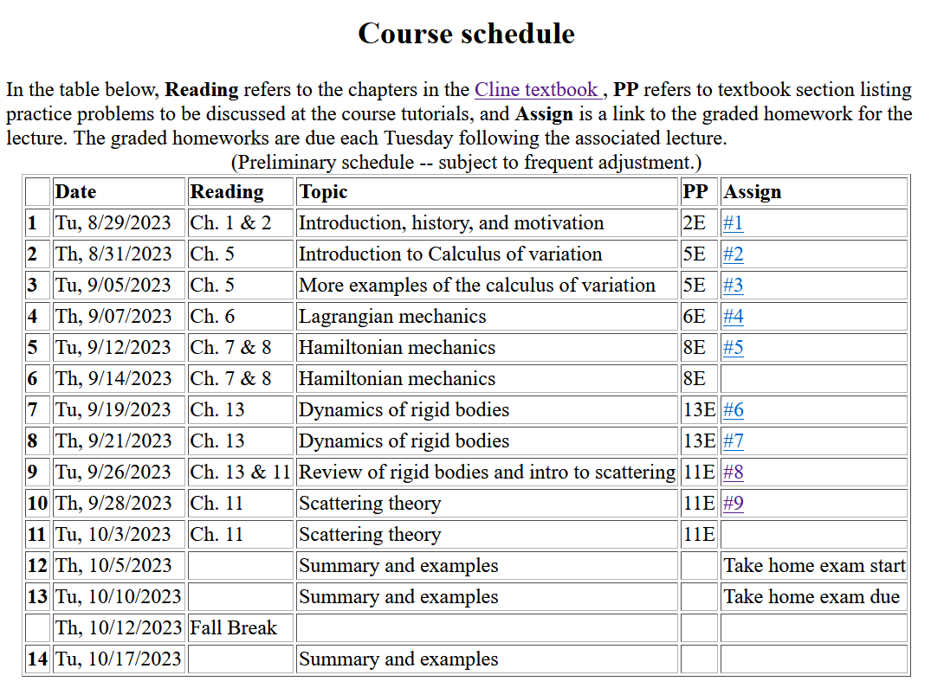

Slide 3
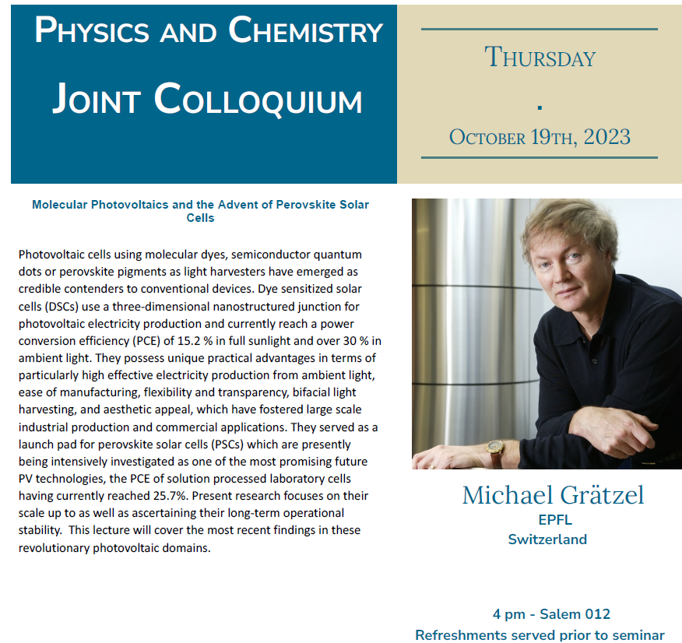
Note that lecture location is in Salem Hall ➔

Slide 4
Review of the concept of the calculus of variation
Based on the notion of minimization, but applied to an integral form
Optimization performed to find a function – such as y(x).
Uses –
Various optimization problems in a variety of applications
Optimizing the “action integral” (Hamilton’s principle)
Richard Feynman applied it to develop an alternative approach to quantum mechanics called path integrals

Slide 5
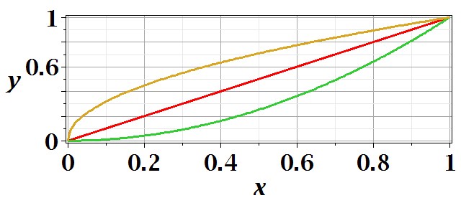
Functional minimization of an integral relationship

Slide 7
After some derivations, we find
Euler-Lagrange equation
➔Differential equation to find
y(x)
Note that this is a
“total” derivative

Slide 10
Application to particle dynamics
Hamilton’s principle states that the dynamical trajectory of a system is given by the path that extremizes the action integral
Simple example: vertical trajectory of particle of mass m subject to constant downward acceleration a=-g.

Slide 11
Potential energy
Kinetic energy

Slide 13
Extension of these ideas to multiple coordinates due to multiple dimensions and/or multiple particles.
1 particle with 1 degree of freedom
many particles with multiple degrees of freedom
➔
1 particle+3 Cartesian dimensions
N particles+3 Cartesian dimensions

Slide 14
Introducing the Hamiltonian --
Lagrangian picture
Switching variables – Legendre transformation

Slide 15
Hamiltonian picture – continued

Slide 16
Recipe for constructing the Hamiltonian and analyzing the equations of motion

Slide 17
Example

Slide 18
Note that D’Alembert’s “justification” of the Lagrangian approach relied on the potential not depending on the particle velocities. We “derived” an exception to this for treating forces due to magnetic fields and/or the vector potential A(r,t)
Note that not all velocity-dependent forces can be treated withing the Lagrangian formalism.

Slide 19
Lorentz forces:
Note: Here we are using cartesian coordinates for convenience.

Slide 20
Example Lorentz force

Slide 21
Example Lorentz force -- continued

Slide 22
Example Lorentz force -- continued

Slide 23
Example Lorentz force -- continued

Slide 24
Constructing the Hamiltonian for this case

Slide 25
ω
r
=0 for rigid body
➔

Slide 27
Note: For a given object and a given coordinate system, one can find the moment of inertia matrix
z
y
x

Slide 28
z’
z
y’
y
x
x’
(x’,y’,z’)

Slide 29
