Slide 1
PHY 337/637 Analytical Mechanics
12:30-1:45 in Olin103
Lecture notes for Lecture 2
Chapter 5 of Cline
Introduction to the calculus of variations
Mathematical construction
Practical use
Examples
Notes:
The topic of “calculus of variation” is covered in Chapter 3, Section 17 of your textbook. We will study the mathematical formalism first before showing how it is useful for studying mechanical systems.

Slide 2
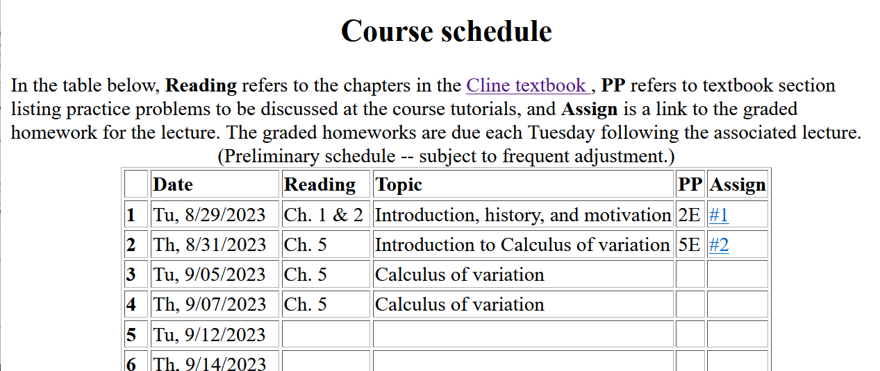
Notes:
There is a short problem on this subject that will be due on Tuesday

Slide 3
The “calculus of variation” as a mathematical construction.

Slide 4
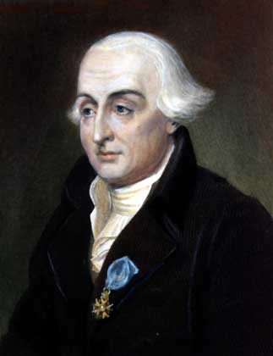
According wikipedia –
Joseph-Louis Lagrange (born Giuseppe Luigi Lagrangia or Giuseppe Ludovico De la Grange Tournier; 25 January 1736 – 10 April 1813), also reported as Giuseppe Luigi Lagrange or Lagrangia, was an Italian mathematician and astronomer, later naturalized French. He made significant contributions to the fields of analysis, number theory, and both classical and celestial mechanics.

Slide 5
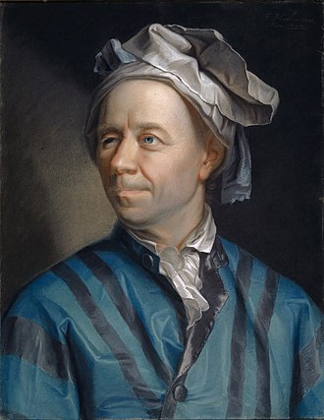
According to Wikipedia –
Leonard Euler (April 7, 1707-September 18, 1783) Swiss mathematician, physicist, astronomer, geographer, logician and engineer who founded the studies of graph theory and topology and made pioneering and influential discoveries in many other branches of mathematics such as analytic number theory, complex analysis, and infinitesimal calculus. He introduced much of modern mathematical terminology and notation, including the notion of a mathematical function. He is also known for his work in mechanics, fluid dynamics, optics, astronomy and music theory.

Slide 6
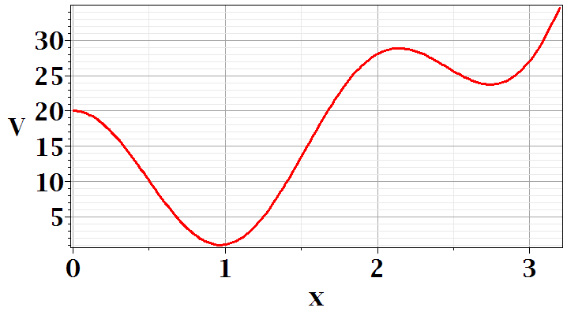
In Chapter 3, the notion of Lagrangian dynamics is developed; reformulating Newton’s laws in terms of minimization of related functions. In preparation, we need to develop a mathematical tool known as “the calculus of variation”.
Minimization of a simple function
local minimum
global minimum
Notes:
First we should review the notion of a minimum in a continuous function. Here is a plot of V(x) showing two different minima at two different points x.

Slide 7
Minimization of a simple function
local minimum
global minimum
Notes:
We see from this plot that a conduction for a function to have a minimum at a point is that its derivative is zero at that point. You see in this example another point where dV/dx, but there is not a minimum. So we say the dV/dx is a necessary but not sufficient condition on having a minimum.

Slide 8
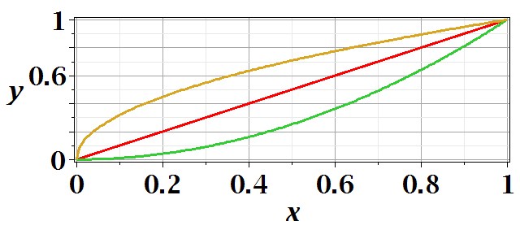
Functional minimization of an integral relationship
Notes:
The calculus of variation also searches for minima, but instead of finding a point where a function has a minimum, we search for a functional form that minimizes the numerical value of an integral.

Slide 9
Difference between minimization of a function V(x) and the minimization in the calculus of variation.
Minimization of a function – V(x)
➔Know V(x) ➔Find x₀ such that V(x₀) is a minimum.
Calculus of variation
Notes:
Comparison

Slide 10
Notes:
For this example, we can evaluate the distance along a curve between two points x=0,y=0 and x=1,y=1 as a normal integral over x as shown.

Slide 11
Calculus of variation example for a pure integral function

Slide 12
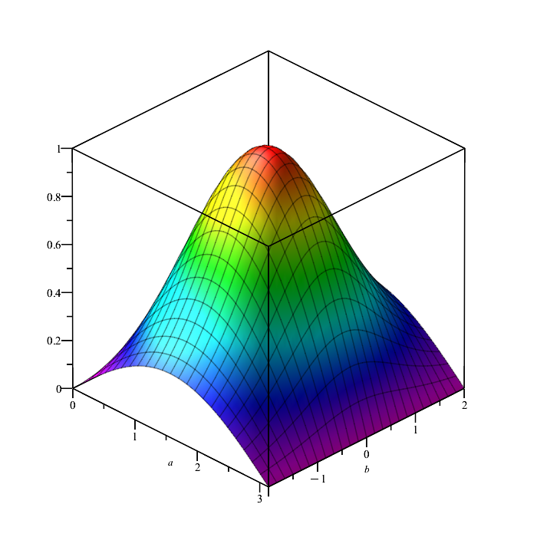

Slide 13
Comment about notation concerning functional dependence and partial derivatives

Slide 14
After some derivations, we find
Note that this is a
“total” derivative
Notes:
Using calculus to simplify the integral.

Slide 15
“Some” derivations --
*
Notes:
Some details.

Slide 17
*

Slide 18
“Some” derivations (continued)--

Slide 19
Clarfication – Why does this term go to zero?

Slide 20
Recap --
Here we conclude that the integrand has to vanish at every argument in order for the integral to be zero
Necessary?
Overkill?

Slide 22
Notes:
Your homework problem is very similar to this. Actually stopped at this slide. Will continue discussion on Wednesday.

Slide 23
Example from your textbook --

Slide 25
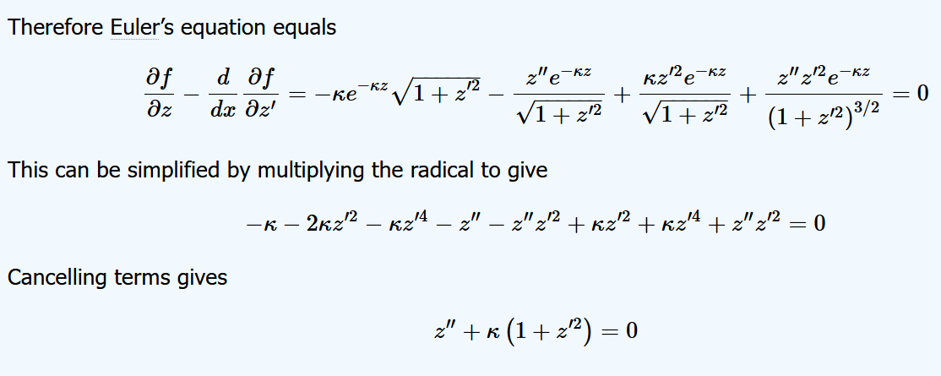
Need to solve this differential equation for z(x) --

Slide 28
Lamp shade shape y(x)
y
x_{i} y_{i}
x
x_{f} y_{f}
Notes:
Here is another example of the use of calculus of variation.

Slide 29
Notes:
After these steps, the solution is found up to some constants.

Slide 30
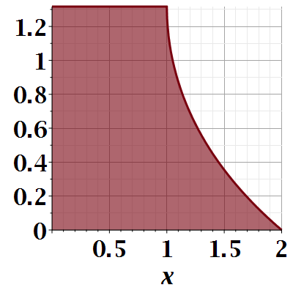

Slide 31
Notes:
Evaluating results for particular boundary values.

Slide 32
Another example:
(Courtesy of F. B. Hildebrand, Methods of Applied Mathematics)
Notes:
Another example.

Slide 33
Euler-Lagrange equation
Alternate Euler-Lagrange equation
Notes:
Summary and extension.

