Slide 1
PHY 337/637 Analytical Mechanics
12:30-1:45 PM TR in Olin103
Lecture notes for Lecture 3
Chapter 5 of Cline
More about the calculus of variations
Review examples – Area of lamp shade
Brachistochrone problem
Calculus of variation with constraints
Notes:
The topic of “calculus of variation” is covered in Chapter 5 of your textbook. We will study the mathematical formalism first before showing how it is useful for studying mechanical systems.

Slide 2
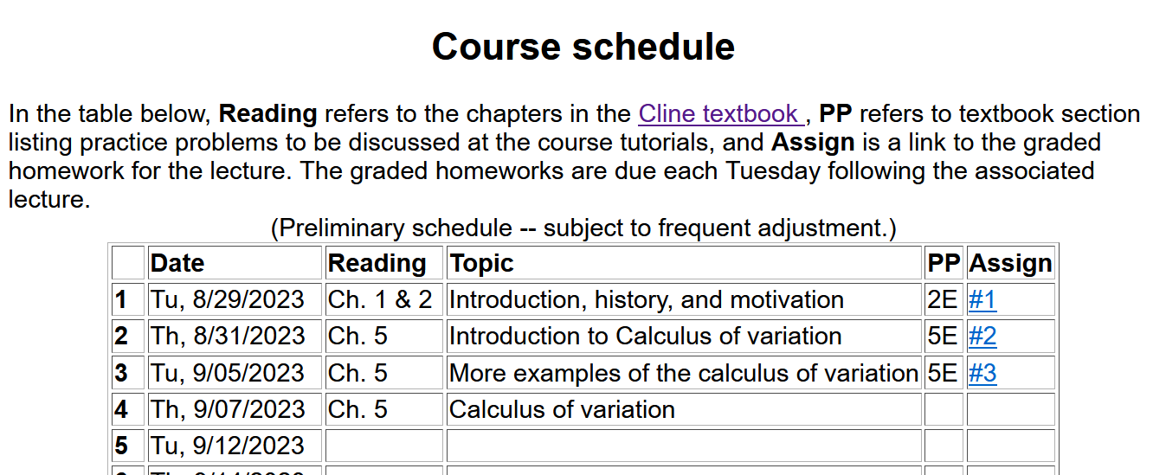
Notes:
There is a short problem on this subject that will be due next Tuesday.

Slide 3
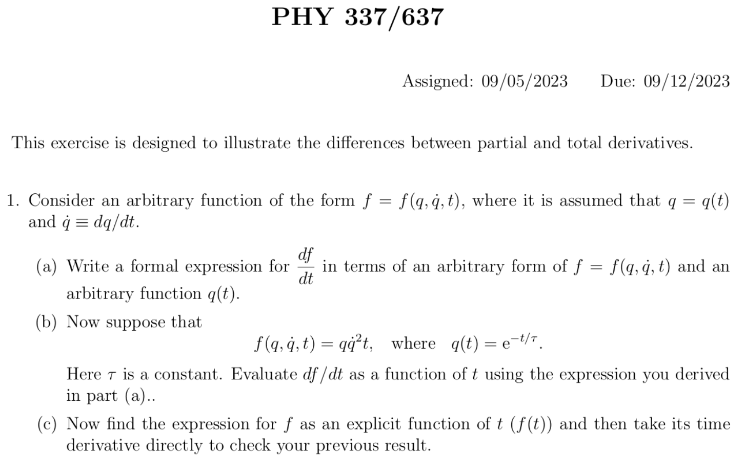

Slide 4
Another interesting problem from your textbook (not assigned for points, but might want to discuss/solve in the tutorial sessions…………..

Slide 5
Summary of the method of calculus of variation --
Notes:
Summary of equations to use.

Slide 6
Notes:
Your homework problem is very similar to this. Actually stopped at this slide. Will continue discussion on Wednesday.

Slide 7
Lamp shade shape y(x)
y
x_{i} y_{i}
x
x_{f} y_{f}
Notes:
Here is another example of the use of calculus of variation.

Slide 9
y
Top view
x
x

Slide 10
Notes:
After these steps, the solution is found up to some constants.

Slide 11
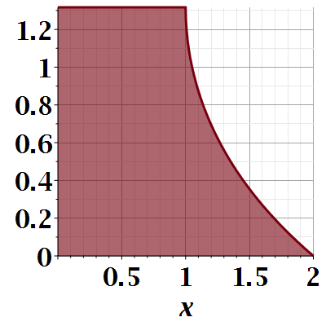

Slide 12
Notes:
Evaluating results for particular boundary values.

Slide 13
Euler-Lagrange equation
Alternate Euler-Lagrange equation
Notes:
Summary of the equations we worked out last time.

Slide 14
A few more steps --

Slide 15
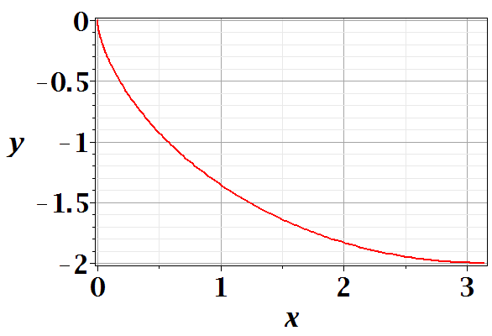
Brachistochrone problem: (solved by Newton in 1696)
http://mathworld.wolfram.com/BrachistochroneProblem.html
A particle of weight mg travels frictionlessly down a path of shape y(x). What is the shape of the path y(x) that minimizes the travel time from
y(0)=0 to y(π)=-2 ?
Notes:
This is the famous problem.

Slide 17
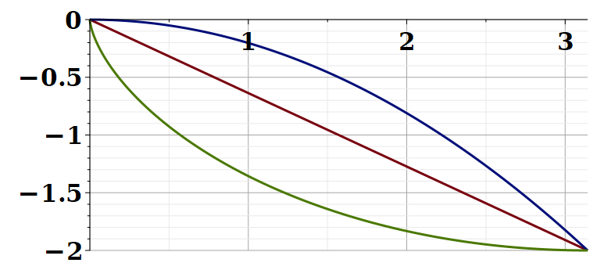
Vote for your favorite path
x
y
Which gives the shortest time?
Green
Red
Blue
Notes:
What curve will win the race?

Slide 18
Notes:
Some details of the Euler-Lagrange equations. The green equations look harder.

Slide 19
Note that your textbook applied a different trick to simplify the equations which also works, effectively switching the role of x←→y

Slide 20
Question – why this choice?
Answer – because the answer will be more beautiful. (Be sure that was not my cleverness.)
Notes:
Calling the integration 2a is very convenient.

Slide 21
Parametric equations for Brachistochrone:
Notes:
Very clever mathematics.

Slide 22
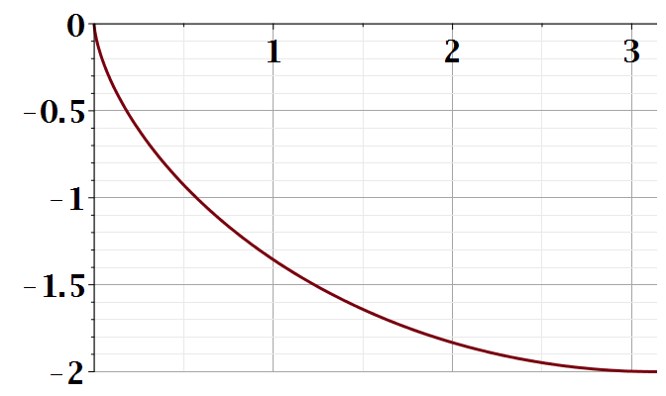
Parametric plot --
plot([theta-sin(theta), cos(theta)-1, theta = 0 .. Pi])
y
x
Notes:
Visualization of the result.

Slide 23
Checking the results
T=4.4429
T=5.2668
T=infinite
Notes:
How did you do with your bet?

Slide 24
Summary of the method of calculus of variation --
Notes:
Summary of equations to use.

Slide 25
Notes:
It is a good idea to remember these equations.

Slide 26
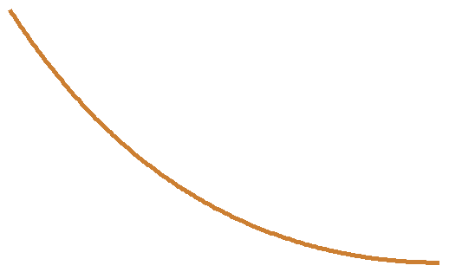
Another example optimization problem:
Determine the shape y(x) of a rope of length L and mass density ρ hanging between two points
x₁ y₁
x₂ y₂
Notes:
Another example needing extra information.

Slide 27
Example from internet --

Slide 28
Lagrange multiplier
Notes:
How to minimize with a constraint.

Slide 30
Notes:
Applying the equations.

Slide 32
Notes:
The solutions in (almost) convenient form.

Slide 33
Summary of results
or
Notes:
Summary again.

Slide 34
Chapter 5 of your textbook covers a number of extensions of these ideas, to multiple degrees of freedom and to application of constraints in additional ways. We will instead now jump to the application of the calculus of variation to its use in the analysis of the motion of particles covered in Chapter 6, where the multiple degrees of freedom and other extensions will then be treated.

Slide 35
Application to particle dynamics
Notes:
We will now start to apply this mathematics to the physics of motion. Here we map the variables that will apply. A is called “action”. L is called “Lagrangian”.

Slide 36
Application to particle dynamics
Hamilton’s principle states that the dynamical trajectory of a system is given by the path that extremizes the action integral
Simple example: vertical trajectory of particle of mass m subject to constant downward acceleration a=-g.
Note that we have not yet justified this!
Notes:
Here we will show how Newton’s laws can be written in terms of the Lagrangian formalism.

Slide 37
http://www-history.mcs.st-and.ac.uk/Biographies/Hamilton.html
(1805–1865)
Notes:
In addition to Euler and Lagrange, we need to thank Hamilton as well.

Slide 38
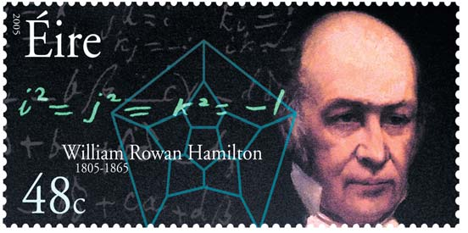
https://irishpostalheritagegpo.wordpress.com/2017/06/08/william-rowan-hamilton-irish-mathematician-and-scientist/

Slide 39
Potential energy
Kinetic energy
Notes:
First we will show that it works with these relationships and then we will try understand why/how.

Slide 40
Perhaps looks familiar?
Notes:
Action is sometimes A and sometimes S.

Slide 41
Notes:
Checking the minimization.

