Slide 1
PHY 337/637 Analytical Mechanics
12:30-1:45 PM TR in Olin103
Lecture notes for Lecture 3
Chapter 5 of Cline
More about the calculus of variations
Review examples – Area of lamp shade
Brachistochrone problem
Calculus of variation with constraints
Notes:
The topic of “calculus of variation” is covered in Chapter 5 of your textbook. We will study the mathematical formalism first before showing how it is useful for studying mechanical systems.

Slide 2
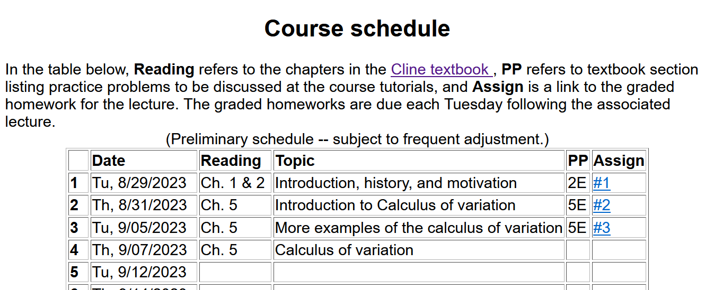
Notes:
There is a short problem on this subject that will be due next Tuesday.

Slide 3
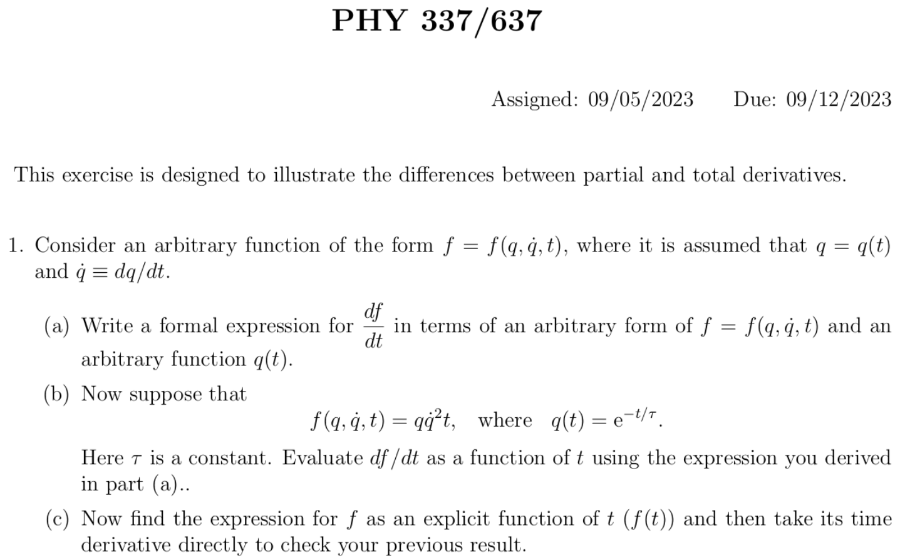

Slide 4
Physics Colloquium Series
The originally scheduled colloquium for this week
has been rescheduled for December 7, 2023
In order to keep up the departmental good spirits, please join
Physics Reception in the Olin Lobby at 3:30 PM
September 7, 2023

Slide 5
Comment on “class participation”
The course webpage mentions this category as part of your grade
The purpose is to help you get into the practice of formulating and articulating questions about the physics and/or the related mathematics
How to earn “class participation” points
After reading/skimming lecturenotes posted on the class website, email me questions about the material or suggested discussion points before class.
Attend one or both course tutorial sessions by graduate student Arezoo Nameny (namea22@wfu.edu)
Tuesdays & Wednesdays at 5:30-7 PM in Olin 107
Ask questions as they arise in office hours, office appointments, via email, etc.

Slide 6
More comments about tutorial sessions
Not required, but hopefully very helpful to you
Arezoo may be able to explain ideas in a more relatable way
Focus on “exercise” problems at the end chapters we cover (some of them can give you insight)
May ask questions about posted HW assignments as well. Arezoo will most likely not work your HW for you, but may point you in a good direction.
Class participation credit points offered for
Attendance
Prepared presentations – the thought being that you can learn a lot by explaining to others

Slide 7
Another interesting problem from your textbook (not assigned for points, but might want to discuss/solve in the tutorial sessions…………..

Slide 8
Your questions –
From Alex:
Would you mind explaining what we need to do for the tutorials with Arezoo at the start of class? I am still a bit confused.

Slide 9
Summary of the method of calculus of variation --
Notes:
Summary of equations to use.

Slide 10
Notes:
Your homework problem is very similar to this. Actually stopped at this slide. Will continue discussion on Wednesday.

Slide 11
Lamp shade shape y(x)
y
x_{i} y_{i}
x
x_{f} y_{f}
Notes:
Here is another example of the use of calculus of variation.

Slide 13
y
Top view
x
x

Slide 14
Notes:
After these steps, the solution is found up to some constants.

Slide 15
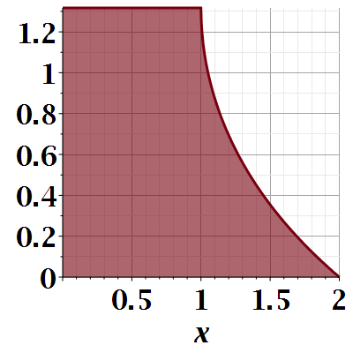

Slide 16
Notes:
Evaluating results for particular boundary values.

Slide 17
Euler-Lagrange equation
Alternate Euler-Lagrange equation
Notes:
Summary of the equations we worked out last time.

Slide 18
A few more steps --

Slide 19
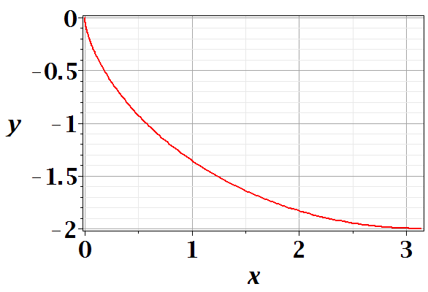
Brachistochrone problem: (solved by Newton in 1696)
http://mathworld.wolfram.com/BrachistochroneProblem.html
A particle of weight mg travels frictionlessly down a path of shape y(x). What is the shape of the path y(x) that minimizes the travel time from
y(0)=0 to y(π)=-2 ?
Notes:
This is the famous problem.

Slide 21
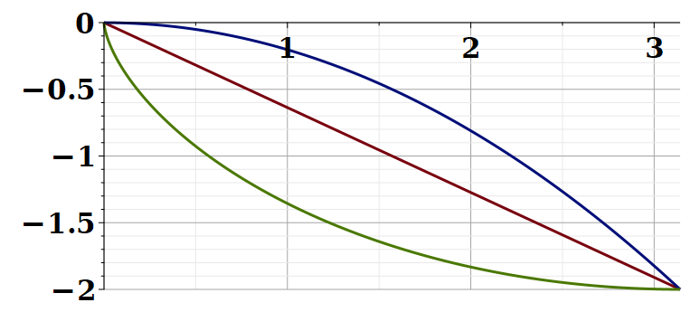
Vote for your favorite path
x
y
Which gives the shortest time?
Green
Red
Blue
Notes:
What curve will win the race?

Slide 22
Notes:
Some details of the Euler-Lagrange equations. The green equations look harder.

Slide 23
Note that your textbook applied a different trick to simplify the equations which also works, effectively switching the role of x←→y

Slide 24
Question – why this choice?
Answer – because the answer will be more beautiful. (Be sure that was not my cleverness.)
Notes:
Calling the integration 2a is very convenient.

Slide 25
Parametric equations for Brachistochrone:
Notes:
Very clever mathematics.

Slide 26
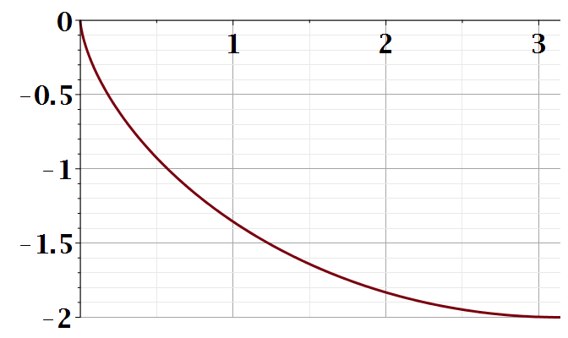
Parametric plot --
plot([theta-sin(theta), cos(theta)-1, theta = 0 .. Pi])
y
x
Notes:
Visualization of the result.

Slide 27
Checking the results
T=4.4429
T=5.2668
T=infinite
Notes:
How did you do with your bet?

Slide 28
Summary of the method of calculus of variation --
Notes:
Summary of equations to use.

Slide 29
Notes:
It is a good idea to remember these equations.

Slide 30
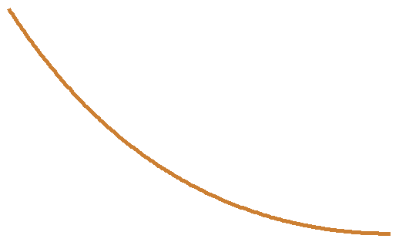
Another example optimization problem:
Determine the shape y(x) of a rope of length L and mass density ρ hanging between two points
x₁ y₁
x₂ y₂
Notes:
Another example needing extra information.

Slide 31
Example from internet --

Slide 32
Lagrange multiplier
Notes:
How to minimize with a constraint.

Slide 34
Notes:
Applying the equations.

Slide 36
Notes:
The solutions in (almost) convenient form.

Slide 37
Summary of results
or
Notes:
Summary again.

Slide 38
Chapter 5 of your textbook covers a number of extensions of these ideas, to multiple degrees of freedom and to application of constraints in additional ways. We will instead now jump to the application of the calculus of variation to its use in the analysis of the motion of particles covered in Chapter 6, where the multiple degrees of freedom and other extensions will then be treated.

Slide 39
Application to particle dynamics
Notes:
We will now start to apply this mathematics to the physics of motion. Here we map the variables that will apply. A is called “action”. L is called “Lagrangian”.

Slide 40
http://www-history.mcs.st-and.ac.uk/Biographies/Hamilton.html
(1805–1865)
Notes:
In addition to Euler and Lagrange, we need to thank Hamilton as well.

Slide 41
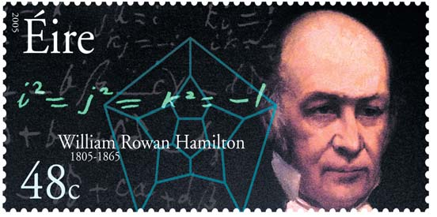
https://irishpostalheritagegpo.wordpress.com/2017/06/08/william-rowan-hamilton-irish-mathematician-and-scientist/

Slide 42
Application to particle dynamics
Hamilton’s principle states that the dynamical trajectory of a system is given by the path that extremizes the action integral
Simple example: vertical trajectory of particle of mass m subject to constant downward acceleration a=-g.
Note that we have not yet justified this!
Notes:
Here we will show how Newton’s laws can be written in terms of the Lagrangian formalism.

Slide 43
Potential energy
Kinetic energy
Notes:
First we will show that it works with these relationships and then we will try understand why/how.

Slide 44
Perhaps looks familiar?
Notes:
Action is sometimes A and sometimes S.

Slide 45
Notes:
Checking the minimization.

