Slide 1
PHY 337/637 Analytical Mechanics
12:30-1:45 PM MWF in Olin 103
Discussion of Lecture 4 – Chap. 6 in Cline
Calculus of variation applied to classical mechanics
Hamilton’s principle and introduction to the Lagrangian
Extension to multiple and generalized coordinates
D’Alembert’s principle
Velocity dependent forces
Notes:
In this lecture, we will continue to develop notions of the calculations of variation and to start to show how they may be applied to classical mechanics.

Slide 2
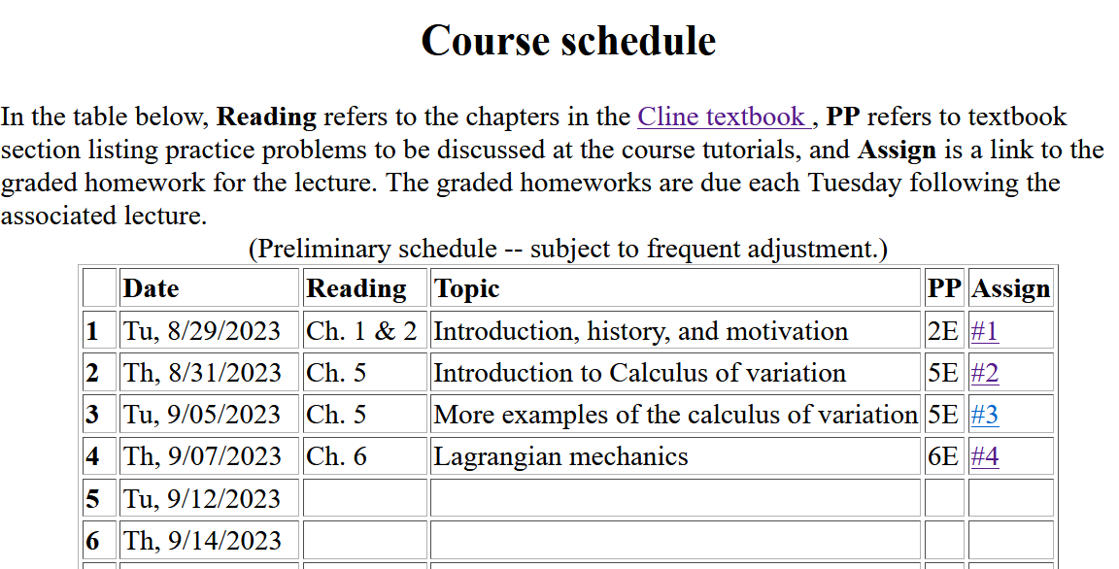
Notes:
There is one homework problem for this lecture.

Slide 4
Physics Colloquium Series
The originally scheduled colloquium for this week
has been rescheduled for December 7, 2023
In order to keep up the departmental good spirits, please join
Physics Reception in the Olin Lobby at 3:30 PM
September 7, 2023

Slide 5
Summary of equations from calculus of variation --
➔differential equation for y(x)
Notes:
Summary again.

Slide 6
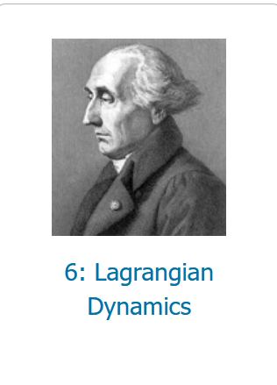
Corresponding chapter in Cline textbook:
Application to particle dynamics
Thanks to Hamilton’s principle
Notes:
We will now start to apply this mathematics to the physics of motion. Here we map the variables that will apply. A is called “action”. L is called “Lagrangian”.

Slide 7
Application to particle dynamics
Hamilton’s principle states that the dynamical trajectory of a system is given by the path that extremizes the action integral
Simple example: vertical trajectory of particle of mass m subject to constant downward acceleration a=-g.
Notes:
Here we will show how Newton’s laws can be written in terms of the Lagrangian formalism.

Slide 8
Potential energy
Kinetic energy
Notes:
First we will show that it works with these relationships and then we will try understand why/how.

Slide 9
Perhaps looks familiar?
Notes:
Action is sometimes A and sometimes S.

Slide 10
Note that, showing that our construction is consistent with Newton’s laws is not a proof. You will get the chance to consider another example to check if that works (or not) as well.
Digression on multiple coordinates due to multiple dimensions and/or multiple particles.
1 particle+1 degree of freedom
1 particle+3 Carthesian dimensions
N particles+3 Carthesian dimensions

Slide 12
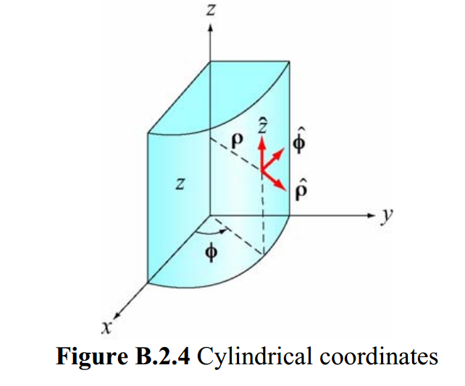
Cylindrical coordinates
(Figure taken from 8.02 handout from MIT.)
Notes:
The derivation is based on the notion of “generalized” coordinates which can be Cartesian coordinates or one of the many transformed coordinates, or even more “general” coordinates.

Slide 13
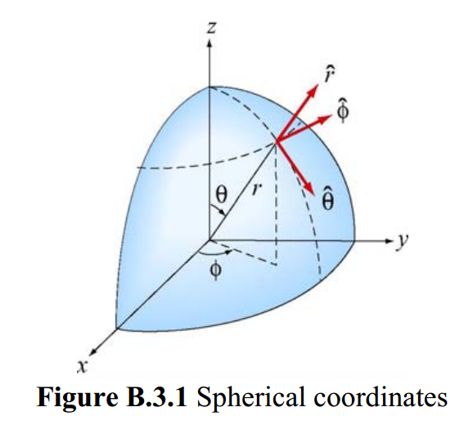
Spherical coordinates
(Figure taken from 8.02 handout from MIT.)
Notes:
Another example of transformed coordinates.

Slide 14
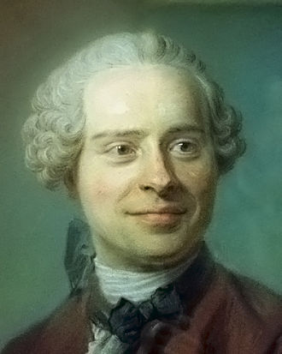
Jean d’Alembert 1717-1783
French mathematician and philosopher
“Deriving” Lagrangian mechanics from Newton’s laws.
Notes:
Previously we introduced the Lagrangian function without justification. Here we follow a “derivation” attributed to d’Alembert.

Slide 15
D’Alembert’s principle:
This is D’Alembert’s principle.
Notes:
Here we start the derivation following D’Alembert’s arguments. x_{i} denotes the cartesian coordinate while q denotes the “generalized” coordinate. In this slide we consider the potential energy terms.

Slide 16
You might ask why we need “generalized” coordinates. In fact, Cartesian coordinates are often just fine, but using the more flexible possibilities reveals important aspects of the formalism. Cartesian coordinates are a special case of generalized coordinates.

Slide 17
Summary up to now --

Slide 18
Notes:
Continuing the derivations we consider the kinetic energy contributions.

Slide 19
Some details
You may be still wondering why we need to introduce “generalized” coordinates when cartesian coordinates are an example. What the generalized coordinates allow us to show is that

Slide 20
Notes:
Continuing the derivation.

Slide 21
Notes:
Summary of results from D’Alembert’s analysis.

Slide 22
When do we need this term?

Slide 23
Notes:
Form of derived Lagrangian provided that the potential does not depend on velocity.

Slide 24
➔Hamilton’s principle from the “backwards” application of the Euler-Lagrange equations --
Notes:
Having shown that the Euler-Lagrangian equations are consistent with Newton’s equations of motion, we can then infer that the integral of the Lagrangian is optimized as is consistent with Hamilton’s principle.

Slide 25
Example:
d
θ
Notes:
Example of using the Lagrangian formalism for a simple pendulum.

Slide 26
Notes:
Another example of Lagrangian formalism that we will encounter when we examine rigid body motion.

Slide 27
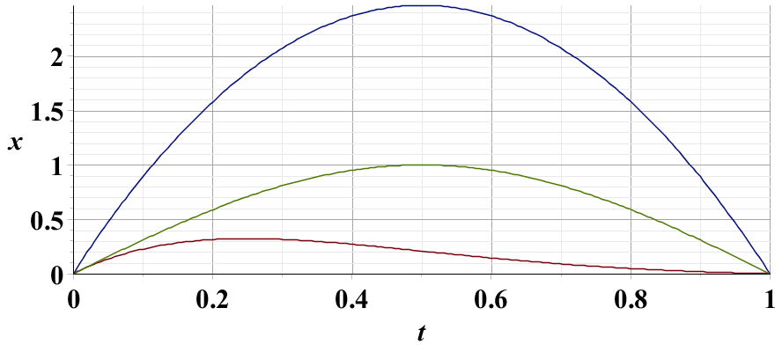
Example – simple harmonic oscillator
x₁
x₂
x₃
Notes:
Harmonic oscillator example. Here we again demonstrate the physical trajectory has the smallest “action”.

Slide 28
Summary –
Hamilton’s principle:
Notes:
Recipe for Lagrangian mechanics.

Slide 29
Note: in “proof” of Hamilton’s principle:
Why do we need velocity dependent forces?
Friction is sometimes represented as a velocity dependent force. (difficult to treat with Lagrangian mechanics.)
Lorentz force on a moving charged particle in the presence of a magnetic field.
Notes:
Important restriction.

Slide 30
Lorentz forces:
Note: Here we are using cartesian coordinates for convenience.
Notes:
While Lagrangian mechanics cannot treat all velocity dependent forces, it is possible to extend the analysis for the case of the Lorentz force. This material is treated in Chapter 6.10 of your textbook.

Slide 31
More details --

Slide 32
Units for electromagnetic fields and forces
cgs Gaussian units -- (used in older textbooks)
SI units --

Slide 33
Lorentz forces, continued:
Notes:
Very clever mathematicians figured out how to incorporate Lorentz into the Lagrangian formalism. Here we are assuming their result and showing that it is consistent.

Slide 34
Lorentz forces, continued:
Notes:
More derivations.

Slide 35
Some details on last step:
Notes:
More derivations.

Slide 36
Lorentz forces, continued:
Notes:
Summary of results.

Slide 37
Example Lorentz force
Notes:
Example for a magnetic field in the z direction.

Slide 38
Example Lorentz force -- continued
Notes:
Finding the Euler-Lagrange equations.

Slide 39
Example Lorentz force -- continued
Notes:
Summary from previous slides.

Slide 40
Example Lorentz force -- continued
Notes:
We get the same motion for this case.

Slide 41
Example Lorentz force -- continued
Does it surprise you that the same equations of motion are obtained with a different Gauge?
Notes:
This is the same magnetic field, but an equivalent vector potential.

Slide 42
How do these two different forms of A correspond to the same B?

