Slide 1
PHY 337/637 Analytical Mechanics
12:30-1:45 PM MWF in Olin 103
Discussion of Lecture 5 – Chap. 7 & 8 in Cline
Lagrangian and Hamiltonian analysis
Review of Lagrangian mechanics
Legendre transformations and construction of the Hamiltonian
Canonical equations of motion
Notes:
In this lecture, we will continue to develop notions of the calculations of variation and to start to show how they may be applied to classical mechanics.

Slide 4
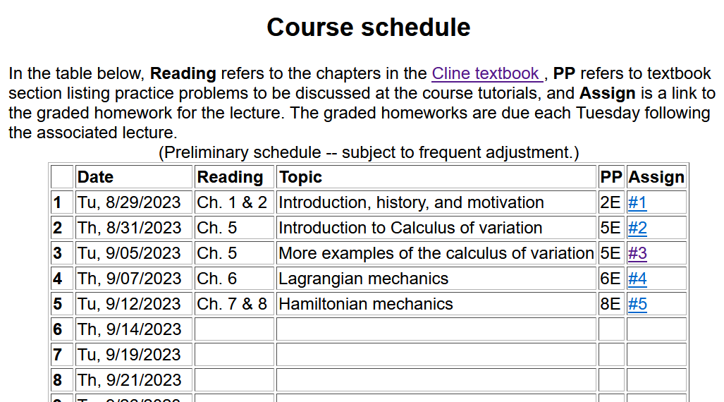
Notes:
There is one homework problem for this lecture.

Slide 6
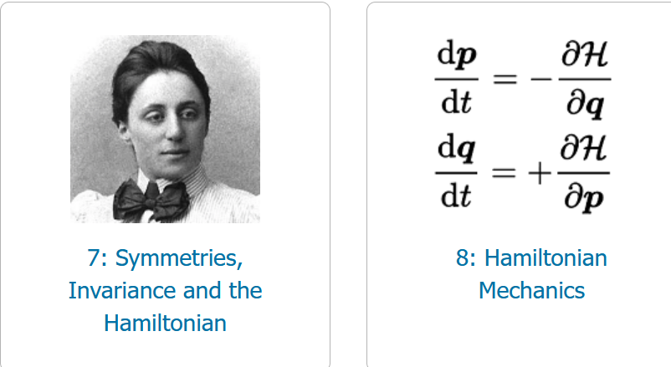
Main focus of today’s lecture

Slide 7
Review of Lagrangian mechanics --

Slide 8
Particle dynamics using the Lagrangian formalism, thanks to Hamilton’s principle –
Hamilton’s principle states that the dynamical trajectory of a system is given by the path that extremizes the action integral
for a system with a single generalized coordinate q(t)
for a system with multiple dimensions and/or particles with generalized coordinates q_{σ}(t)
Kinetic energy
Potential energy
Notes:
Here we will show how Newton’s laws can be written in terms of the Lagrangian formalism.

Slide 9
Digression: Is the Lagrangian function unique?
Yes
No

Slide 10
Uniqueness of the Lagrangian – continued --
➔It is possible to find two different Lagrangians for the same system that both satisfy Hamilton’s according to:
=0

Slide 11
Idea of Legendre transformations
1752-1833 Paris, France

Slide 12
Mathematical transformations for continuous functions of several variables & Legendre transforms --
Notes:
Relationships between the old and new variables.

Slide 13
Now that we see that these transformations are possible, we should ask the question why we might want to do this?
An example comes from thermodynamics where we have various interdependent variables such as temperature T, pressure P, volume V, etc. etc. Often a measurable property can be specified as a function of two of those, while the other variables are also dependent on those two. For example we might specify T and P while the volume will be V(T,P). Or we might specify T and V while the pressure will be P(T,V).

Slide 14
Other examples from thermo --
For thermodynamic functions:
Notes:
Examples from thermodynamic functions

Slide 15
Notes:
Common thermodynamic energy functiosn.

Slide 16
Lagrangian picture
Switching variables – Legendre transformation
Notes:
Applying the ideas of variable change to the Lagrangian formulation.

Slide 17
Hamiltonian picture – continued
Notes:
Transforming from the Lagrangian to Hamiltonian formulation of mechanics. We will continue this discussion on Friday.

Slide 18
Lagrangian picture
Switching variables – Legendre transformation
Notes:
Starting with the Lagrangian and then performing a Legendre transformation.

Slide 19
Generalization to multiple dimensions q_{σ} and p_{σ} is straightforward …

Slide 20
Hamiltonian picture – continued
Notes:
Finding the Hamiltonian equations of motion.

Slide 21
Direct application of Hamiltonian’s principle using the Hamiltonian function --
Notes:
Showing that Hamilton’s principle can be formulated with the Hamiltonian formulation.

Slide 22
Hamilton’s principle continued:
Canonical equations
0
Notes:
So called “Canonical” equations.

Slide 23
More comments about “details”
Vanishes because
δq(t_{f})=δq(t_{i}) due to
the premise of
Hamilton’s principle.

Slide 24
In the Hamiltonian formulation --
Why are these equations known as the “canonical equations”?
Because they are beautiful.
The term is meant to elevate their importance to the level of the music of J. S. Bach
To help you remember them
No good reason; it is just a name

Slide 25
Recipe for constructing the Hamiltonian and analyzing the equations of motion
Notes:
Important recipe. Tape this to your wall!!!

Slide 26
What happens when you miss a step in the recipe?
No big deal
Big deal – can lead to shame and humiliation (or at least wrong analysis)
Lagrangian picture
Hamiltonian picture

Slide 27
Constants of the motion in Hamiltonian formalism
Notes:
Finding constants of the motion within the Hamiltonian formalism.

Slide 28
What is the physical meaning of a constant H?
Comment -- Whenever you find a constant of the motion, it is helpful for analyzing the trajectory. In this case, H often represents the mechanical energy of the system so that constant H implies that energy is conserved.

Slide 29
Notes:
Example.

Slide 30
Notes:
Another example

Slide 31
Other examples
Notes:
Another example

Slide 32
Other examples
Canonical form
Notes:
Example with magnetic field.

Slide 33
Canonical equations of motion for constant magnetic field:
Notes:
Working out the equations of motion.

Slide 34
Canonical equations of motion for constant magnetic field -- continued:
Notes:
More evaluation of the equations of motion.

Slide 35
Are these results equivalent to the results of the Lagrangian analysis?
a. Yes
b. No

Slide 36
Notes:
Recap of treatment of electromagnetic interactions in the Lagrangian and Hamiltonian formulations.

Slide 37
Canonical form
Notes:
Continued.

