Slide 1
PHY 337/637 Analytical Mechanics
12:30-1:45 PM MWF in Olin 103
Discussion of Lecture 6 – Chap. 7 & 8 in Cline
Lagrangian and Hamiltonian analysis -- continued
Review of Lagrangian and Hamiltonian formalisms
Examples
Brief comments about phase space

Slide 4
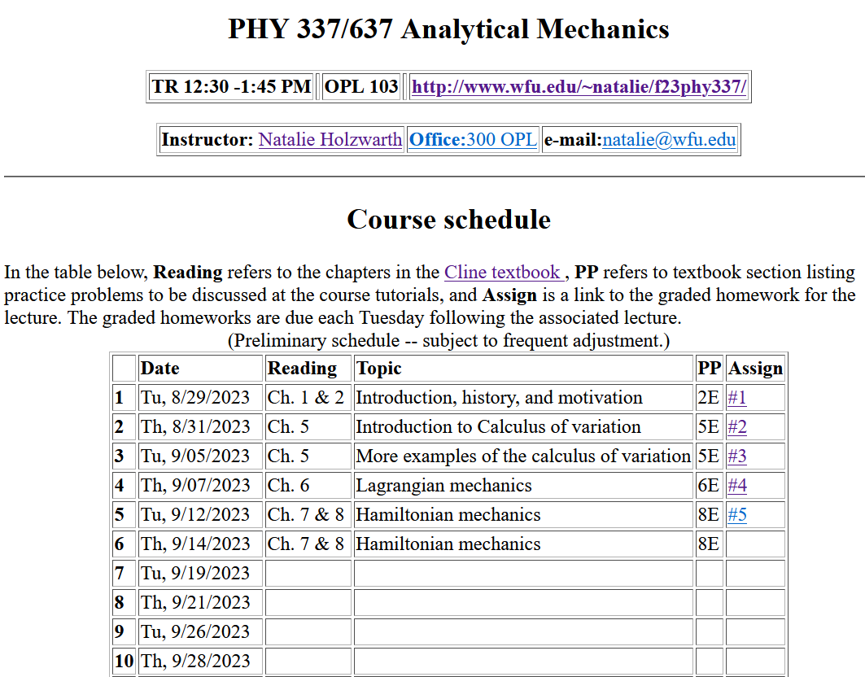
Notes:
There is one homework problem for this lecture.

Slide 5
Review of Lagrangian and Hamiltonian formalisms

Slide 6
Particle dynamics using the Lagrangian formalism, thanks to Hamilton’s principle –
Hamilton’s principle states that the dynamical trajectory of a system is given by the path that extremizes the action integral
for a system with a single generalized coordinate q(t)
for a system with multiple dimensions and/or particles with generalized coordinates q_{σ}(t)
Kinetic energy
Potential energy
Notes:
Here we will show how Newton’s laws can be written in terms of the Lagrangian formalism.

Slide 7
Lagrangian picture
Switching variables – Legendre transformation
Notes:
Starting with the Lagrangian and then performing a Legendre transformation.

Slide 8
In the Hamiltonian formulation --
Why are these equations known as the “canonical equations”?
Because they are beautiful.
The term is meant to elevate their importance to the level of the music of J. S. Bach
To help you remember them
No good reason; it is just a name

Slide 9
Recipe for constructing the Hamiltonian and analyzing the equations of motion
Notes:
Important recipe. Tape this to your wall!!!

Slide 10
Constants of the motion in Hamiltonian formalism
Notes:
Finding constants of the motion within the Hamiltonian formalism.

Slide 11
Notes:
Example.

Slide 12
Notes:
Another example

Slide 13
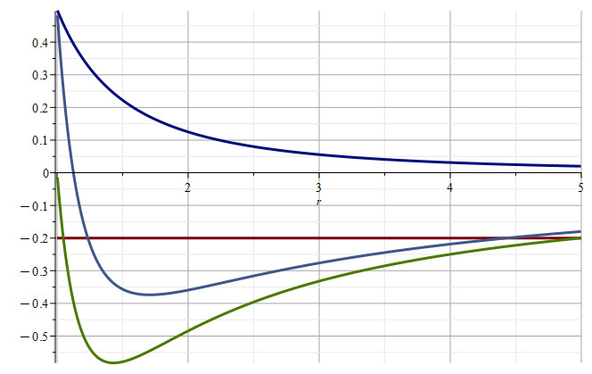
Example of motion in a central potential

Slide 14
Notes:
Recap of treatment of electromagnetic interactions in the Lagrangian and Hamiltonian formulations.

Slide 15
Canonical form
Notes:
Continued.

Slide 16
Some more examples of using Lagrangian and/or Hamiltonian formalism for analyzing motion --

Slide 17
Example – linear molecule
m₁
m₂
m₃

Slide 22
m₁
m₂
m₃
m₁
m₂
m₃
m₁
m₂
m₃
Notes:
Reviewing results for example isolated molecule.

Slide 23
(with help from Maple)
N,N’ are normalization constants.

Slide 24
What about Hamiltonian formulation → notion of phase space.

Slide 25
Phase space
The notion of density of particles in phase space is simply the ratio of the number of particles per unit phase space volume. It seems reasonable that under conditions where there are no sources or sinks for the particles, that the density should remain constant in time.
Notes:
Notion of phase space

Slide 26
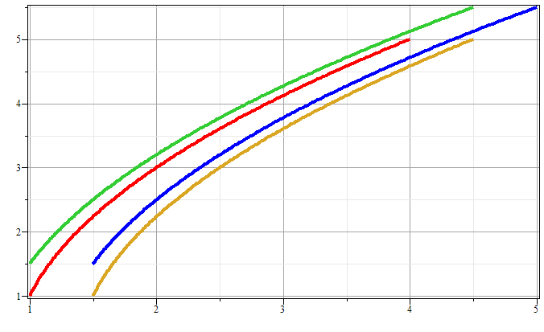
Phase space diagram for one-dimensional motion due to constant force
p
x
Notes:
Example of time evolution of phase space.

Slide 27
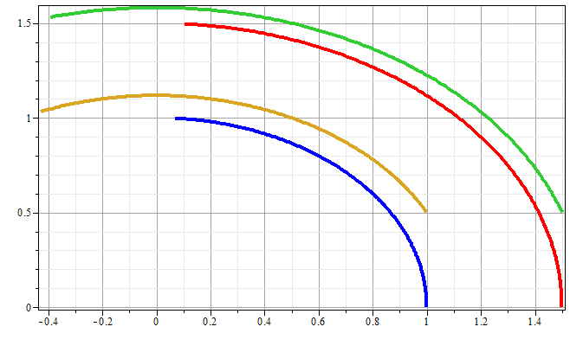
Phase space diagram for one-dimensional motion due to spring force
p
x
Notes:
Another example of time evolution of phase space.

Slide 28
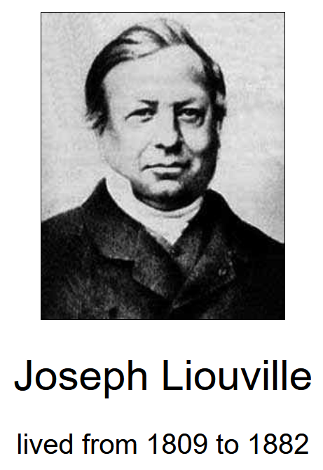
Liouville’s Theorem (1838)
The density of representative points in phase space corresponding to the motion of a system of particles remains constant during the motion.
Notes:
Application to the density of phase space – Liouville theorm.

Slide 29
Liouville’s theorem
(x,p+Δp)
(x+Δx,p+Δp)
p
(x,p)
(x+Δx,p)
x
Notes:
Diagram of flow in phase space.

Slide 30
Liouville’s theorem -- continued
(x,p+Δp)
(x+Δx,p+Δp)
p
(x,p)
(x+Δx,p)
x
Notes:
Some details.

Slide 31
Liouville’s theorem -- continued
(x,p+Δp)
(x+Δx,p+Δp)
p
(x,p)
(x+Δx,p)
x
Notes:
More details.

Slide 32
Summary:
Liouville’s theorem:
Imagine a collection of particles obeying the Canonical equations of motion in phase space.
Note that we are assuming that no particles are created or destroyed in these processes.
Notes:
Summary of Liouville theorem.

Slide 33
Importance of Liouville’s theorem to statistical mechanical analysis:
In statistical mechanics, we need to evaluate the probability of various configurations of particles. The fact that the density of particles in phase space is constant in time, implies that each point in phase space is equally probable and that the time average of the evolution of a system can be determined by an average of the system over phase space volume. Computationally this can be approximated using molecular dynamics or sampling methods.
Notes:
Comment.

Slide 34
“Molecular dynamics” is a subfield of computational physics focused on analyzing the motions of atoms in fluids and solids with the goal of relating the atomistic and macroscopic properties of materials. Ideally molecular dynamics calculations can numerically realize the statistical mechanics viewpoint.
Notes:
Brief introduction to the approach of H. C. Andersen

Slide 35
r_{ij}
➔From this Lagrangian, can find the 3N coupled 2nd order differential equations of motion and/or find the corresponding Hamiltonian, representing the system at constant energy, volume, and particle number N (N,V,E ensemble).
Notes:
Schematic drawing of system modeled.

Slide 36
Lagrangian and Hamiltonian forms
By solving these coupled equations, we can use our atomic scale ideas to model macroscopic systems…
Notes:
Lagrangian and Hamiltonian of particle system.

Slide 37
Digression on numerical evaluation of differential equations
x
t
Notes:
The equations cannot generally be solved analytically so that numerical methods must be used. This slide shows some of the ideas for numerical devaluations.

