Slide 1
PHY 337/637 Analytical Mechanics
12:30-1:45 PM TR in Olin 103
Notes for Lecture 8: Rigid bodies –
Chap. 13 (Cline)
1. Comment about HW #5
2. More about moment of inertia tensor
Torque free motion
Euler angles

Slide 2
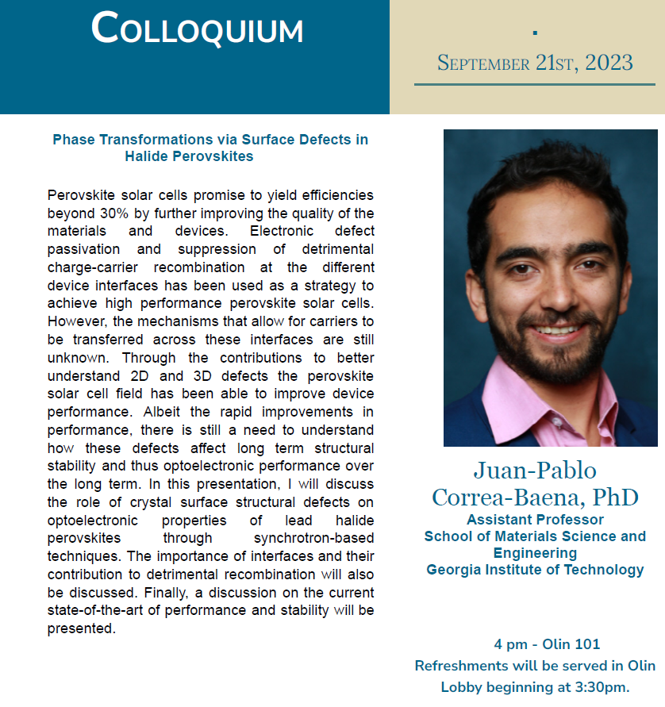

Slide 3
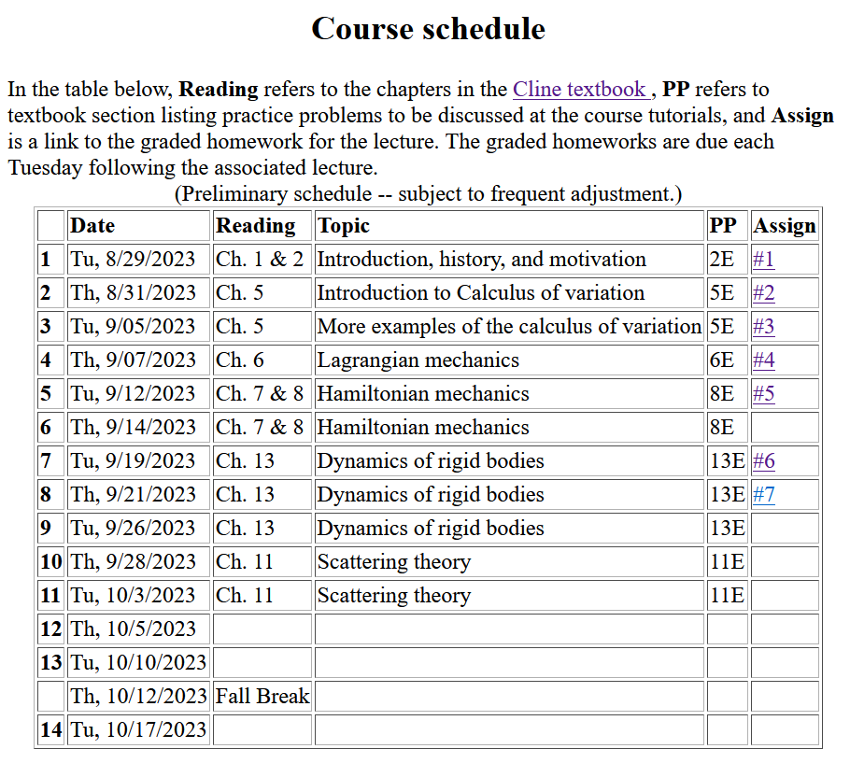
Notes:
In this lecture we will consider the rotational motion of rigid bodies as presented in Chapter 5 of your textbook.

Slide 4
7

Slide 6
Note: For a given object and a given coordinate system, one can find the moment of inertia matrix
z
y
x

Slide 7
z’
z
y’
y
x
x’
(x’,y’,z’)

Slide 8
z
Example:
c
y
a
b
x
Notes:
Consider a simple rectangular solid with a coordinate system at the edge of the system.

Slide 9
Properties of moment of inertia tensor:
Symmetric matrix ➔real eigenvalues I₁,I₂,I₃
➔orthogonal eigenvectors
Notes:
The moment of inertia tensor in matrix form is a symmetric matrix and therefore can be diagonalized. The eigenvalues are known as principal moments of inertia and the eigenvectors are known as principal axes.

Slide 10
Changing origin of rotation
z
z’
r_{p}
r’_{p}
c
R
y’
y
a
x’
b
x
Notes:
Here we consider what happens when we evaluate the moment of inertia tensor about a different origin. In this case, the new origin happens to be at the center of mass.

Slide 11
z
z’
r_{p}
r’_{p}
c
R
y’
y
a
x’
b
x
Notes:
Some details.

Slide 12
Note that changing origin of coordinate system changes moment of inertia tensor.
z
z’
r_{p}
r’_{p}
Note: This is a special case; changing the center of rotation does not necessarily result in a diagonal I’
c
R
y’
y
a
x’
b
x
Notes:
When the dust clears for this case. Note that I’ happens to be diagonal already, however it is not generally true that shifting the origin for the moment of inertia would result in a diagonal matrix.

Slide 13
Descriptions of rotation about a given origin
ω
Notes:
In the next slides we will focus on the fact that each rigid body has 3 principal axes and 3 moments of inertia for a given origin. It is often convenient to use that coordinate system to analyze rigid body motion.

Slide 14
Descriptions of rotation about a given origin -- continued
Notes:
Here we consider the angular moment expressed in the diagonalized body fixed frame of reference.

Slide 15
Descriptions of rotation about a given origin -- continued
Notes:
While it is very difficult to express torque in this reference frame, we can readily solve problems with zero torque.

Slide 16
➔
Notes:
For the general system with three distinct moment of inertia, the solutions are difficult, but simplifications occur when two moments are the same, in this I1=I2.

Slide 17
Solution of Euler equations for symmetric object continued
Notes:
Time dependence of the symmetric top in free space

Slide 18
➔
Notes:
Now consider the more general case.

Slide 19
Notes:
Reasonable approximations.

Slide 20
Euler equations for asymmetric object continued
Notes:
We see that there are conditions that allow stability for this system,. --- to be continued.

Slide 21
Summary of previous results
describing rigid bodies rotating
about a fixed origin
ω
r
Notes:
Review of notions of rigid body motion.

Slide 22
Moment of inertia tensor
Notes:
In general there is a symmetric tensor which defines the moment of inertia. By rotating the coordinates about a fixed origin we can find the matrix in diagonal form.

Slide 23
Descriptions of rotation about a given origin -- continued
Notes:
When there is zero torque acting on the system, the angular velocity components are coupled through these Euler equations.

Slide 24
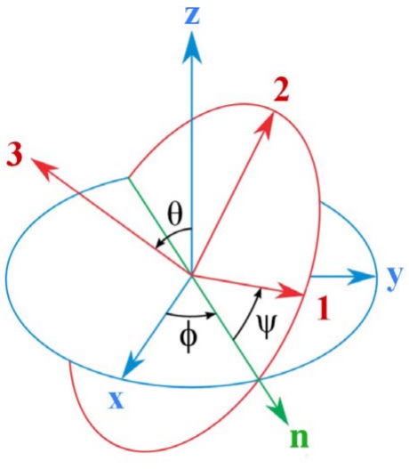
Transformation between body-fixed and inertial coordinate systems – Euler angles
inertial
Comment – Since this is an old and intriguing subject, there are a lot of terminologies and conventions, not all of which are compatible. We are following the convention found in your textbook mechanics texts and NOT the convention found in most quantum mechanics texts. Euler’s main point is that any rotation can be described by 3 successive rotations about 3 different (not necessarily orthogonal) axes. In this case, one is along the inertial z axis and another is along the body fixed 3 axis. The middle rotation is along an intermediate n axis.
body
From section 13.13 of Cline
Notes:
In order to consider motion of a rigid body more generally, in the presence of torque, it will be necessary to consider how to relate the body – fixed coordinates that diagonalize the moment of inertia tensor to another coordinate system which in general be an inertial coordinate system. Here again, we use ideas of Euler. This notation or it is equivalent is typically consistent with quantum mechanics text books.

Slide 25
Need to express all components in body-fixed frame:
Notes:
Euler said that the transformation of body-fixed → inertial frames can be accomplished in 3 steps and the corresponding angles are alpha, beta, and gamma. In this case, we want to express all results in the body fixed frame.

Slide 26
Euler’s idea:
Practical idea:
Notes:
We can express the angular velocities in terms of the time rate of change of the alpha, beta, and gamma Euler angles. We can also express the rotation axes in terms of the instantaneous Euler angles as well. Here is the transformation of the middle axis.

Slide 27
Notes:
Result to remember.

Slide 28
Rotational kinetic energy
Notes:
General expression of the rotational kinetic energy and the special case of the symmetric top.

Slide 29
Recap --
Transformation between body-fixed and inertial coordinate systems – Euler angles
inertial
body
Notes:
In addition to the dynamic transformation needed for rigid body mechanics, this formalism is more generally useful when relating coordinate systems of different orientations.

Slide 30
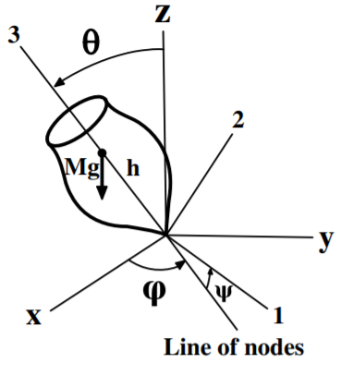
Motion of a symmetric top under the influence of the torque of gravity:
Notes:
Now consider the motion of a symmetric top in which the pivot point is fixed and torque is applied by gravity acting at the center of mass of the top. Here l denotes the distance of the pivot point to the center of mass.

Slide 31
http://www.physics.usyd.edu.au/~cross/SPINNING%20TOPS.htm
See also --

Slide 32
https://drive.google.com/file/d/0B14RyYwpwSDNcXdxTWl3OExHX1k/view

