Slide 1
PHY 337/637 Analytical Mechanics
12:30-1:45 PM TR in Olin 103
Notes for Lecture 9: Scattering analysis –
Chap. 11 ( Cline; especially 11.12)
Some comments on rigid body motion; especially the dynamics of a rotation symmetric top
Review of particle interactions
Two particles interacting with a central potential
Conservation of energy and angular momentum
Definition of differential scattering cross section

Slide 2
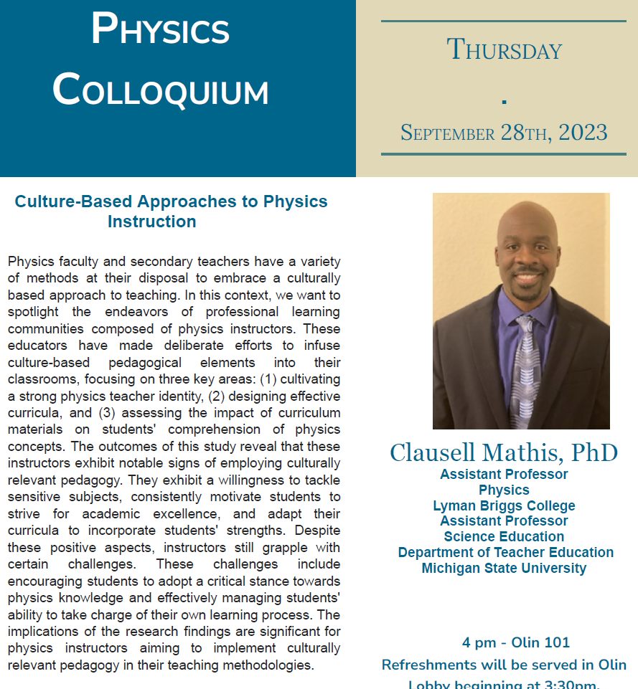

Slide 4
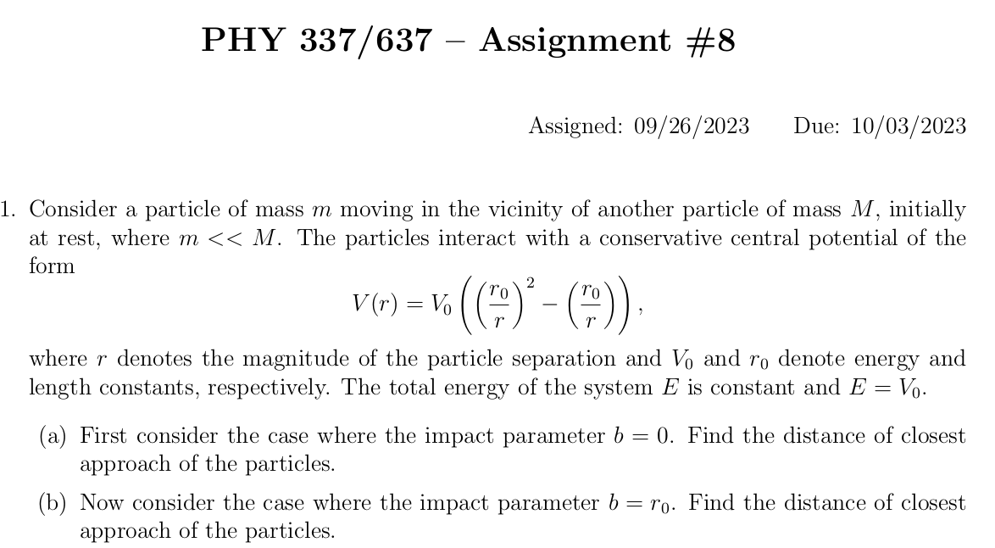

Slide 5
Summary of previous results
describing rigid bodies rotating
about a fixed origin
ω
r
Notes:
Review of notions of rigid body motion.

Slide 6
Moment of inertia tensor
Notes:
In general there is a symmetric tensor which defines the moment of inertia. By rotating the coordinates about a fixed origin we can find the matrix in diagonal form.

Slide 7
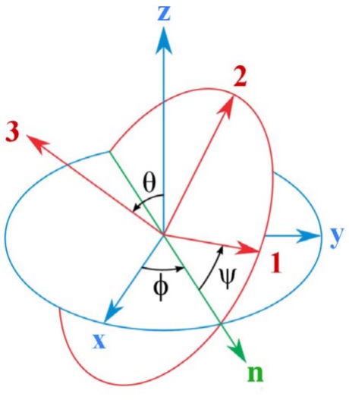
Transformation between body-fixed and inertial coordinate systems – Euler angles
inertial
Comment – Since this is an old and intriguing subject, there are a lot of terminologies and conventions, not all of which are compatible. We are following the convention found in your textbook mechanics texts and NOT the convention found in most quantum mechanics texts. Euler’s main point is that any rotation can be described by 3 successive rotations about 3 different (not necessarily orthogonal) axes. In this case, one is along the inertial z axis and another is along the body fixed 3 axis. The middle rotation is along an intermediate n axis.
body
From section 13.13 of Cline
Notes:
In order to consider motion of a rigid body more generally, in the presence of torque, it will be necessary to consider how to relate the body – fixed coordinates that diagonalize the moment of inertia tensor to another coordinate system which in general be an inertial coordinate system. Here again, we use ideas of Euler

Slide 8
Need to express all components in body-fixed frame:
Notes:
Euler said that the transformation of body-fixed → inertial frames can be accomplished in 3 steps and the corresponding angles are alpha, beta, and gamma. In this case, we want to express all results in the body fixed frame.

Slide 9
Notes:
Result to remember.

Slide 10
Rotational kinetic energy
Notes:
General expression of the rotational kinetic energy and the special case of the symmetric top.

Slide 11
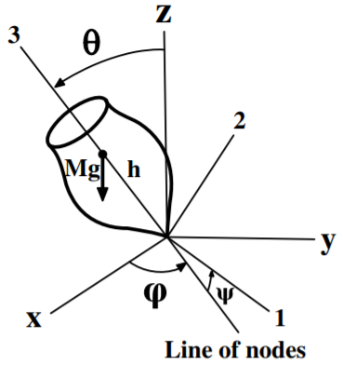
Motion of a symmetric top under the influence of the torque of gravity:
Notes:
Now consider the motion of a symmetric top in which the pivot point is fixed and torque is applied by gravity acting at the center of mass of the top. Here h denotes the distance of the pivot point to the center of mass.

Slide 13
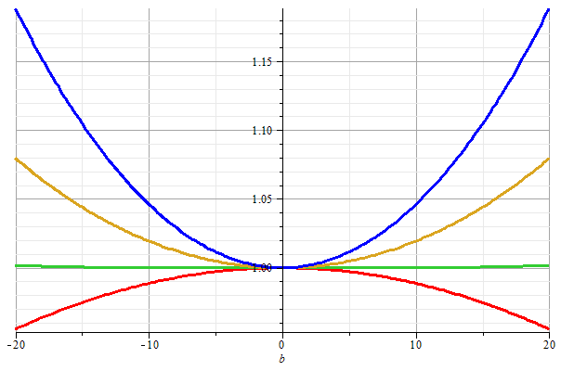
Note that energy is also conserved:
Stable/unstable solutions near
θ=0
Notes:
Special case where top is spinning nearly vertically.

Slide 14
←θ→

Slide 15
Introduction to the analysis of the energy and forces between two particles –
This treatment can be formulated with Lagrangians and Hamiltonians, but we will directly use the Newtonian approach for now..

Slide 16
First consider fundamental picture of particle interactions
Classical mechanics of a conservative 2-particle system.
y
1
2
r₁
r₂
x
For this discussion, we will assume that V(r)=V(r) (a central potential).
Notes:
First consider the basic particle interactions which govern their motion.

Slide 17
Energy is conserved:
1
2
r₁
r₂
For a central potential V(r)=V(r), angular momentum is conserved.
For the moment we also make the simplifying assumption that m₂>>m₁ so that particle 1 dominates the motion.
Notes:
The last assumption is being made for convenience. We will consider the center of mass and relative motion much more carefully later.

Slide 18
Typical two-particle interactions –
Notes:
These represent typical particle interactions. Only the Coulomb or gravitational forms are precisely found in nature. The others serve as convenient models.

Slide 19
More details of two particle interaction potentials
This means that the interaction only depends on the distance between the particles and not on the angle between them. This would typically be true of the particles are infinitesimal points without any internal structure such as two infinitesimal charged particles or two infinitesimal masses separated by a distance r:
Example – Interaction between a proton and an electron. Note we are treating the interactions with classical mechanics; in some cases, quantum effects are non-trivial.

Slide 20
Other examples of central potentials --
Example
Two marbles
Two Ar atoms
Note – not all systems are described by this form. Some counter examples:
Molecules (internal degrees of freedom)
Systems with more than two particles such as crystals

Slide 21
Some more details --
z
r(t₁)
θ(t₁)
y
x

Slide 22
Comments continued --
V_{eff}(r)

Slide 23
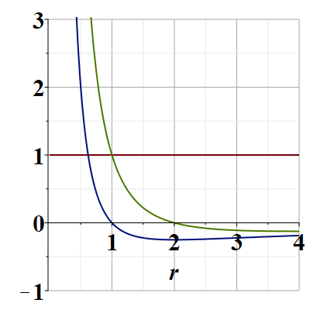
Representative plots of V_{eff} (r)
V_{eff}(r)/V₀
E/V₀
Note that particles are not bound; can reach infinite separation
Distances of closest approach
Notes:
Potential energy diagram showing important aspects of the particle trajectory.

Slide 24
What is the impact parameter?
Briefly, a convenient distance that depends on the conserved energy and angular momentum of the process.
b
b

Slide 25
Example of trajectory with particular b
b
What is the scattering angle?
What would the trajectory look like for b=0?
b

Slide 26
Which of the following are true for a particle moving in a central potential field:
The particle moves in a plane.
For any interparticle, potential the trajectory can be determined/calculated.
Only for a few special interparticle potential forms can the trajectory be determined.
Why should we care about this?
We shouldn’t really care.
It is only of academic interest
It is of academic interest but can be measured.
Many experiments can be analyzed in terms of the particle trajectory.
Notes:
What do you think about these?

Slide 27
Scattering theory:
detector
Notes:
This is the ideal configuration of a scattering experiment.

Slide 28
Scattering theory:
detector
Some reasons that scattering theory is useful:
It allows comparison between measurement and theory
The analysis depends on knowledge of the scattering particles when they are far apart
The scattering results depend on the interparticle interactions

Slide 29
Standard measure of differential cross section

Slide 30
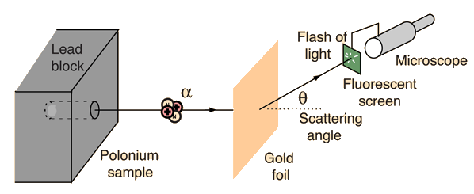
Example: Diagram of Rutherford scattering experiment
http://hyperphysics.phy-astr.gsu.edu/hbase/rutsca.html
Notes:
This illustrates the setup of the famous Rutherford scattering experiment.

Slide 31
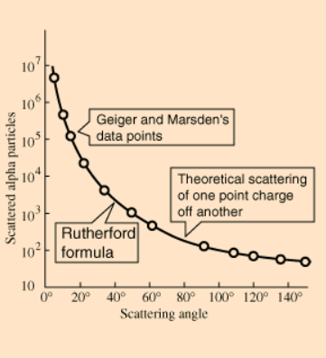
Graph of data from scattering experiment
From website: http://hyperphysics.phy-astr.gsu.edu/hbase/Nuclear/rutsca2.html
Notes:
Reconstruction experimental data from the Rutherford experiment.

Slide 32
Standardization of scattering experiments --
Impact parameter: b
b
Figure from Marion & Thorton, Classical Dynamics
Notes:
Some details of scattering geometry and analysis.

Slide 33
Note: The notion of cross section is common to many areas of physics including classical mechanics, quantum mechanics, optics, etc. Only in the classical mechanics can we calculate it from a knowledge of the particle trajectory as it relates to the scattering geometry.
b
Figure from Marion & Thorton, Classical Dynamics
Note: We are assuming that the process is isotropic in ϕ
Notes:
More details.

Slide 34
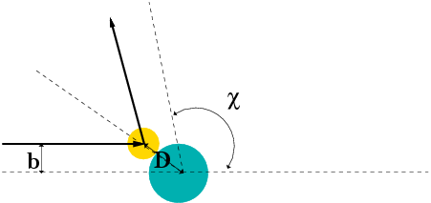
Simple example – collision of hard spheres having mutual radius D; very large target mass
Microscopic view:
Notes:
Illustration of the analysis for the scattering of a hard sphere on a massive hard sphere.

Slide 35
Some details --
θ

Slide 36
Simple example – collision of hard spheres -- continued
Hard sphere:
Notes:
Total cross section versus partical cross section.

Slide 37
More details of hard sphere scattering –
Hidden in the analysis are assumptions about the scattering process such as:
No external forces ➔ linear momentum is conserved
No dissipative phenomena ➔ energy is conserved
No torque on the system ➔ angular momentum is conserved
Target particle is much more massive than scattering particle
Other assumptions??
Note that for quantum mechanical hard spheres at low energy the total cross section is 4 times as large.
Notes:
Some questions and comments. The discussion of scattering theory will be continued next time.

