Slide 1
PHY 711 Classical Mechanics and Mathematical Methods
10-10:50 AM MWF in Olin 103
Notes for Lecture 10: Rigid bodies –
Chap. 5 (F &W)
Rigid body motion
Notion of the center of mass
Moment of inertia tensor
Torque free motion

Slide 2
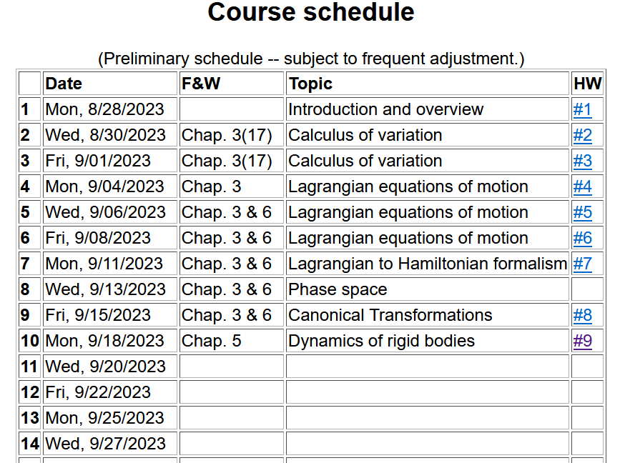
Notes:
In this lecture we will consider the rotational motion of rigid bodies as presented in Chapter 5 of your textbook.

Slide 4
Up to now, we have considered the motions of idealized point particles of mass m, moving along a trajectory with generalized coordinates q_{σ}(t) according to Newton’s laws and the Lagrangian and Hamiltonian equations of motion.
In this case, the kinetic energy of the particle depends only on the squared velocity of the particle scaled by its mass m.
In studying rigid body motion, we consider a system with distributed mass in which the motion is more complicated.

Slide 5
Example of a rigid body system consisting of two masses:
r₂
m₂
m₁
r₁
With rigid bodies, we should consider motion of the body, both relative to an inertial frame of reference and also internal motion of the body. For rigid body motion, it is assumed that no deformations or vibrations occur.

Slide 6
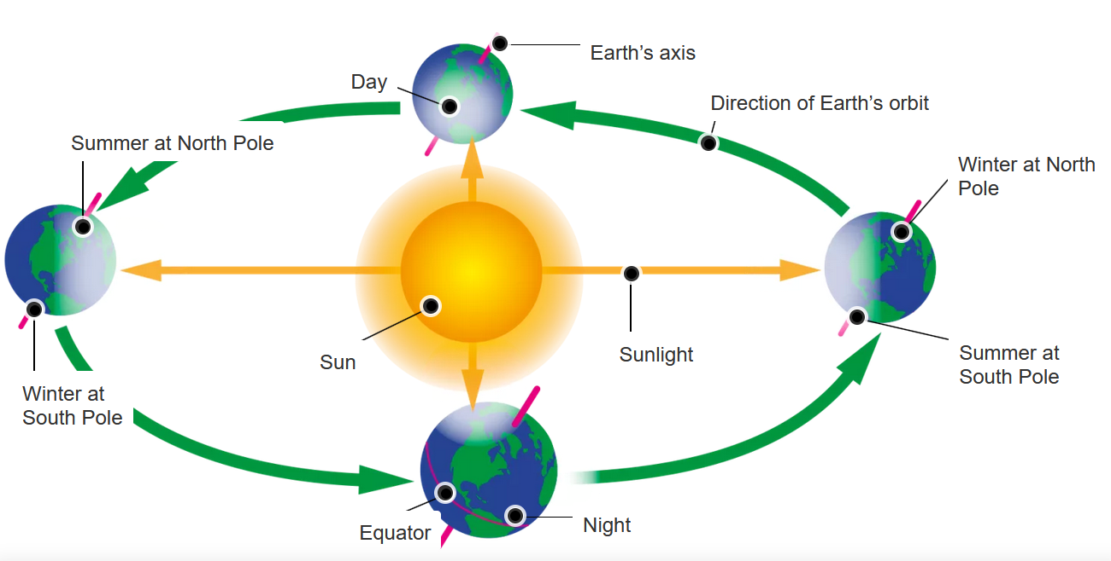
https://www.dkfindout.com/us/space/solar-system/earths-orbit/
Knowing that the laws of physics are most conveniently applied with in an inertial frame of reference, we will focus on how to analyze rotations of a rigid body.

Slide 7
The physics of rigid body motion; body fixed frame vs inertial frame; (using notation from Chapter 2 of F & W)
Notes:
Determining the relationship between the inertial and body frames.

Slide 8
Comparison of analysis in “inertial frame” versus “non-inertial frame”
Notes:
Recall our previous discussion of rotating frames of reference.

Slide 9
Properties of the frame motion (rotation):
dΘ
dΘ
Notes:
Consider an infinitesimal rotation.

Slide 10
Effects on acceleration:
Notes:
Rotational acceleration.

Slide 11
ω
r
=0 for rigid body
➔
Notes:
For a rigid body, internal motions are negligible.

Slide 12
Notes:
It is convenient to group terms that depend on the body geometry – leading to the definition of the moment of inertia tensor.

Slide 13
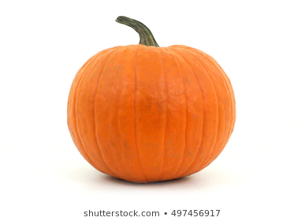
Note: For a given object and a given coordinate system, one can find the moment of inertia matrix
z
y
x

Slide 14
z’
z
y’
y
x
x’
(x’,y’,z’)

Slide 15
ω
r
=0 for rigid body
➔
Notes:
The angular momentum can also be calculated.

Slide 16
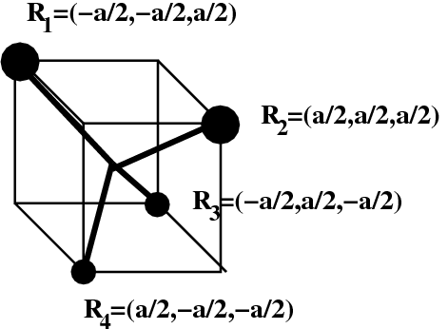
An example with 4 point masses and massless rigid bonds
z
2m
2m
y
m
x
m

Slide 17
Example continued --
z
2m
2m
y
m
x
m
Principal moments:

Slide 18
z
Example:
c
y
a
b
x
Notes:
Consider a simple rectangular solid with a coordinate system at the edge of the system.

Slide 19
Properties of moment of inertia tensor:
Symmetric matrix ➔real eigenvalues I₁,I₂,I₃
➔orthogonal eigenvectors
Notes:
The moment of inertia tensor in matrix form is a symmetric matrix and therefore can be diagonalized. The eigenvalues are known as principal moments of inertia and the eigenvectors are known as principal axes.

Slide 20
Changing origin of rotation
z
z’
r_{p}
r’_{p}
c
R
y’
y
a
x’
b
x
Notes:
Here we consider what happens when we evaluate the moment of inertia tensor about a different origin. In this case, the new origin happens to be at the center of mass.

Slide 21
z
z’
r_{p}
r’_{p}
c
R
y’
y
a
x’
b
x
Notes:
Some details.

Slide 22
z
z’
Note: This is a special case; changing the center of rotation does not necessarily result in a diagonal I’
r_{p}
r’_{p}
c
R
y’
y
a
x’
b
x
Notes:
When the dust clears for this case. Note that I’ happens to be diagonal already, however it is not generally true that shifting the origin for the moment of inertia would result in a diagonal matrix.

Slide 23
Descriptions of rotation about a given origin
ω
Notes:
In the next slides we will focus on the fact that each rigid body has 3 principal axes and 3 moments of inertia for a given origin. It is often convenient to use that coordinate system to analyze rigid body motion.

Slide 24
Descriptions of rotation about a given origin -- continued
Notes:
Here we consider the angular moment expressed in the diagonalized body fixed frame of reference.

Slide 25
Descriptions of rotation about a given origin -- continued
Notes:
While it is very difficult to express torque in this reference frame, we can readily solve problems with zero torque.

Slide 26
➔
Notes:
For the general system with three distinct moment of inertia, the solutions are difficult, but simplifications occur when two moments are the same, in this I1=I2.

Slide 27
Solution of Euler equations for symmetric object continued
Notes:
Time dependence of the symmetric top in free space

Slide 28
➔
Notes:
Now consider the more general case.

Slide 29
Notes:
Reasonable approximations.

Slide 30
Euler equations for asymmetric object continued
Notes:
We see that there are conditions that allow stability for this system,. --- to be continued.

