Slide 1
PHY 711 Classical Mechanics and Mathematical Methods
10-10:50 AM MWF in Olin 103
Notes for Lecture 12 – Chap. 5 (F &W)
    Rotational motion of rigid bodies
    Comment about HW #7
    Review of rigid body motion
    Euler angles
    Symmetric top motion
Notes:
In this lecture, we continue our discussion of rigid body motion.

Slide 2
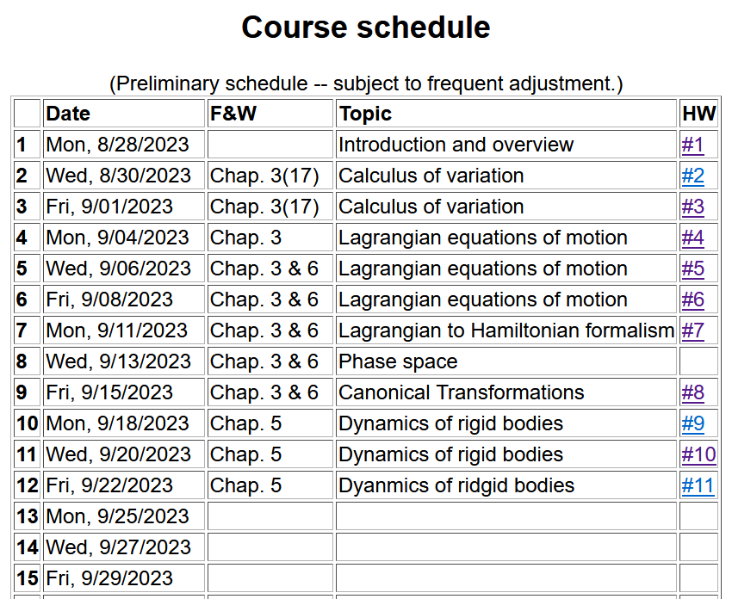
Notes:
Since you will be turning in your exams today, we will resume the homework assignments.

Slide 3
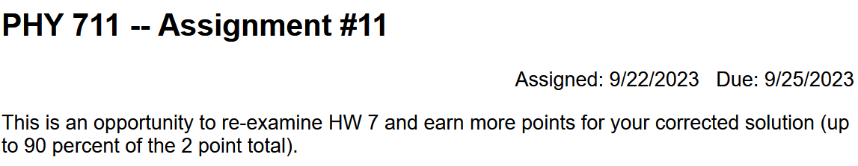
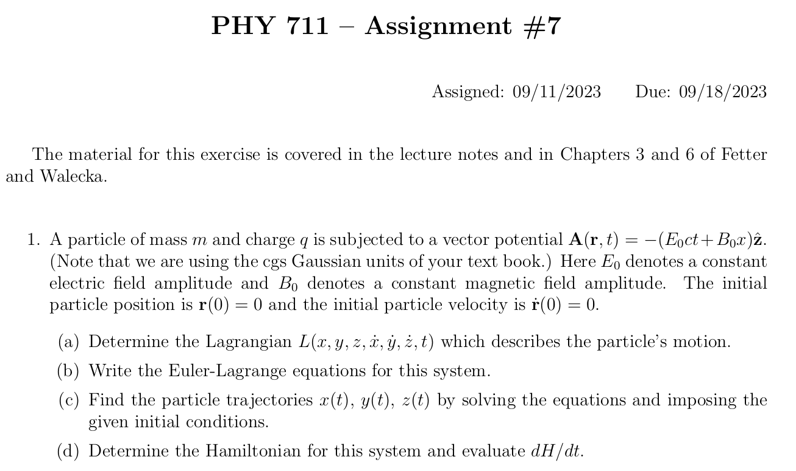

Slide 5
Summary of previous results
describing rigid bodies rotating
about a fixed origin
ω
r
Notes:
Review of notions of rigid body motion.

Slide 6
Moment of inertia tensor
Notes:
In general there is a symmetric tensor which defines the moment of inertia. By rotating the coordinates about a fixed origin we can find the matrix in diagonal form.

Slide 7
Continued -- summary of previous results describing rigid bodies rotating about a fixed origin
ω
r
Notes:
In addition to the kinetic energy, the angular momentum also can be expressed in terms of the moment of inertia tensor.

Slide 8
Descriptions of rotation about a given origin -- continued
Notes:
It is convenient to express the angular moment in terms of the principal moments .

Slide 9
Descriptions of rotation about a given origin -- continued
Notes:
When there is zero torque acting on the system, the angular velocity components are coupled through these Euler equations.

Slide 10
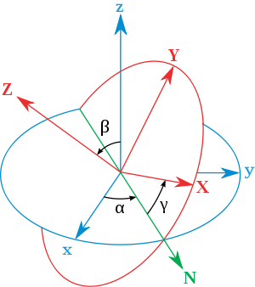
Transformation between body-fixed and inertial coordinate systems – Euler angles
inertial
Comment – Since this is an old and intriguing subject, there are a lot of terminologies and conventions, not all of which are compatible. We are following the convention found in most quantum mechanics texts and NOT the convention found in most classical mechanics texts. Euler’s main point is that any rotation can be described by 3 successive rotations about 3 different (not necessarily orthogonal) axes. In this case, one is along the inertial z axis and another is along the body fixed Z axis. The middle rotation is along an intermediate N axis.
body
x
y
y
x
http://en.wikipedia.org/wiki/Euler_angles
Notes:
In order to consider motion of a rigid body more generally, in the presence of torque, it will be necessary to consider how to relate the body – fixed coordinates that diagonalize the moment of inertia tensor to another coordinate system which in general be an inertial coordinate system. Here again, we use ideas of Euler. This notation or it is equivalent is typically consistent with quantum mechanics text books.

Slide 11
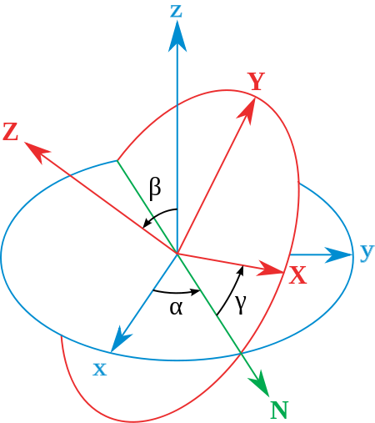
Comment on conventions
Our diagram On web (for CM)
body
x
y
y
x

Slide 12
x
Need to express all components in body-fixed frame:
y
y
x
Notes:
Euler said that the transformation of body-fixed → inertial frames can be accomplished in 3 steps and the corresponding angles are alpha, beta, and gamma. In this case, we want to express all results in the body fixed frame.

Slide 13
When the dust clears --
Notes:
Putting all of the transformations together, we now have expressions for the angular velocity components referenced to the body fixed frame.

Slide 14
x
y
y
x
Notes:
Result to remember.

Slide 15
Rotational kinetic energy
Notes:
General expression of the rotational kinetic energy and the special case of the symmetric top.

Slide 16
General transformation between rotated coordinates – Euler angles
inertial
body
x
y
y
x
http://en.wikipedia.org/wiki/Euler_angles
Notes:
In general any transformation can be expressed in terms of the three Euler angles.

Slide 17
Motion of a symmetric top under the influence of the torque of gravity:
γ
β
Mg
α
Notes:
Now consider the motion of a symmetric top in which the pivot point is fixed and torque is applied by gravity acting at the center of mass of the top. Here l denotes the distance of the pivot point to the center of mass.

Slide 18
Notes:
Lagrangian and its solution.

Slide 19
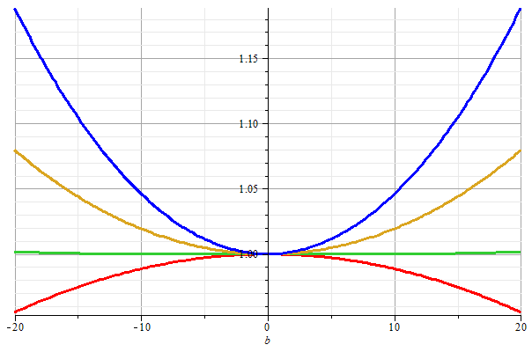
Stable/unstable solutions near
β=0
Notes:
Special case where top is spinning nearly vertically.

Slide 20
What happens when β→0?

Slide 22
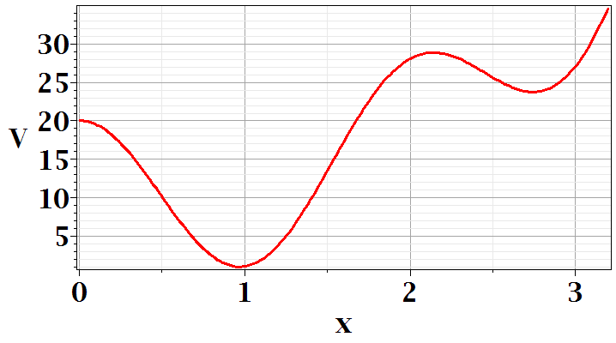
Question: How do we decide stable/unstable solutions for the symmetric top motion?
Comment – When we discussed one dimensional motion, we discussed stable and unstable equilibrium points. At equilibrium dV/dx=0, but only when V(x) has a minimum at that point, is the system stable in the sense that for small displacements from equilibrium, there are restoring forces to move the system back to the equilibrium point.
Minimization of a simple function
maximum
local minimum
global minimum

Slide 23
Notes:
Approximate solution for that case.

Slide 24
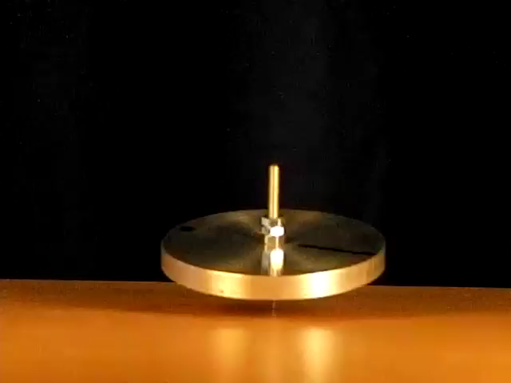

http://www.physics.usyd.edu.au/~cross/SPINNING%20TOPS.htm
See also --

Slide 25
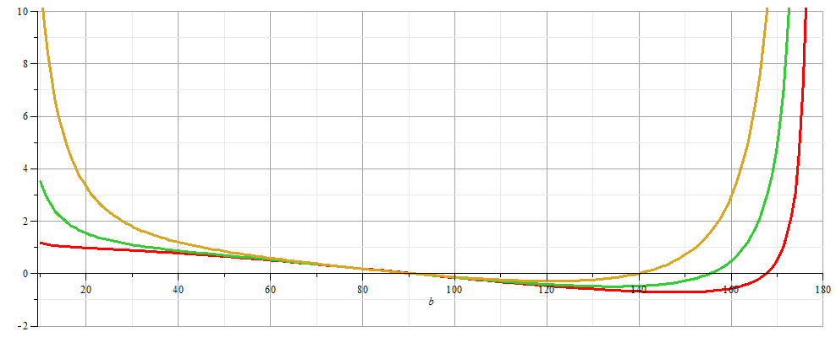
More general case:
Notes:
For a spinning bicycle suspended by a rope, the beta angle can be greater than 90 degress

Slide 26
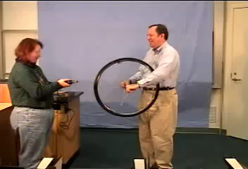
https://drive.google.com/file/d/0B14RyYwpwSDNcXdxTWl3OExHX1k/view

Slide 27
β
Mg
α
Notes:
Summary of results.

