Slide 1
PHY 711 Classical Mechanics and Mathematical Methods
10-10:50 AM MWF in Olin 103
Discussion for Lecture 16 – Chap. 4 (F & W)
Analysis of motion near equilibrium
Small oscillations about equilibrium
Normal modes of vibration
Notes:
In this lecture we will analyze systems near equilibrium. This system represents a lot of physical systems and is associated with a rich toolbox of mathematical formalisms.

Slide 2
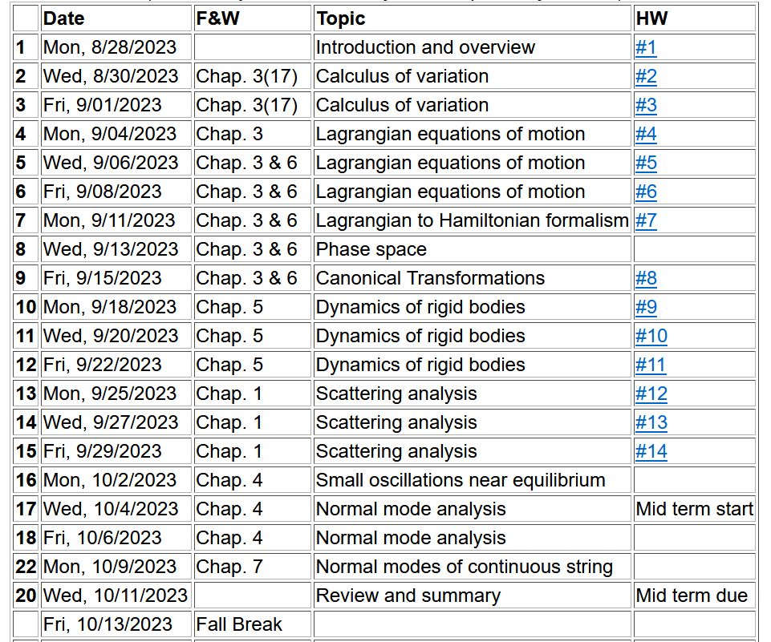
Notes:
We are starting the material covered in Chap. 4.

Slide 3
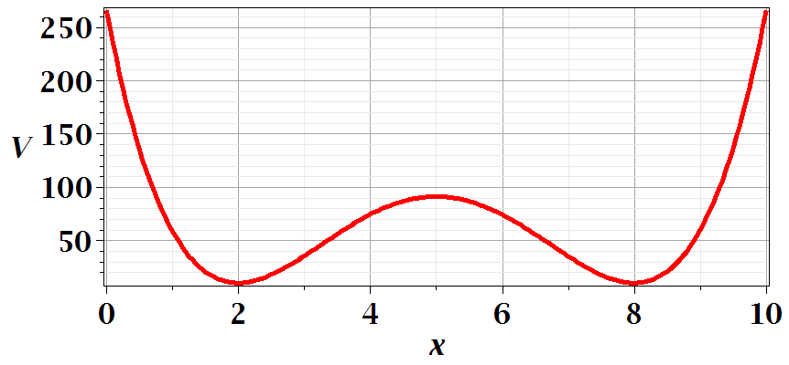
Motivation for studying small oscillations – many interacting systems have stable and meta-stable configurations which are well approximated by:
Notes:
This is a plot for an arbitrary one dimensional potential function showing two stable equilibria near x=2 and x=8.

Slide 4
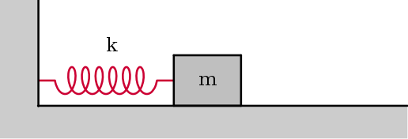
Notes:
Lagrangian analysis and general solution.

Slide 5
Coupled oscillators --
Example – linear molecule
m₁
m₂
m₃
Equilibrium lengths
Notes:
A more complicated example with 3 masses connected with springs.

Slide 6
Notes:
Analyzing the equations of motion.

Slide 7
Notes:
Coupled differential equation and tricks for solution.

Slide 8
Notes:
Resulting linear equations also written in matrix form.

Slide 9
Notes:
The original equations are not symmetric. With this transformation, we can make the equations take a symmetric form.

Slide 10
Digression:
Notes:
Digression on linear algebra theory.

Slide 11
Digression on matrices -- continued
Eigenvalues of a matrix are “invariant” under a similarity transformation
Notes:
Similarity transformations used to analyze our system.

Slide 12
Example of transformation:
Notes:
Details for our case..

Slide 13
Notes:
More details for our case.

Slide 15
m₁
m₂
m₃
m₁
m₂
m₃
m₁
m₂
m₃
Notes:
Visualization of the solution for our case.

Slide 16
Notes:
The general solution will depend on initial values or boundary values.

Slide 17
Comment on solving for eigenvalues and eigenvectors – while it is reasonable to find these analytically for 2x2 or 3x3 matrices, it is prudent to use Maple or Mathematica for larger systems.
Maple example
Mathematica example

Slide 18
Additional digression on matrix properties
Singular value decomposition
Notes:
An unrelated digression that may be useful – singular value decomposition.

Slide 19
Singular value decomposition -- continued
Notes:
Digression continued.

Slide 20
Consider an extended system of masses and springs:
m
m
m
Notes:
Another example; this one is in your textbook.

Slide 21
Notes:
Details for N masses.

Slide 22
Can solve as an eigenvalue problem --
Notes:
Form of matrix equations. Remaining slides will be discussed on Monday.

Slide 23
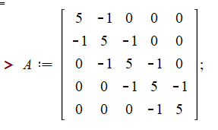
Notes:
Finding eigenvalues with Maple.

Slide 24
This example also has an algebraic solution --
Notes:
Analytic methods for this highly symmetric case.

Slide 25
Notes:
Setting the boundary values.

Slide 26
Notes:
Boundary conditions continued.

Slide 27
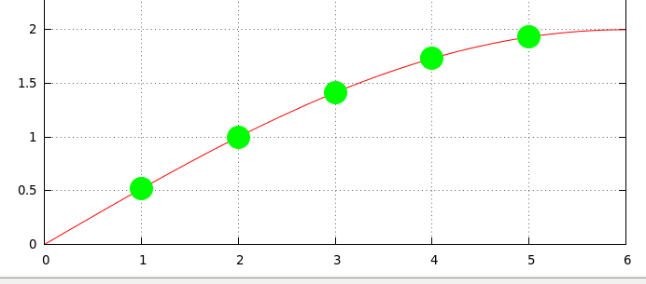
Notes:
Plot of the results.

