Slide 1
PHY 711 Classical Mechanics and Mathematical Methods
10-10:50 AM MWF in Olin 103
Discussion for Lecture 18 – Chap. 4 (F & W)
Analysis of motion near equilibrium –
Normal Mode Analysis
Normal modes for finite 2 and 3 dimensional systems
Normal modes for extended systems

Slide 2
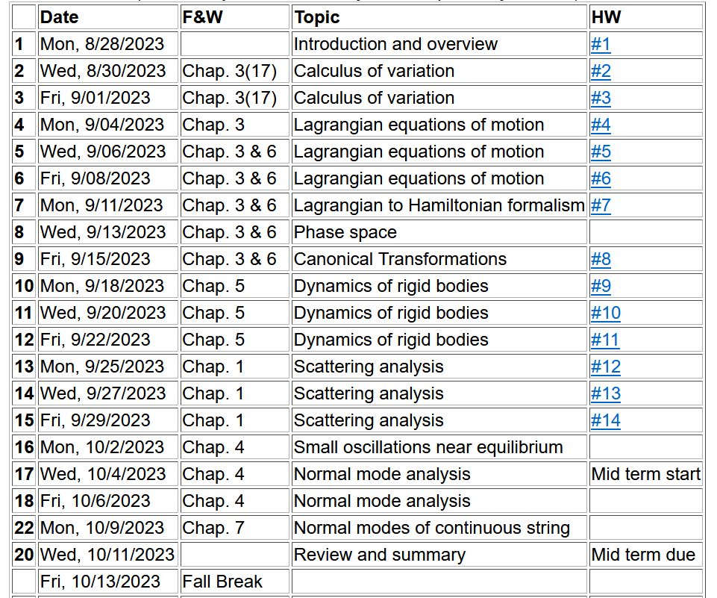
Notes:
We are starting the material covered in Chap. 4.

Slide 3
Now consider a potential system in 2 dimensions near its equilibrium point --
V(x,y)
Notes:
Returning to the finite systems, consider equilibria in two dimensions as shown.

Slide 4
Example – normal modes of a system with the symmetry of an equilateral triangle
3
u₃
m
k
k
u₂
1
2
u₁
k
m
m
Notes:
Specifically, we will consider 3 masses in an equilateral triangle configuration as shown.

Slide 5
Some details for this case of the equilateral triangle --
3
u₃
m
k
k
u₂
1
2
u₁
k
m
m

Slide 6
Example – normal modes of a system with the symmetry of an equilateral triangle -- continued
3
u₃
u₂
1
2
u₁
Notes:
We need to consider displacements from equilibrium in the x-y plane. Keeping only linear terms in the displacements we wind up with a simple relationship to analyze.

Slide 7
negligible
Note that this analysis of the leading term is true in 1, 2, and 3 dimensions.

Slide 8
Example – normal modes of a system with the symmetry of an equilateral triangle -- continued
3
u₃
u₂
1
2
u₁
Notes:
We need to consider displacements from equilibrium in the x-y plane. Keeping only linear terms in the displacements we wind up with a simple relationship to analyze.

Slide 9
Example – normal modes of a system with the symmetry of an equilateral triangle -- continued
Notes:
Analyzing the 3 displacements for the equilateral triangle geometry, we find these equations.

Slide 10
Example – normal modes of a system with the symmetry of an equilateral triangle -- continued
= ω²
Notes:
The results is a 6x6 matrix problem to find eigenvalues and eigenvectors.

Slide 11
Example – normal modes of a system with the symmetry of an equilateral triangle -- continued
With help from Maple
3
u₃
m
k
k
u₂
1
2
u₁
k
m
m
Notes:
Results from Maple. We have 6 eigenvalues and 3 non-zero modes for this case.

Slide 12
3
u₃
What can you say about the 3 zero frequency modes?
m
k
k
u₂
1
2
What can you say about the 3 non-zero frequency modes?
u₁
k
m
m

Slide 13
More general treatment of atomic system near equilibrium
Notes:
Some equations for extended systems.

Slide 14
Notes:
More euqations.

Slide 15
q maps distinct configurations of periodic states.

Slide 16
Notes:
More equations.

Slide 17
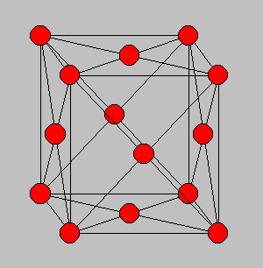
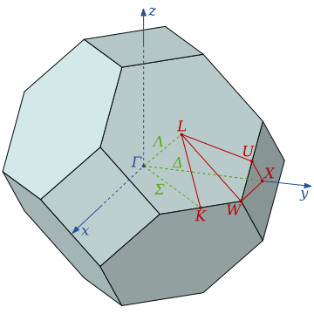
3-dimensional periodic lattices
Example – face-centered-cubic unit cell (Al or Ni)
Diagram of atom positions
Diagram of q-space ν(q)
Notes:
Interesting extensions to a 3-dimensional crystalline system.

Slide 18
From: PRB 59 3395 (1999); Mishin et. al. ν(q)
Note that for each q, there are 3 frequencies.
Notes:
Results of normal modes from experiment and simulations for face centered cubic Al (left) and Ni (right). Interestingly, the phonon frequency patterns are similar for these very different materials.

Slide 19
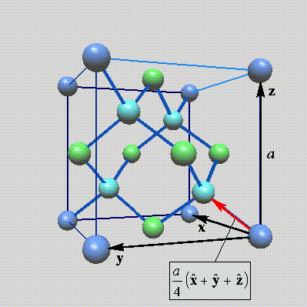
Lattice vibrations for 3-dimensional lattice
Example: diamond lattice
Ref: http://phycomp.technion.ac.il/~nika/diamond_structure.html
Notes:
Another example – diamond.

Slide 20
B. P. Pandy and B. Dayal, J. Phys. C. Solid State Phys. 6 2943 (1973)
Notes:
Results for diamond from simulation and experiment.

Slide 21
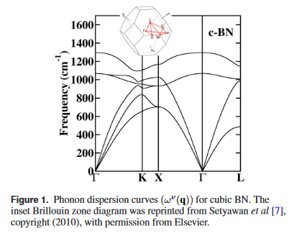
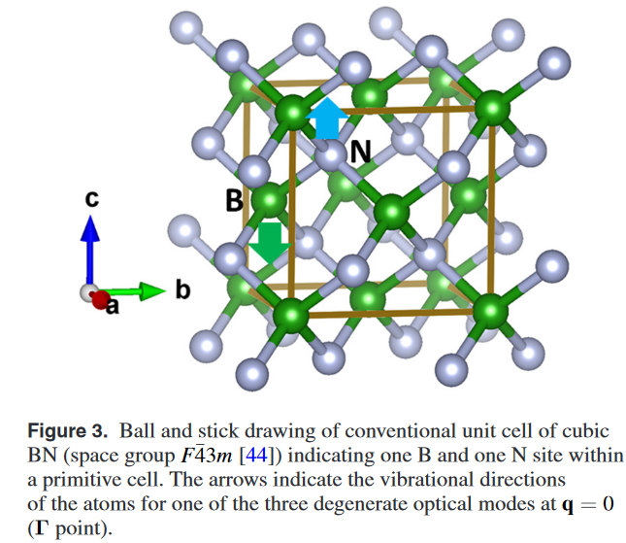
Examples of phonon spectra of two forms of boron nitride
Cubic structure

Slide 22
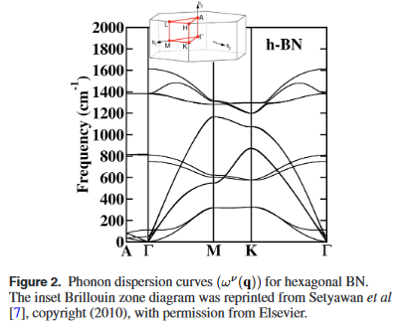
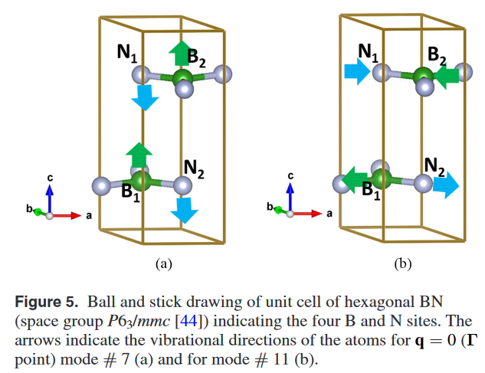
Examples of phonon spectra of two forms of boron nitride
Hexagonal structure

Slide 23
Helmholz free energy for vibrational energy at temperature T:
Phonon density of states:

Slide 24
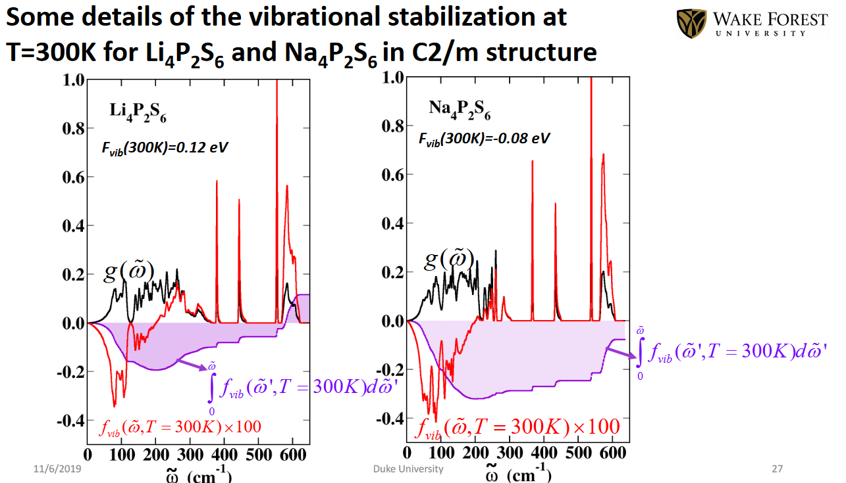
An example of phonon analysis for two similar materials --
From calculations by Yan Li

Slide 25
From calculations by Yan Li

