Slide 1
PHY 711 Classical Mechanics and Mathematical Methods
10-10:50 AM MWF in Olin 103
Notes for Lecture 20: Review
Chap. 3,6,5,1,4,7 (F&W)
Calculus of variation
Lagrangian/Hamiltonian formalisms
Phase space and the Liouville theorem
Rigid body motion
Scattering theory
Small oscillations about equilibrium
Wave motion in continuous media

Slide 2
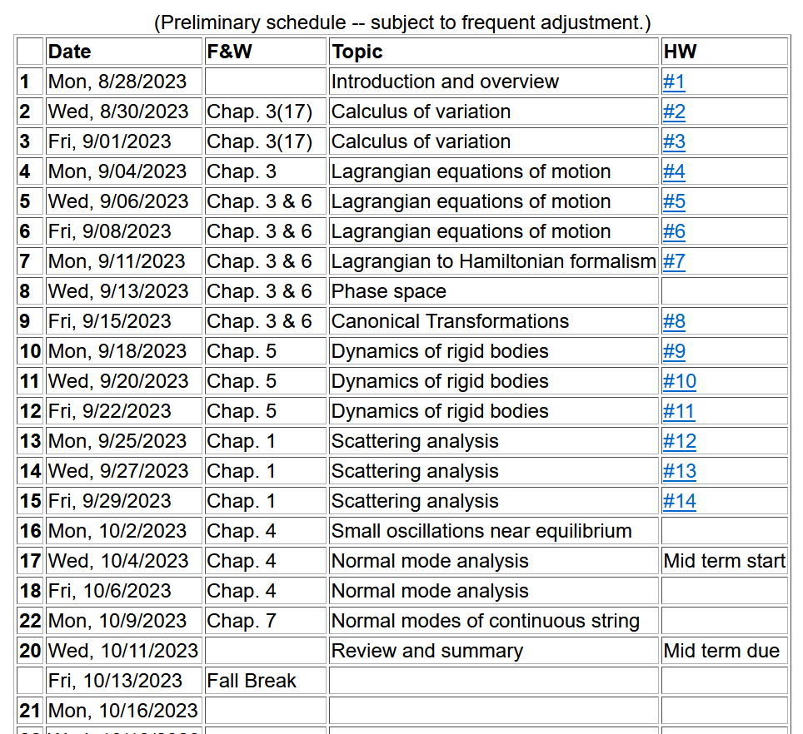
Notes:
Start reading Chapter 7.

Slide 3
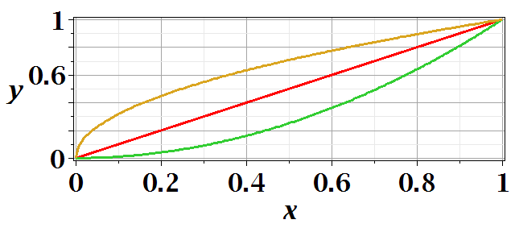
Calculus of variation –

Slide 4
After some derivations, we find
Note that this is a
“total” derivative

Slide 5
Summary --
Euler-Lagrange equation

Slide 7
Application to particle dynamics
Hamilton’s principle states that the dynamical trajectory of a system is given by the path that extremizes the action integral
Simple example: vertical trajectory of particle of mass m subject to constant downward acceleration a=-g.

Slide 8
Potential energy
Kinetic energy

Slide 10
Extension of these ideas to multiple coordinates due to multiple dimensions and/or multiple particles.
1 particle with 1 degree of freedom
many particles with multiple degrees of freedom
➔
1 particle+3 Cartesian dimensions
N particles+3 Cartesian dimensions

Slide 12
Modification of Lagrangian due to electric and magnetic fields

Slide 13
Introducing the Hamiltonian --
Lagrangian picture
Switching variables – Legendre transformation

Slide 14
Hamiltonian picture – continued

Slide 15
Recipe for constructing the Hamiltonian and analyzing the equations of motion

Slide 16
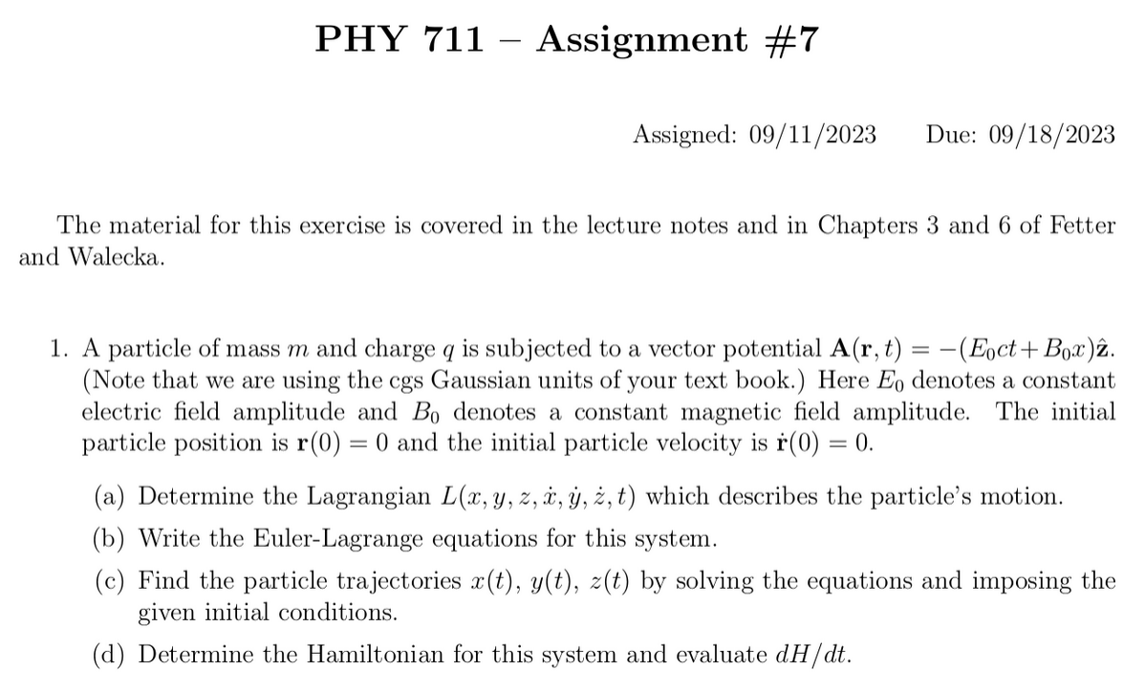
Example problem --

Slide 17
Steps for tackling a problem –
What are the basic concepts the apply to this problem.
Write down the fundamental equations
Solve
Check.
In this case, we expect that we should use the Lagrangian formalism and thus we need to know how to represent electric and magnetic fields in the Lagrangian.

Slide 19
Is this correct?

Slide 21
Comment on solving equations of motion
Use these two equations to decouple x(t) and z(t)

Slide 22
Introduction to rigid body analysis
Note: For a given object and a given coordinate system, one can find the moment of inertia matrix
z
y
x

Slide 23
z’
z
y’
y
x
x’
(x’,y’,z’)

Slide 24
Descriptions of rotation about a given origin; analyzed in the body fixed frame

Slide 25
➔

Slide 26
Solution of Euler equations for symmetric object continued

Slide 27
detector
Scattering theory:

Slide 28
b
Figure from Marion & Thorton, Classical Dynamics

Slide 29
More generally, it is possible to use numerical integration methods (with care) to evaluate b(θ) to relate exp and theory.

