Slide 1
PHY 711 Classical Mechanics and Mathematical Methods
10-10:50 AM MWF in Olin 103
Notes for Lecture 23: Chap. 7
& App. A-D (F&W)
Generalization of the one dimensional wave equation ➔ various mathematical problems and techniques including:
Completeness property of Sturm-Liouville eigenfunctions
Construction of Green’s functions
Fourier transforms
Laplace transforms
Complex variables
Contour integrals
Notes:
In this lecture we will start to cover various useful mathematical techniques.

Slide 2
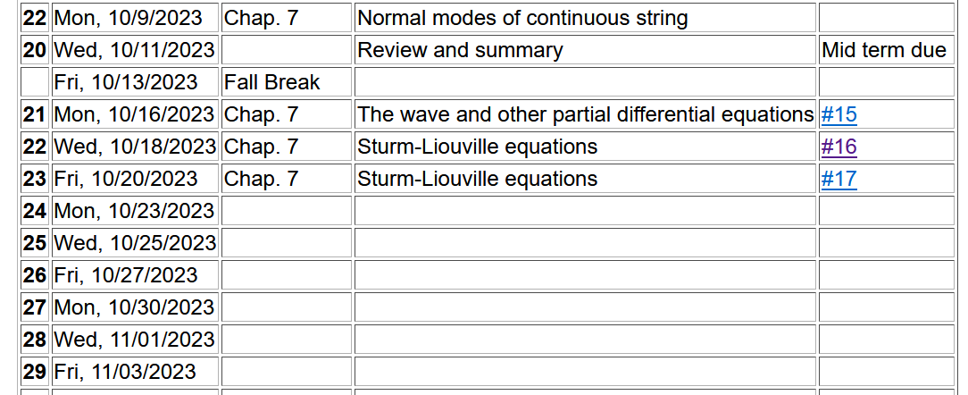

Slide 3
Review – Sturm-Liouville equations defined over a range of x.
Note that, because Sturm-Liouville operator is Hermitian, the eigenvalues are real and the eigenfunctions are orthogonal. In the last lecture, we argued that the eigenfunctions form a “complete” set over the range of x defined for the particular system.
Notes:
Review of the Sturm Liouville equations.

Slide 4
Notes:
Specializing to the simplest case.

Slide 7
Example Sturm-Liouville system --

Slide 9
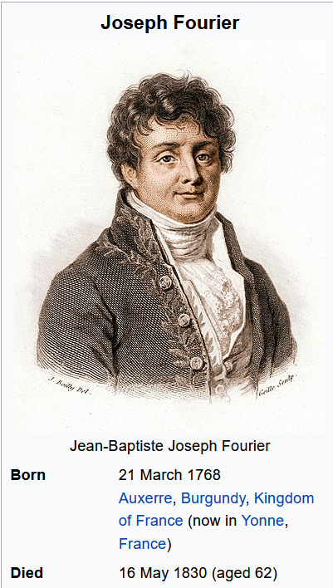

Slide 11
Example
x

Slide 12
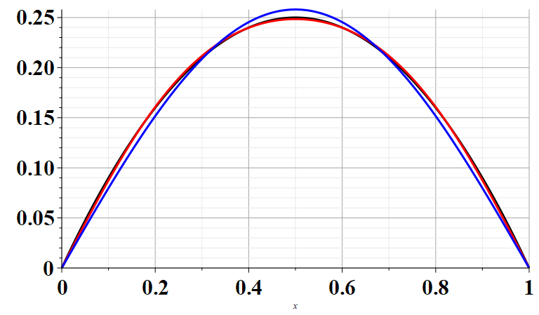
Example
x

Slide 13
Note that this analysis can also apply to time dependent functions. In the remainder of the lecture, we will consider time dependent functions.

Slide 14
Comment on complex functions –
We can also treat complex functions, typically separately considering the real and imaginary parts.

Slide 15
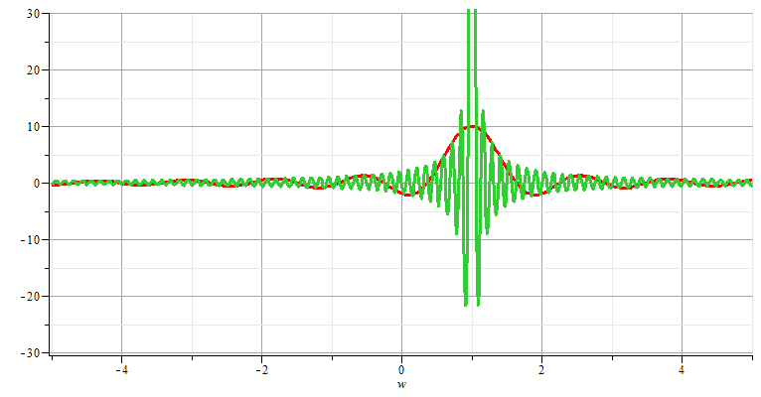
Generalization to infinite range -- Fourier transforms

Slide 16
Note: The location of the 2π factor varies among texts.

Slide 17
Question about forward and backward transforms –
Comment – Nomenclature for forward and backward can be confusing, but the point is that if we know the time dependence, we can determine the frequency dependence and if we know the frequency dependence, we can determine the time dependence.

Slide 18
Note that for an infinite time range, the Fourier transform is continuous in both time and frequency.

Slide 19
Use of Fourier transforms to solve wave equation

Slide 20
Use of Fourier transforms to solve wave equation -- continued
Note that at this point, we do not know the coefficients A_{n}; however, it clear that the solutions are consistent with D’Alembert’s analysis of the wave equation.

Slide 24
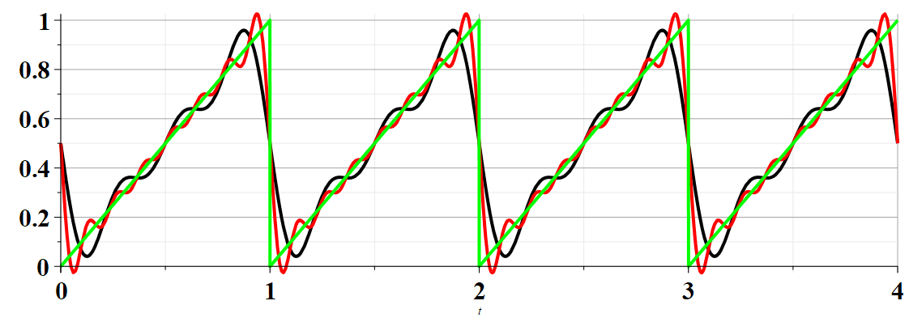
Example:

Slide 25
Summary –
Find discrete frequencies ω for functions f(t) over finite time domain of for functions f(t) which are periodic: f(t)=f(t+nT)
➔Numerically, there is an advantage of tabulating double discrete Fourier transforms (discrete in ω and in t).

Slide 26
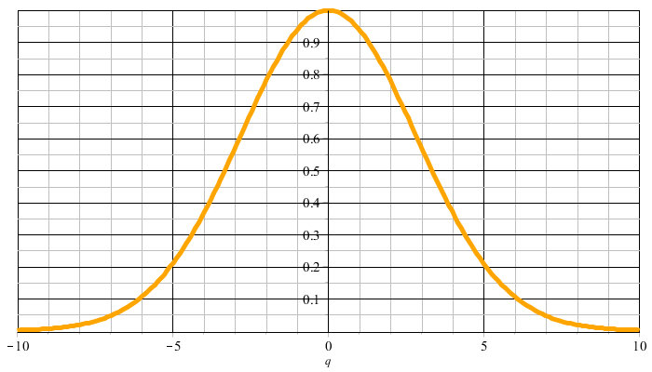
Example:
f(t)
t
F(νΩ)
νΩ

Slide 27
F(νΩ)
νΩ
ν=M
νΩ
ν=-M

Slide 28
Constructed frequency periodic function --

Slide 30
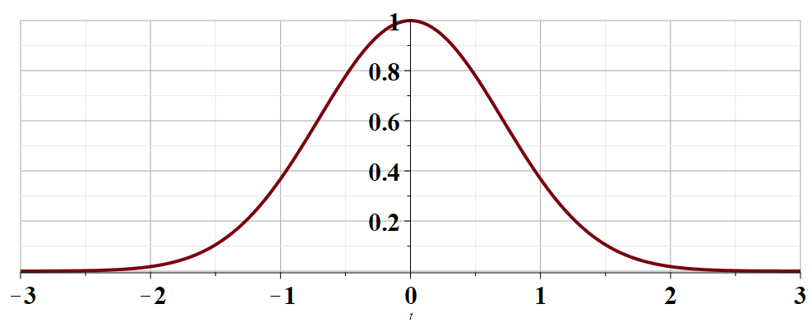
t →

Slide 33
Cooley-Tukey algorithm: J. W. Cooley and J. W. Tukey, “An algorithm for machine calculation of complex Fourier series” Math. Computation 19, 297-301 (1965)

Slide 34
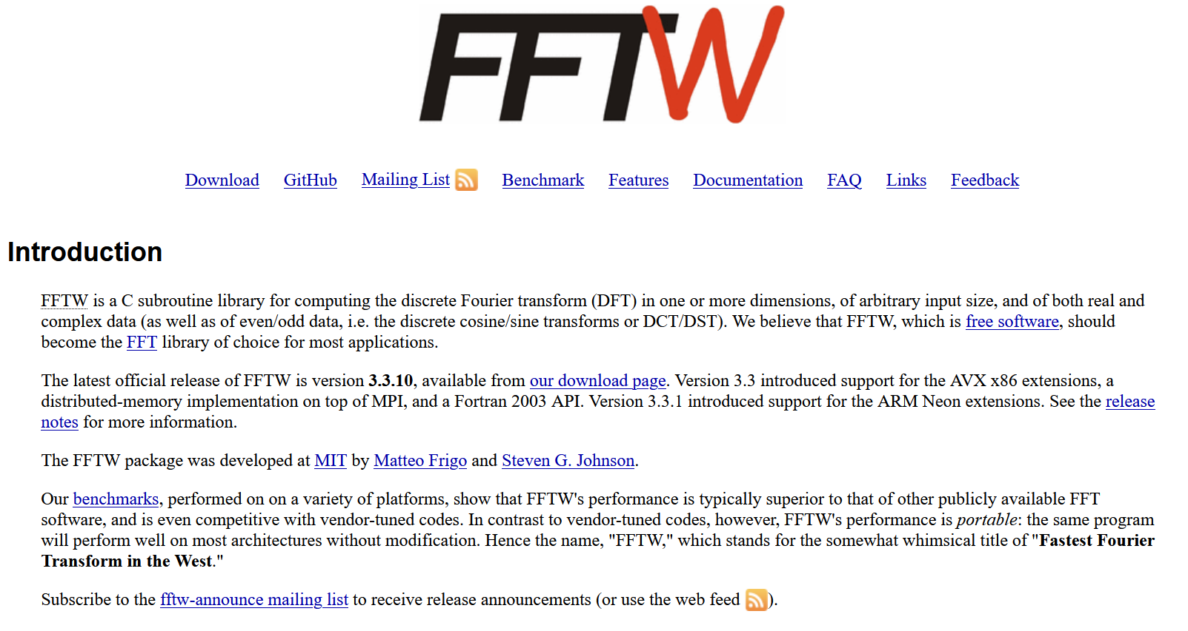
http://www.fftw.org/

Slide 35
Fourier series and Fourier transforms are useful for solving and analyzing a wide variety of functions, also beyond the Sturm-Liouville context.
Next time, we will consider a related concept – the Laplace transform.
Notes:
We now consider another technique that is uses to solve initial value equations.

