Slide 1
PHY 711 Classical Mechanics and Mathematical Methods
10-10:50 AM MWF in Olin 103
Notes for Lecture 25: Chap. 7
& App. A-D (F&W)
Generalization of the one dimensional wave equation ➔ various mathematical problems and techniques including:
Complex variables
Contour integrals
Kramers-Kronig relationships

Slide 2
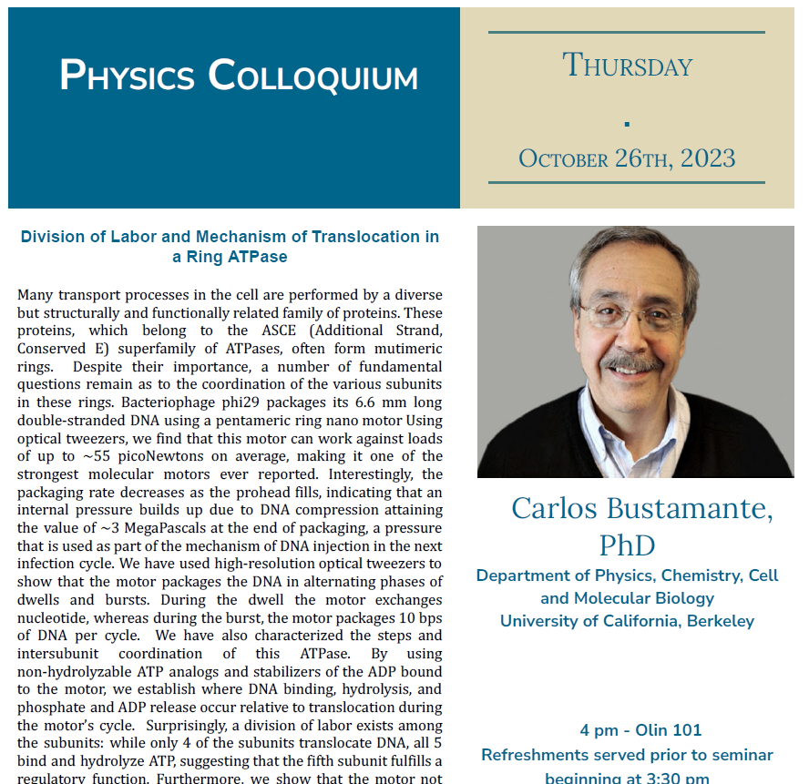

Slide 3
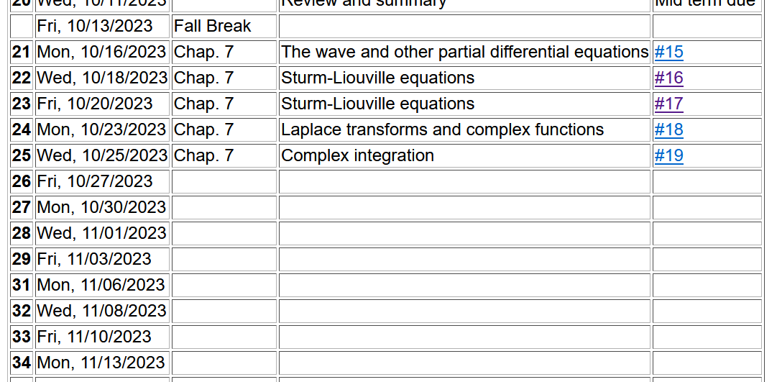

Slide 4
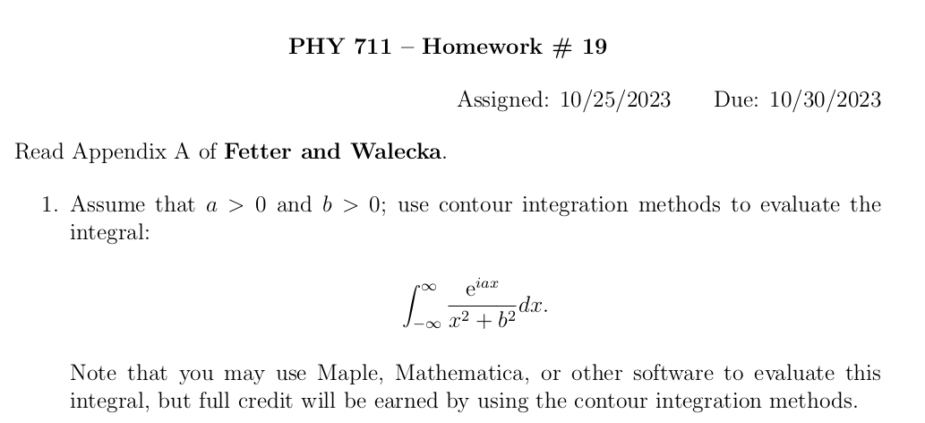

Slide 5
Basic ideas of complex integration --
Notes:
Examples of non-analytic functions. Special property of contour integrals about a function with a simple “pole”.

Slide 6
Integration does not include z_{p}
Integration does include z_{p}

Slide 7
No contribution
C
Notes:
Contributions to a closed contour from various contributions.

Slide 8
In the following examples m=1
Notes:
Residue theorem

Slide 9
Example:
Im(z)
Re(z)
Note:
m=1
Notes:
Example of a contour integral using the residue theorem.

Slide 10
Some details:
Question – Could we have chosen the contour in the lower half plane?
a. Yes b. No
Notes:
Some details.

Slide 11
Another example:
Note:
m=1
Im(z)
Re(z)
Notes:
Another example.

Slide 12
Question – Could we have chosen the contour in the lower half plane?
a. Yes b. No
Notes:
Some details.

Slide 13
Another example:
Im(z)
ia
Re(z)
10/30/2017
PHY 711 Fall 2017 -- Lecture 25
13
Notes:
Another example

Slide 14
Notes:
More details.

Slide 15
Im(z)
Re(z)

Slide 16
Notes:
Another example from the Drude model.

Slide 17
Cauchy integral theorem for analytic function f(z):
Notes:
Another useful theorem from Cauchy.

Slide 18
Example
Im(z)
Re(z)
Notes:
Considering real and imaginary parts.

Slide 19
Example -- continued
Im(z)
Re(z)
Notes:
Real and imaginary parts for Cauchy’s integral relation.

Slide 20
Example -- continued
Im(z’)
x
Re(z’)
Notes:
Detail of how to evaluate the point x=x’ in terms of the principal parts integral.

Slide 21
Im(z’)
x
Re(z’)
Notes:
Some details.

Slide 22
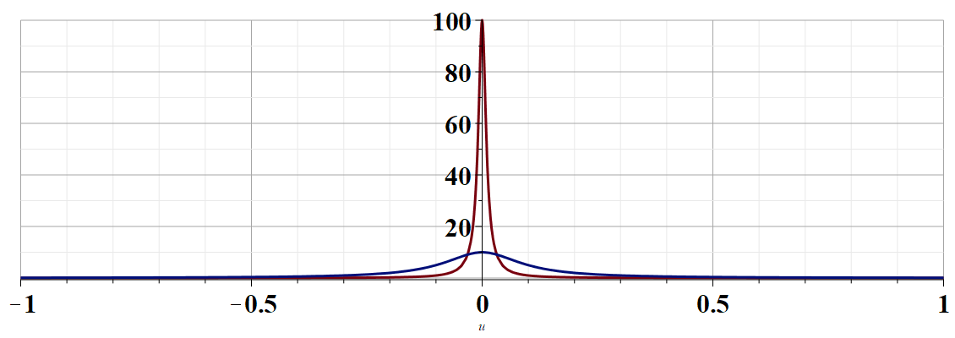
More details --
u
Notes:
Justification of the delta function result.

Slide 23
Example -- continued
Kramers-Kronig relationships
Notes:
Final result relating real and imaginary parts of complex function.

Slide 24
Comment on evaluating principal parts integrals
y’
x’
Notes:
Some details.

Slide 25
b(x’)
-2L
-L
L
2L
x’
Notes:
Simple example for complex function.

Slide 26
Notes:
For given imaginary function, this is the form of the real function.

Slide 27
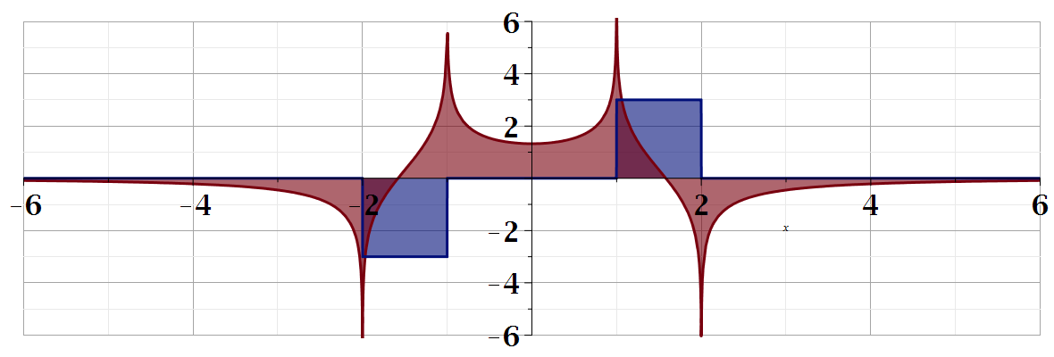
For our example:
b(x)
a(x)
Notes:
Summary of results.

Slide 28
Summary
?
Notes:
Summary.

Slide 29
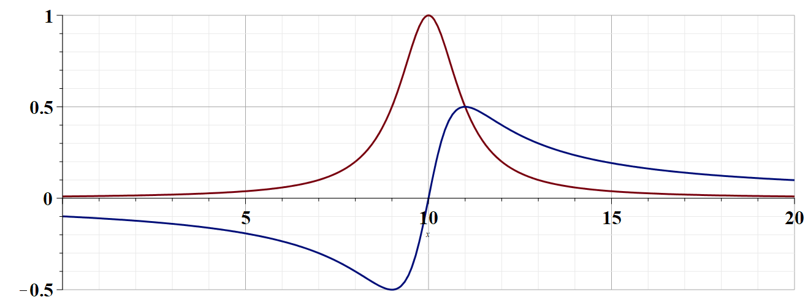

Slide 30
Continued:

