Slide 1
PHY 711 Classical Mechanics and Mathematical Methods
10-10:50 AM MWF in Olin 103
Notes for Lecture 26 – Chap. 8 (F & W)
Motions of elastic membranes
Review of standing waves on a string
Standing waves on a two dimensional membrane.
Boundary value problems
Notes:
In this lecture, we will resume our consideration of elastic media, extending the one dimensional analysis of a string to a two dimensional membrane.

Slide 2
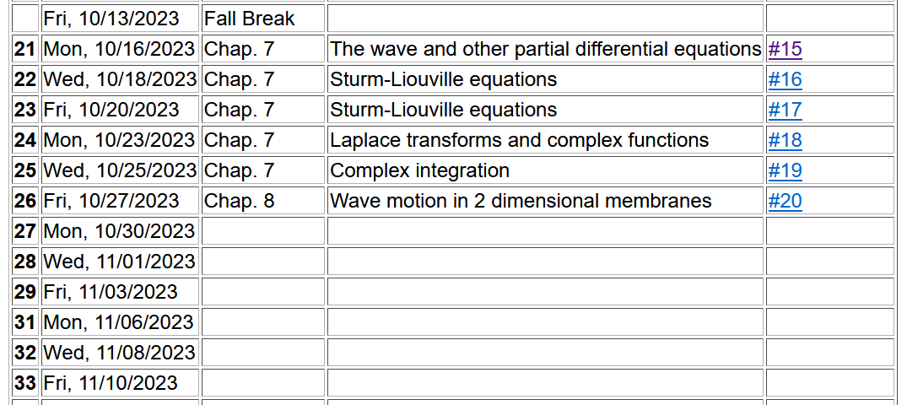

Slide 4
Elastic media in two or more dimensions --
Review of wave equation in one-dimension – here μ(x,t) can describe either a longitudinal or transverse wave.
Traveling wave solutions --
Notes:
Review of the wave equation in one special dimension.

Slide 5
Notes:
Review continued.

Slide 6
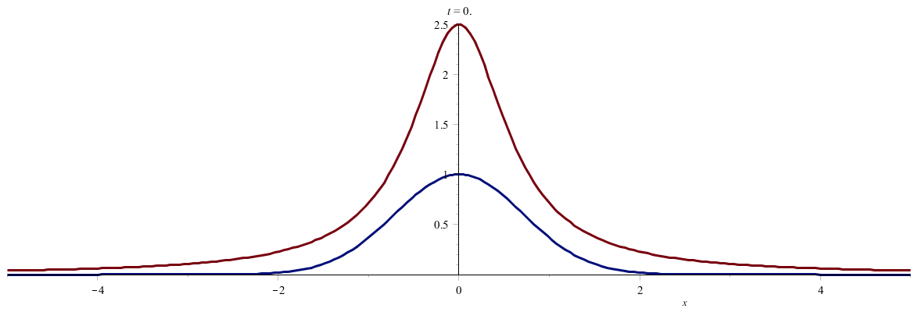
Notes:
Two examples of traveling waves.

Slide 7
Standing wave solutions of wave equation:
Notes:
Standing wave solutions for constrained string.

Slide 8
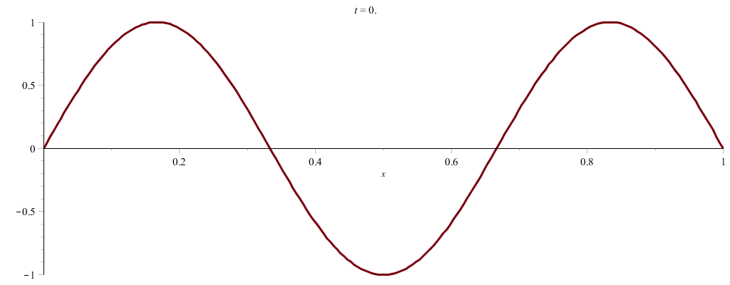
Notes:
Some more details of standing waves.

Slide 9
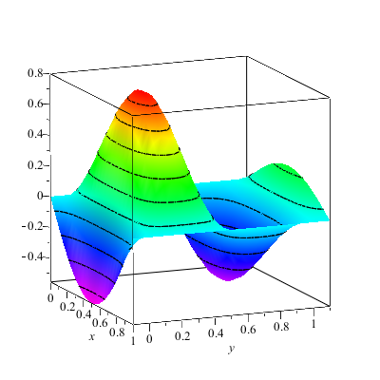
Wave motion on a two-dimensional surface – elastic membrane (transverse wave; linear regime).
Note that here we are visualizing transverse waves. Longitudinal waves can also exist.
Notes:
Now consider, the same idea, generalized to two spatial dimensions. Here we will focus on standing wave solutions.

Slide 11
Notes:
It is possible to formulate the treatment using a continuous Lagrangian.

Slide 12
Notes:
Some details.

Slide 13
Consider a rectangular boundary:
b
a
Notes:
An example of the rectangular membrane clamped on all edges.

Slide 14
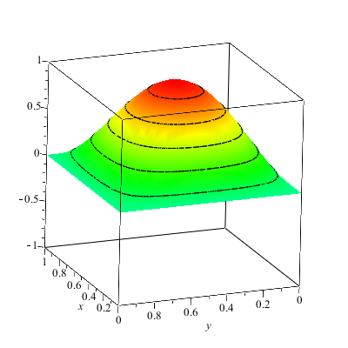
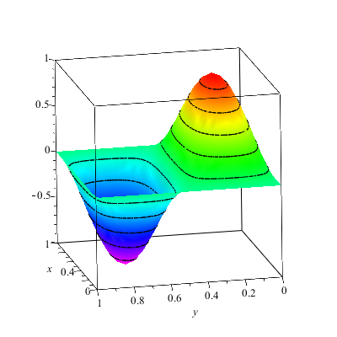
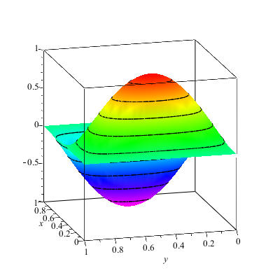
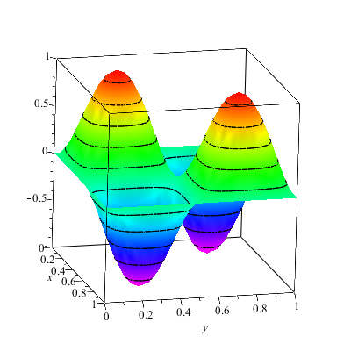
Notes:
Some two dimensional standing waves.

Slide 15
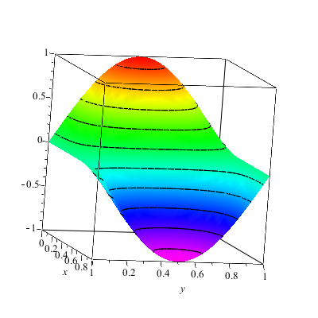
More general boundary conditions:
Notes:
Other possible boundary conditions.

Slide 16
Consider a circular boundary:
R
Notes:
Another example of a membrane, this time clamped at the boundary of a circle. (Such as in a drum for example.) It is convenient to polar coordinates.

Slide 17
Consider circular boundary -- continued
Notes:
The radial equation has this special form which is conveniently expressed in terms of Bessel functions.

Slide 18
Some properties of Bessel functions
Notes:
Some properties of Bessel functions of integer order.

Slide 19
http://dlmf.nist.gov/
Notes:
A resource for finding properties of special functions including Bessel functions.

Slide 20
Series expansions of Bessel and Neumann functions
Notes:
Some details.

Slide 21
Some properties of Bessel functions -- continued
Notes:
Patient mathematicians worked out lots of useful relationships. We are particularly interested in aligning the zeros of the Bessel functions with the boundaries of our membrane.

Slide 22
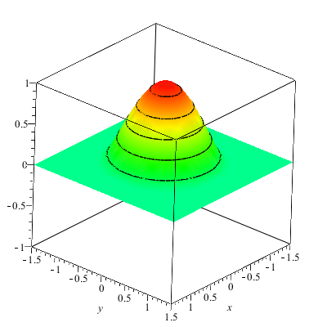
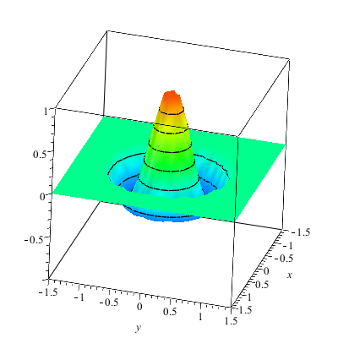
Notes:
Some examples.

Slide 23
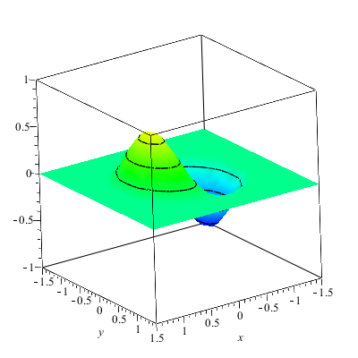
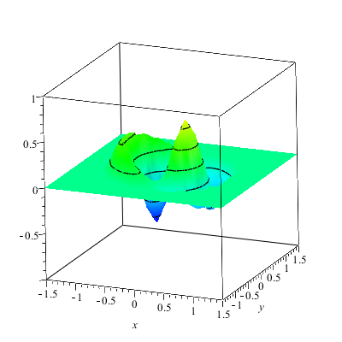
Notes:
More examples.

Slide 24
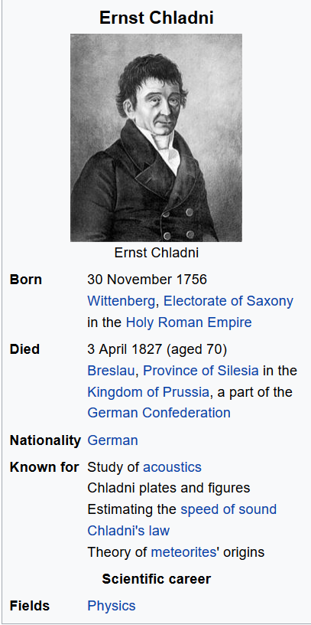
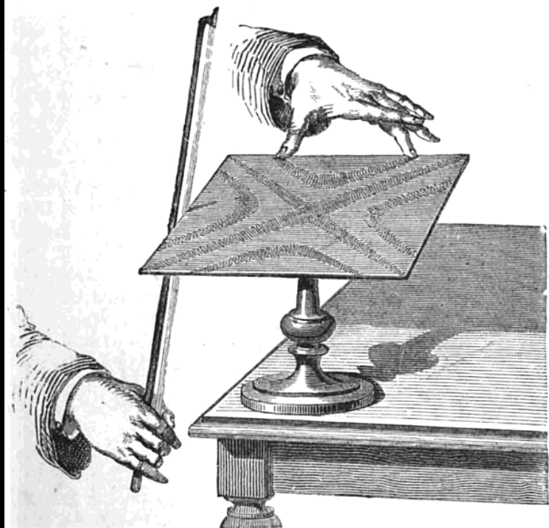
Notes:
A very nice demonstration of these standing waves was invented by Chladni

Slide 25
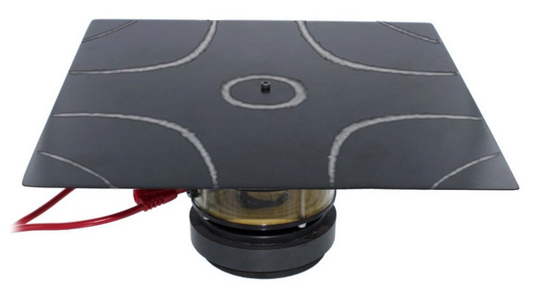
Demonstration with motor in the middle – (PASCO)
Notes:
A picture of the demo we have in Olin.

Slide 26
http://www.physics.wfu.edu/resources/education-resources/demo-videos/waves/
Notes:
Movie thanks to Eric Chapman.

Slide 27
More complicated geometry – annular membrane
a
b
Notes:
A non-trivial example with two boundaries.

Slide 28
Consider circular boundary -- continued
Notes:
In this case, both Bessel and Neumann functions are needed.

Slide 29
Normal modes of an annular membrane -- continued
a
b
Notes:
We need to find the linear coefficients A and B and the wavevector k.

Slide 30
Normal modes of an annular membrane -- continued
a
b
Notes:
A method of solving this problem.

Slide 31
Normal modes of an annular membrane -- continued
a
b

Slide 32
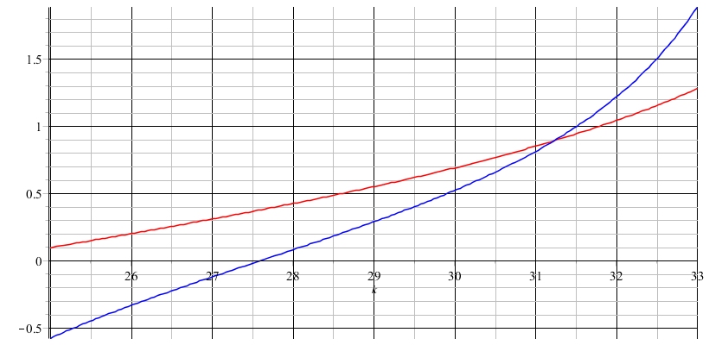
Analysis for m=0 and a=0.1, b=0.2:
Notes:
Finding a solution graphically.

Slide 34
a
b
Notes:
Solution for this case.

