Slide 1
PHY 711 Classical Mechanics and Mathematical Methods
10-10:50 AM MWF in Olin103
Lecture notes for Lecture 3
Chapter 3.17 of F&W
More about the calculus of variations
Review examples – Area of lamp shade
Brachistochrone problem
Calculus of variation with constraints
Notes:
The topic of “calculus of variation” is covered in Chapter 3, Section 17 of your textbook. We will study the mathematical formalism first before showing how it is useful for studying mechanical systems.

Slide 2
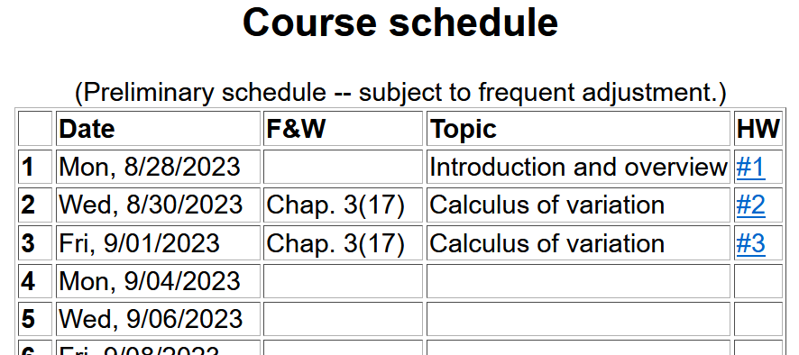
Note that Monday is not a holiday for us…
Notes:
There is a short problem on this subject that will be due on Monday.

Slide 3
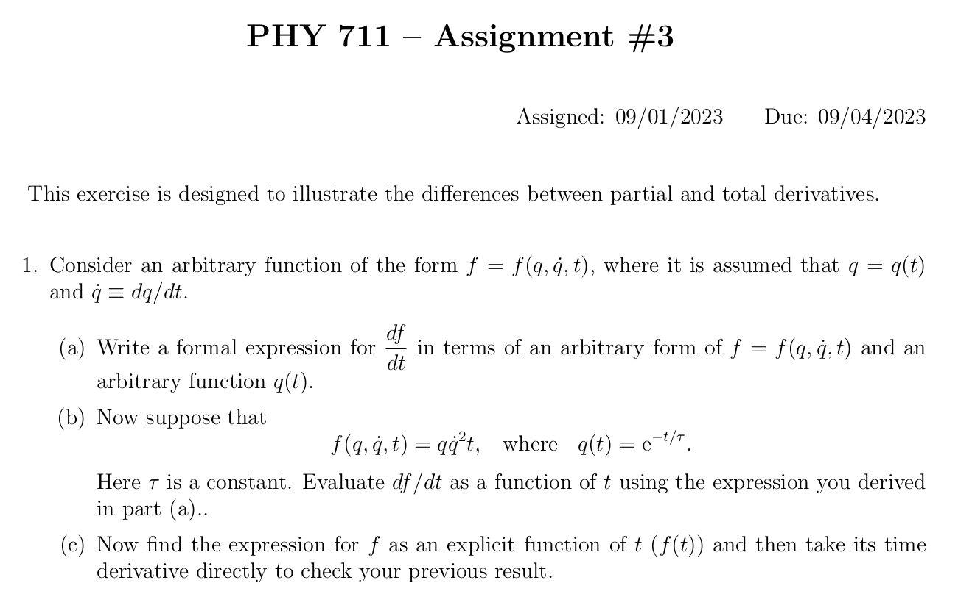

Slide 4
Summary of the method of calculus of variation --
Notes:
Summary of equations to use.

Slide 5
Notes:
Your homework problem is very similar to this. Actually stopped at this slide. Will continue discussion on Wednesday.

Slide 6
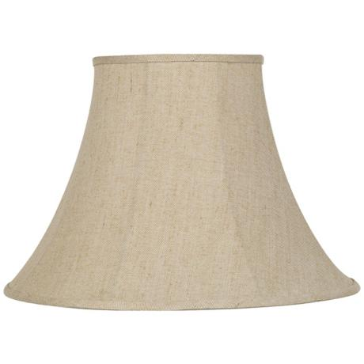
Lamp shade shape y(x)
y
x_{i} y_{i}
x
x_{f} y_{f}
Notes:
Here is another example of the use of calculus of variation.

Slide 8
y
Top view
x
x

Slide 9
Notes:
After these steps, the solution is found up to some constants.

Slide 10
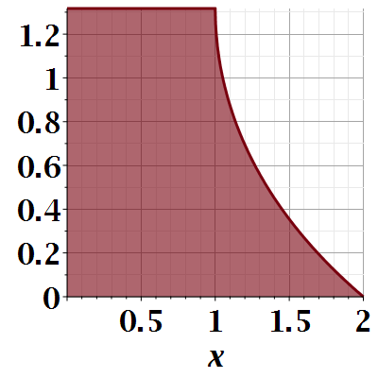

Slide 11
Notes:
Evaluating results for particular boundary values.

Slide 12
Euler-Lagrange equation
Alternate Euler-Lagrange equation
Notes:
Summary of the equations we worked out last time.

Slide 13
A few more steps --

Slide 14
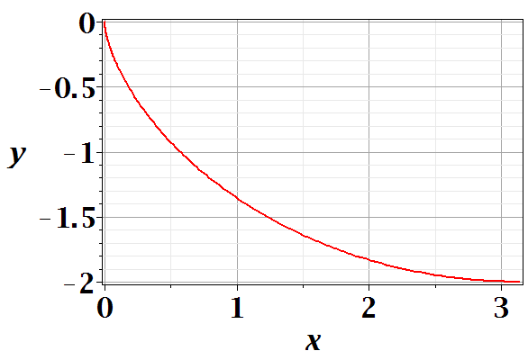
Brachistochrone problem: (solved by Newton in 1696)
http://mathworld.wolfram.com/BrachistochroneProblem.html
A particle of weight mg travels frictionlessly down a path of shape y(x). What is the shape of the path y(x) that minimizes the travel time from
y(0)=0 to y(π)=-2 ?
Notes:
This is the famous problem.

Slide 16
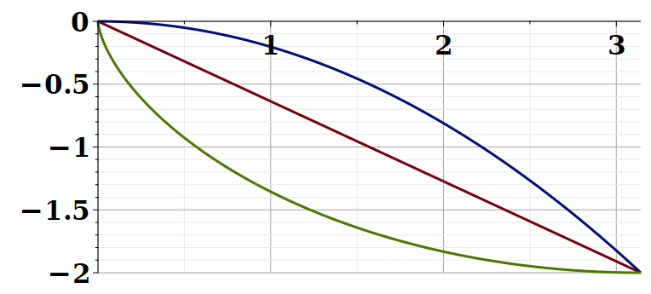
Vote for your favorite path
x
y
Which gives the shortest time?
Green
Red
Blue
Notes:
What curve will win the race?

Slide 17
Notes:
Some details of the Euler-Lagrange equations. The green equations look harder.

Slide 18
Question – why this choice?
Answer – because the answer will be more beautiful. (Be sure that was not my cleverness.)
Notes:
Calling the integration 2a is very convenient.

Slide 19
Parametric equations for Brachistochrone:
Notes:
Very clever mathematics.

Slide 20
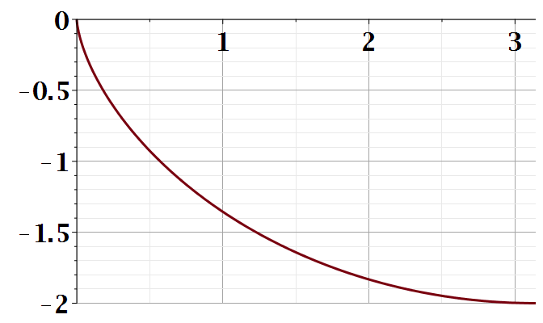
Parametric plot --
plot([theta-sin(theta), cos(theta)-1, theta = 0 .. Pi])
y
x
Notes:
Visualization of the result.

Slide 21
Checking the results
T=4.4429
T=5.2668
T=infinite
Notes:
How did you do with your bet?

Slide 22
Summary of the method of calculus of variation --
Notes:
Summary of equations to use.

Slide 23
Notes:
It is a good idea to remember these equations.

Slide 24
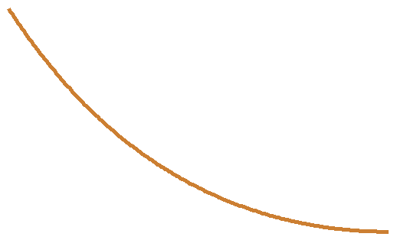
Another example optimization problem:
Determine the shape y(x) of a rope of length L and mass density ρ hanging between two points
x₁ y₁
x₂ y₂
Notes:
Another example needing extra information.

Slide 25
Example from internet --

Slide 26
Lagrange multiplier
Notes:
How to minimize with a constraint.

Slide 28
Notes:
Applying the equations.

Slide 30
Notes:
The solutions in (almost) convenient form.

Slide 31
Summary of results
or
Notes:
Summary again.

