Slide 1
PHY 711 Classical Mechanics and Mathematical Methods
10-10:50 AM MWF in Olin 103
Notes on Lecture 31: Chap. 9 of F&W
Linear and non-linear sound waves
Comment on HW #21
Summary of linear sound phenomena
Introduction to non-linear effects
Analysis of instability – shock phenomena
Notes:
In this lecture, we will consider traveling wave solutions to the sound wave equations.

Slide 3
Note that the speed of the water changes as the water flows out.
10m
y
1m

Slide 4
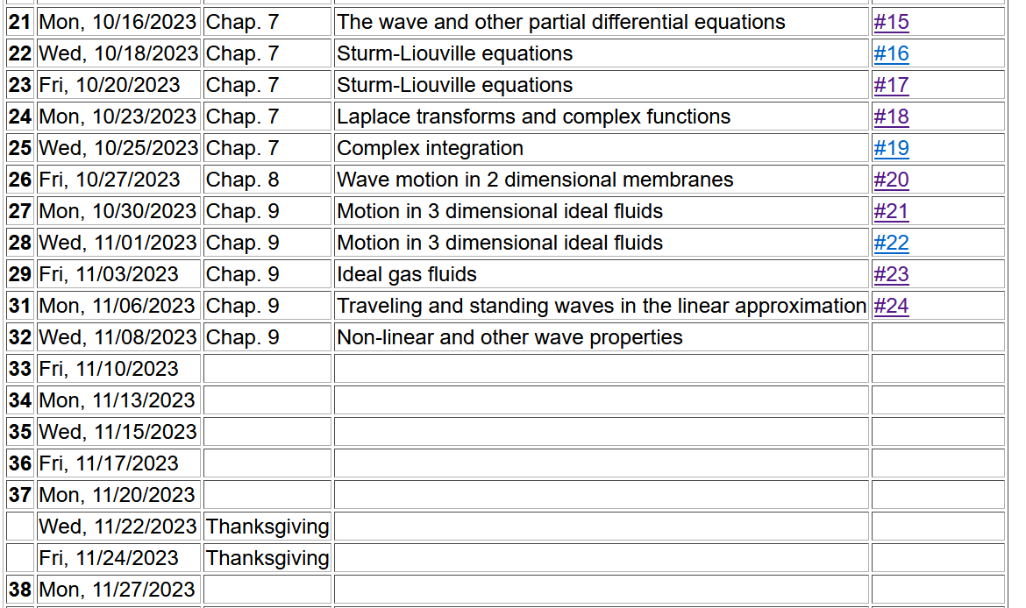
No explicit homework, but please send me your presentation topic by
Mon. 10/13/2023
Notes:
Schedule.

Slide 5
Driven sound wave in linear approximation

Slide 6
In order to understand how audible sound couples to sound wave resonances, consider the following simple model of a sound amplifier --
Wave equation with source:
z
y
x
Notes:
This is what we will consider on Monday.

Slide 7
Wave equation with source:
Notes:
Now think of wave equation with a source. The Green’s function is a very powerful tool for solving these problems. We will use similar techniques in solving the wave equation for electromagnetic waves.

Slide 8
In general, the Green’s function can be designed to solve the differential equations with the correct boundary values.

Slide 9
Notes:
In order to motivate the use of Green’s functions, we consider the famous Green’s theorem. Note that these details/derivations will also be discussed when we consider mathematically similar situations for electrodynamic systems.

Slide 10
➔extra contributions from boundary
Notes:
Derivation continued.

Slide 11
Treatment of boundary values for time-harmonic force:
Notes:
In this case, we need to use a modified Green’s function to satisfy the boundary condition at z=0.

Slide 12
Notes:
Some details.

Slide 13
Some more details --
Need this term to vanish at z’=0

Slide 14
Notes:
Changing to more convenient coordinates. Preparing to evaluate the expression far from the moving piston.

Slide 15
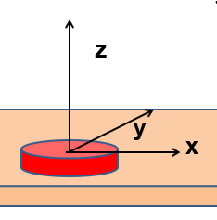
More details
r
θ

Slide 16
Notes:
Approximate solution continued. In this approximation, the integral can be evaluated in terms of Bessel functions.

Slide 17
Notes:
Estimating the power of the sound wave in this asymptotic regime.

Slide 18
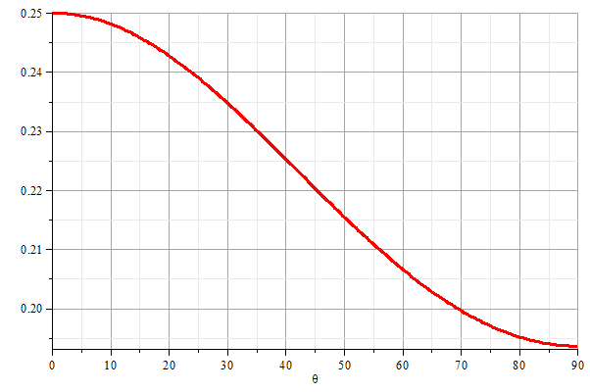
z
θ
y
x
Notes:
Graph of the power as a function of the polar angle theta.

Slide 19
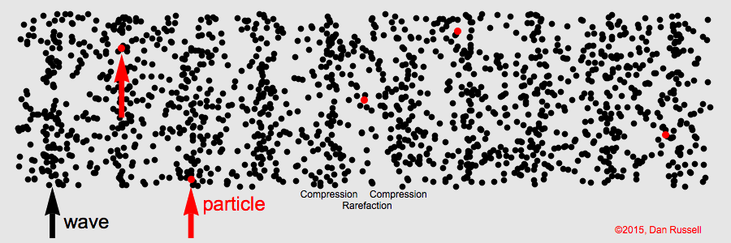
Visualization of longitudinal wave motion
From the website:
https://www.acs.psu.edu/drussell/Demos/waves/wavemotion.html

Slide 20
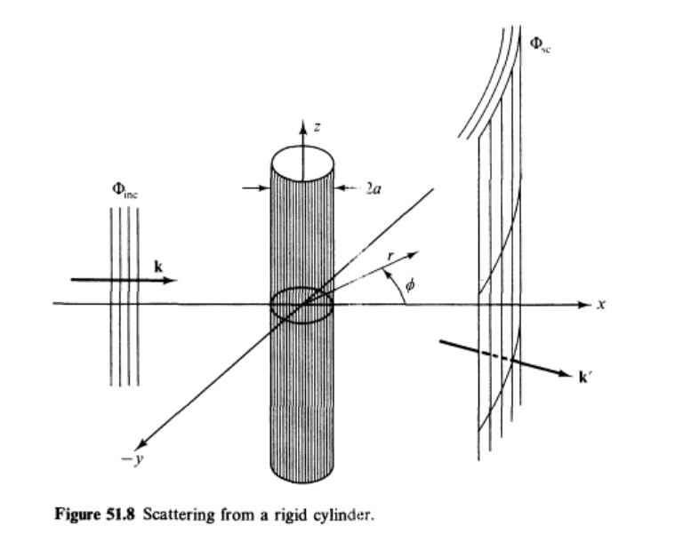
Continuing to discuss linear sound waves –
Scattering from a rigid cylinder
Figure from Fetter and Walecka pg. 337
Notes:
Now consider the case of a plane wave of sound, scattering off of a cylindrical object. Can you think of a physical situation for this model?

Slide 21
Example of cylindrical scattering objects --
Suppose a trumpeter is playing near the columns. Maximal scattering occurs when
a. Facing toward the column b. Facing away from the column.

Slide 22
Scattering of sound waves –
for example, from a rigid cylinder
Notes:
Analysis of the scattering wave using cylindrical coordinates.

Slide 23
Notes:
In this case we expect a cylindrical wave that can be represented in terms of Bessel and Neumann functions, or more conveniently in terms of Hankel functions H. Satisfying the boundary values on the surface of the scattering cylinder, we find the coefficients of the expression.

Slide 24
Notes:
Using the asymptotic form of the Hankel functions we can analyze the results further.

Slide 25
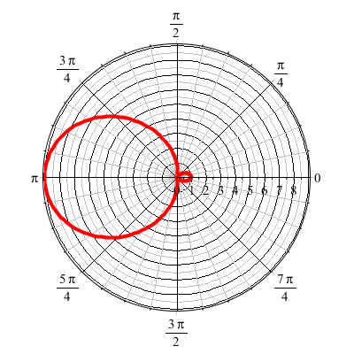
For ka << 1
Notes:
Defining the appropriate scattering cross section, we can analyze the results further. For ka<<1 (long wavelengths, low frequencies) we find that most of the sound is scattered backwards from the propagation direction.

Slide 26
Revisiting the trumpeter question --
Conclusion – be careful when choosing a place to play your trumpet --

Slide 27
Now consider some non-linear effects in sound
Examples?
We will consider the simple case –
One dimension for motion
Fluid is assumed to be an ideal gas
Adiabatic conditions
All variables will be expressed in terms of the density ρ(x,t)

Slide 28
Effects of nonlinearities in fluid equations
-- one dimensional case
Notes:
Review of basic equations, specializing in one spatial dimension.

Slide 29
Notes:
Decoupling the variables.

Slide 30
Digression – What is gamma?

Slide 31
Notes:
More analysis.

Slide 32
Notes:
Further derivations.

Slide 33
Notes:
Using adiabatic relationships.

Slide 34
Notes:
Analysis of fluid velocity from a knowledge of the wave velocity.

Slide 35
Traveling wave solution:
Notes:
Analysis for a traveling wave.

Slide 36
Traveling wave solution -- continued:
Notes:
Checking the linear result

Slide 37
Some details

Slide 38
Traveling wave solution -- full non-linear case:
w
Notes:
Analysis of how to visualize the traveling wave solution.

Slide 39
Visualization continued:
Notes:
More details.

Slide 40
Summary
Notes:
Summary.

Slide 41
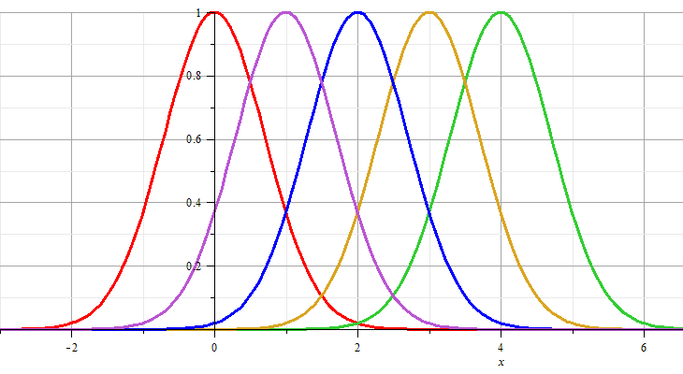
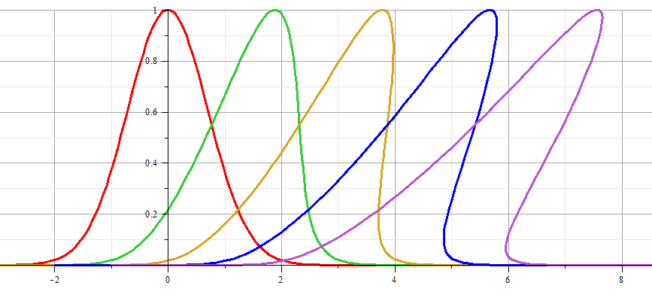
Linear wave:
Non-linear wave:
Notes:
Example visualization.

Slide 42
Linear wave
Non-linear wave
Notes:
Animations from Maple.

Slide 43
Analysis of shock wave
Plots of δρ
Solution becomes unphysical
shock
Notes:
Note that the vertical axis represents the longitudinal wave displacement. When this displacement becomes multivalued for a given coordinate x as shown, the solution becomes unphysical. At this point we need to consider the analysis in a different way.

Slide 44
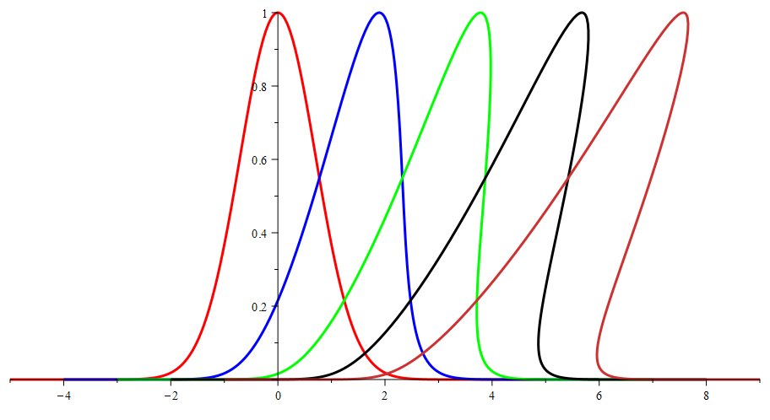
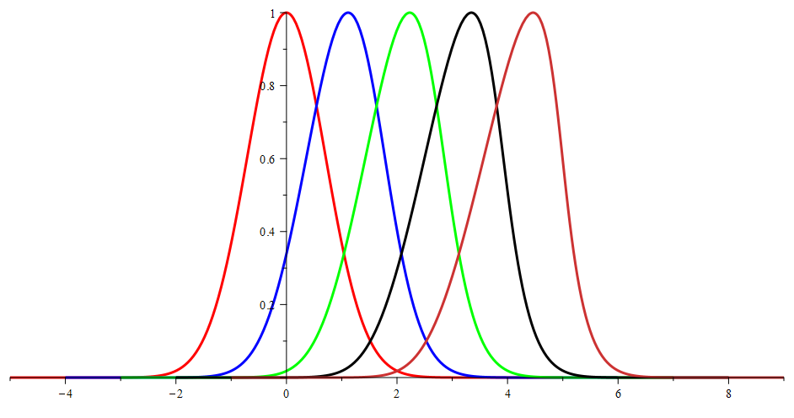
Effects of amplitude of δρ
Large amplitude
Smaller amplitude

Slide 45
Analysis of shock wave – assumed to moving at velocity u
After shock
t₂
δρ₂, δv₂, δp₂
Before shock
t₁
δρ₁, δv₁, δp₁
Shock front
x
u
Note that in this case u is assumed to be a given parameter of the system.
Notes:
Your textbook discusses the shock wave analysis. Here we assume that there is a region (blue) where the analysis fails, but assumes that we can properly analyze the physics before and after the shock. The notation given here is similar to that given in your text.

Slide 46
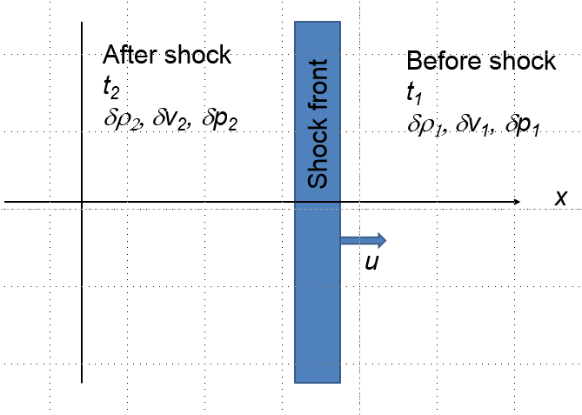
Analysis of shock wave – continued
While analysis in the shock region is complicated, we can use conservation laws to analyze regions 1 and 2
Notes:
Some of the details of the analysis before and after the shock event.

Slide 47
Analysis of shock wave – continued
While analysis in the shock region is complicated, we can use conservation laws to analyze regions 1 and 2
Notes:
Analyzing the equations.

Slide 48
Analysis of shock wave – continued
For adiabatic ideal gas, also considering energy and momentum conservation:
ρ₂/ρ₁
For γ=1.5
p₂/p₁
Notes:
Analyzing ratio of the density after and before the shock wave.

Slide 49
Analysis of shock wave – continued
For adiabatic ideal gas, entropy considerations::
Notes:
Analyzing the entropy before and after the shock wave. In general, many more relationships can be analyzed. Consult your textbook for more details.

