Slide 1
PHY 711 Classical Mechanics and Mathematical Methods
10-10:50 AM MWF in Olin 103
Notes for Lecture 34: Chapter 10 in F & W
Surface waves
Summary of linear surface wave solutions
Non-linear contributions and soliton solutions
Notes:
In this lecture, we will continue analyzing surface waves in water including the special non-linear soliton solutions.

Slide 3
This material is covered in Chapter 10 of your textbook using similar notation.

Slide 4
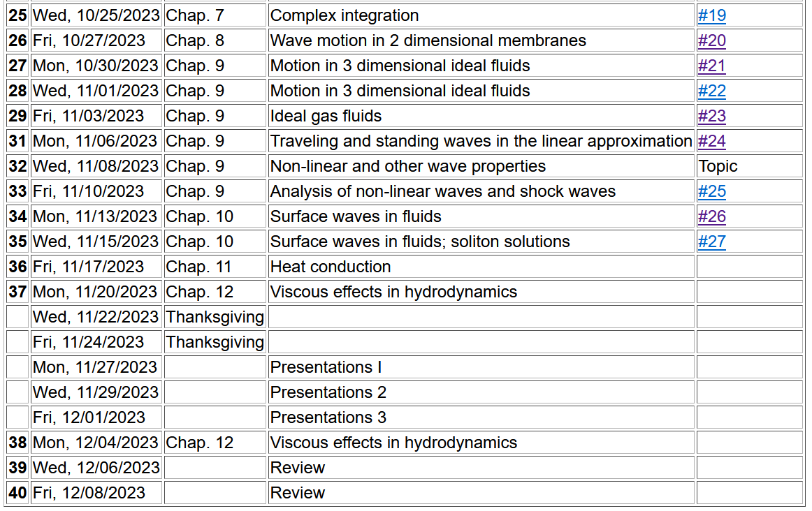
Notes:
Schedule.

Slide 5
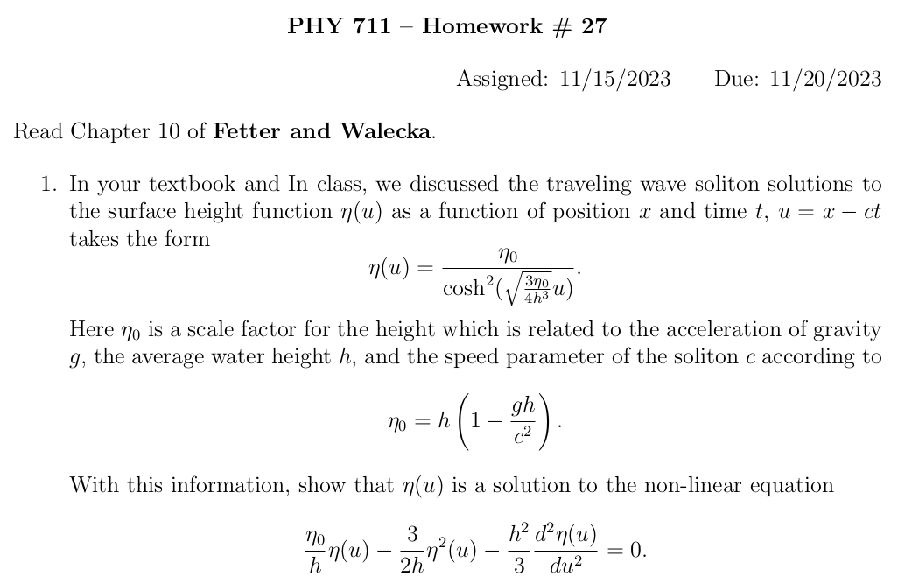

Slide 6
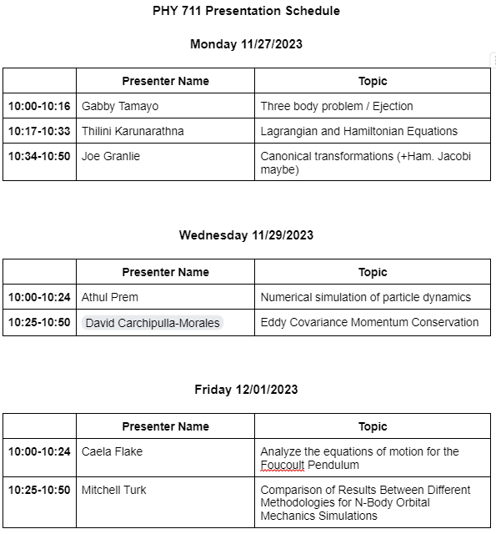

Slide 7
Note about presentations
Please consult with me if you have any questions about the content, format, expectations, etc..
Please prepare a ~ 10 (Mon) or 15 (Wed/Fri) minute presentation using powerpoint or equivalent software, leaving ~ 5 minutes for questions
Please turn in your presentation, your preparation notes, mathematica, maple, matlab,… work if appropriate. If your topic follows a paper or write-up from the literature, please also include a copy of that.

Slide 8
Consider a container of water with average height h and surface h+ζ(x,y,t)
p₀
ζ
z
h
y
x
Notes:
Reference system and notation.

Slide 9
p₀
ζ
z
h
y
x
Notes:
Summarizing the linear analysis.

Slide 10
Keep only linear terms and assume that horizontal variation is only along x:
Notes:
Continue analysis of linear equations.

Slide 11
Note that this solution represents a pure plane wave. More likely, there would be a linear combination of wavevectors k.
Additionally, your text considers the effects of surface tension. In this lecture, we will focus on the effects of the non-linear effects of Euler and continuity equations.
Notes:
Consistent analysis of the wave speed.

Slide 12
Surface waves in an incompressible fluid
General problem
including
non-linearities
p₀
ζ
z
h
y
x
Notes:
Returning to the full problem with non-linearities.

Slide 13
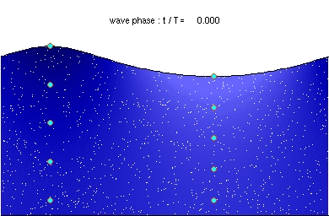
Some relationships at surface --
From wikipedia

Slide 14
p₀
ζ
z
h
y
x
Notes:
Specializing to motion along the x direction and surface direction in the z direction.

Slide 15
Non-linear effects in surface waves:
p₀
ζ
z
h
y
z=0
x
Notes:
Answer that we will find for the soliton solution.

Slide 16
Detailed analysis of non-linear surface waves
[Note that these derivations follow Alexander L. Fetter and John Dirk Walecka, Theoretical Mechanics of Particles and Continua (McGraw Hill, 1980), Chapt. 10.]
The surface of the fluid is described by z=h+ζ(x,t). It is assumed that the fluid is contained in a structure (lake, river, swimming pool, etc.) with a structureless bottom defined by the z = 0 plane and filled to an equilibrium height of z = h.
Notes:
Summary of assumptions for our analysis.

Slide 17
Defining equations for Φ(x,z,t) and ζ(x,t)
Bernoulli equation (assuming irrotational flow) and gravitation potential energy
Notes:
Working through the equations within water.

Slide 18
Boundary conditions on functions –
Zero velocity at bottom of tank:
Consistent vertical velocity at water surface
Notes:
Boundary effects at the bottom of the channel and at the surface.

Slide 19
Analysis assuming water height z is small relative to variations in the direction of wave motion (x) Taylor’s expansion about z = 0:
Note that the zero vertical velocity at the bottom suggest that to a good approximation, that all odd derivatives vanish from the Taylor expansion. In addition,
the Laplace equation allows us to convert all even derivatives with respect to z to derivatives with respect to x.
Notes:
Here we start a number of steps to analyze the leading terms in the linearities. In this case we perform a Taylor’s expansion about z=0 at the bottom of the channel.

Slide 20
Some details --

Slide 21
Check linearized equations and their solutions:
Bernoulli equations --
Using Taylor's expansion results to lowest order
➔linear wave equation with c²=gh
Notes:
Checking lowest order (linear) term.

Slide 22
Analysis of non-linear equations --
Notes:
Back to non-linear equations using Taylor’s expansion.

Slide 23
Analysis of non-linear equations -- keeping the lowest order nonlinear terms and include up to 4th order derivatives in the linear terms.
Notes:
Systematic keeping/limiting terms in non-linearity and in high order derivatives. The highlighted equations are the coupled equations that we will analyze.

Slide 24
Note that the wave “speed” c will be consistently determined
Notes:
Decoupling the equations.

Slide 25
Integrating and re-arranging coupled equations
Notes:
Analysis continued.

Slide 26
Integrating and re-arranging coupled equations – continued --
Expressing modified surface velocity equation in terms of η(u):
Notes:
More derivations.

Slide 27
Solution of the famous Korteweg-de Vries equation
Modified surface amplitude equation in terms of η
Soliton solution
Notes:
Finally arriving at the famous equation and the famous soliton solution.

Slide 28
Notes:
More details.

Slide 29
Two soliton solutions with different amplitudes --
Notes:
Visualization

Slide 30
Relationship to “standard” form of Korteweg-de Vries equation
Notes:
Some notational manipulations.

Slide 31
More details
Notes:
More details.

Slide 32
Summary
Soliton solution
Notes:
Summary.

Slide 33
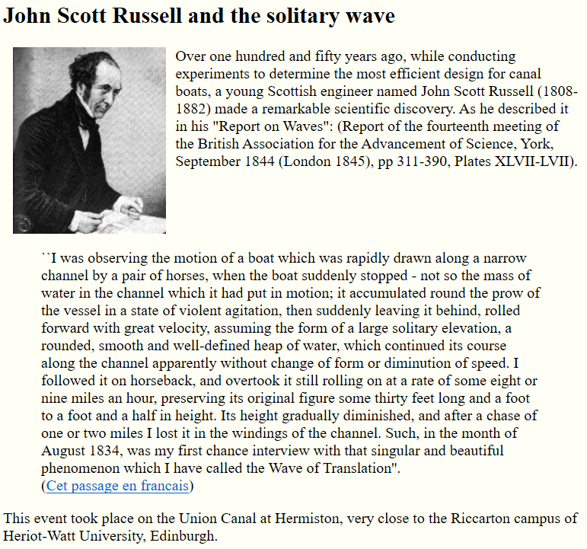
https://www.macs.hw.ac.uk/~chris/scott_russell.html
Notes:
First observer of the soliton phenomenon.

Slide 34
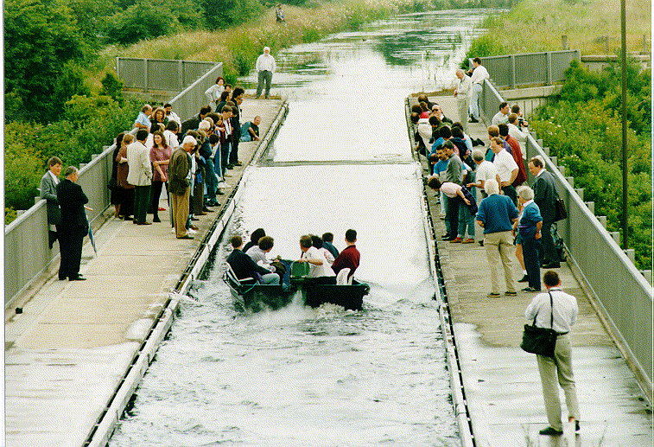
Photo of canal soliton http://www.ma.hw.ac.uk/solitons/
(link no longer active)
Some links:
Website – http://www.ma.hw.ac.uk/solitons/
Notes:
Historic realization of the soliton wave in a channel.

Slide 35
