Slide 1
PHY 711 Classical Mechanics and Mathematical Methods
10-10:50 AM MWF in Olin 103
Notes on Lecture 39
Continuing review
Mathematical methods
Classical mechanics concepts

Slide 2
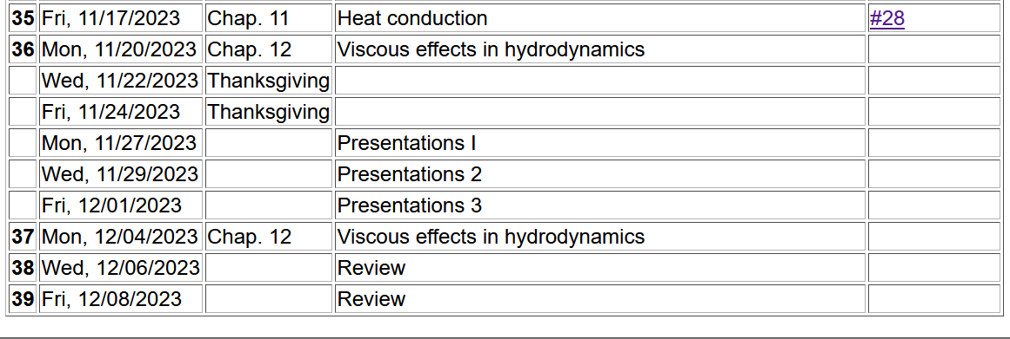
Please fill out the course evaluation form for PHY 711
at the end of today’s class
Final exam during finals week
Exam will be available at end of class today
Due < Monday 12/18/2023 at 11 AM
2

Slide 3
Brief comment on numerical methods --
Here it is assumed that h is small and h³<<h²

Slide 4
x
t

Slide 5
Note that it is possible to check the magnitude of the terms that you are neglecting and estimate the error. Also, one needs to be careful of device-dependent restrictions. In general, it is useful to use scaled coordinates.
When you perform numerical work, you need to take care about your algorithms both in terms of software and hardware.

Slide 6
Notions of phase space and
Liouville’s Theorem (1838)
The density of representative points in phase space corresponding to the motion of a system of particles remains constant during the motion.

Slide 7
Importance of Liouville’s theorem to statistical mechanical analysis:
In statistical mechanics, we need to evaluate the probability of various configurations of particles. The fact that the density of particles in phase space is constant in time, implies that each point in phase space is equally probable and that the time average of the evolution of a system can be determined by an average of the system over phase space volume. Computationally this can be approximated using molecular dynamics or sampling methods.

Slide 8
r_{ij}
➔From this Lagrangian, can find the 3N coupled 2nd order differential equations of motion and/or find the corresponding Hamiltonian, representing the system at constant energy, volume, and particle number N (N,V,E ensemble).

Slide 9
Rigid body motion
In a reference frame attached to the object,
there are 3 moments of inertia and 3
distinct principal axes
Representation of rotational kinetic
energy:
z
y
x

Slide 10
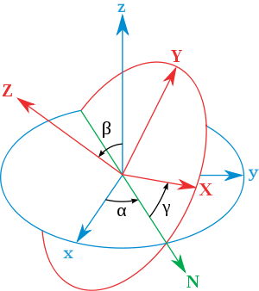
Euler’s transformation between body fixed and inertial reference frames
x
y
y
x

Slide 11
Normal modes of vibration -- potential in 2 and more dimensions
V(x,y)

Slide 12
Example – normal modes of a system with the symmetry of an equilateral triangle -- continued
3
u₃
u₂
1
2
u₁

Slide 13
Example – normal modes of a system with the symmetry of an equilateral triangle -- continued

Slide 14
Example – normal modes of a system with the symmetry of an equilateral triangle -- continued
= ω²

Slide 15
Discrete particle interactions → continuous media →
The wave equation

Slide 16
Mechanical motion of fluids
Newton’s equations for fluids
Use Euler formulation; following “particles” of fluid
Viscosity contributions

Slide 17
Fluid mechanics of incompressible fluid plus surface
Non-linear effects in surface waves:
p₀
ζ
z
h
y
z=0
x

Slide 18
Defining equations for Φ(x,z,t) and ζ(x,t)
Bernoulli equation (assuming irrotational flow) and gravitation potential energy

Slide 19
Boundary conditions on functions –
Zero velocity at bottom of tank:
Consistent vertical velocity at water surface

Slide 20
Analysis follows a number of steps based on a knowledge of the velocity potential at z=0 and discarding small and high order non-linearities.

Slide 21
Note that the wave “speed” c will be consistently determined

Slide 22
Integrating and re-arranging coupled equations

Slide 23
Solution of the famous Korteweg-de Vries equation
Modified surface amplitude equation in terms of η
Soliton solution

