Slide 1
PHY 711 Classical Mechanics and Mathematical Methods
10-10:50 AM MWF in Olin 103
Discussion of Lecture 5 – Chap. 3&6 in F&W
Lagrangian mechanics
Lagrange’s equations in the presence of velocity dependent potentials – such as electromagnetic interactions.
Effects of constraints
Notes:
This material follows your textbook in both Chapter 3 and Chapter 6.

Slide 2
Physics Colloquium Series
The originally scheduled colloquium for this week
has been rescheduled for December 7, 2023
In order to keep up the departmental good spirits, please join
Physics Reception in the Olin Lobby at 3:30 PM
September 7, 2023

Slide 3
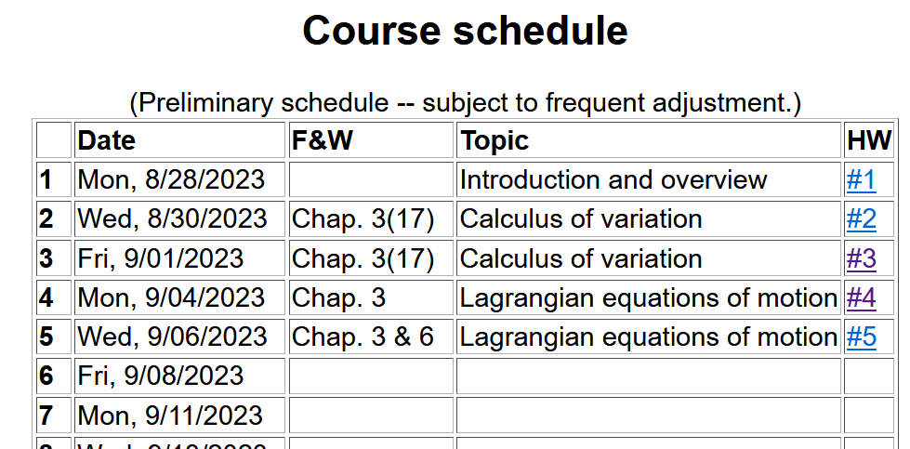
Notes:
Here is the updated schedule. Note that HW 5 which will be covered in today’s lecture will be due next Monday.

Slide 4
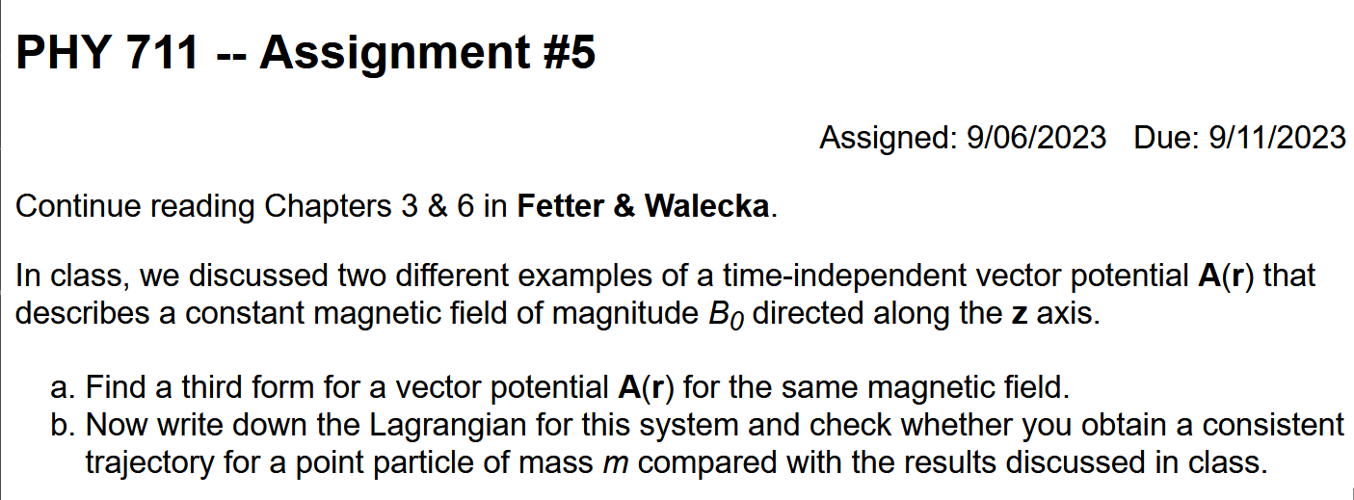
Notes:
Homework problem due on Wednesday..

Slide 5
Your questions –
From David:
I understand that the extra component from D'Alembert's analysis modifies the Hamiltonian in a way that we need to use Lagrande multipliers. Could you make that transition more explicitly and general?
From Athul:
When there are multiple charged particles in a magnetic field, can the same equations be used to find the total force or we can only apply to one point particle at a time?

Slide 6
Comment on single and multiple coordinates --
Note that the trajectory components can be independent (as in the case of cartesian coordinates and/or multiple particles or can be dependent in which case we can use the “trick” of Lagrange multipliers.

Slide 7
Previously derived form for the Lagrangian --
Notes:
Form of derived Lagrangian provided that the potential does not depend on velocity.

Slide 8
➔Hamilton’s principle from the “backwards” application of the Euler-Lagrange equations to
Notes:
Having shown that the Euler-Lagrangian equations are consistent with Newton’s equations of motion, we can then infer that the integral of the Lagrangian is optimized as is consistent with Hamilton’s principle.

Slide 9
Summary –
Hamilton’s principle:
Notes:
Recipe for Lagrangian mechanics.

Slide 10
Note: in “proof” of Hamilton’s principle:
Why do we need velocity dependent forces?
Friction is sometimes represented as a velocity dependent force. (difficult to treat with Lagrangian mechanics.)
Lorentz force on a moving charged particle in the presence of a magnetic field.
Notes:
Important restriction.

Slide 11
Some details --

Slide 12
Lorentz forces:
Note: Here we are using cartesian coordinates for convenience.
Notes:
While Lagrangian mechanics cannot treat all velocity dependent forces, it is possible to extend the analysis for the case of the Lorentz force. This material is treated in Chapter 6, Section 33 of your textbook. We are following the textbook’s units of cgs Gaussian units.

Slide 13
More details --

Slide 14
Units for electromagnetic fields and forces
cgs Gaussian units -- (as used your textbook)
SI units --

Slide 15
Lorentz forces, continued:
Notes:
Very clever mathematicians figured out how to incorporate Lorentz into the Lagrangian formalism. Here we are assuming their result and showing that it is consistent.

Slide 16
Lorentz forces, continued:
Notes:
More derivations.

Slide 17
Some details on last step:
Notes:
More derivations.

Slide 18
Lorentz forces, continued:
Notes:
Summary of results.

Slide 19
Example Lorentz force
Notes:
Example for a magnetic field in the z direction.

Slide 20
Example Lorentz force -- continued
Notes:
Finding the Euler-Lagrange equations.

Slide 21
Example Lorentz force -- continued
Notes:
Summary from previous slides.

Slide 22
Example Lorentz force -- continued
Notes:
We get the same motion for this case.

Slide 23
Example Lorentz force -- continued
Does it surprise you that the same equations of motion are obtained with a different Gauge?
Notes:
This is the same magnetic field, but an equivalent vector potential.

Slide 24
How do these two different forms of A correspond to the same B?

Slide 25
Now consider formulation of motion with constraints --
Comments on generalized coordinates:
Here we have assumed that the generalized coordinates
q_{σ} are independent. Now consider the possibility that the coordinates are related through constraint equations of the form:
Lagrange
multipliers
Notes:
Shifting topics, we now consider examples where the generalized coordinates are related by some constraints.

Slide 26
Some details --

Slide 27
Simple example:
u
θ
y
x
θ
Notes:
Here is a simple example of an inclined plane. If we were so silly as to treat the x and y motions separately, we would have use a constraint equation as shown.

Slide 28
Which method would you use to solve the problem?
Case 1
Case 2
Force of constraint;
normal to incline
Notes:
In this case we see that the constraint is related to the normal force which can be considered as a force of constraint.

Slide 29
Rational for Lagrange multipliers
Notes:
Here we justify the use of Lagrange multipliers in a similar way that we used them when discussing the calculus of variation.

Slide 30
Euler-Lagrange equations with constraints:
Example:
r
θ
mg
Notes:
Another example of constrained motion.

Slide 31
Example continued:
Notes:
Continued analysis of pendulum motion

Slide 32
Another example:
Notes:
Example of Atwood’s machine with two masses and a pulley.

