Slide 1
PHY 711 Classical Mechanics and Mathematical Methods
10-10:50 AM MWF in Olin 103
Notes for Lecture 11: Rigid bodies –
Chap. 5 (F &W)
1. More about moment of inertia tensor
Torque free motion
Digression on matrix diagonalization

Slide 2
Your questions
From Julia –
For the asymmetric object, why is the solution only stable if the frequencies have the same sign? The book sort of explains it, but it isn't completely clear to me.
From Conell –
Given the equation dL/dt=Gamma(e) (eq.27.1 in text)
The 2nd case is given. “remains valid if the origin is located at the center of mass, independent of translational motion”. Im not sure I understand this, could you please explain further.

Slide 3
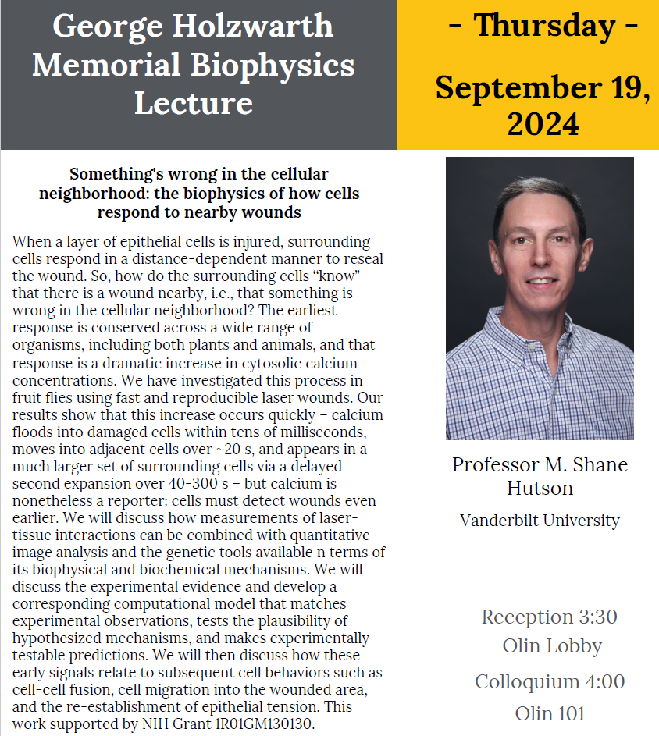

Slide 4
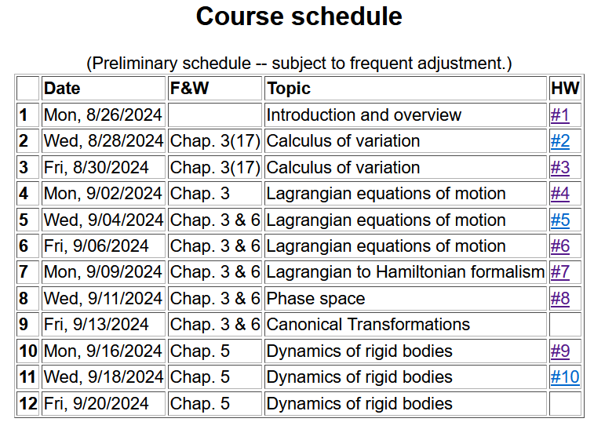
Notes:
In this lecture we will consider the rotational motion of rigid bodies as presented in Chapter 5 of your textbook.

Slide 5
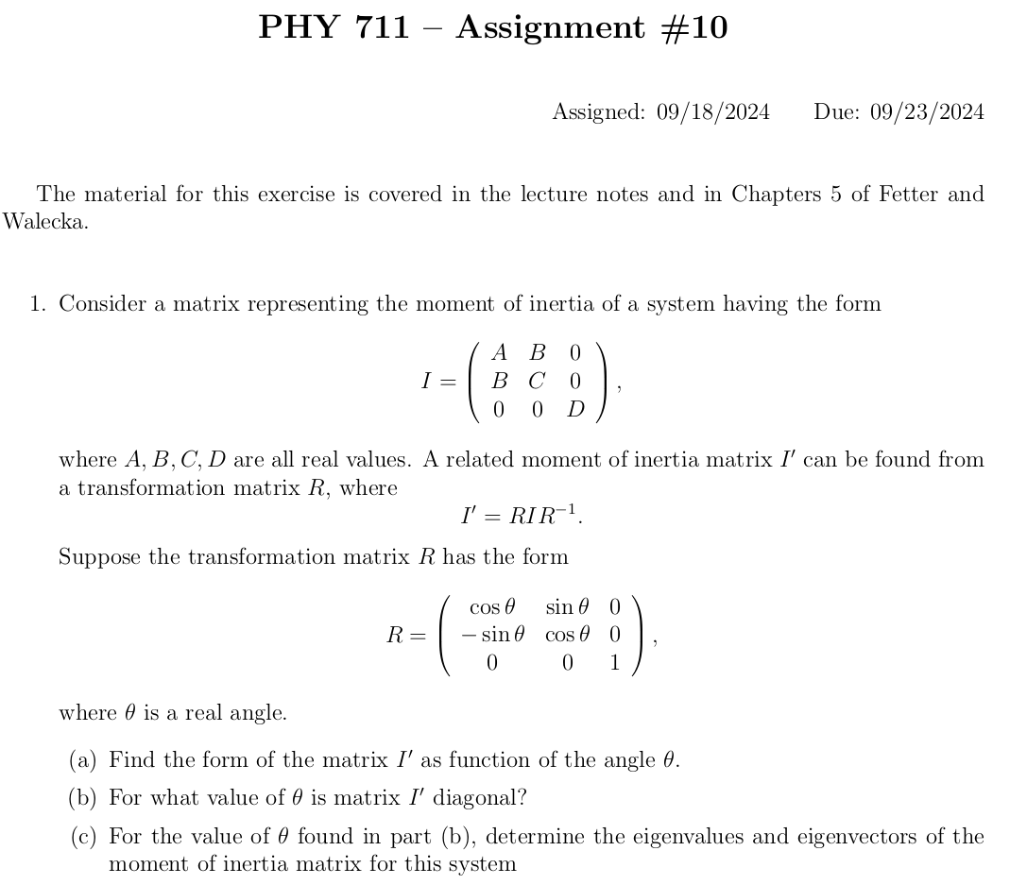

Slide 6
Note: For a given object and a given coordinate system, one can find the moment of inertia matrix
z
y
x

Slide 7
z’
z
y’
y
x
x’
(x’,y’,z’)

Slide 8
z
Example:
c
y
a
b
x
Notes:
Consider a simple rectangular solid with a coordinate system at the edge of the system.

Slide 9
Properties of moment of inertia tensor:
Symmetric matrix ➔real eigenvalues I₁,I₂,I₃
➔orthogonal eigenvectors
Notes:
The moment of inertia tensor in matrix form is a symmetric matrix and therefore can be diagonalized. The eigenvalues are known as principal moments of inertia and the eigenvectors are known as principal axes.

Slide 10
Changing origin of rotation
z
z’
r_{p}
r’_{p}
c
R
y’
y
a
x’
b
x
Notes:
Here we consider what happens when we evaluate the moment of inertia tensor about a different origin. In this case, the new origin happens to be at the center of mass.

Slide 11
z
z’
r_{p}
r’_{p}
c
R
y’
y
a
x’
b
x
Notes:
Some details.

Slide 12
Note that changing origin of coordinate system changes moment of inertia tensor.
z
z’
r_{p}
r’_{p}
Note: This is a special case; changing the center of rotation does not necessarily result in a diagonal I’
c
R
y’
y
a
x’
b
x
Notes:
When the dust clears for this case. Note that I’ happens to be diagonal already, however it is not generally true that shifting the origin for the moment of inertia would result in a diagonal matrix.

Slide 13
Descriptions of rotation about a given origin
ω
Notes:
In the next slides we will focus on the fact that each rigid body has 3 principal axes and 3 moments of inertia for a given origin. It is often convenient to use that coordinate system to analyze rigid body motion.

Slide 14
Descriptions of rotation about a given origin -- continued
Notes:
Here we consider the angular moment expressed in the diagonalized body fixed frame of reference.

Slide 15
Descriptions of rotation about a given origin -- continued
Notes:
While it is very difficult to express torque in this reference frame, we can readily solve problems with zero torque.

Slide 16
➔
Notes:
For the general system with three distinct moment of inertia, the solutions are difficult, but simplifications occur when two moments are the same, in this I1=I2.

Slide 17
Solution of Euler equations for symmetric object continued
Notes:
Time dependence of the symmetric top in free space

Slide 18
Example symmetric top --
3
1
2

Slide 19
➔
Notes:
Now consider the more general case.

Slide 20
Notes:
Reasonable approximations.

Slide 21
Euler equations for asymmetric object continued
Notes:
We see that there are conditions that allow stability for this system,. --- to be continued.

Slide 22
Summary of previous results
describing rigid bodies rotating
about a fixed origin
ω
r
Notes:
Review of notions of rigid body motion.

Slide 23
Moment of inertia tensor
Notes:
In general there is a symmetric tensor which defines the moment of inertia. By rotating the coordinates about a fixed origin we can find the matrix in diagonal form.

Slide 24
Descriptions of rotation about a given origin -- continued
Notes:
When there is zero torque acting on the system, the angular velocity components are coupled through these Euler equations.

Slide 25
Digression on matrix diagonalization
➔Eigenvalues of a symmetric matrix are real and eigenvectors are orthogonal.

Slide 28
Digression on matrices -- continued
Eigenvalues of a matrix are “invariant” under a similarity transformation
This means that if a matrix is “similar” to a Hermitian matrix,
it has the same eigenvalues. The corresponding eigenvectors of M and M’ are not the same but

Slide 29
Note, here we have defined S as a transformation matrix (often called a similarity transformation matrix)
How can you find a unitary transformation that also diagonalizes a matrix?

Slide 30
Note that this “trick” is special for 2x2 matrices, but numerical extensions based on the trick are possible.

Slide 31
Note that transformations using unitary matrices are often
convenient and they can be easily constructed from the
eigenvalues of a matrix.

