Slide 1
PHY 711 Classical Mechanics and Mathematical Methods
10-10:50 AM MWF in Olin 103
Notes for Lecture 13 – Chap. 1 (F &W)
Scattering analysis
Review of particle interactions
Two particles interacting with a central potential
Conservation of energy and angular momentum
Definition of differential scattering cross section
Notion of “impact” parameter and its role in calculating the differential cross section.
Notes:
In this lecture, we introduce the concept of scattering theory .h

Slide 2
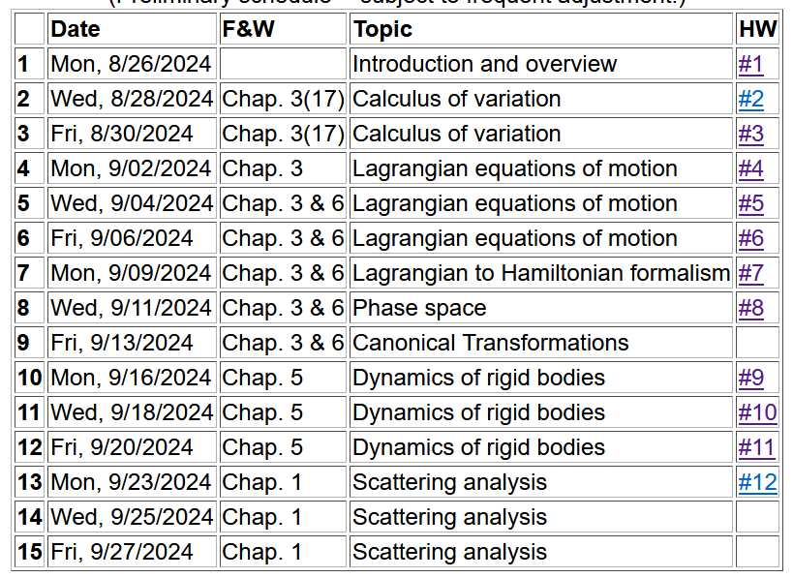

Slide 3
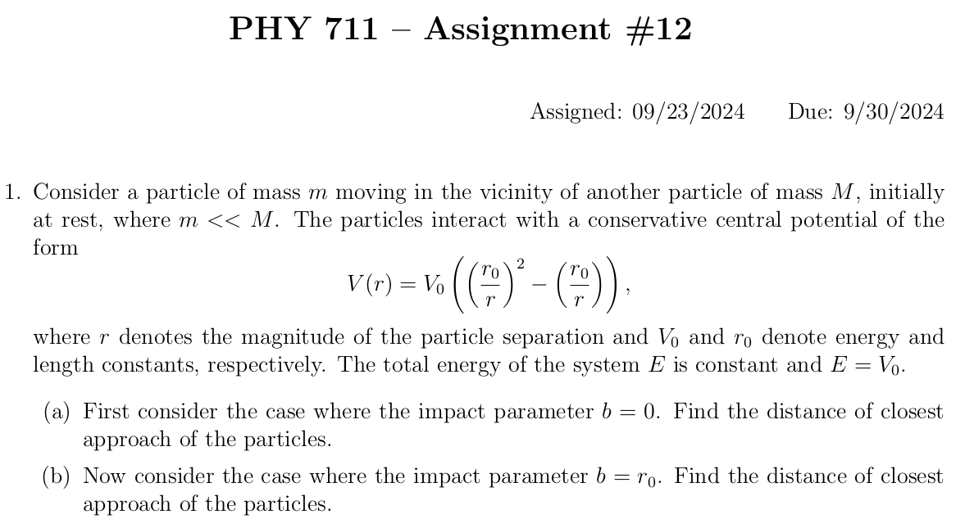

Slide 4
Introduction to the analysis of the energy and forces between two particles –
This treatment can be formulated with Lagrangians and Hamiltonians, but we will directly use the Newtonian approach for now..

Slide 5
First consider fundamental picture of particle interactions
Classical mechanics of a conservative 2-particle system.
y
1
2
r₁
r₂
x
For this discussion, we will assume that V(r)=V(r) (a central potential).
Notes:
First consider the basic particle interactions which govern their motion.

Slide 6
Energy is conserved:
1
2
r₁
r₂
For a central potential V(r)=V(r), angular momentum is conserved.
For the moment we also make the simplifying assumption that m₂>>m₁ so that particle 1 dominates the motion.
Notes:
The last assumption is being made for convenience. We will consider the center of mass and relative motion much more carefully later.

Slide 7
Typical two-particle interactions –
Notes:
These represent typical particle interactions. Only the Coulomb or gravitational forms are precisely found in nature. The others serve as convenient models.

Slide 8
More details of two particle interaction potentials
This means that the interaction only depends on the distance between the particles and not on the angle between them. This would typically be true of the particles are infinitesimal points without any internal structure such as two infinitesimal charged particles or two infinitesimal masses separated by a distance r:
Example – Interaction between a proton and an electron. Note we are treating the interactions with classical mechanics; in some cases, quantum effects are non-trivial.

Slide 9
Other examples of central potentials --
Example
Two marbles
Two Ar atoms
Note – not all systems are described by this form. Some counter examples:
Molecules (internal degrees of freedom)
Systems with more than two particles such as crystals

Slide 10
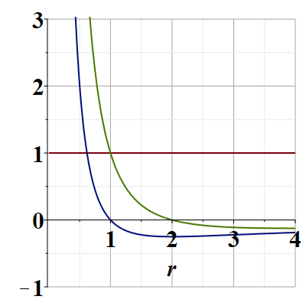
Representative plot of V(r)
V(r)/V₀
E/V₀
Note that particles are not bound; can reach infinite separation
Distances of closest approach
Notes:
Potential energy diagram showing important aspects of the particle trajectory.

Slide 11
Some more details --
z
r(t₁)
θ(t₁)
y
x

Slide 12
Comments continued --
V_{eff}(r)

Slide 13
What is the impact parameter?
Briefly, a convenient distance that depends on the conserved energy and angular momentum of the process.
b
b

Slide 14
Which of the following are true for a particle moving in a central potential field:
The particle moves in a plane.
For any interparticle, potential the trajectory can be determined/calculated.
Only for a few special interparticle potential forms can the trajectory be determined.
Why should we care about this?
We shouldn’t really care.
It is only of academic interest
It is of academic interest but can be measured.
Many experiments can be analyzed in terms of the particle trajectory.
Notes:
What do you think about these?

Slide 15
Scattering theory:
detector
Notes:
This is the ideal configuration of a scattering experiment.

Slide 16
Scattering theory:
detector
Some reasons that scattering theory is useful:
It allows comparison between measurement and theory
The analysis depends on knowledge of the scattering particles when they are far apart
The scattering results depend on the interparticle interactions

Slide 17
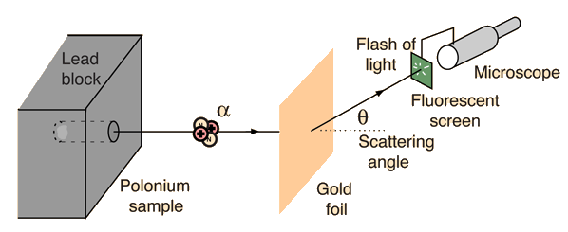
Example: Diagram of Rutherford scattering experiment
http://hyperphysics.phy-astr.gsu.edu/hbase/rutsca.html
Notes:
This illustrates the setup of the famous Rutherford scattering experiment.

Slide 18
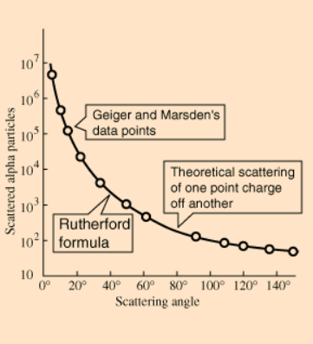
Graph of data from scattering experiment
From website: http://hyperphysics.phy-astr.gsu.edu/hbase/Nuclear/rutsca2.html
Notes:
Reconstruction experimental data from the Rutherford experiment.

Slide 19
Standardization of scattering experiments --
Impact parameter: b
b
Figure from Marion & Thorton, Classical Dynamics
Notes:
Some details of scattering geometry and analysis.

Slide 20
Note: The notion of cross section is common to many areas of physics including classical mechanics, quantum mechanics, optics, etc. Only in the classical mechanics can we calculate it from a knowledge of the particle trajectory as it relates to the scattering geometry.
b
Figure from Marion & Thorton, Classical Dynamics
Note: We are assuming that the process is isotropic in ϕ
Notes:
More details.

Slide 21
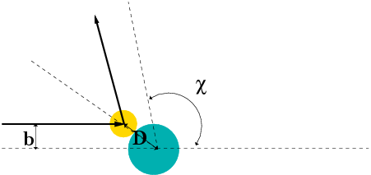
Simple example – collision of hard spheres having mutual radius D; very large target mass
Microscopic view:
Notes:
Illustration of the analysis for the scattering of a hard sphere on a massive hard sphere.

Slide 22
Some more details of form of b(θ)
D
b

Slide 23
Simple example – collision of hard spheres -- continued
Hard sphere:
Notes:
Total cross section versus partical cross section.

Slide 24
More details of hard sphere scattering –
Hidden in the analysis are assumptions about the scattering process such as:
No external forces ➔ linear momentum is conserved
No dissipative phenomena ➔ energy is conserved
No torque on the system ➔ angular momentum is conserved
Target particle is much more massive than scattering particle
Other assumptions??
Note that for quantum mechanical hard spheres at low energy the total cross section is 4 times as large.
Notes:
Some questions and comments. The discussion of scattering theory will be continued next time.

Slide 25
A typical energy diagram, can help the analysis of the particle motion:
V(r)/V₀
E/V₀
Distances of closest approach

Slide 26
In the next few lectures we will
Discuss the extension of these ideas to the case where the interacting particle is not necessarily massive.
“Derive” the famous Rutherford scattering formula.

