Slide 1
PHY 711 Classical Mechanics and Mathematical Methods
10-10:50 AM MWF in Olin 103
Notes for Lecture 15: Scattering analysis –
Chap. 1 ( F & W)
Definition of differential scattering cross section
Calculation of particle trajectories for a central potential
Relation of particle trajectories to the differential scattering cross section
Example of Rutherford scattering

Slide 2
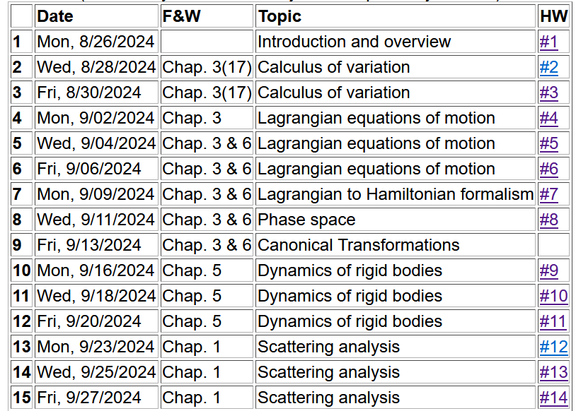

Slide 3
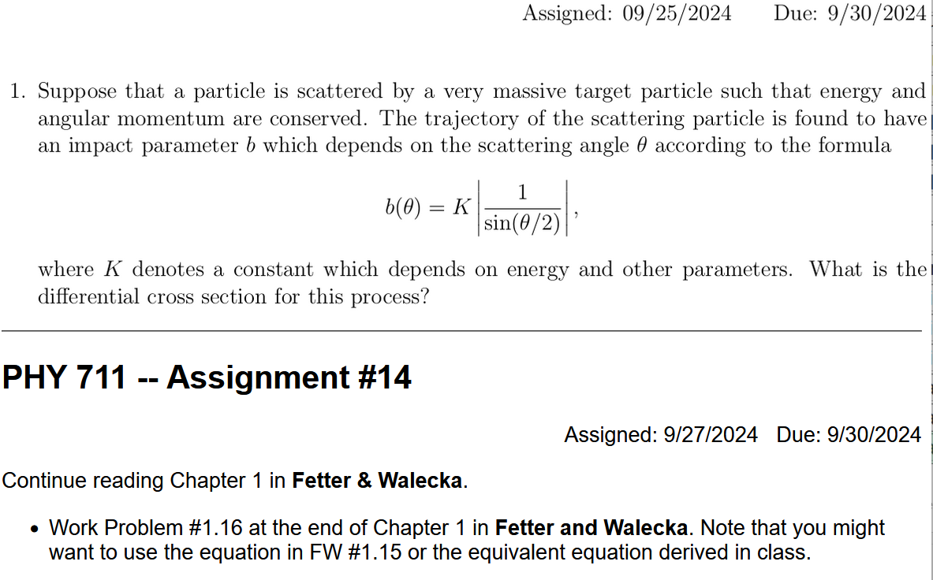

Slide 4
Scattering theory:
detector
Notes:
This is the ideal configuration of a scattering experiment.

Slide 5
Scattering theory:
detector
Some reasons that scattering theory is useful:
It allows comparison between measurement and theory
The analysis depends on knowledge of the scattering particles when they are far apart
The scattering results depend on the interparticle interactions

Slide 6
Standard measure of differential cross section

Slide 7
Standardization of scattering experiments --
Impact parameter: b
b
Figure from Marion & Thorton, Classical Dynamics
Notes:
Some details of scattering geometry and analysis.

Slide 8
Note: The notion of cross section is common to many areas of physics including classical mechanics, quantum mechanics, optics, etc. Only in the classical mechanics can we calculate it from a knowledge of the particle trajectory as it relates to the scattering geometry.
b
Figure from Marion & Thorton, Classical Dynamics
Note: We are assuming that the process is isotropic in ϕ
Notes:
More details.

Slide 9
https://www.aps.org/publications/apsnews/200605/history.cfm

Slide 10
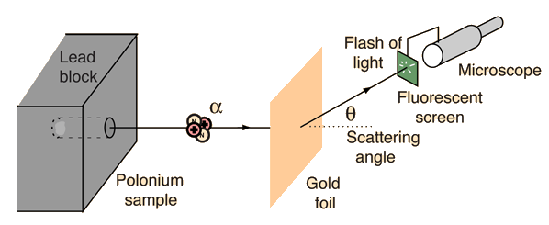
Example: Diagram of Rutherford scattering experiment
http://hyperphysics.phy-astr.gsu.edu/hbase/rutsca.html
Notes:
This illustrates the setup of the famous Rutherford scattering experiment.

Slide 11
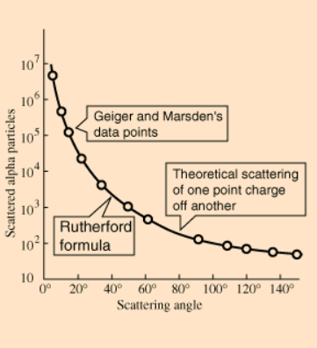
Graph of data from scattering experiment
From website: http://hyperphysics.phy-astr.gsu.edu/hbase/Nuclear/rutsca2.html
Notes:
Reconstruction experimental data from the Rutherford experiment.

Slide 13
More complete picture --
Energy of the center mass motion
Energy within the center of mass reference frame
In some of the slides, E_{rel} is written E

Slide 14
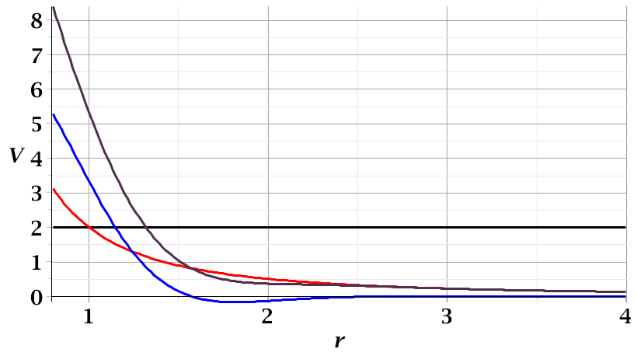
For a continuous potential interaction V(r)
Need to relate these parameters to differential cross section
E_{rel}
r_{min}

Slide 15
More details
Since r(t) represents motion in a plane, we will analyze the system in that plane and use polar coordinates.

Slide 16
➔

Slide 17
r(χ)
χ_{m}
χ
➔Need to find an equation for r(χ)
r_{min}
center of scattering.

Slide 18
How is this related to scattering?
➔
χ_{max}
χ_{max}
θ
Note that here θ measures the scattering angle

Slide 19
Evaluation of constants far from scattering center --
r(t)
r_{min}
Notes:
Relating the constants of the problems to values determined when the particles are very far apart.

Slide 21
Notes:
Up to now we are expressing the trajectory as a function of time t. For this analysis however, we would like to find the trajectory as a function of the angle \phi. The relationship of the constant angular momentum to the \psi and time variables allows us to find r(\psi).

Slide 22
Notes:
Lots of algebra ….

Slide 23
Notes:
The scattering process involves the aspects of the trajectory at large separations.

Slide 24
r(χ)
χ_{m}
χ
➔Need to find an equation for r(χ)
r_{min}
center of scattering.

Slide 25
Notes:
When r=rmin, \phi=0. \phi increases to a maximum value.

Slide 26
For a continuous potential interaction V(r)
Need to relate these parameters to differential cross section
E_{rel}
r_{min}

Slide 27
Close up of repulsive interaction for a particular trajectory;
Also visualizing impact parameter b
Relationship between χ_{max} and θ:
Here, θ represents the scattering angle in the center of mass frame and φ is used instead of χ.
Notes:
Problem with consistent notation. Here we are using the textbook’s definition of theta which is OK if the target mass is infinite.

Slide 28
General equations for central potential V(r)
Notes:
The last equation is a convenient change of variables.

Slide 29
➔These equations relate scattering angle to impact parameter b
To go further, we need to know V(r)
Notes:
The last equation is a convenient change of variables.

Slide 30
Example: Diagram of Rutherford scattering experiment
http://hyperphysics.phy-astr.gsu.edu/hbase/rutsca.html
Notes:
Here we use a diagram from the web about the Rutherford geometry.

Slide 31
Notes:
Summary of all of the equations and then specializing to the Coulomb interaction form.

Slide 32
Some details –

Slide 33
Notes:
In this case, the integrals can all be evaluated analytically and simplify to this famous result.

Slide 34
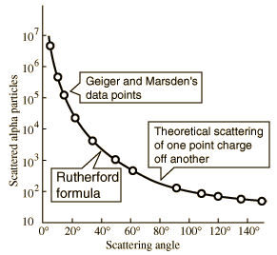
What happens as
θ →0?
From webpage: http://hyperphysics.phy-astr.gsu.edu/hbase/nuclear/rutsca2.html#c3
Notes:
Reconstructed data taken from the web.

Slide 35
Original experiment performed with α particles on gold
(in SI units)
Notes:
Evaluation of constant for this case.

Slide 36
More generally, it is possible to use numerical integration methods (with care) to evaluate b(θ).

Slide 37
Transformation between lab and center of mass results:
Differential cross sections in different reference frames – continued:
For elastic scattering
Notes:
As discussed last Wednesday.

