Slide 1
PHY 711 Classical Mechanics and Mathematical Methods
10-10:50 AM MWF in Olin 103
Notes for Lecture 17 – Chap. 1-6 (F & W)
Review
Some advice about problem solving
Solutions of selected problems
Systematic review

Slide 2
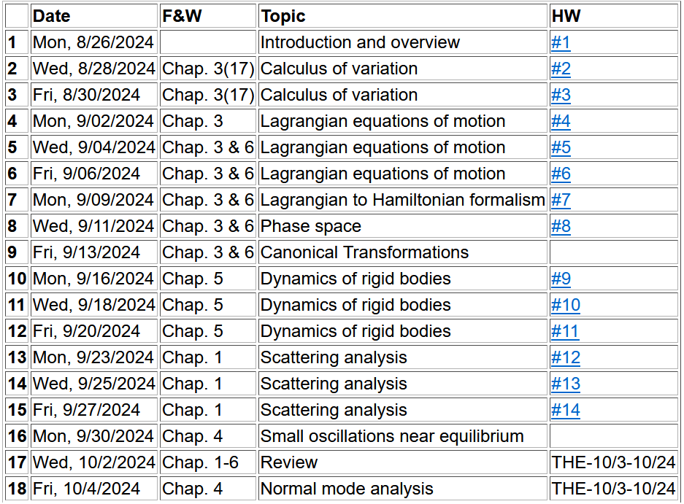

Slide 3
4 PM
Olin 101

Slide 4
Comments about the exam
Will be available tomorrow (10/3/2024)
Due --
It must be your own work, under the honor code
Please make sure that the grader can read your answers.
Grading is based on the correct answer AND the correct reasoning to arrive at the correct answer. Full credit is obtained only with both. Partial credit also benefits from clear reasoning and results.
Please meet with me only (in person or by email) if you have questions about the exam.

Slide 5
Comments on exam
The purpose of the exam is to help you with your understanding of the material
In accordance with the honor code, the solutions you hand in must be your own work. That is, if you have any questions, please consult with me, but no one else.
You will get credit for the reasoning and derivations as well as for the right answer. You may use software such as including Mathematica, Maple, etc. as long as you include all input/output with your exam.
This is an open “book” exam which means that you can consult textbooks and lecture notes as long as you cite themIt is often helpful approach problems in more than one way – recalling that undergraduate physics is still true.

Slide 6
Steps for tackling a problem –
What are the basic concepts that apply to this problem?
Write down the fundamental equations specific to this situation.
Solve.
Check.

Slide 7
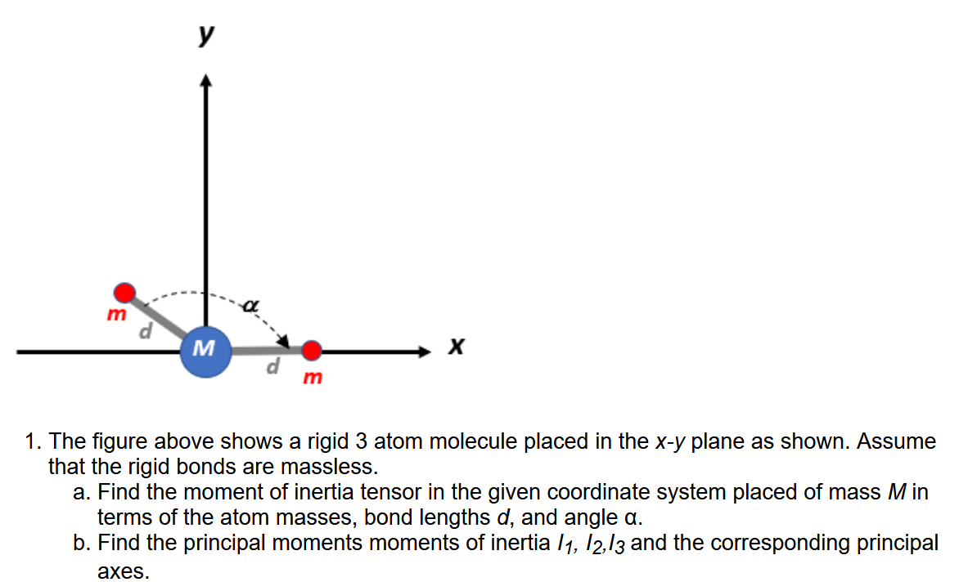
Example Problem -- HW #5

Slide 8
Example solution – Problems 5&7

Slide 10
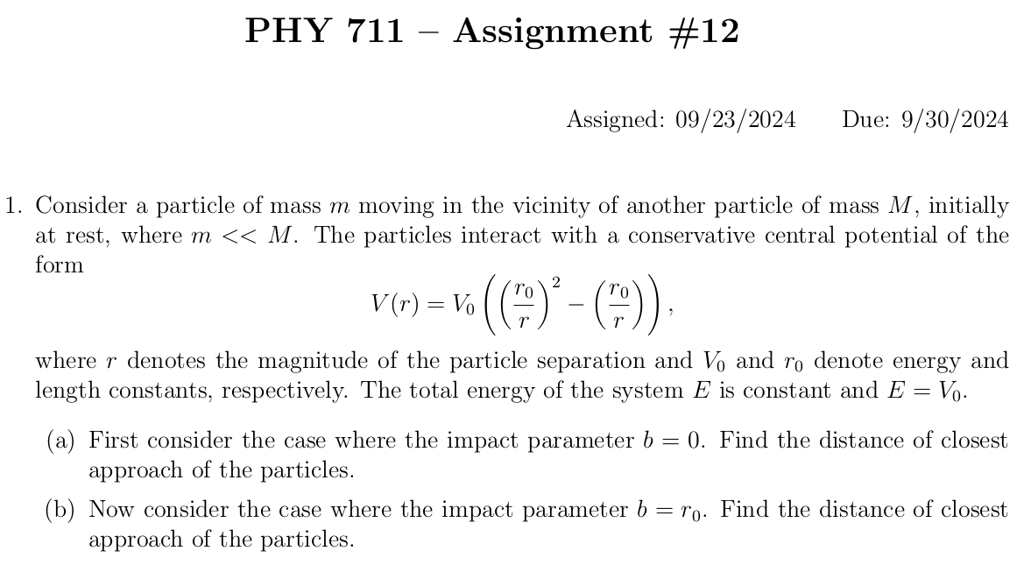

Slide 11
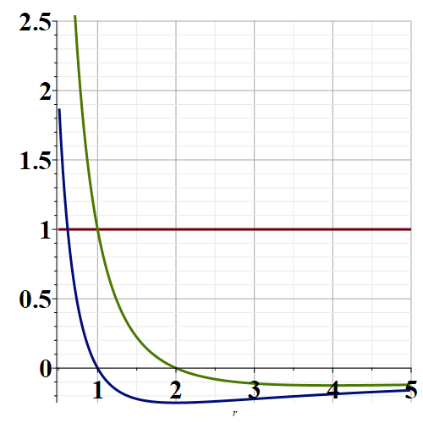
E/V₀
b=r₀
b=0
r/r₀
r_{min}
r_{min}

Slide 12
χ_{max}
χ_{max}
θ

Slide 13
Lecture 15 has the opposite sign and is not correct.
χ_{max}
χ_{max}
θ

Slide 14
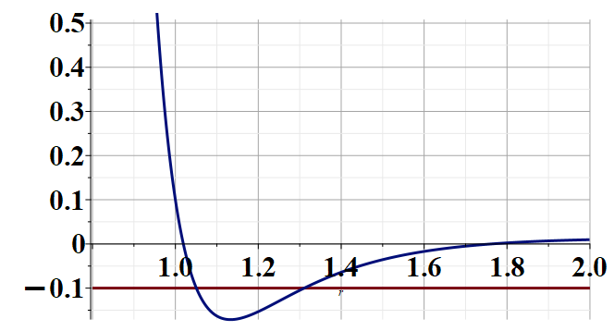
Systematic review
Basic principles
Scattering analysis
Mechanics of central forces
r
E

Slide 15
Systematic review
2. Accelerated Coordinate Systems

Slide 16
Physical laws as described in non-inertial coordinate systems
Newton’s laws are formulated in an inertial frame of reference
For some problems, it is convenient to transform the the equations into a non-inertial coordinate system
Note that in addition to rotation, linear acceleration can also contribute to non-inertial effects.

Slide 17
Comparison of analysis in “inertial frame” versus “non-inertial frame”
This represents the time rate of change of V measured within the e frame.

Slide 18
e⁰ example
z
V(t₁)
V(t₂)
y
x
e example – same motion described in moving coordinate system.

Slide 19
Properties of the frame motion (rotation only):
dΩ
dΩ

Slide 20
Properties of the frame motion (rotation only):
dΩ
dΩ
rotation matrix

Slide 21
More details

Slide 22
Properties of the frame motion (rotation only):
dΩ
dΩ

Slide 23
Properties of the frame motion (rotation only) -- continued
Effects on 2nd time derivative -- acceleration (rotation only):

Slide 24
Application of Newton’s laws in a coordinate system which has an angular velocity ω and linear acceleration a
(Here we generalize previous case to add linear acceleration a.)
Newton’s laws; Let r denote the position of particle of mass m:
Coriolis
force
Centrifugal
force

Slide 25
ω
y (east)
z (up)
θ
x (south)
Motion of a Foucoult Pendulum

Slide 26
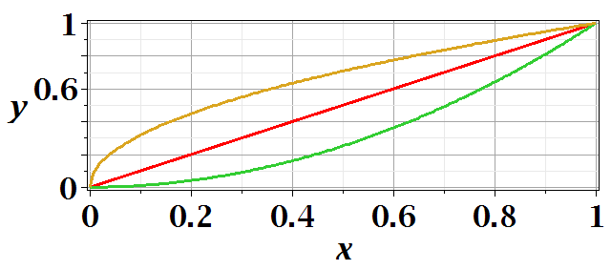
Chapter 3 -- Calculus of variation –

Slide 27
After some derivations, we find
Note that this is a
“total” derivative

Slide 28
Summary --
Euler-Lagrange equation

Slide 30
Application to particle dynamics
Hamilton’s principle states that the dynamical trajectory of a system is given by the path that extremizes the action integral
Simple example: vertical trajectory of particle of mass m subject to constant downward acceleration a=-g.

Slide 31
Potential energy
Kinetic energy

Slide 33
Modification of Lagrangian due to electric and magnetic fields

Slide 34
Introducing the Hamiltonian --
Lagrangian picture
Switching variables – Legendre transformation

Slide 35
Hamiltonian picture – continued

Slide 36
Recipe for constructing the Hamiltonian and analyzing the equations of motion

