Slide 1
PHY 711 Classical Mechanics and Mathematical Methods
10-10:50 AM MWF in Olin 103
Discussion for Lecture 18 – Chap. 4 (F & W)
Analysis of motion near equilibrium –
Normal Mode Analysis
Normal modes of vibration for simple systems
Some concepts of linear algebra
Normal modes of vibration for more complicated systems

Slide 2
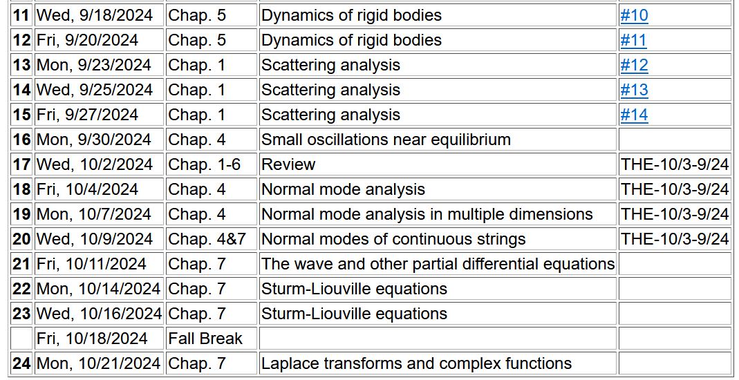

Slide 3
From last time – example of system near equilibrium
Coupled oscillators --
Example – linear molecule
m₁
m₂
m₃

Slide 4
Analysis using linear algebra methods
Notes:
More details for our case.

Slide 6
Note that the normalization of the eigenvector is arbitrary.

Slide 7
m₁
m₂
m₃
m₁
m₂
m₃
m₁
m₂
m₃
Notes:
Visualization of the solution for our case.

Slide 9
Consider an extended system of masses and springs:
m
m
m
Notes:
Example of one dimensional system with fixed boundary values.

Slide 10
Notes:
Review of detailed equations.

Slide 11
Can solve as an eigenvalue problem –
(Why did we not have to transform the equations as we did in the previous example?)

Slide 12
Because of its very regular form, this example also has an algebraic solution --
Here “a” is the equilibrium length of a spring and q has the units of 1/length.
Is this treatment cheating?
Yes.
No cheating, but we are not done.

Slide 13
Notes:
Boundary conditions.

Slide 15
Notes:
Full solution.

Slide 16
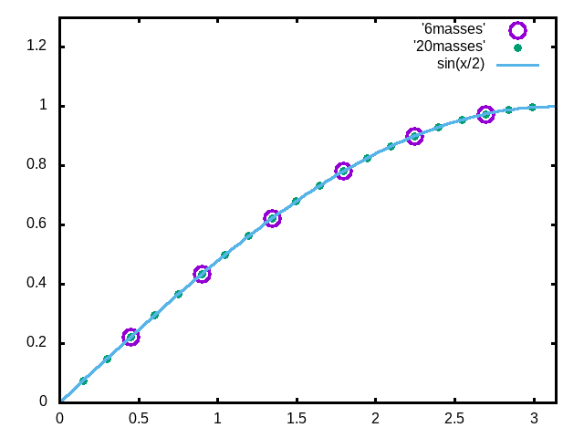
Examples
N=6
N=20
Note that solution form remains correct for N→∞
Notes:
Plot for example. Now consider the case where N is very large.

Slide 17
For extended (infinite) chain without boundaries:
m
m
…
…
m
Note that we are assuming that all masses and springs are identical here.
Here “a” is the equilibrium length of a spring and q has the units of 1/length.
Notes:
Now consider the case where N is infinite so that there are an infinite number of solutions parameterized by qa as a continuous variable.

Slide 18
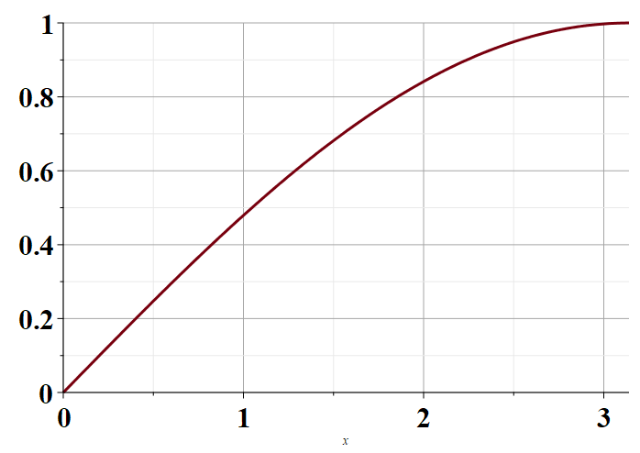
Plot of distinct values of ω_{ν}(q)
π
Note that for N→ ∞ , q becomes a continuous variable within the range 0 < qa < π.
Notes:
Distinct solutions occur for qa in the range of 0-pi as shown in the plot.

Slide 19
For extended (infinite) chain without boundaries:
m
m
…
…
m
Note that there are an infinite number of normal mode frequencies!
Does this make sense?
(A) Yes (B) No

Slide 20
Consider an infinite system of masses and springs now with two kinds of masses:
m
M
m
M
m
m

Slide 21
Note that 2qa is an unknown parameter.
Does this form seem reasonable?

Slide 22
Comment on notation --
m
M
m
M
m
m
Using 2qa as our unknown parameter is a convenient choice so that we can easily relate our solution to the m=M case.

Slide 23
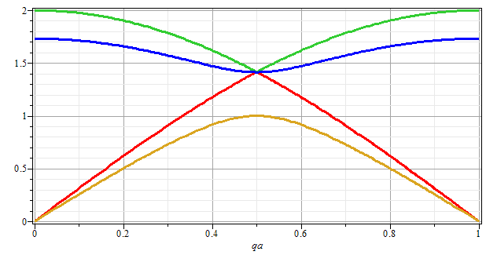
ω
qa/π

Slide 24
Next time –
Extension of these ideas to 2 and 3 dimensions
Extension of these ideas to continuous elastic media.

