Slide 1
PHY 711 Classical Mechanics and Mathematical Methods
10-10:50 AM MWF in Olin 103
Notes for Lecture 20: Chap. 4&7 (F&W)
One dimensional motion of many coupled masses ➔continuous elastic string and related systems
Comments on linear vs. non-linear differential equations – considering beyond harmonic oscillations
Back to linear analyses -- masses coupled by springs ⬅➔mass continuum coupled by string
Mechanics and mathematics of one-dimensional continuous system
Notes:
The one dimensional motion of a large number masses interconnected with springs provides a model of longitudinal motions of a continuous elastic spring and related topics covered in Chapter 7 of your textbook

Slide 2
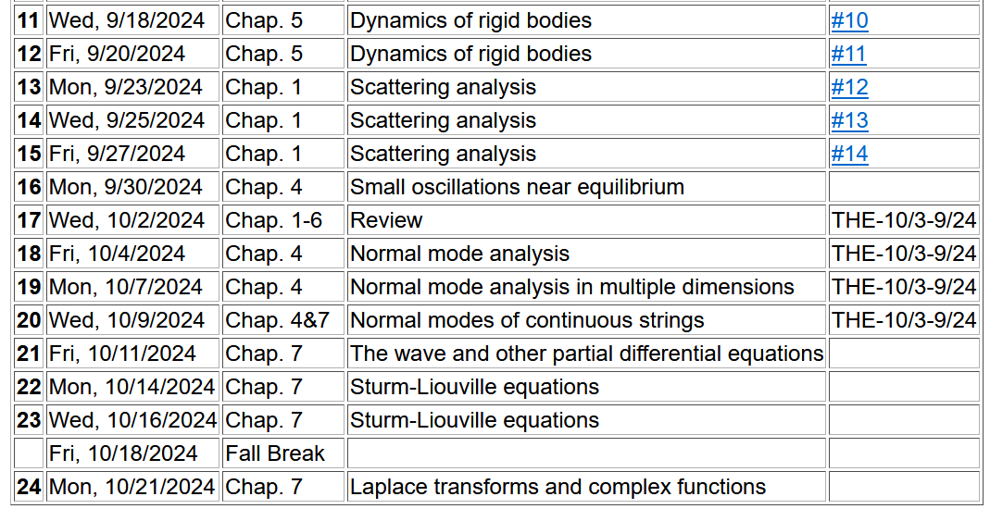
Notes:
Start reading Chapter 7.

Slide 3
4 PM
Olin 101

Slide 4
Digression – comment on linear vs non-linear equations
Notes:
Digression on the special properties of linear equations in contrast to complications for non-linear equations.

Slide 5
Notes:
An example of the effects of non-linearity.

Slide 6
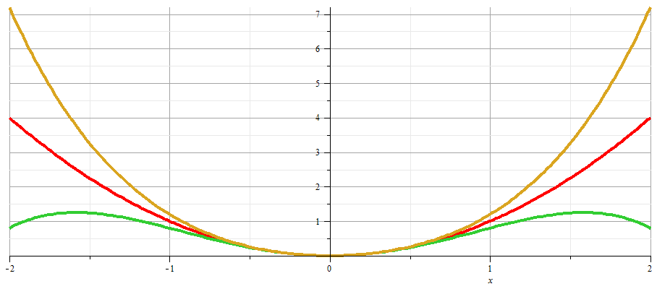
x
Notes:
Plot of nonlinear potentials.

Slide 7
Notes:
Approximate solution to example non-linear equation.

Slide 8
Notes:
Non-linear equation continued.

Slide 9
Notes:
More details.

Slide 10
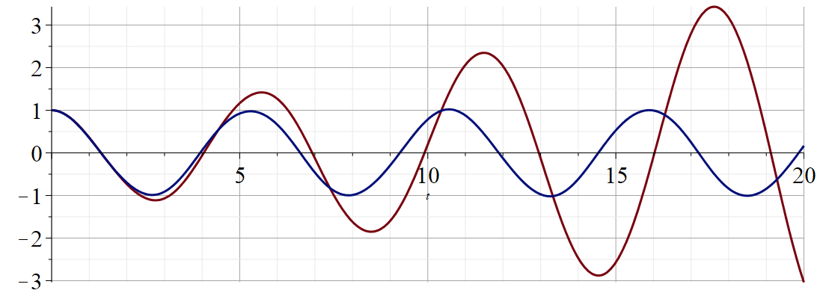
Regrouped expansion
x
t
Original perturbation expansion
Numerical solution according to Maple
Notes:
Plot of results.

Slide 11
Back to linear equations –
Longitudinal case: a system of masses and springs:
m
m
m
Notes:
Showing how the case of the extended mass and spring system approximates the continuous elastic string.

Slide 12
More details

Slide 13
system parameter with units of (velocity)²
Notes:
Regrouping constants in terms of spring constant times increment of length and mass per unit length which combine to give a squared velocity for the longitudinal case. For the transverse case, string tension is involved.

Slide 14
More details
Transverse case
τ₁
θ₁
y+Δy
θ₂
y
τ₂
x
x+Δx

Slide 15
Transverse displacement:
τ
μ(x,t)
Notes:
The diagram shows how the y component of the net tension contributes to the transverse motion.

Slide 16
Notes:
It is possible to adapt the Lagrangian formalism to this continuous system.

Slide 17
Notes:
The continuum version of the Euler-Lagrange equations result in the wave equation for this example.

Slide 18
Note that this is an example of a partial differential equation
Longitudinal motion
Often, it is useful to seek a solution in terms of ordinary
differential equations:
Transverse motion
Notes:
In the next several slides we will discuss solutions to the wave equation. Note that the one dimensional wave equation has some special properties.

Slide 19
Solving partial differential equation using ordinary differential
equations – continued.
We will work out additional details of this separation of variables
method a little later.

Slide 20
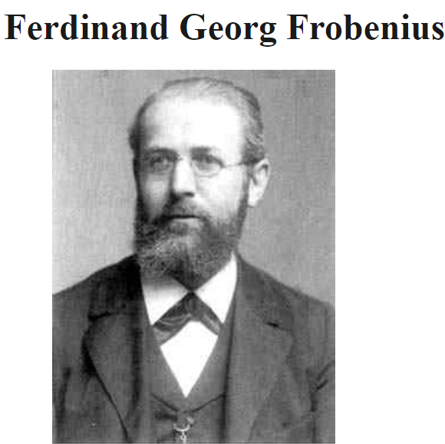
Digression on tools for solving ordinary differential equations – Method of Frobenius
https://mathshistory.st-andrews.ac.uk/Biographies/Frobenius/
Born: 26 October 1849
Berlin-Charlottenburg, Prussia (now Germany)
Died: 3 August 1917
Berlin, Germany
Summary: Georg Frobenius combined results from the theory of algebraic equations, geometry, and number theory, which led him to the study of abstract groups, the representation theory of groups and the character theory of groups. He also developed methods for solving linear differential equations.

Slide 22
Continued --
(infinite series, converges slowly)

Slide 23
We can use the Frobenius method for this example; in this case the series truncates.

Slide 24
Special properties of particular partial differential equations
Notes:
In the next several slides we will discuss solutions to the wave equation. Note that the one dimensional wave equation has some special properties.

Slide 25
These functions would be given
Notes:
This method by D’Alembert is based on the special property of the wave equation.

Slide 26
Notes:
D’Alembert’s method continued.

Slide 27
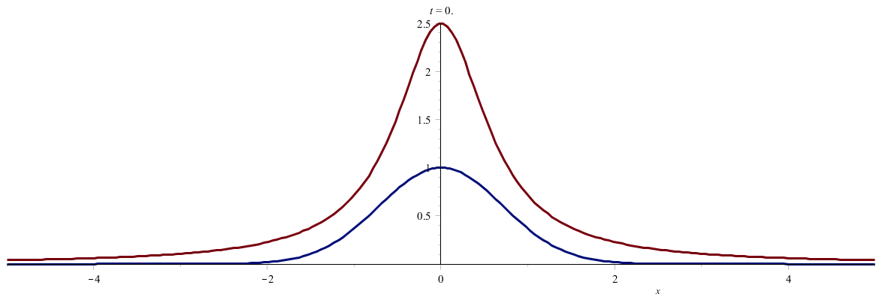
Notes:
An example. (Use slide show to see animation.)

Slide 28
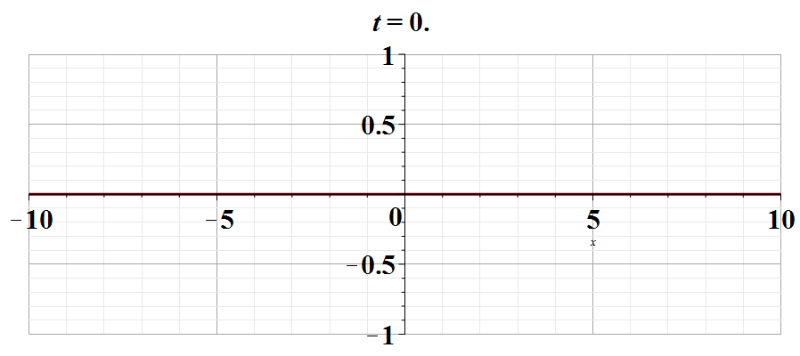
Notes:
Another example. Use slide show to see animation.

