Slide 1
PHY 711 Classical Mechanics and Mathematical Methods
10-10:50 AM MWF in Olin 103
Lecture 21 – Chap. 7 (F&W)
Ordinary and partial differential equations
The wave equation – traveling wave solutions
The wave equation – standing wave solutions
The Sturm-Liouville equation
Notes:
In this lecture, we follow the textbook to use the example of the one-dimensional wave equation to discuss ordinary differential equations more generally and develop some solution methods.

Slide 2
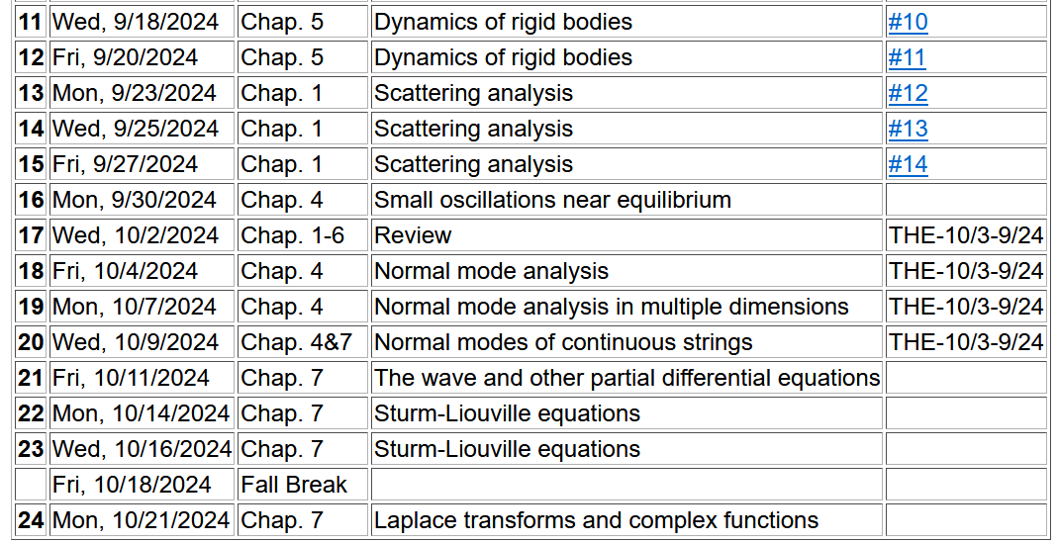
Notes:
Expected schedule for the next weeks…

Slide 3
One-dimensional wave equation
representing longitudinal or transverse displacements as a function of x and t , an example of a partial differential equation --
Traveling wave solutions thanks to D’Alembert --
Notes:
Review of wave equation.

Slide 4
These functions would be given
Notes:
This method by D’Alembert is based on the special property of the wave equation.

Slide 5
Notes:
D’Alembert’s method continued.

Slide 7
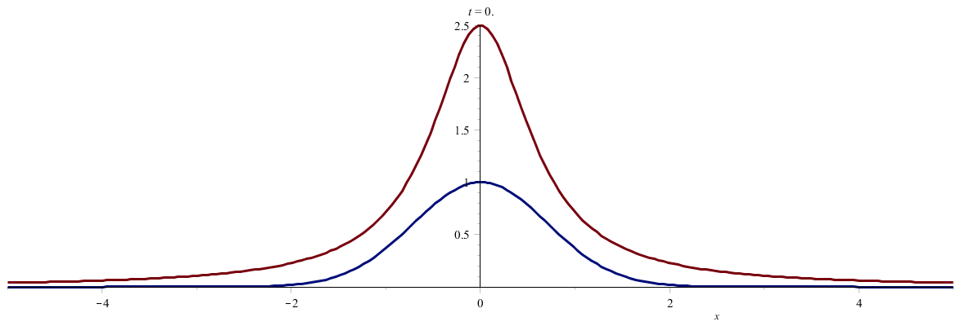
Notes:
An example. (Use slide show to see animation.)

Slide 8
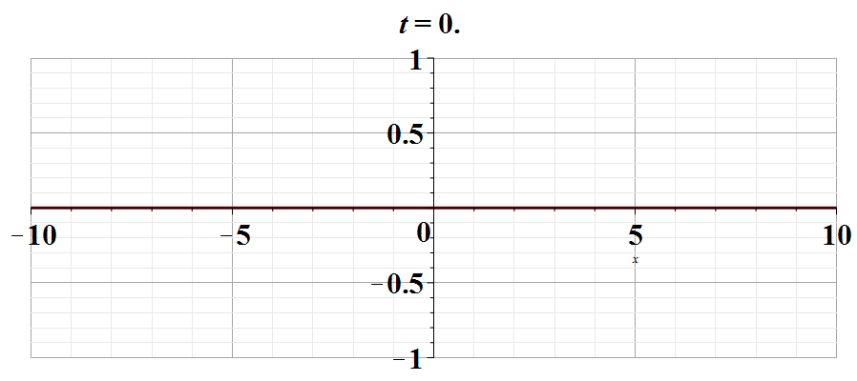
Notes:
Another example. Use slide show to see animation.

Slide 11
It is often the case, there are boundary values specified for
X(x).

Slide 12
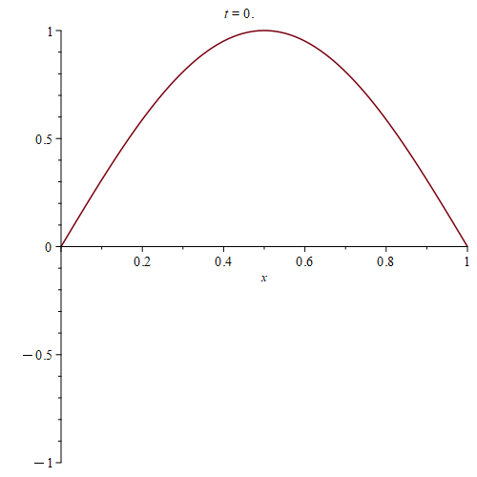
Standing wave --

Slide 13
How are the traveling wave and standing wave solutions to the wave equations related?
They are exactly the same
They are not related
???
More general solution with boundaries at x=0,a :

Slide 14
The wave equation and related linear PDE’s
Notes:
Generalization of the wave equation. Equations in this class are separable in the time variables and the spatial variable satisfies a generalized eigenvalue problem of this form.

Slide 15
Linear second-order ordinary differential equations
Sturm-Liouville equations
given functions
applied force
When applicable, it is assumed that the form of the applied force is known.
solution to be determined
Homogenous problem: F(x)=0
Notes:
We will sometimes want to generalize even further with an “inhomogeneous” term such as an applied force.

Slide 16
Examples of Sturm-Liouville eigenvalue equations --
Notes:
For now, we will focus on eigenvalues of the homogeneous equations.

Slide 17
Solution methods of Sturm-Liouville equations (assume all functions and constants are real):
Notes:
The eigenfunctions of these equations have very useful properties such as completeness.

Slide 18
Why all of the fuss about eigenvalues and eigenvectors?
They are sometimes useful in finding solutions to differential equations
Not all eigenfunctions have analytic forms.
It is possible to solve a differential equation without the use of eigenfunctions.
Eigenfunctions have some useful properties.

Slide 19
Comment on orthogonality of eigenfunctions
Notes:
Orthogonality of eigenfunctions.

Slide 20
Comment on orthogonality of eigenfunctions -- continued
Vanishes for various boundary conditions at x=a and x=b
Notes:
Orthogonality continued.

Slide 21
Comment on orthogonality of eigenfunctions -- continued
Notes:
Orthogonality continued.

Slide 22
Comment on “completeness”
It can be shown that for any reasonable function h(x), defined within the interval a < x <b, we can expand that function as a linear combination of the eigenfunctions f_{n}(x)
These ideas lead to the notion that the set of eigenfunctions f_{n}(x) form a ``complete'' set in the sense of ``spanning'' the space of all functions in the interval
a < x <b, as summarized by the statement:
Notes:
Notion of completeness.

Slide 23
Comment on “completeness” -- continued
Notes:
Notion of completeness and practical applications. Next time, we will extend this idea of completeness to develop important relationships.

Slide 24
Comment on “completeness”
Note that we have “proven” that
which follows from the identities
Notes:
Notion of completeness and practical applications. Next time, we will extend this idea of completeness to develop important relationships.

Slide 25
Eigenvalues and eigenfunctions of Sturm-Liouville equations
Notes:
General properties.

Slide 26
Variation approximation to lowest eigenvalue
In general, there are several techniques to determine the eigenvalues λ_{n} and eigenfunctions f_{n}(x). When it is not possible to find the ``exact'' functions, there are several powerful approximation techniques. For example, the lowest eigenvalue can be approximated by minimizing the function
where is a variable function which satisfies the
correct boundary values. The ``proof'' of this inequality is
based on the notion that can in principle be expanded
in terms of the (unknown) exact eigenfunctions f_{n}(x):
where the coefficients C_{n} can be
assumed to be real.
Notes:
Comment on the Raleigh-Ritz approximation for the lowest eigenvalues.

Slide 27
Estimation of the lowest eigenvalue – continued:
From the eigenfunction equation, we know that
It follows that:
Notes:
Proof of the Rayleigh-Ritz theorem.

Slide 28
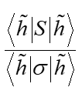
Some additional comments --
0
1

Slide 29
Rayleigh-Ritz method of estimating the lowest eigenvalue
Notes:
Review of example from last lecture.

Slide 30
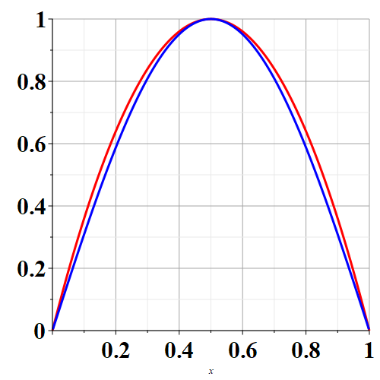
f₁ exact
f
f_{trial}
x

Slide 31
Rayleigh-Ritz method of estimating the lowest eigenvalue
Another example – this time with a variable parameter
Notes:
Another example.

Slide 32
Recap -- Rayleigh-Ritz method of estimating the lowest eigenvalue
Exact answer
Do you think that there is a reason for getting the correct answer from this method?
Chance only
Skill
Notes:
In this case, the minimization process yield’s the exact answer.

