Slide 1
PHY 711 Classical Mechanics and Mathematical Methods
10-10:50 AM MWF in Olin 103
Notes for Lecture 24: Chap. 7
& App. A-D (F&W)
Generalization of the one dimensional wave equation ➔ various mathematical problems and techniques including:
Laplace transforms
Complex variables
Contour integrals

Slide 2
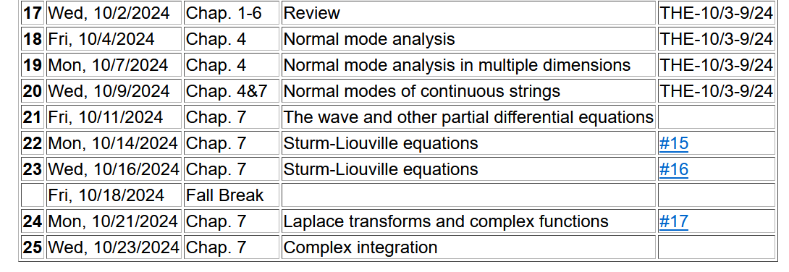
Notes:
No new homework while working on mid term exam.

Slide 3
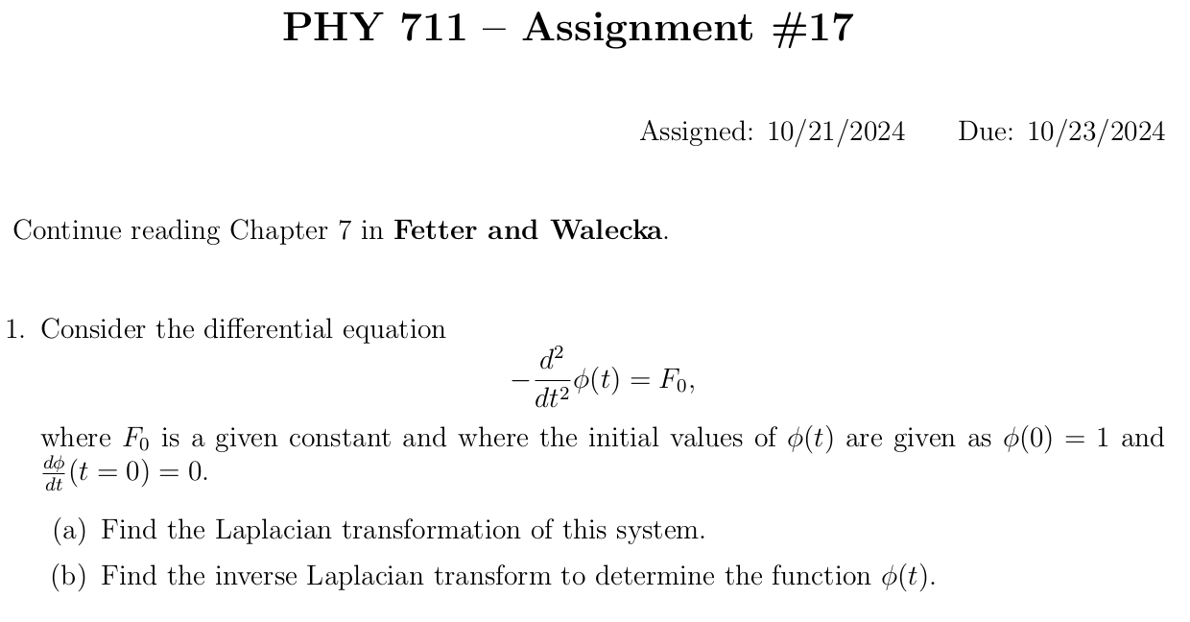

Slide 4
Last time, we introduced the Fourier Transform --
In this lecture, we will discuss a similar concept – the Laplace Transform.

Slide 5
A brief introduction to Laplace transforms --

Slide 6
Some details (integrating by parts)--

Slide 10
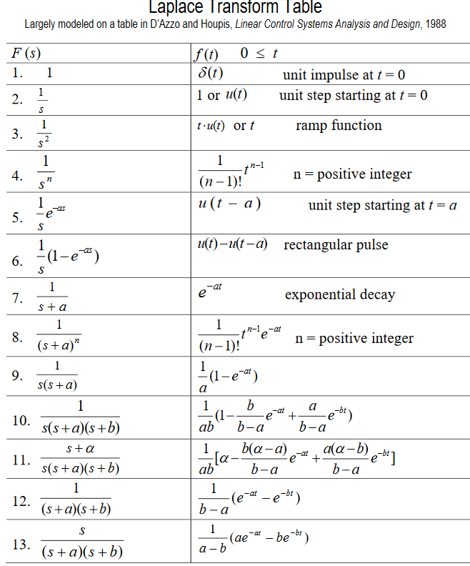
Table of Laplace transforms
https://www.dartmouth.edu/~sullivan/22files/New%20Laplace%20Transform%20Table.pdf

Slide 11
In order to evaluate these integrals, we need to use complex analysis.

Slide 12
In general – to calculate inverse Laplace transforms, we need to introduce concepts of complex numbers and contour integration
Introduction to complex variables
Basic properties
Notion of an analytic complex function
Cauchy integral theory
Analytic functions and functions with poles
Evaluating integrals of functions in the complex plane
Notes:
We will review/introduce the basic ideas associated with complex variables.

Slide 13
Complex numbers
Functions of complex variables
Derivatives:
Cauchy-Riemann equations
Notes:
First we consider the basic definitions and representations of a complex number. Then we consider a function of complex numbers. The Cauchy relationships follow from the notion that a function that is differentiable in the complex plane must have consistent partial derivatives along the real and imaginary axes.

Slide 14
Analytic function
Examples of analytic functions
Notes:
Notion of an analytic function and an example that satisfies the conditions.

Slide 15
Examples of non-analytic functions
Notes:
Examples of non-analytic functions. Special property of contour integrals about a function with a simple “pole”.

Slide 16
Integration does not include z_{p}
Integration does include z_{p}

Slide 17
No contribution
C
Notes:
Contributions to a closed contour from various contributions.

Slide 18
In the following examples m=1
Notes:
Residue theorem

Slide 19
Example:
Im(z)
Re(z)
Note:
m=1
Notes:
Example of a contour integral using the residue theorem.

Slide 20
Some details:
Question – Could we have chosen the contour in the lower half plane?
a. Yes b. No
Notes:
Some details.

Slide 21
Another example:
Note:
m=1
Im(z)
Re(z)
Notes:
Another example.

Slide 22
Question – Could we have chosen the contour in the lower half plane?
a. Yes b. No
Notes:
Some details.

Slide 23
Another example:
Im(z)
ia
Re(z)
10/30/2017
PHY 711 Fall 2017 -- Lecture 25
23
Notes:
Another example

Slide 24
Notes:
More details.

Slide 25
Im(z)
Re(z)

Slide 26
Notes:
Another example from the Drude model.

