Slide 1
PHY 711 Classical Mechanics and Mathematical Methods
10-10:50 AM MWF in Olin 103
Notes on Lecture 36
Continued discussion of viscous fluids: Chap. 12 in F & W
Some general comments
Navier-Stokes equation
Review of results from last time – Stokes “law”
Effects on linearized sound waves
Notes:
In this lecture, we will consider some effects of viscosity on the motion of fluids, following Chapter 12 of your textbook.

Slide 2
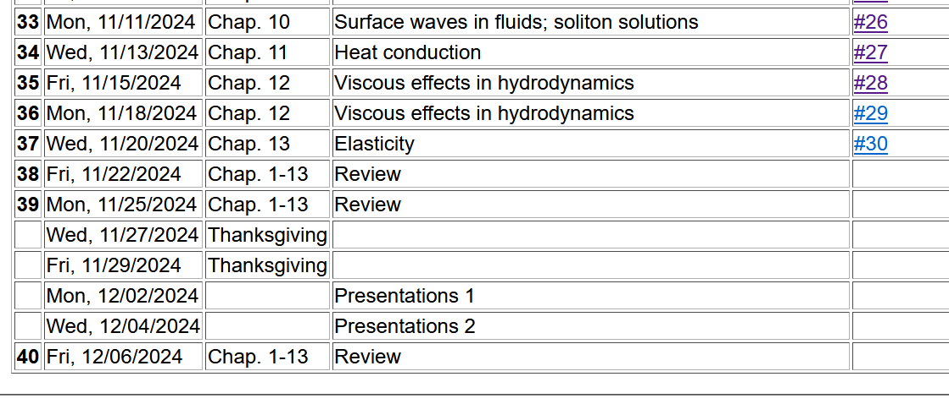
2
Notes:
Schedule.

Slide 3
Comment on outstanding homework.

Slide 4
Equations for motion of non-viscous fluid --
Notes:
Here we recognize terms that have the units of force/area and can be described as a stress tensor Tij.

Slide 5
Now consider the effects of viscosity
As an example of a viscous effect, consider --
A
F_{x}
y
v_{x}(y)
material dependent parameter
x
Notes:
The next step is to imagine that the additional effects of viscosity should/can be represented as a viscous stress tensor. The example of sheer force suggests that the viscous stress tensor involves derivatives of the velocity of the fluid.

Slide 6
Effects of viscosity
viscosity
bulk (or dilational) viscosity
Notes:
Imagining the most general form of the viscous tensor, we consider all derivatives of all components of fluid velocity, separating out the terms with zero trace, with the remaining terms proportional to the divergence of the velocity and representing the “bulk” viscosity.

Slide 7
Effects of viscosity -- continued
Notes:
Now we can write the fluid equations with the full stress tensor. The continuity equation still applies. The so-called Navier-Stokes equation summarizes the expected behavior of fluids in terms of the material dependent viscosity parameters eta and zera.

Slide 8
Newton-Euler equations for viscous fluids
Typical viscosities at 20º C and 1 atm:
Fluid | η/ρ (m²/s) | η (Pa s)
Water | 1.00 x 10⁻⁶ | 1 x 10⁻³
Air | 14.9 x 10⁻⁶ | 0.018 x 10⁻³
Ethyl alcohol | 1.52 x 10⁻⁶ | 1.2 x 10⁻³
Glycerine | 1183 x 10⁻⁶ | 1490 x 10⁻³
Notes:
Here is a list of some typical values of the viscosity parameter eta.

Slide 9
More discussion of viscous effects in incompressible fluids
u
F_{D}
“Derivation”
Consider the general effects of viscosity on fluid equations
Solve the linearized equations for the case of steady-state flow of a sphere of radius R
Infer the drag force needed to maintain the steady-state flow
Note that solution is special to the sphere geometry.
Notes:
Changing to an analysis of viscous flow as a drag force.

Slide 10
Some of the details

Slide 11
Additional effects of viscosity – allowing for changes in entropy
-- particularly in the case of sound waves in air

Slide 12
Newton-Euler equations for viscous fluids

Slide 13
Newton-Euler equations for viscous fluids – effects on sound
Without viscosity terms:

Slide 14
Sound waves without viscosity -- continued
➔Pure longitudinal harmonic wave solutions

Slide 15
Newton-Euler equations for viscous fluids – effects on sound
Recall full equations:
viscosity causes heat transfer

Slide 16
Newton-Euler equations for viscous fluids – effects on sound
Note that pressure now depends both on density and entropy so that entropy must be coupled into the equations

Slide 17
Newton-Euler equations for viscous fluids – linearized equations

Slide 18
Newton-Euler equations for viscous fluids – linearized equations
heat capacity at constant volume

Slide 19
Newton-Euler equations for viscous fluids – linearized equations

Slide 20
Newton-Euler equations for viscous fluids – effects on sound
Linearized equations (with the help of various thermodynamic relationships):

Slide 21
Linearized hydrodynamic equations

Slide 22
Linearized hydrodynamic equations; plane wave solutions:
➔Entropy and mechanical modes are independent

Slide 23
Linearized hydrodynamic equations; full plane wave solutions:

Slide 24
Linearized hydrodynamic equations; full plane wave solutions:

Slide 25
Linearized hydrodynamic equations; full plane wave solutions:
New phenomena in the linear regime
Spatial attenuation of waves
New transverse modes

Slide 26
Comment on HW 29 -- Analysis of special case of linearized sound wave equations

