Slide 1
PHY 711 Classical Mechanics and Mathematical Methods
10-10:50 AM MWF in Olin 103
Notes for Lecture 38
Starting course review; revisiting
physics analyzed in accelerated coordinate frames – Chap 2 F&W
    Angular acceleration
    Linear and angular acceleration
    Foucault pendulum

Slide 2
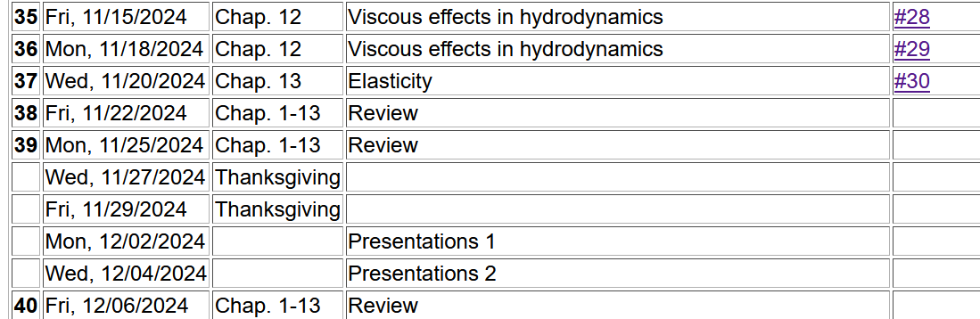
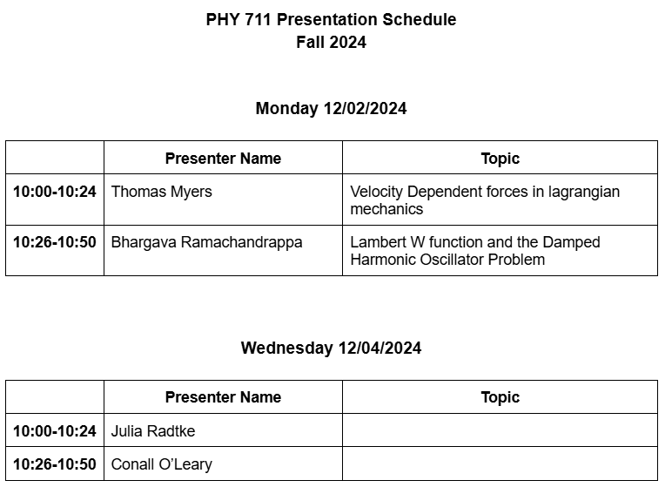

Slide 3
Physical laws as described in non-inertial coordinate systems
  Newton’s laws are formulated in an inertial frame of reference
  For some problems, it is convenient to transform the the equations into a non-inertial coordinate system
Note that in addition to rotation, linear acceleration can also contribute to non-inertial effects.
Notes:
By “inertial” frame of reference, we mean a reference frame that is either stationary or is moving at constant velocity. A non-inertial frame of reference is the opposite.

Slide 4
Comparison of analysis in “inertial frame” versus “non-inertial frame”
This represents the time rate of change of V measured within the e frame.
Notes:
The first question is how analyze quantities such as a vector V in the two frames of reference. The vector V may vary in time and its components

Slide 5
e⁰ example
z
V(t₁)
V(t₂)
y
x
e example – same motion described in moving coordinate system.

Slide 6
Properties of the frame motion (rotation only):
dΩ
dΩ
Notes:
Here omega is a vector whose magnitude is the time rate of change of rotation of the coordinate frame and whose direction is pointing along the axis of rotation (in this case the x-axis.

Slide 7
Properties of the frame motion (rotation only):
dΩ
dΩ
rotation matrix
Notes:
Here we “derive” the cross product relation using the expression for finite rotation and then expanding to infinitesimal angle dOmega.

Slide 8
More details

Slide 9
Properties of the frame motion (rotation only):
dΩ
dΩ
Notes:
Summary of previous results.

Slide 10
Properties of the frame motion (rotation only) -- continued
Effects on 2nd time derivative -- acceleration (rotation only):
Notes:
Having established how to analyze the first time derivative, we apply the time derivative to the result in order to analyze the second time derivative (acceleration).

Slide 11
Application of Newton’s laws in a coordinate system which has an angular velocity ω and linear acceleration a
(Here we generalize previous case to add linear acceleration a.)
Newton’s laws; Let r denote the position of particle of mass m:
Coriolis
force
Centrifugal
force
Notes:
The highlighted terms are often called “fictitious” forces.

Slide 12
Have you ever experienced any of these “fictitious” forces?
Examples –
Playing on a swing
Playing on a merry-go-round
Riding on a roller coaster
Sitting on the surface of the earth
Astronaut aboard the International Space Station
???

Slide 13
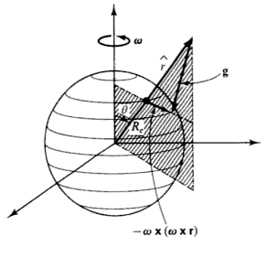
Motion on the surface of the Earth:
Earth’s gravity
Support force
Notes:
Considering now our case, standing or sitting on the surface of the rotating earth (neglecting other details like orbiting the sun). F’ is the support force meaning the floor on which we are standing/sitting and its support due to earth’s crust.

Slide 14
Non-inertial effects on effective gravitational “constant”
0.03 m/s²
9.80 m/s²
Notes:
Some details.

Slide 15
Is this justified?
Yes
No
According to Google – the rate of rotation of the earth has changed during its existence….
https://www.discovermagazine.com/planet-earth/the-earths-rotation-is-gradually-slowing-down

Slide 16
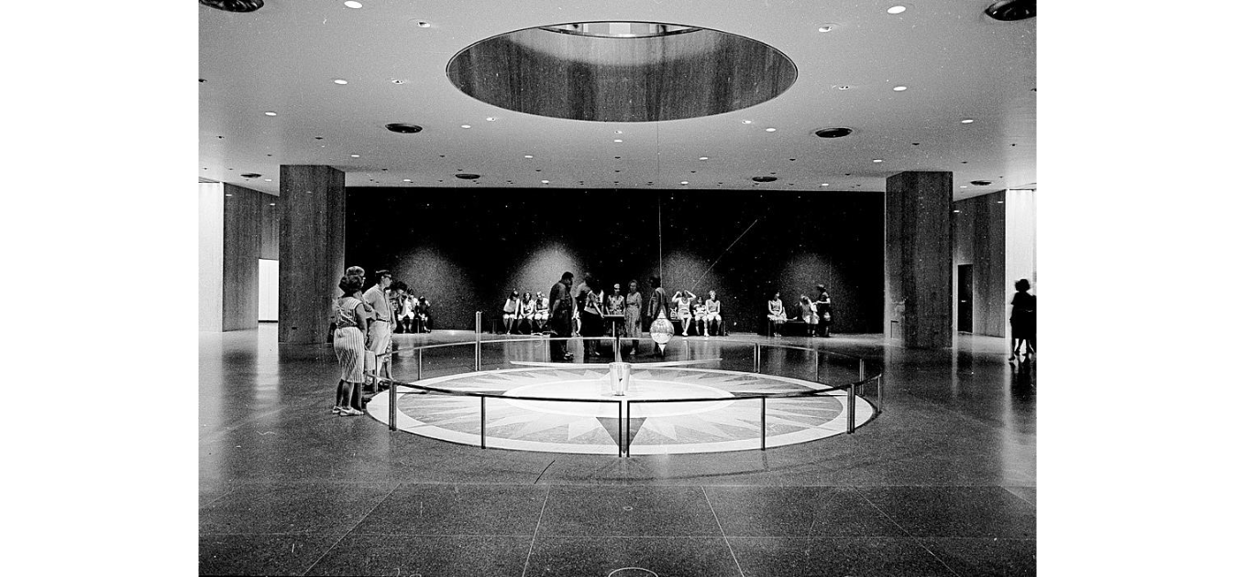
Foucault pendulum
http://www.si.edu/Encyclopedia_SI/nmah/pendulum.htm
The Foucault pendulum was displayed for many years in the Smithsonian's National Museum of American History. It is named for the French physicist Jean Foucault who first used it in 1851 to demonstrate the rotation of the earth.
Notes:
A very interesting example designed to show the effects of the earth’s rotation.

Slide 17
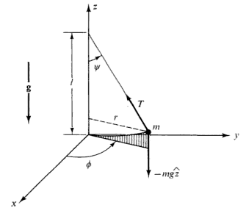
Equation of motion on Earth’s surface
ω
y (east)
z (up)
θ
x (south)

Slide 18
Foucault pendulum continued – keeping leading terms:
z
ψ
T
Notes:
Analyzing the pendulum motion in the given geometry.

Slide 20
Foucault pendulum continued – keeping leading terms:
Notes:
Simplifying the equations for the dominant terms.

Slide 21
Foucault pendulum continued – coupled equations:
Notes:
More details

Slide 22
Foucault pendulum continued – coupled equations:
Notes:
Solving the differential equations.

Slide 23
Notes:
More details and approximations.

Slide 24
Summary of approximate solution for Foucault pendulum:
Notes:
Summary

Slide 25
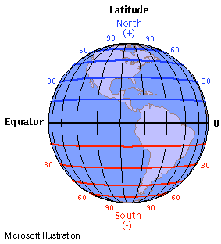
ω
y (east)
z (up)
θ
x (south)
Notes:
It is interesting to estimate the effects in different parts of the globe. Note that theta is defined for the polar angle, while if you look up your latitude you will find 90-theta.

Slide 26
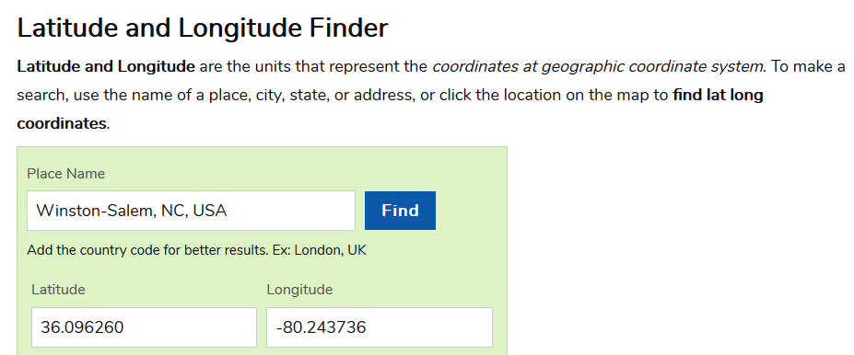
Latitude and Longitude
https://www.latlong.net/
Note that θ=90º - Latitude

