Slide 1
PHY 711 Classical Mechanics and Mathematical Methods
10-10:50 AM MWF in Olin 103
Notes on Lecture 39
Review of topics covered in this course
  Basic mathematical tools
  Mathematical methods
  Physical concepts

Slide 2
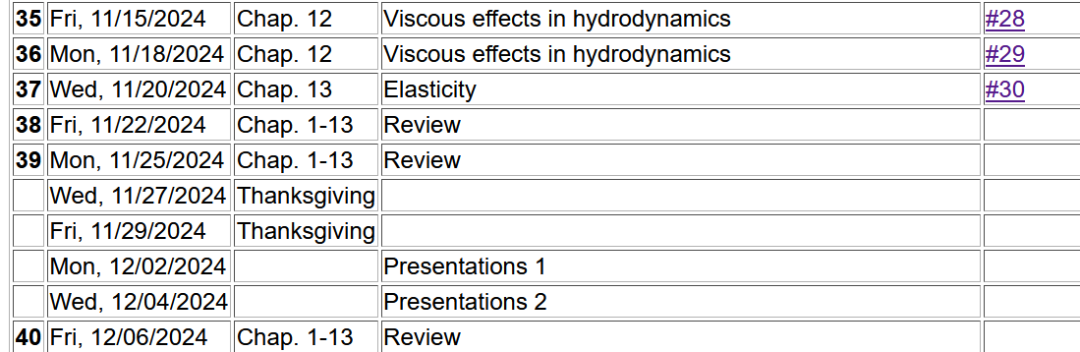
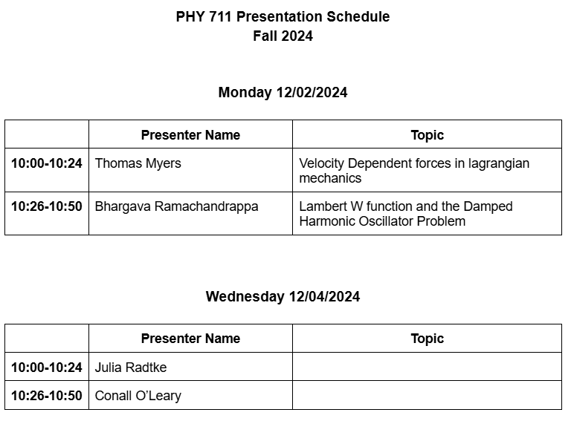
2
Notes:
Comment on order of topics???

Slide 3
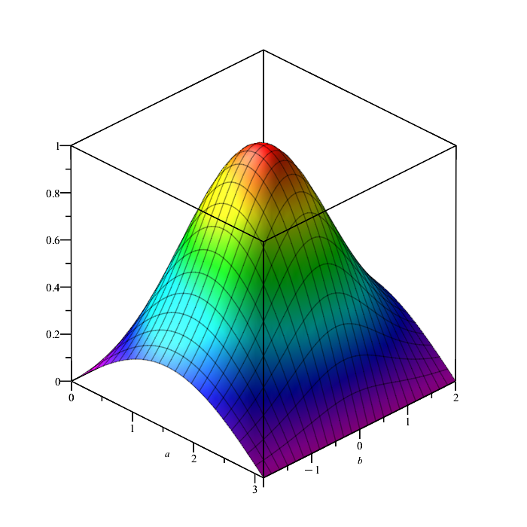
Some comments on basic functional dependencies and partial and total derivatives --
Note that in the case, a and b are independent variables.
a
b

Slide 6
Changing functional dependencies – Legendre transformations

Slide 7
Changing functional dependencies – Legendre transformations

Slide 8
Recipe for constructing the Hamiltonian and analyzing the equations of motion
Note that the equations of motion should yield equivalent trajectories for the Lagrangian and Hamiltonian formulations.

Slide 9
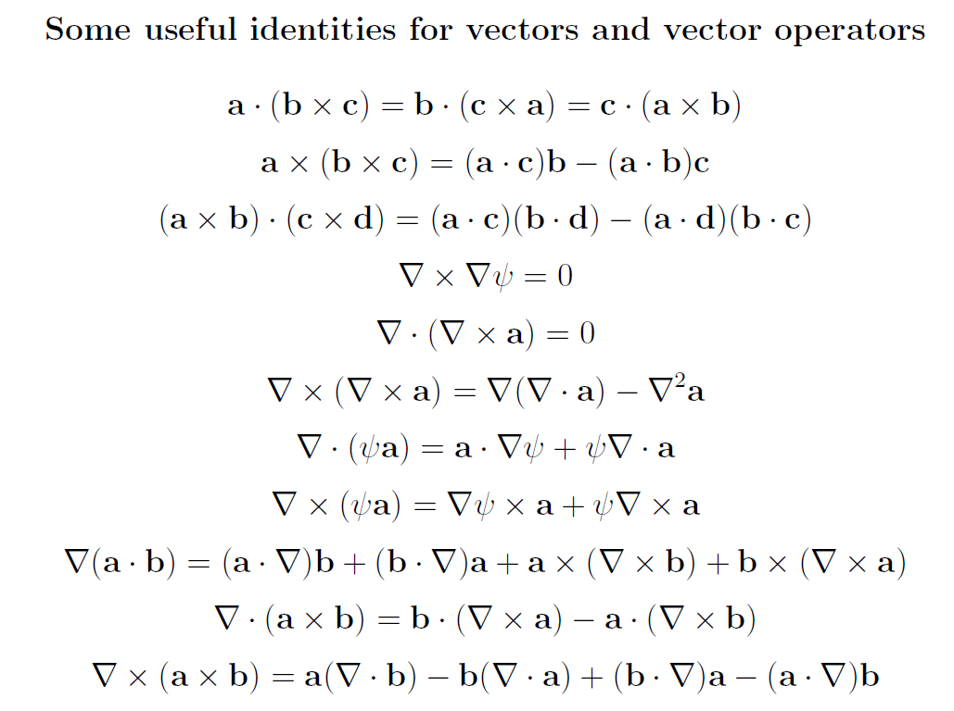
Review of mathematical methods

Slide 10
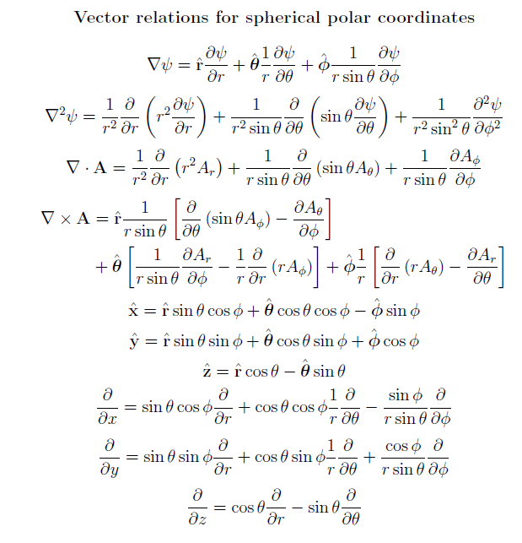

Slide 11
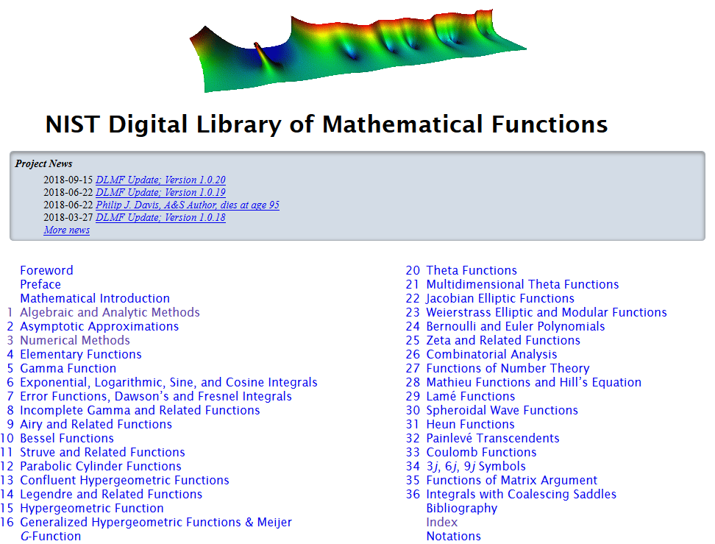
https://dlmf.nist.gov/

Slide 12
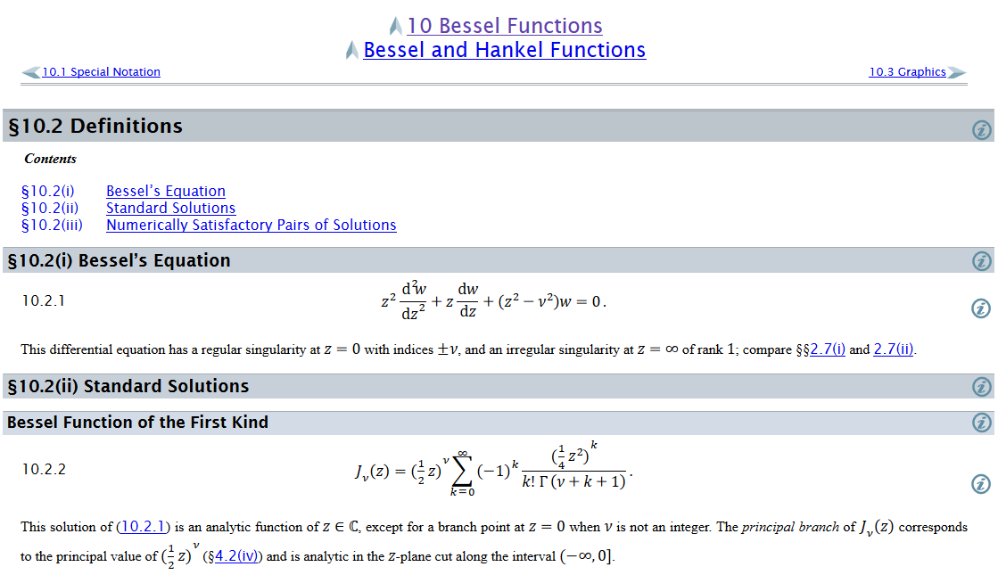
Example – special functions

Slide 13
Complex numbers
Functions of complex variables
Derivatives:
Cauchy-Riemann equations

Slide 14
Analytic function
➔A closed integral of an analytic function is zero.
However:

Slide 15
Contour integration methods --
No contribution
C

Slide 17
Fourier transforms --
Note: The location of the 2π factor varies among texts.

Slide 19
Doubly discrete Fourier Transforms
➔Fast Fourier Transforms (FFT)

Slide 20
Notions of eigenvalues and eigenvectors
In the context of linear algebra --
In the context of Sturm-Liouville differential equations --

Slide 21
Notions of eigenvalues and eigenvectors -- continued

Slide 22
Calculus of variation – a method to find a function (y(x)) which optimizes a particular integral relationship.
Euler-Lagrange equation

Slide 23
Lagrangian in the presence of electromagnetic forces

Slide 24
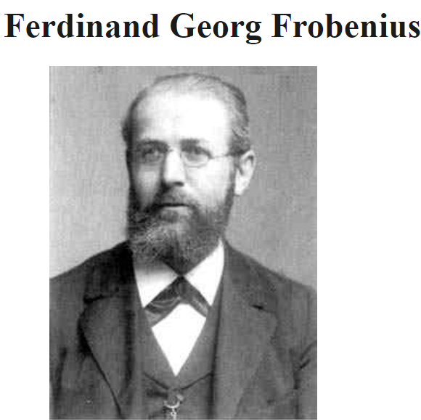
Digression on tools for solving ordinary differential equations – Method of Frobenius
https://mathshistory.st-andrews.ac.uk/Biographies/Frobenius/
Born: 26 October 1849
Berlin-Charlottenburg, Prussia (now Germany)
Died: 3 August 1917
Berlin, Germany
Summary: Georg Frobenius combined results from the theory of algebraic equations, geometry, and number theory, which led him to the study of abstract groups, the representation theory of groups and the character theory of groups. He also developed methods for solving linear differential equations.

Slide 26
Continued --
(infinite series, converges slowly)

Slide 27
We can use the Frobenius method for this example; in this case the series truncates.

Slide 28
Mechanics topics
  Scattering theory
  Non-inertial reference frames
  Lagrangian mechanics
  Hamiltonian mechanics
  Liouville theorem
  Rigid body motion
  Normal modes of oscillation about equilibrium
  Wave motion
  Fluid mechanics (ideal or including viscosity; linear and nonlinear)
  Heat conduction
  Elasticity
Note: The following review slides are necessarily brief. Please refer to the original lecture slides for details. Please email: natalie@wfu.edu with any corrections/suggestions

Slide 29
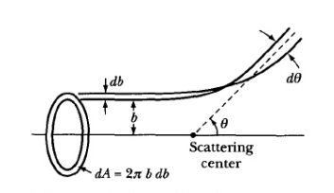
Scattering theory
Note: The notion of cross section is common to many areas of physics including classical mechanics, quantum mechanics, optics, etc. Only in the classical mechanics can we calculate it from a knowledge of the particle trajectory as it relates to the scattering geometry.
b
Figure from Marion & Thorton, Classical Dynamics
Note: We are assuming that the process is isotropic in φ

Slide 30
Lagrangian mechanics

Slide 31
Example of solving coupled equations
Lagrangian equations of motion for a Lorentz force

Slide 33
Recipe for constructing the Hamiltonian and analyzing the equations of motion

Slide 34
Important tool for analyzing Lagrangian and/or Hamiltonian systems -- finding constants of the motion
In Lagrangian formulation --

Slide 35
Constants of the motion in the Hamiltonian formulation

Slide 36
Question – Why use this fancy formalism when simple conservation of energy or momentum intuitively apply?
You should use your intuition whenever possible.
You should never trust your intuition.
The equations should be consistent with correct intuitive solutions and also reveal additional solutions (perhaps beyond intuition)

Slide 37
Liouville’s Theorem (1838)
The density of representative points in phase space corresponding to the motion of a system of particles remains constant during the motion.

Slide 38
Rigid body motion
In a reference frame attached to the object, there are 3 moments of inertia and 3 distinct principal axes
Representation of rotational kinetic energy:

Slide 39
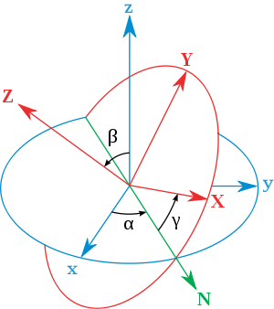
Euler’s transformation between body fixed and inertial reference frames
x
y
y
x

Slide 40

Normal modes of vibration -- potential in 2 and more dimensions
V(x,y)

Slide 41
Example – normal modes of a system with the symmetry of an equilateral triangle -- continued
3
u₃
u₂
1
2
u₁

Slide 42
Example – normal modes of a system with the symmetry of an equilateral triangle -- continued

Slide 43
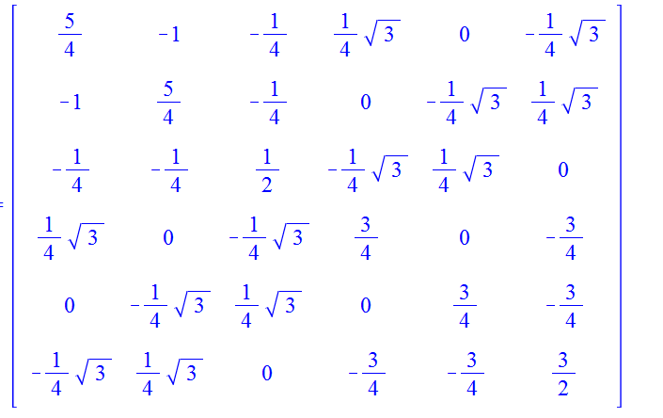
Example – normal modes of a system with the symmetry of an equilateral triangle -- continued
= ω²

Slide 44
Discrete particle interactions → continuous media →
The wave equation

Slide 45
Mechanical motion of fluids
Newton’s equations for fluids
  Use Euler formulation; following “particles” of fluid
Viscosity contributions

Slide 46
Fluid mechanics of incompressible fluid plus surface
Non-linear effects in surface waves:
p₀
ζ
z
h
y
z=0
x

