Slide 1
PHY 711 Classical Mechanics and Mathematical Methods
10-10:50 AM MWF in Olin 103
Notes on Lecture 40
Review of topics covered in this course
Comment on numerical methods
Review of the Sturm-Liouville equation
Solving some example problems

Slide 2
b
Please fill out the course evaluation form for PHY 711
Today
Final available
Final due
2
Notes:
Comment on order of topics???

Slide 3
Brief comment on numerical methods --
Here it is assumed that h is small and h³<<h²

Slide 4
x
t

Slide 5
Note that it is possible to check the magnitude of the terms that you are neglecting and estimate the error. Also, one needs to be careful of device-dependent restrictions. In general, it is useful to use scaled coordinates.
When you perform numerical work, you need to take care about your algorithms both in terms of software and hardware.

Slide 6
Review of the Sturm-Liouville equations
Linear second-order ordinary differential equations
Sturm-Liouville equations
given functions
applied force
When applicable, it is assumed that the form of the applied force is known.
solution to be determined
Homogenous problem: F(x)=0

Slide 7
Why are Sturm-Liouville equations interesting?
A. They sound fancy?
B. They describe all second-order differential equations?
C. Another method of graduate student torture?
D. Several special functions are solutions to Sturm-Liouville equations?
E. They have several interesting properties?

Slide 8
Examples of Sturm-Liouville eigenvalue equations --

Slide 10
Comment on orthogonality of eigenfunctions

Slide 11
Comment on orthogonality of eigenfunctions -- continued
Vanishes for various boundary conditions at x=a and x=b

Slide 12
Comment on orthogonality of eigenfunctions -- continued

Slide 13
For additional information about Sturm-Liouville equations, see Lectures 21,22,23

Slide 14
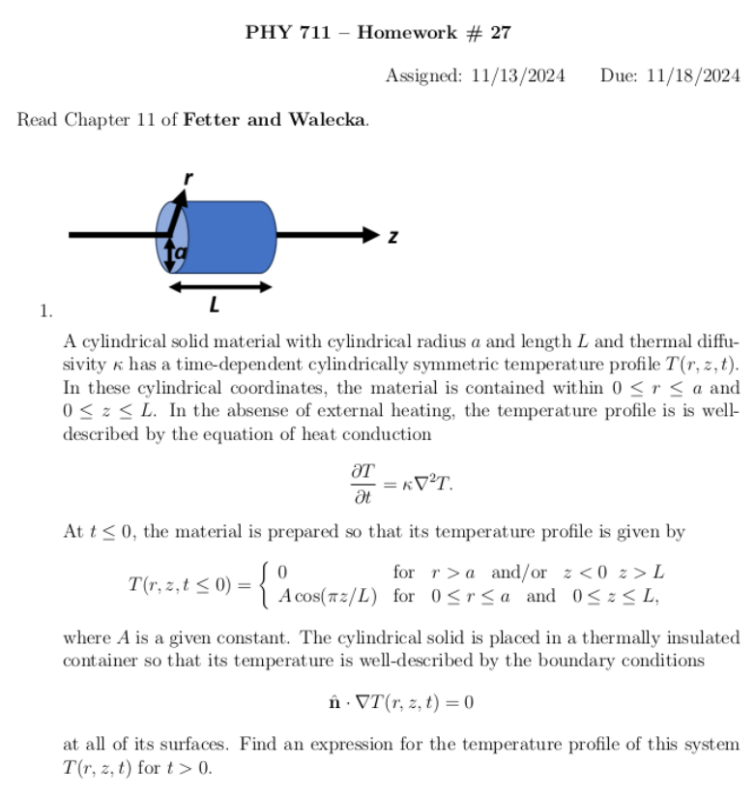
14
Notes:
Schedule.

Slide 20
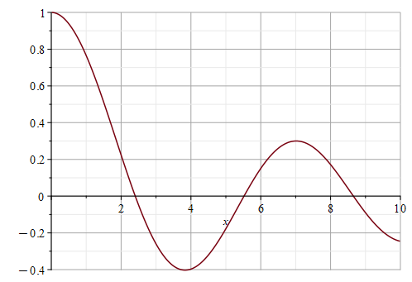
Satisfies the radial differential equation, but does not satisfy boundary conditions
J₀(x)

Slide 24
Finishing up --

Slide 26
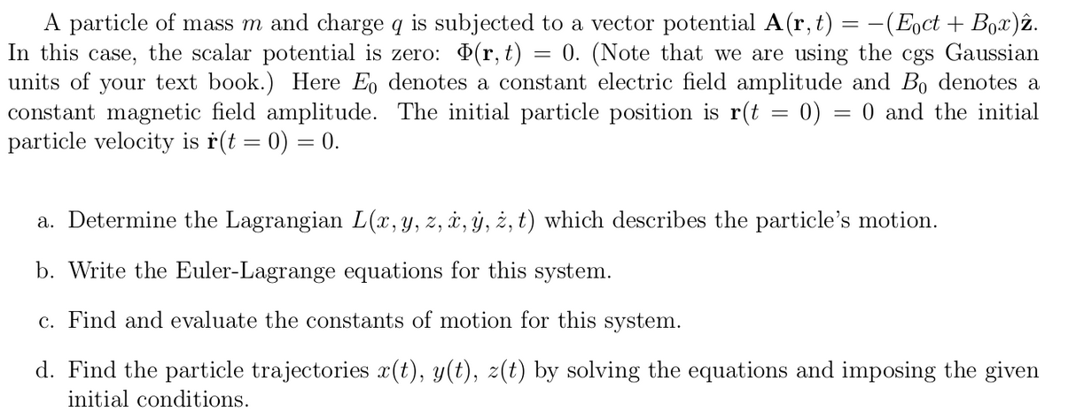
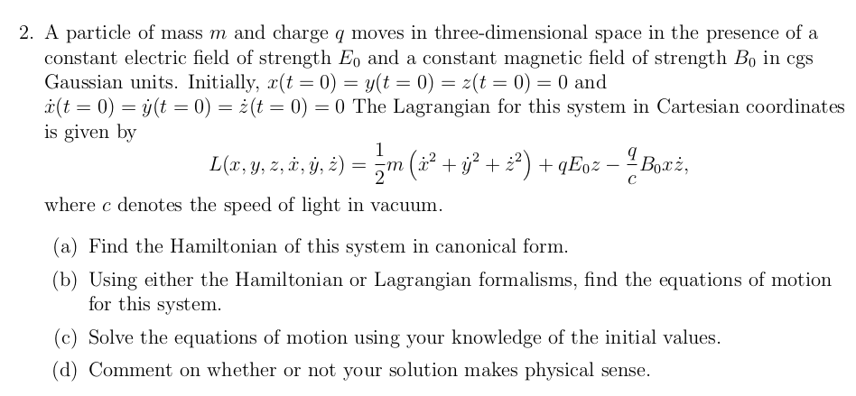
Advice about problem solving such as coupled differential equations

Slide 27
What can you say about these two cases?

Slide 28
Do these solutions satisfy the equations?
Do these solutions satisfy the initial conditions?

