Slide 1
PHY 712 Electrodynamics
10-10:50 AM MWF Olin 103
Notes for Lecture 11 --
Complete reading Chapter 4 (Sec. 4.5-4.7 in JDJ)
Microscopic ⬅➔macroscopic polarizability and dielectric functions and susceptibility
Clausius-Mossotti equation
Electrostatic energy in dielectric media
Comment on “modern theory of polarization”

Slide 2
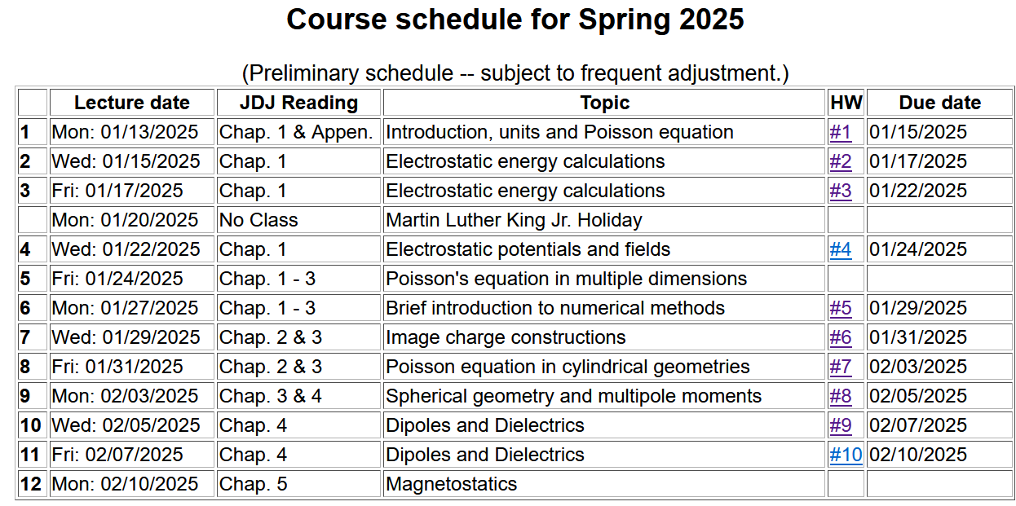

Slide 3
r
a
d
ε
q
ε₀

Slide 4
Review -- Focus on dipolar fields:
(Assuming that p is located at the origin.)

Slide 5
Now consider a distribution of monopoles and dipoles --
It will be convenient to define some new electrostatic fields --

Slide 7
Coarse grain representation of macroscopic distribution of dipoles -- continued:

Slide 8
More relationships due to the properties of materials --
Note: In practice, some dielectric functions may be dependent on time and/or space.
Boundary value problems in dielectric materials

Slide 9
Boundary value problems in the presence of dielectrics – example:
ε₁
ε₂
E₁
E₂
D₁
D₂
For isotropic dielectrics:

Slide 10
More details
ε₁
ε₂
E₁
E₂
D₁
D₂

Slide 11
Boundary value problems in the presence of dielectrics – example:
E₀
a
E
θ
z
ε
ε₀

Slide 12
Boundary value problems in the presence of dielectrics – example -- continued:

Slide 13
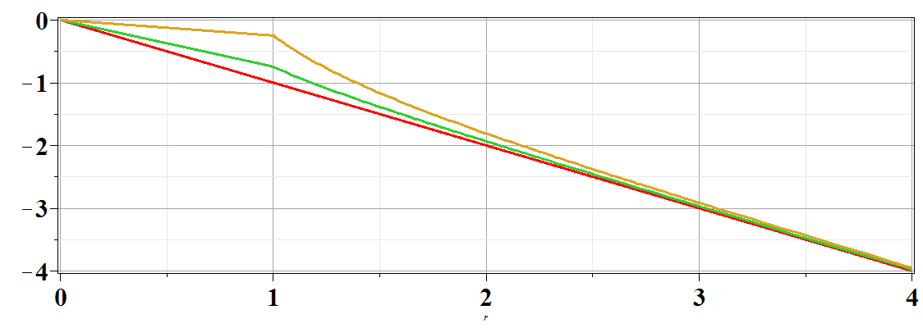
Boundary value problems in the presence of dielectrics – example -- continued:
Φ(r,θ=0)
ε/ε₀=
10
2
1
r/a

Slide 14
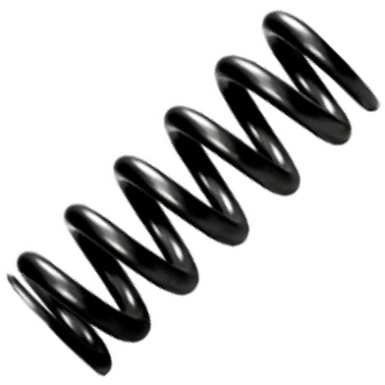
Microscopic origin of dipole moments
Polarizable atoms/molecules
Anisotropic charged molecules aligned in random directions
Polarizable systems
E=0
E
k=mω₀²
-q
+q
δx

Slide 15
Polarizable atoms/molecules – continued:
k=mω₀²
-q
+q
E
δx
Molecular susceptibility for this model:

Slide 16
For a neutral atom
E=0
E

Slide 17
Alignment of molecules with permanent dipoles p₀:
E
p₀
+
-
Molecular susceptibility for this model:

Slide 18
Now consider a superposition of dipoles in an electric field
E_{ext}
E_{dipole}
E_{ext}
E_{dipole}
E_{ext}
E_{dipole}

Slide 19
Field due to collection of induced dipoles
1
2
7
3
6
5
4
9
E_{ext}
8

Slide 20
Field due to collection of induced dipoles -- continued
2
1
7
3
5
6
4
9
E_{ext}
8
Averaging:

Slide 21
Field due to collection of induced dipoles -- continued

Slide 22
Field due to collection of induced dipoles -- continued
2
1
7
3
5
6
4
9
E_{ext}
8
Claussius-Mossotti equation

Slide 23
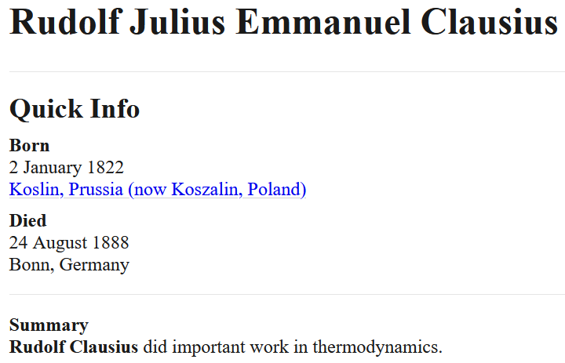
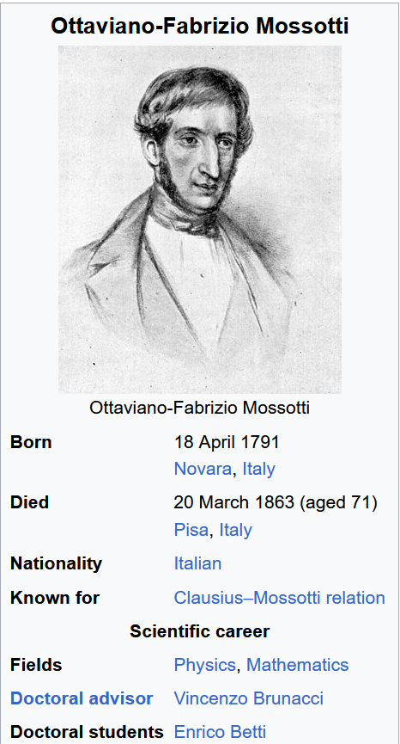
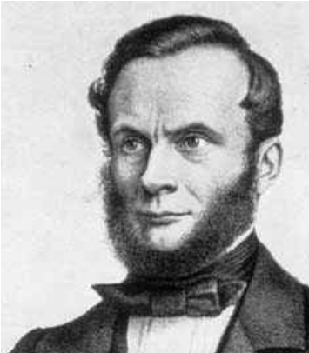

Slide 24
Example of the Clausius-Mossotti equation –
Pentane (C₅H₁₂) at various densities
Density (g/cm3) | Mol/m3 | ε/ε0 | 3V*(ε/ε0-1)/(ε/ε0+2)
0.613 | 5.12536E+27 | 1.82 | 1.25646E-28
0.701 | 5.86114E+27 | 1.96 | 1.24084E-28
0.796 | 6.65544E+27 | 2.12 | 1.22536E-28
0.865 | 7.23236E+27 | 2.24 | 1.2131E-28
0.907 | 7.58353E+27 | 2.33 | 1.2151E-28
γ_{mol} = 1.2 x 10⁻²⁸ m³= 0.12 nm³

Slide 25
Re-examination of electrostatic energy in dielectric media

Slide 26
Comment on the “Modern Theory of Polarization”
Some references:
R. D.King-Smith and D. Vanderbilt, Phys. Rev. B 47, 1651 (1993)
R. Resta, Rev. Mod. Physics 66, 699 (1994)
R. Resta, J. Phys. Condens. Matter 23, 123201 (2010)
N. A. Spaldin, J. Solid State Chem. 195, 2 (2012)
Note: In general P is highly dependent on the boundary values; often it is more convenient/meaningful to calculate ΔP.

Slide 27
Comment on the “Modern Theory of Polarization”
-- continued
Note: The concept of the polarization of a periodic solid is not unique:

Slide 28
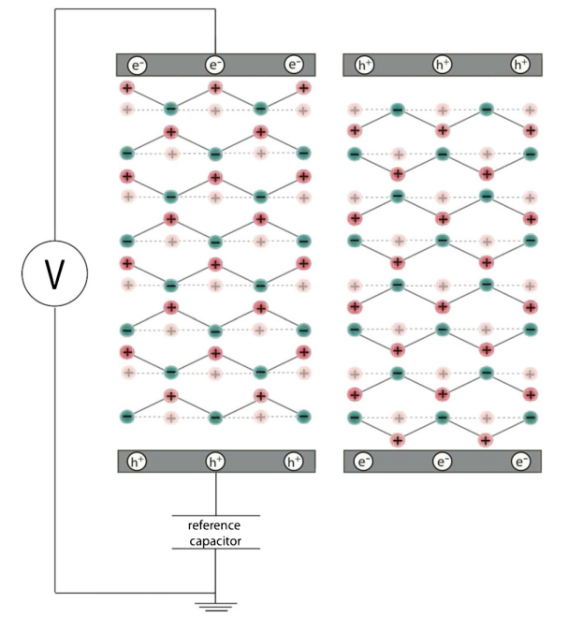
ΔP example

Slide 29
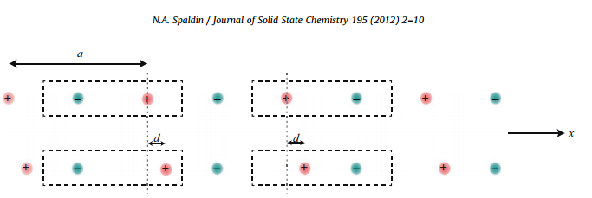
ΔP example -- linear visualization
Effects on the electronic distribution
Na
Cl

Slide 30
Summary of electrostatics – Chapter 1-4 in Jackson
By “statics” we mean that all properties are constant in time

