Slide 1
PHY 712 Electrodynamics
10-10:50 AM MWF in Olin 103
Class notes for Lecture 13:
Continue reading Chap. 5 – Sec. 5.6-5.7 in JDJ
Examples of magnetostatic fields
Magnetic dipoles
Hyperfine interaction

Slide 2
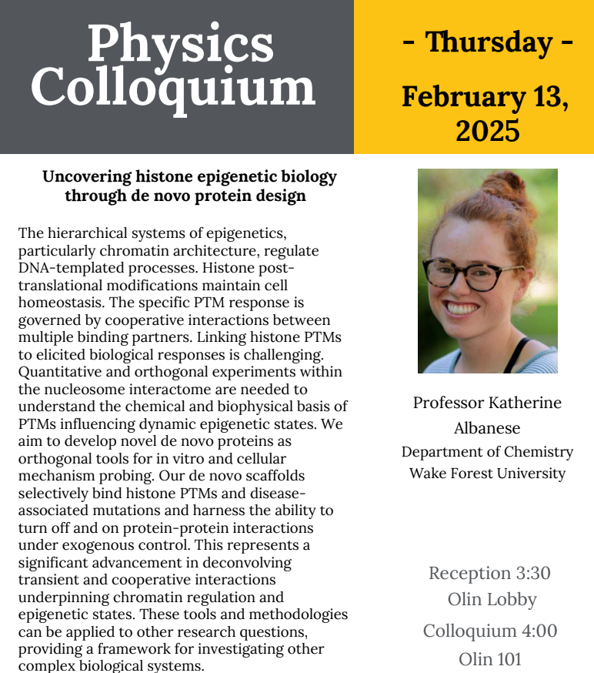

Slide 3
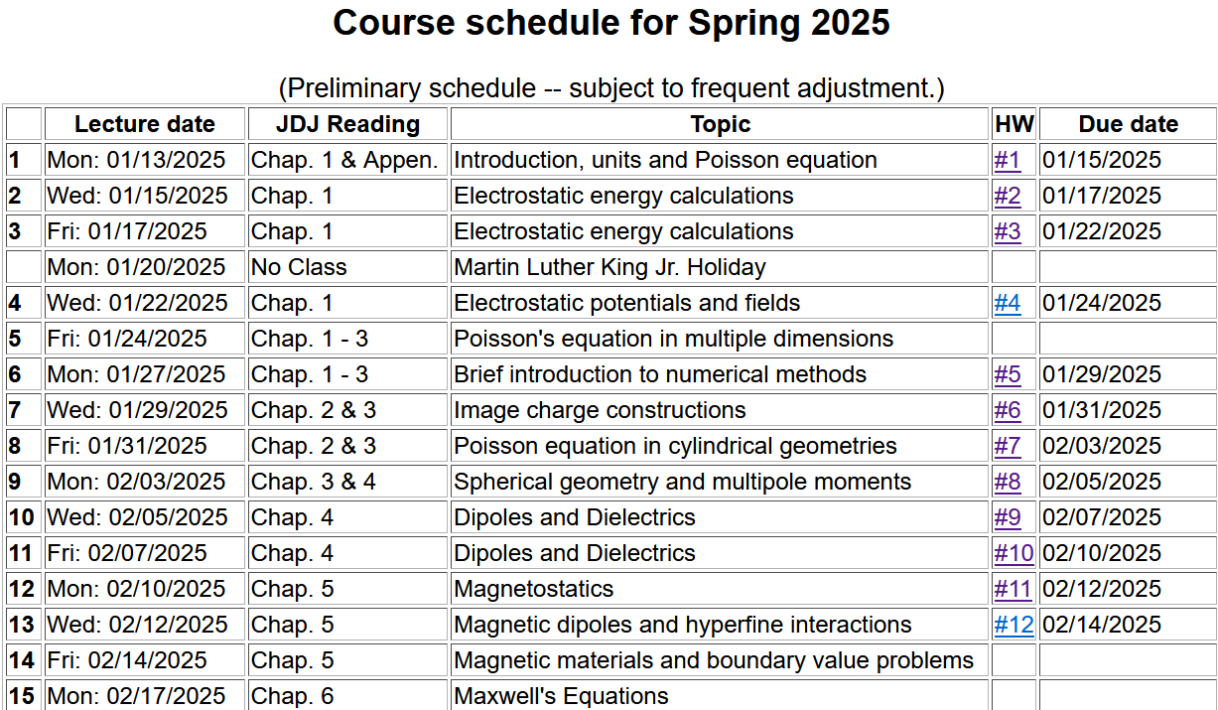

Slide 4
3

Slide 5
Comment about spherical polar coordinates
Ref: https://www.cpp.edu/~ajm/materials/delsph.pdf

Slide 7
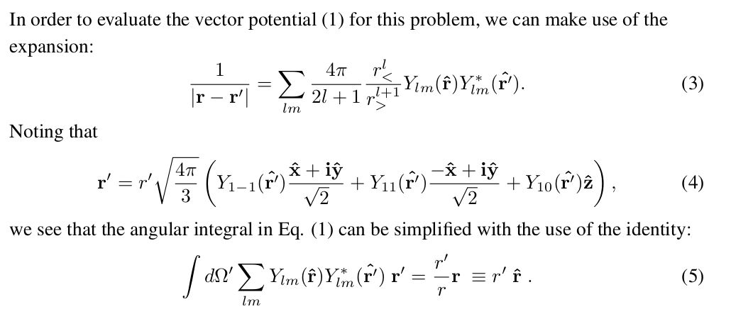
Note result given in “detailed” pdf file:

Slide 8
https://users.wfu.edu/natalie/s25phy712/lecturenote/

Slide 9
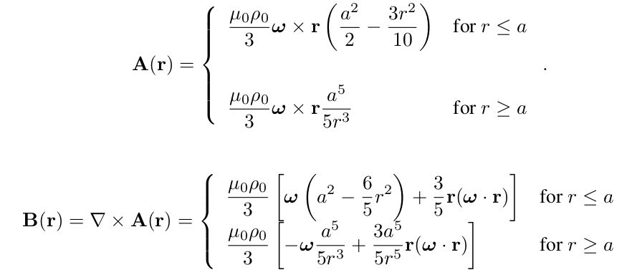
Example macroscopic localized current source --
For the model current density --

Slide 10
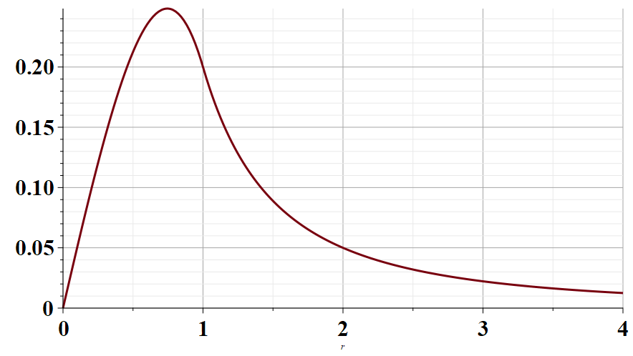
Radial part of A(r)
r/a →

Slide 11
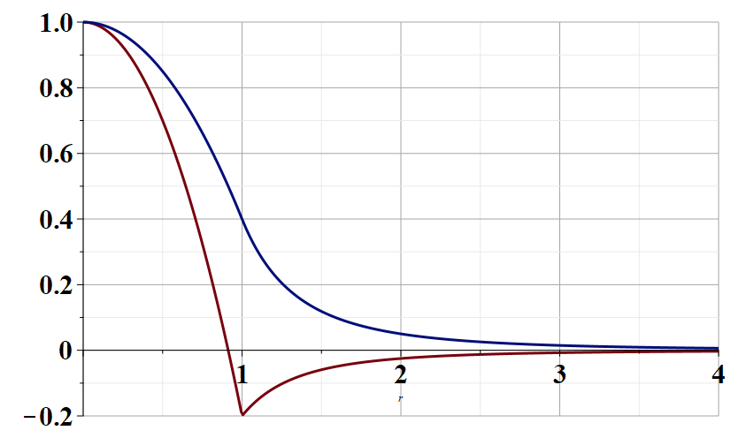
r parallel to B
Radial dependence of B(r)
r/a →
r perpendicular to B

Slide 12
Various forms of Ampere’s law :

Slide 13
Other examples of current density sources:

Slide 14
Details of the electron orbital magnetic dipole moment
Note that:

Slide 15
Significance of magnetic dipole – multipole approximation to vector potential and magnetic field

Slide 16
Note that the electron orbital magnetic dipole moment, discussed in previous slides, is only one example of magnetic dipoles found in nature.
Many particles – electrons, protons, neutrons, composite nuclei, … have “intrinsic” magnetic dipole moments. For these, we may not be able to calculate the magnetic dipole moment from the formula
,
but their moments can be measured, and they effect the fields and energies of the systems which contain them.

Slide 17
Summary of magnetic field generated by point magnetic dipole moment discussed in the detailed notes:

Slide 18
