Slide 1
PHY 712 Electrodynamics
10-10:50 AM in Olin 103
Notes for Lecture 18:
Continue reading Chapter 7 (Sec. 7.5,7.10 in JDJ)
Real and imaginary contributions to electromagnetic response
Frequency dependence of dielectric materials; Drude model
Kramers-Kronig relationships

Slide 2
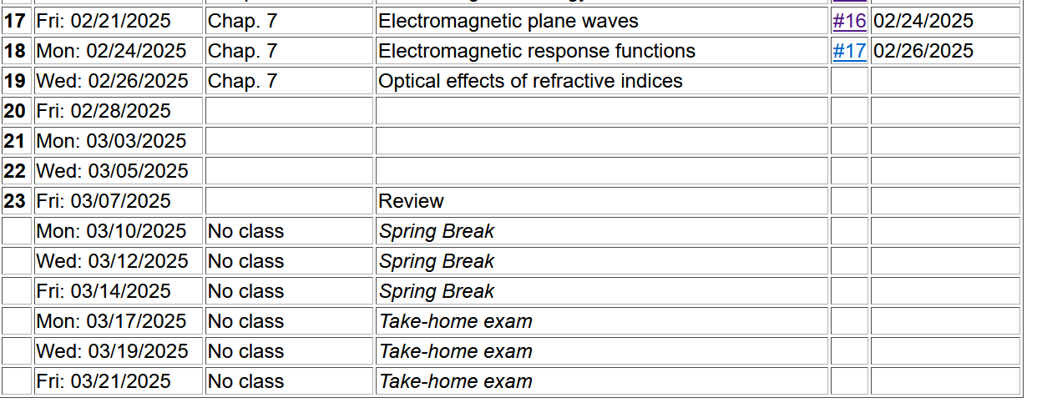

Slide 4
http://theor.jinr.ru/~kuzemsky/drudbio.html

Slide 5
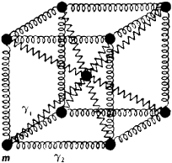
Drude model:
Vibration of particle of charge q and mass m near equilibrium:
δr
http://img.tfd.com/ggse/d6/gsed_0001_0012_0_img2972.png
Note that:
γ > 0 represents dissipation of energy.
ω₀ represents the natural frequency of the vibration; ω₀=0 would represent a free (unbound) particle
Note that this version of the model does not include consideration of any spatial variation.

Slide 6
Drude model:
Vibration of particle of charge q and mass m near equilibrium:
δr
http://img.tfd.com/ggse/d6/gsed_0001_0012_0_img2972.png

Slide 7
Drude model:
Vibration of particle of charge q and mass m near equilibrium:
δr
http://img.tfd.com/ggse/d6/gsed_0001_0012_0_img2972.png

Slide 8
Drude model:
Vibration of particle of charge q and mass m near equilibrium:
δr
http://img.tfd.com/ggse/d6/gsed_0001_0012_0_img2972.png

Slide 9
Drude model dielectric function:

Slide 10
Drude model dielectric function:

Slide 11
Drude model dielectric function – some analytic properties:

Slide 12
Drude model dielectric function – some analytic properties:

Slide 13
Analytic properties of the dielectric function (in the Drude model or from “first principles” -- Kramers-Kronig transform
Im(z)
α
Re(z)

Slide 14
Kramers-Kronig transform -- continued
Im(z)
α
Re(z)
=0

Slide 15
Kramers-Kronig transform -- continued

Slide 16
Kramers-Kronig transform -- continued

Slide 17
u
a u_{s} b

Slide 19
Analysis for Drude model dielectric function:

Slide 20
Analysis for Drude model dielectric function – continued --
Analytic properties:

Slide 22
Because of these analytic properties, Cauchy’s integral theorem results in:
Kramers-Kronig transform – for dielectric function:
Is this useful???

Slide 23
Further comments on analytic behavior of dielectric function

Slide 24
Further comments on analytic behavior of dielectric function

Slide 25
Some details

Slide 26
z_{P}

