Slide 1
PHY 712 Electrodynamics
10-10:50 AM in Olin 103
Discussion for Lecture 19:
Complete reading of Chapter 7 (Sec. 7.1-7.5, 7.10)
Additional results of Drude model of permittivity in materials
Summary of complex response functions for electromagnetic fields
Comment on spectral properties of electromagnetic waves

Slide 2
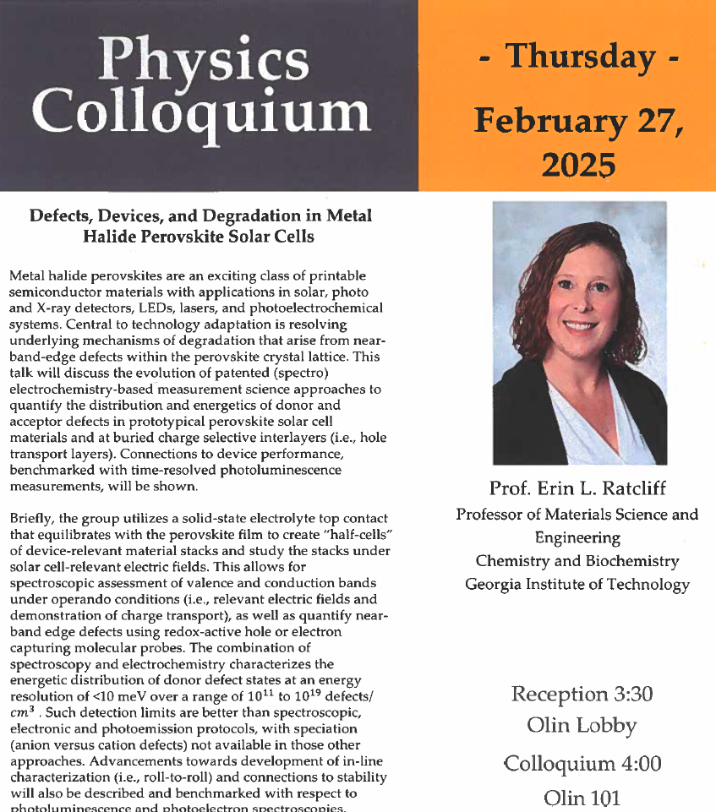
4 PM Olin 101

Slide 3
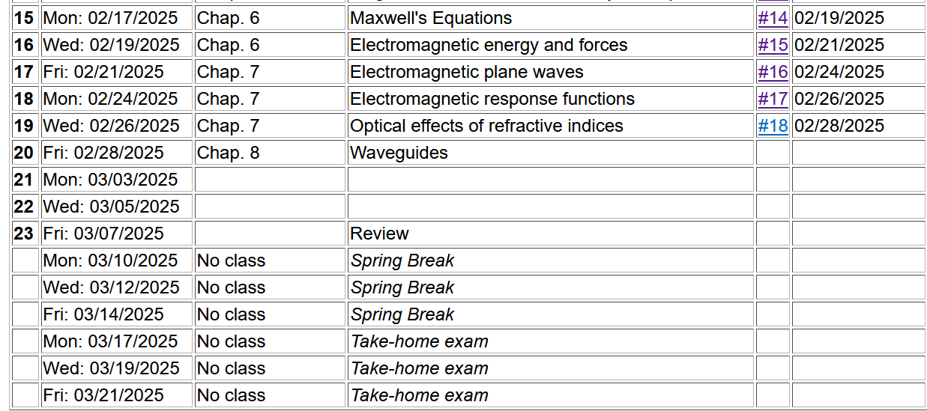

Slide 4
More results for Drude model dielectric function:

Slide 5
Analysis for Drude model dielectric function – continued --
Analytic properties:

Slide 7
Because of these analytic properties, Cauchy’s integral theorem results in:
Kramers-Kronig transform – for dielectric function:

Slide 8
Further comments on analytic behavior of dielectric function

Slide 9
Further comments on analytic behavior of dielectric function

Slide 10
Some details

Slide 11
z_{P}

Slide 13
Review of Fresnel equations --
Electromagnetic plane waves in isotropic medium with linear and real permeability and permittivity: μ ε.
Note that special care is needed when these quantities are complex.

Slide 14
Some comments on the Fresnel Equations
Different behaviors of s and p polarization
Brewster’s angle
Total internal reflection

Slide 15
Review:
Reflection and refraction of plane electromagnetic waves at a plane interface between dielectrics (assumed to be lossless)
μ’ ε’
k’
θ
μ ε
k_{R}
k_{i}
i
R

Slide 16
Review:
Reflection and refraction between two isotropic media
μ’ ε’
θ
k’
μ ε
k_{i}
k_{R}
i
R

Slide 17
For s-polarization (E perpendicular to plane of incidence)
For p-polarization (E in plane of incidence)

Slide 18
Special case: normal incidence (i=0, θ=0)
PHY 712 Spring 2013 -- Lecture 19
18

Slide 19
Fresnel equations for reflectivity in general --
Reflectance for s-polarization
Reflectance for p-polarization

Slide 20
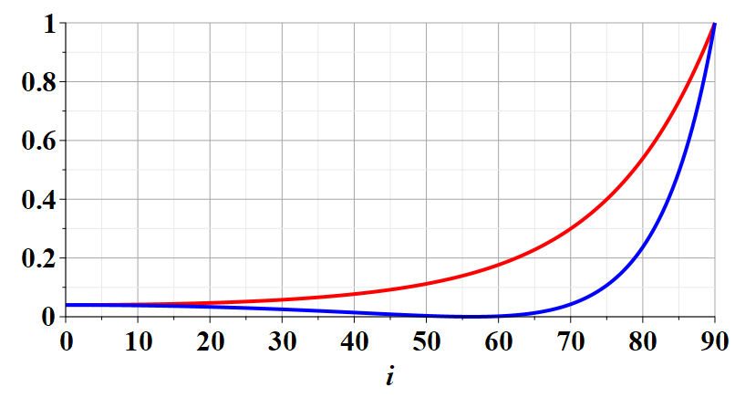
s-polarization
p-polarization
i

Slide 21
Analysis --
Reflectance for s-polarization
Reflectance for p-polarization

Slide 22
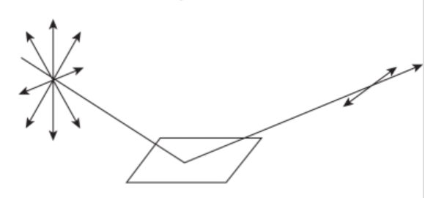
n=1
surface normal
k_{i}
k_{R}
i
n’>1
Polarization due to reflection from a refracting surface

Slide 23
Reflection and refraction between two isotropic media -- continued
μ’ ε’
θ
k’
μ ε
k_{i}
k_{R}
i
R
Total internal reflection:
For i > i₀

Slide 24
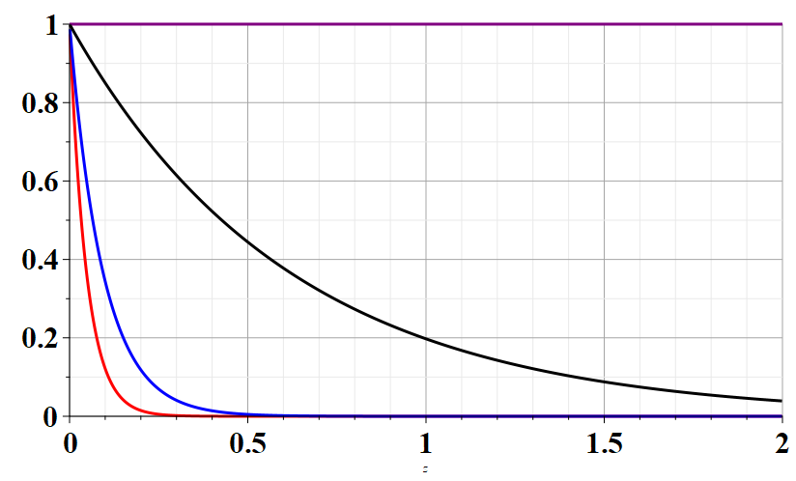
Example of total internal reflection
n’=1 and n=1.5 ➔ i₀ = sin⁻¹(1/1.5)=41.8103148º
i=i₀
Relative transmitted intensity
i=42º
i=50º
i=90º
z/λ
Transmitted illumination confined within a few wavelengths of the surface.

Slide 25
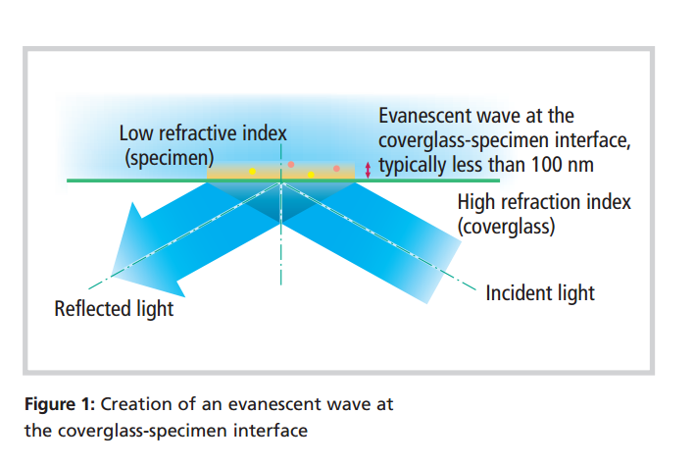
TIRF (total internal reflection fluorescence)
www.nikon.com/products/microscope-solutions/bioscience.../nikon_note_10_lr.pdf

Slide 26
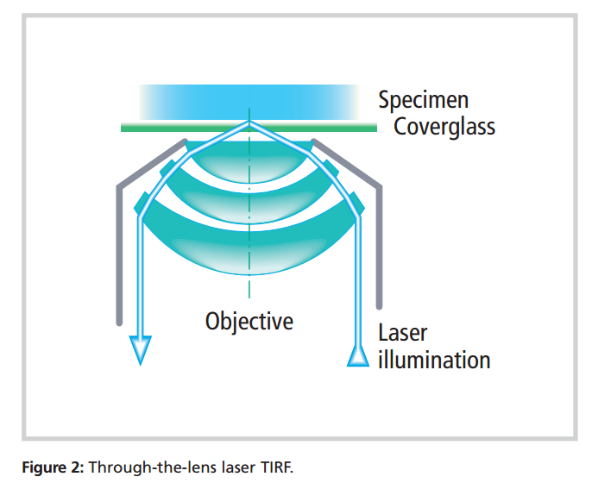
Design of TIRF device using laser and high power lens

Slide 27
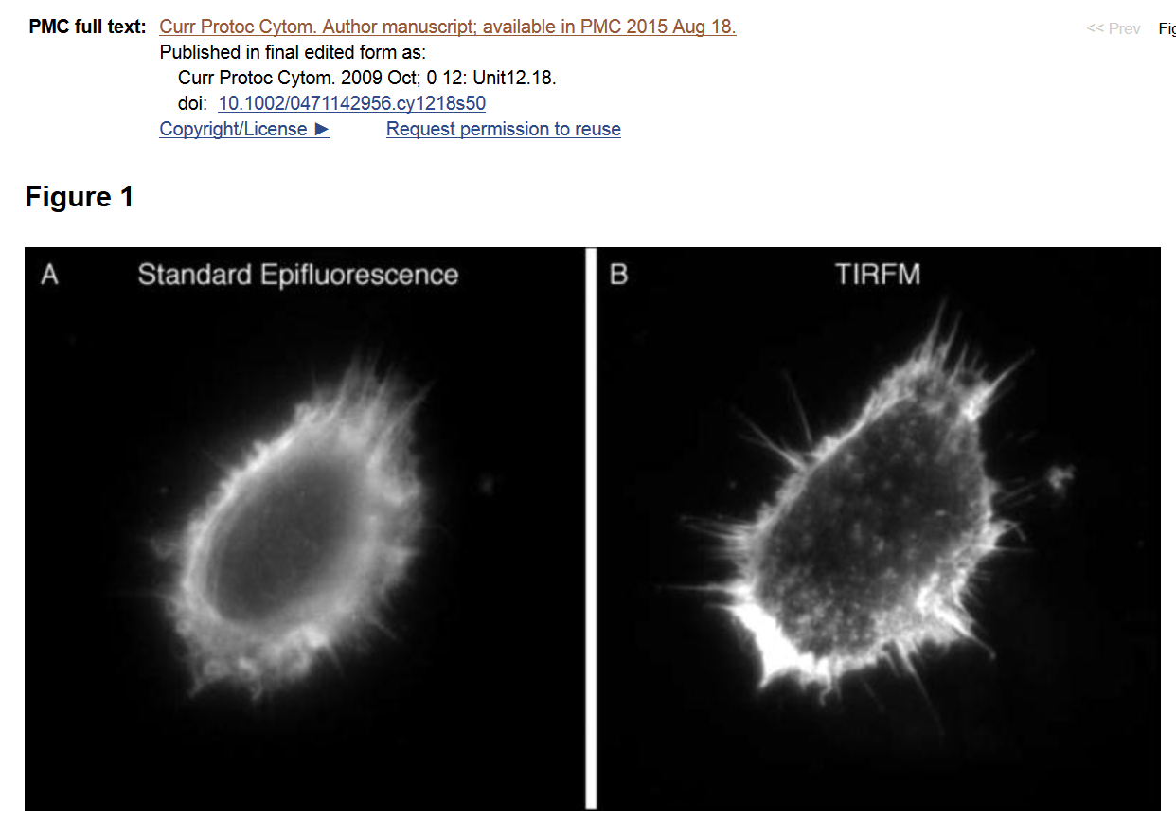

Slide 28
Extension to complex refractive index n= n_{R} + i n_{I}
The general Fresnel equations can be similarly adapted for complex refractive indices.

Slide 29
Origin of imaginary contributions to permittivity --
Review: Drude model dielectric function:

Slide 30
Drude model dielectric function:

Slide 31
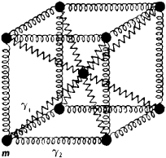
Extensions of the Drude model for lattice vibrations
In principle, the ideas of the Drude model apply both to the ionic vibrations which occur at low frequency (~10¹² Hz) contributing to the so called static permittivity function ε_{s} and to the electronic vibrations which occur at high frequency (~10¹⁵ Hz) contributing to the so called high frequency permittivity function ε∞.
δr

Slide 32
In terms of the Drude model form:

Slide 33
Comment: The Drude model allows us to “derive”:
Kramers-Kronig transform – for dielectric function:
Practical applications -- It is often possible/more convenient to calculate the imaginary response and use KK to deduce the real response or visa versa.

Slide 34
Analysis of Maxwell’s equations without sources -- continued:
E₀
B₀
k

Slide 35
Transverse electric and magnetic waves (TEM)
TEM modes describe electromagnetic waves in lossless media and vacuum
E₀
B₀
For real
ε, μ, n, k
k

Slide 36
Effects of complex dielectric; fields near the surface on an ideal conductor

Slide 37
Some details:

Slide 38
Fields near the surface on an ideal conductor -- continued

Slide 39
Some representative values of skin depth
Ref: Lorrain and Corson
 | σ (10⁷ S/m) | μ/μ₀ | δ (0.001m) at 60 Hz | δ (0.001m) at 1 MHz
Al | 3.54 | 1 | 10.9 | 84.6
Cu | 5.80 | 1 | 8.5 | 66.1
Fe | 1.00 | 100 | 1.0 | 10.0
Mumetal | 0.16 | 2000 | 0.4 | 3.0
Zn | 1.86 | 1 | 15.1 | 117

Slide 40
Relative energies associated with field

Slide 41
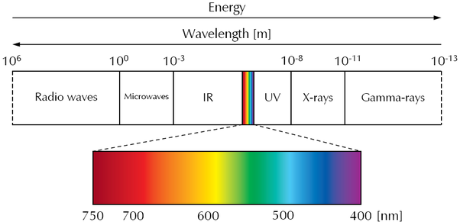
Various wavelengths λ --

Slide 42
General relationships

