Slide 1
PHY 712 Electrodynamics
10-10:50 AM MWF Olin 103
Notes for Lecture 1:
Reading: Appendix 1 and Chapters I&1
Course structure and expectations
Units – SI vs Gaussian
Electrostatics – Poisson equation
Notes:
Welcome to Electrodynamics. In this lecture we will discuss the course structure and jump right into Chapters I (introduction) and 1 (electrostatics).

Slide 2
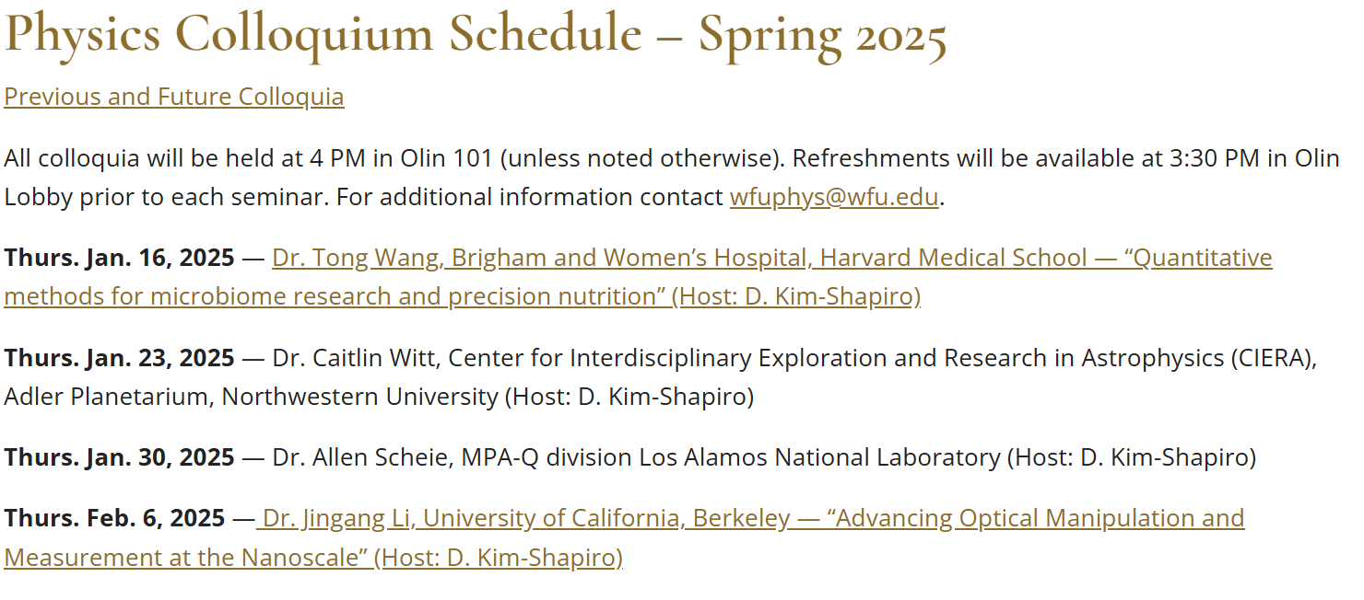
Comment on upcoming physics colloquia –
https://physics.wfu.edu/wfu-phy-news/colloquium/seminar-spring-2025/

Slide 3
4 PM Olin 101

Slide 4
If the posted “Office hours” are not convenient to your
Schedule, NAWH is happy to meet with you at other times.
Please send email to natalie@wfu.edu to set up a mutually
convenient schedule.

Slide 5
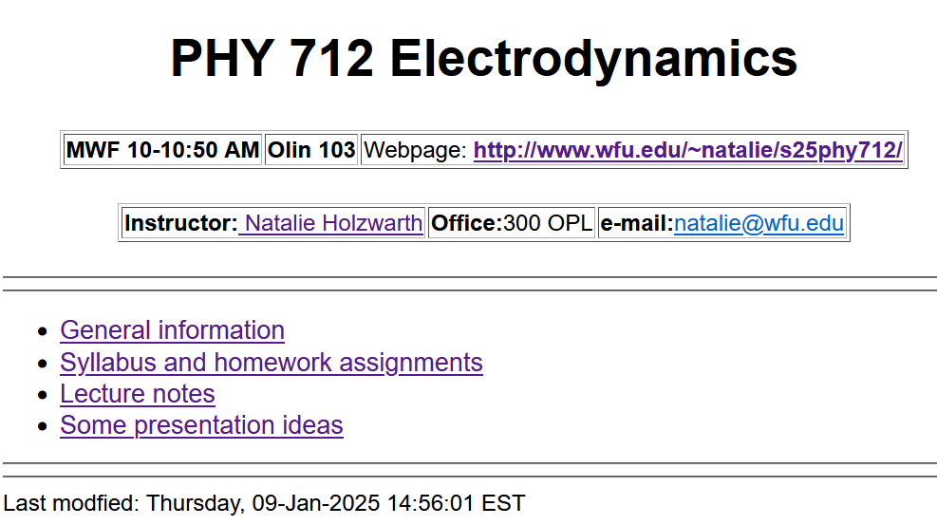
http://users.wfu.edu/natalie/s25phy712/
Notes:
Back to our regularly scheduled program. Our webpage is set up and is the source of all information about the course.

Slide 6
Optional supplements
Textbook
Third edition
Notes:
The text book is the 3rd addition of the classic textbook by John David Jackson. (Please note that you will need the 3rd edition in order to follow the lectures.) Some of you may want another (perhaps less mathematically focused) and will find that the textbook by Andrew Zangwill to be helpful. Personally, I find that Jackson’s text has served me well to understand the basics of electrodynamics.

Slide 7
http://users.wfu.edu/natalie/s25phy712/info
Notes:
Information about the course structure is on our web page. The structure of the course is very much like the structure we used last semester for PHY 711. We want to focus class time on discussing your questions. Please prepare at least one question 3 hours before (preferably the night before) each class. We will use your questions as well as spontaneous questions to form the basis of the class discussions. Again, there will typically be one homework per class, nominally due the day of the next class meeting.

Slide 8
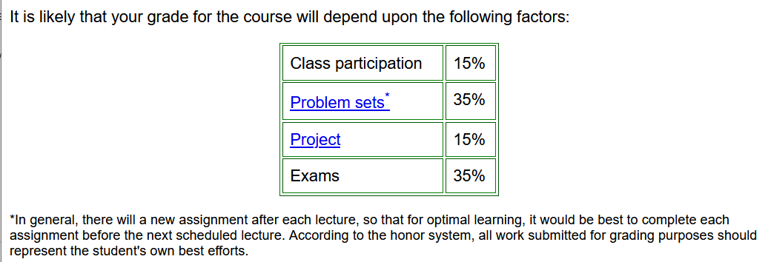
➔ Email your questions >= 1 hour before each class, schedule weekly one-on-one meetings, and/or attend office hours
Notes:
This is the expected grade distribution. Last semester the weekly one-on-one meetings seemed to be mostly productive, particularly for improving the completely online format. We will try to continue this during the spring semester. I need information from you to set up the appropriate timing.

Slide 9
Today’s questions from Paoblo:
I am not sure how to link the definition for Gauss' Law for continuum distributions and for discrete charge distributions. Is it possible to write the continuum definition such that it simplifies to the discrete one? Maybe using delta functions? Same question would apply for the superposition of electric fields. If we had a discrete system which can initially be modeled as continuous, how would the distribution function be rewritten as we randomly took out particles from the system? Also, looking at Gauss' differential form, for a point charge, it would suggest that it "dilutes" inside the Gaussian surface, it works for Gauss' Law but is not correct. How should I interpret this?
Some short (incomplete) answers – The discrete and continuous formulations have to be equivalent. In today’s lecture, some details – such as boundary values have been omitted.

Slide 10
Notes:
This semester we will also have individual projects due at the end of the semester. Here is a list from last year. During the course, please keep your eye out for topics that interest you worthy of your extra attention.

Slide 11
http://users.wfu.edu/natalie/s25phy712/homework/
H:
There will be a grade penalty for late homework
Notes:
The class schedule is available on the webpage and except for today’s lecture topic, subject to change. (The schedule is based on the topics we covered last year.)

Slide 12
Notes:
This is a “warm up” problem to review energy units for an electrostatic interaction.

Slide 13
https://physics.nist.gov/cuu/Constants/

Slide 15
Tentative additional information –
Spring break March 10-14
Mid term grades due March 10 (based on HW only)
Take-home mid-term exam March 17-21 (no class)
Mon Apr 28 – Last day of class
May 1-7 – Final exams
Notes:
.

Slide 16
Remember to check your algebraic manipulation software --
https://software.wfu.edu/audience/students/
Notes:
It is expected that some of your homework will need to use algebraic manipulation software such as Maple or Mathematica which are available at the website mentioned above.

Slide 17
Material discussed in Appendix of textbook --
Notes:
Now for some discussion of our favorite topic. First we need to be clear about units. In general, the standard unit system is “SI”. The appendix discusses alternative unit systems found in the literature and IN THE SECOND HALF OF THIS TEXTBOOK!!!!! While for mechanics this is not such a big deal, for E & M it causes great pain and suffering.

Slide 18
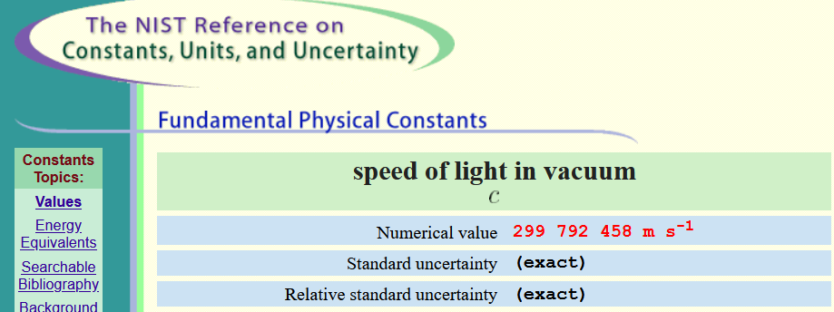

Slide 19
Notes:
Here are some relationships between the two unit systems used in this text.

Slide 20
m/s²
cm/s²
Notes:
More about units

Slide 21
Notes:
More about units. Note that while SI units are the current “standard”, many papers in the literature and older textbooks use other unit systems.

Slide 22
As we will see throughout the course, the E and B fields represent the basic electric and magnetic fields while the other fields include electric and magnetic effects of matter.
Notes:
More about units. Note that while SI units are the current “standard”, many papers in the literature and older textbooks use other unit systems.

Slide 23
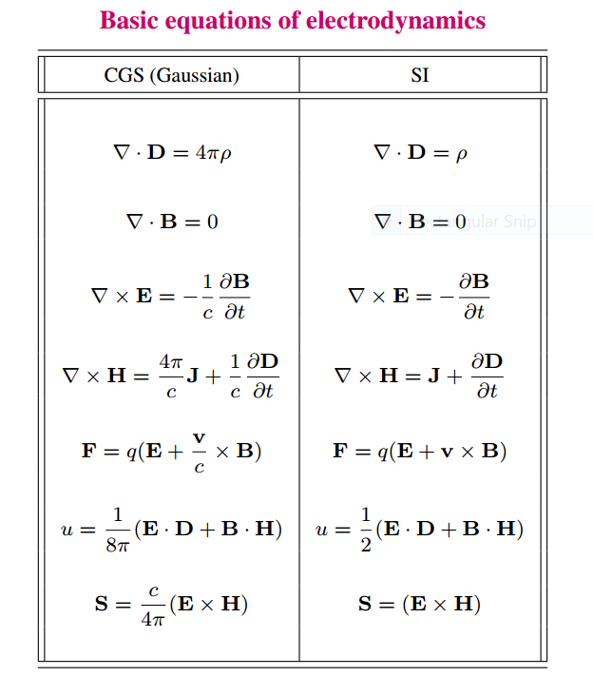
Notes:
Maxwell’s equations and other relationships that we will see during this course in the two different unit systems.

Slide 24
Units choice for this course:
SI units for Jackson in Chapters 1-10
Gaussian units for Jackson in Chapters 11-16
Electrostatics
q₂
q₁
q₃
q₄
Notes:
Starting review of electrostatics both for a discrete collection of charges and for a continuous distribution of charge.

Slide 25
Electrostatics
Discrete versus continuous charge distributions
Notes:
Note that we can use a Dirac delta function to express discrete charges in terms of a distribution. The digression lists some useful relationships for various coordinate systems.

Slide 26
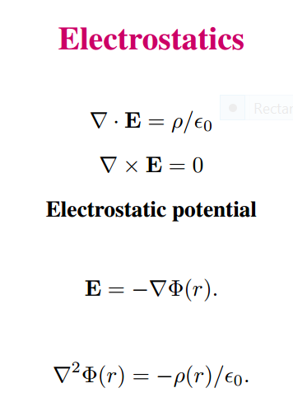
Differential equations --
Notes:
In addition to the integral relationships, electrostatics can also be expressed in terms of differential forms. Mathematically, the electrostatic potential is a convenient form in which to analyze electrostatic systems.

Slide 27
Relationship between integral and differential forms of electrostatics --
Notes:
Comparison of differential and integral relationships.

Slide 28
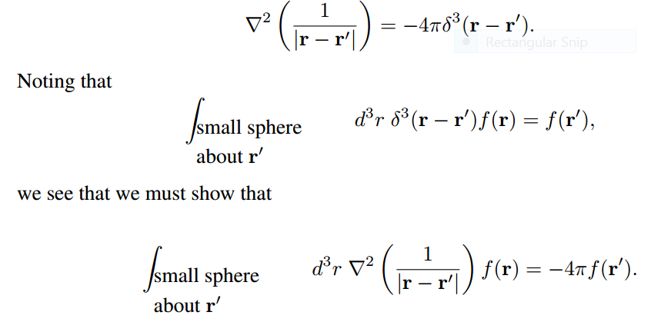
Relationship between integral and differential forms of electrostatics --
Need to show:
Notes:
The identity of the differential and integral forms follows from the singular behavior of the Coulomb kernel expressed on the top line. We need to “prove” this identity.

Slide 29
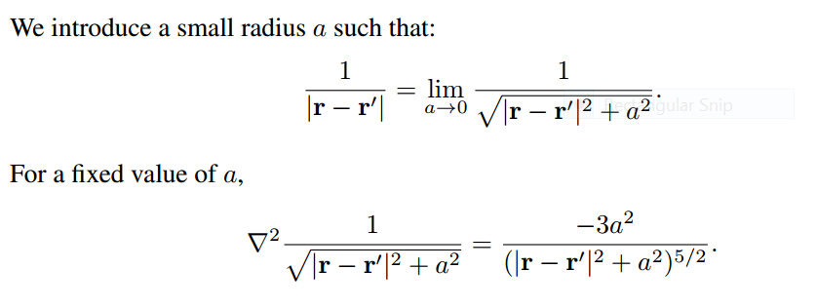
Notes:
Proof using the limit of an expression for a→0.

Slide 30
Notes:
Analytic results for finite a.

Slide 31
➔
➔
Notes:
From analytic result, evaluate for fixed R and a→0. Find that the result is independent of R and the identity is found to be justified.

Slide 32
Memorable identity

