Slide 1
PHY 712 Electrodynamics
10-10:50 AM in Olin 103
Notes for Lecture 20:
Wave Guides - Chap. 8 (Sec. 8.1-8.4 in JDJ)
TEM, TE, and TM modes of electromagnetic waves
Justification for boundary conditions; behavior of waves near conducting surfaces
Rectangular waveguide

Slide 2
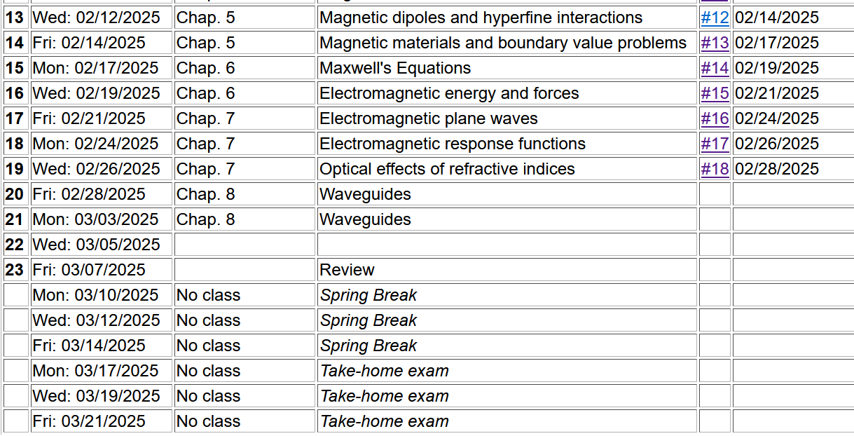
No HW assignment for Monday, but it would be good to start thinking about your presentation topics.

Slide 4
Maxwell’s equations

Slide 5
Analysis of Maxwell’s equations without sources -- continued:

Slide 6
Analysis of Maxwell’s equations without sources -- continued:
Both E and B fields are solutions to a wave equation:

Slide 7
Analysis of Maxwell’s equations without sources -- continued:
Note: ε, μ, n, k can all be complex; for the moment we will assume that they are all real (no dissipation).
For real
ε, μ, n, k

Slide 8
Analysis of Maxwell’s equations without sources -- continued:
E₀
B₀
k

Slide 9
Transverse electric and magnetic waves (TEM)
TEM modes describe electromagnetic waves in lossless media and vacuum
E₀
B₀
For real
ε, μ, n, k
k
Note that linear combinations of TEM modes are also TEM.

Slide 10
Effects of complex dielectric; fields near the surface on an ideal conductor

Slide 11
Some details:

Slide 12
Fields near the surface on an ideal conductor -- continued
“skin depth”

Slide 13
Some representative values of skin depth
Ref: Lorrain² and Corson
 | σ (10⁷ S/m) | μ/μ₀ | δ (0.001m) at 60 Hz | δ (0.001m) at 1 MHz
Al | 3.54 | 1 | 10.9 | 84.6
Cu | 5.80 | 1 | 8.5 | 66.1
Fe | 1.00 | 100 | 1.0 | 10.0
Mumetal | 0.16 | 2000 | 0.4 | 3.0
Zn | 1.86 | 1 | 15.1 | 117

Slide 14
Relative energies associated with field

Slide 15
Fields near the surface on an ideal conductor -- continued
r||
0
z

Slide 16
Fields near the surface on an ideal conductor -- continued
(Note that we are assuming no extra charges or currents beyond material responses via ε,σ,μ.)
r||
0
z

Slide 17
Boundary values for ideal conductor
At the boundary of an ideal conductor, the E and H fields decay in the direction normal to the interface.
H₀
E₀

Slide 18
Wave guides – dielectric media with one or more metal boundary
Continuity conditions for fields near metal boundaries --
E
H
Waveguide terminology
TEM: transverse electric and magnetic (both E and H fields are perpendicular to wave propagation direction)
TM: transverse magnetic (H field is perpendicular to wave propagation direction)
TE: transverse electric (E field is perpendicular to wave propagation direction)

Slide 19
Analysis of rectangular waveguide
Boundary conditions at surface of waveguide:
E_{tangential}=0, B_{normal}=0
y
x
z
Cross section view
b
a

Slide 20
Analysis of rectangular waveguide
y
x
z

Slide 21
Solution of Maxwell’s equations within the pipe:
F = E or H
propagation along z.

Slide 22
Maxwell’s equations within the pipe in terms of all 6 components:

Slide 23
TE modes for rectangular wave guide continued:

Slide 24
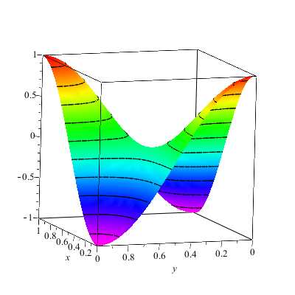
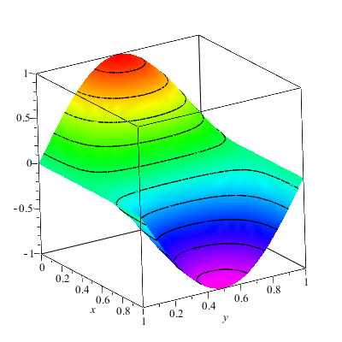
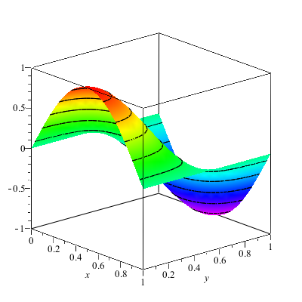
Solution for m=n=1

Slide 25
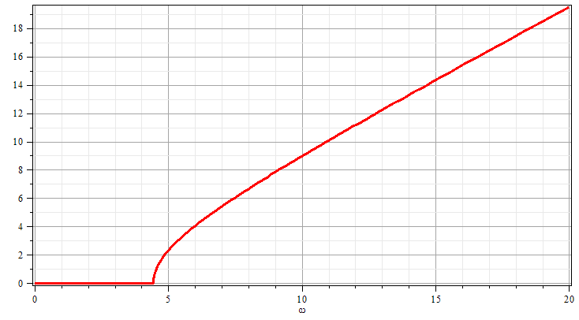
Solution for m=n=1
k
ω

Slide 26
Solution for m=n=1 -- more details
(direction along the wave guide)

