Slide 1
PHY 712 Electrodynamics
10-10:50 AM in Olin 103
Notes for Lecture 21:
Propagating EM waves in optical waveguides and cavities
Chap. 8 in Jackson –
Review of rectangular waveguides
Optical cavitites
Cylindrical waveguides
Coaxial cables

Slide 2
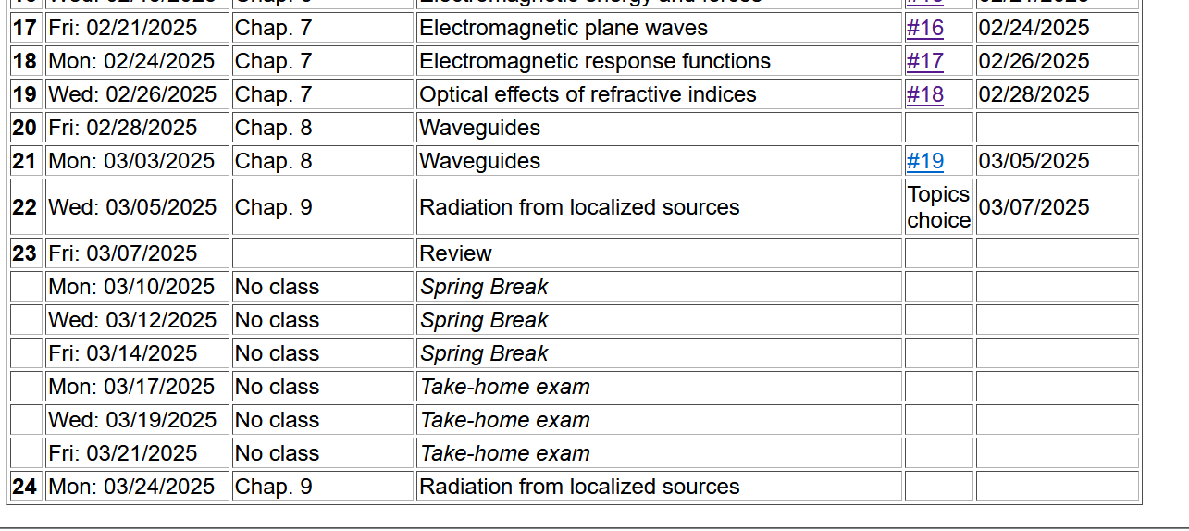

Slide 3
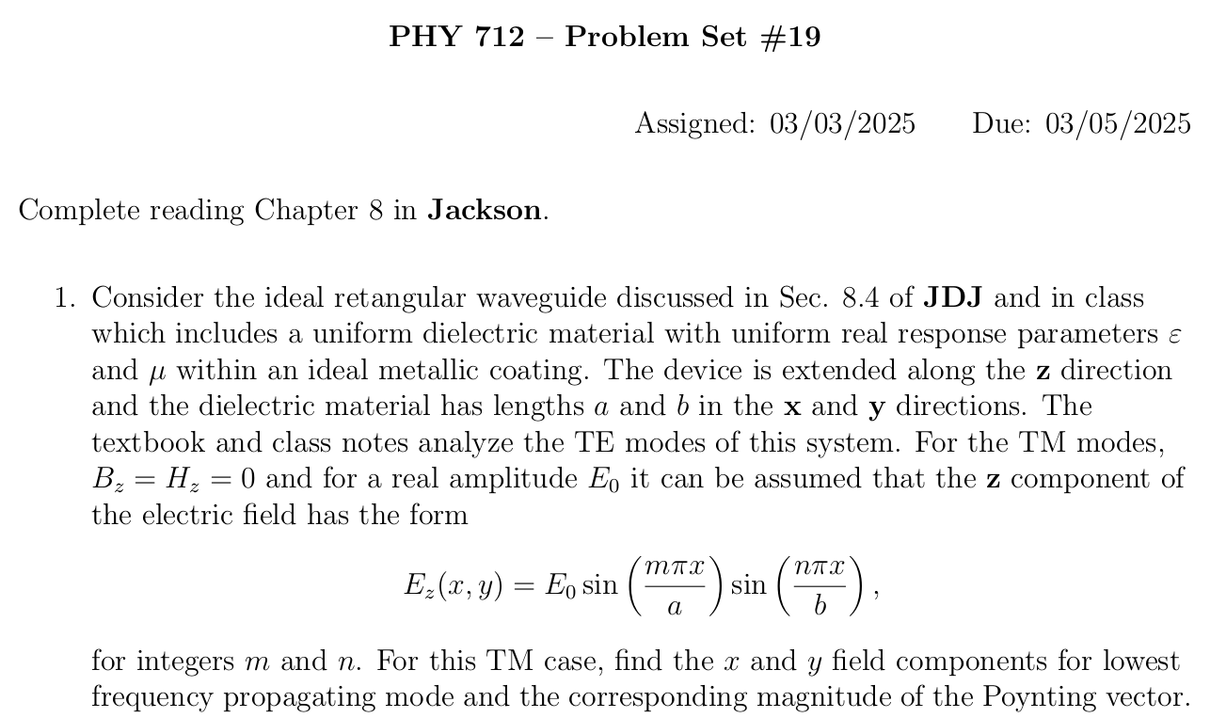

Slide 4
Review of waveguides
Note that, JDJ and these lecture notes focus on waveguides and cavities based on devices with ideal metal boundaries and real dielectric interiors. There are many other possibilities.

Slide 5
Boundary values of EM fields near the surface
of an ideal conductor
At the boundary of an ideal conductor, the E and H fields decay in the direction normal to the interface.
➔These properties control the forms of EM waves that can exist close to these boundaries
H₀
E₀

Slide 6
Wave guides – dielectric media with one or more metal boundary
Continuity conditions for fields near metal boundaries --
E
H
Waveguide terminology
TEM: transverse electric and magnetic (both E and H fields are perpendicular to wave propagation direction)
TM: transverse magnetic (H field is perpendicular to wave propagation direction)
TE: transverse electric (E field is perpendicular to wave propagation direction)

Slide 7
Analysis of rectangular waveguide
Boundary conditions at surface of waveguide:
E_{tangential}=0, B_{normal}=0
y
x
z
Cross section view
b
a

Slide 8
Analysis of rectangular waveguide
y
x
z

Slide 9
Solution of Maxwell’s equations within the pipe:
F = E or B
propagation along z.

Slide 10
Maxwell’s equations within the pipe in terms of all 6 components:

Slide 11
TE modes for rectangular wave guide continued:

Slide 12
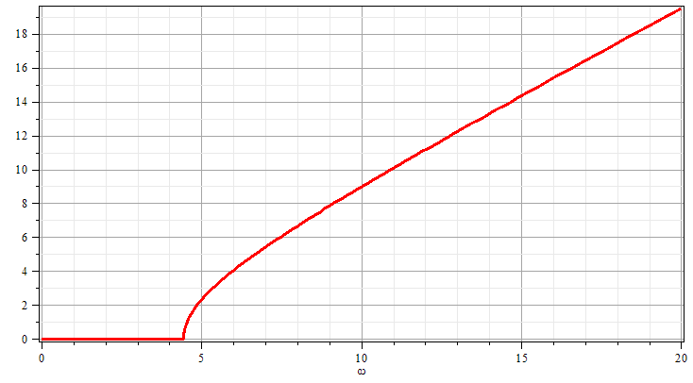
k
Solution for m=n=1
ω

Slide 14
Now consider the case of a rectangular box bounded by an ideal conductor --
Resonant cavity
y
x
z
Propagating wave form becomes a standing wave along z.

Slide 15
Resonant cavity
y
x
z
15

Slide 16
Now consider the case of a rectangular box bounded by an ideal conductor --
Resonant cavity
y
x
z

Slide 17
For example --
Typically, microwave oven use frequencies of 2.45 GHz and the wavelength is ~12 cm
Resources online: https://www.sfu.ca/phys/346/121/resources/physics_of_microwave_ovens.pdf
https://impi.org/wp-content/uploads/2019/09/History-MW-ovens.pdf
Other info on waveguides for fiber optics –
https://www.thefoa.org/tech/wavelength.htm

Slide 18
Other geometries -- a simple cylindrical waveguide
r
z
For the rectangular geometry, Maxwell’s equations within the pipe:

Slide 19
Simple cylindrical waveguide -- continued
r
z
For the cylindrical geometry, Maxwell’s equations within the pipe:

Slide 20
Simple cylindrical waveguide
r
z

Slide 21
Simple cylindrical waveguide -- continued

Slide 22
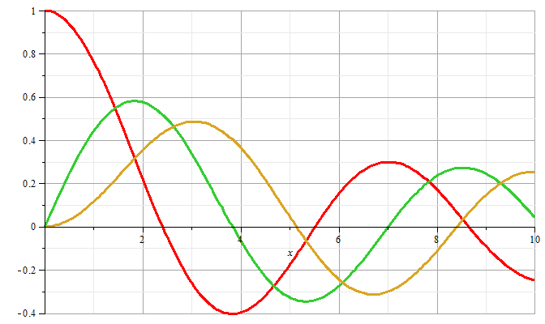
m=0
m=1
m=2
Locations of zeroes of Bessel functions x_{nm}

Slide 23
r
z

Slide 24
Note that in the examples with the “simple” waveguide, having a single outer metallic boundary, TE or TM modes can be produced.
For a more complicated design, it is possible to have TEM modes --

Slide 25
Wave guides – dielectric media with one or more metal boundary
Coaxial cable
TEM modes
Simple optical pipe
TE or TM modes
k
k
E
H
Waveguide terminology
TEM: transverse electric and magnetic (both E and H fields are perpendicular to wave propagation direction)
TM: transverse magnetic (H field is perpendicular to wave propagation direction)
TE: transverse electric (E field is perpendicular to wave propagation direction)

Slide 26
Wave guides
Top view:
z
μ ε
Inside medium, μ ε assumed to be real
a
b
Coaxial cable
TEM modes
(following problem 8.2 in Jackson’s text)

Slide 27
Electromagnetic waves in a coaxial cable -- continued
Top view:
μ ε
ρ
a
φ
b

Slide 28
Electromagnetic waves in a coaxial cable -- continued
Top view:
μ ε
ρ
a
φ
b

