Slide 1
PHY 712 Electrodynamics
10-10:50 AM MWF Olin 103
Notes on Lecture 24:
Radiation from time harmonic sources
Chap. 9 (Sec. 9.1-9.4)
Discussion of course schedule
Review of Lecture 22 – radiation from time harmonic localized microscopic sources
Radiation from time harmonic macroscopic sources

Slide 2
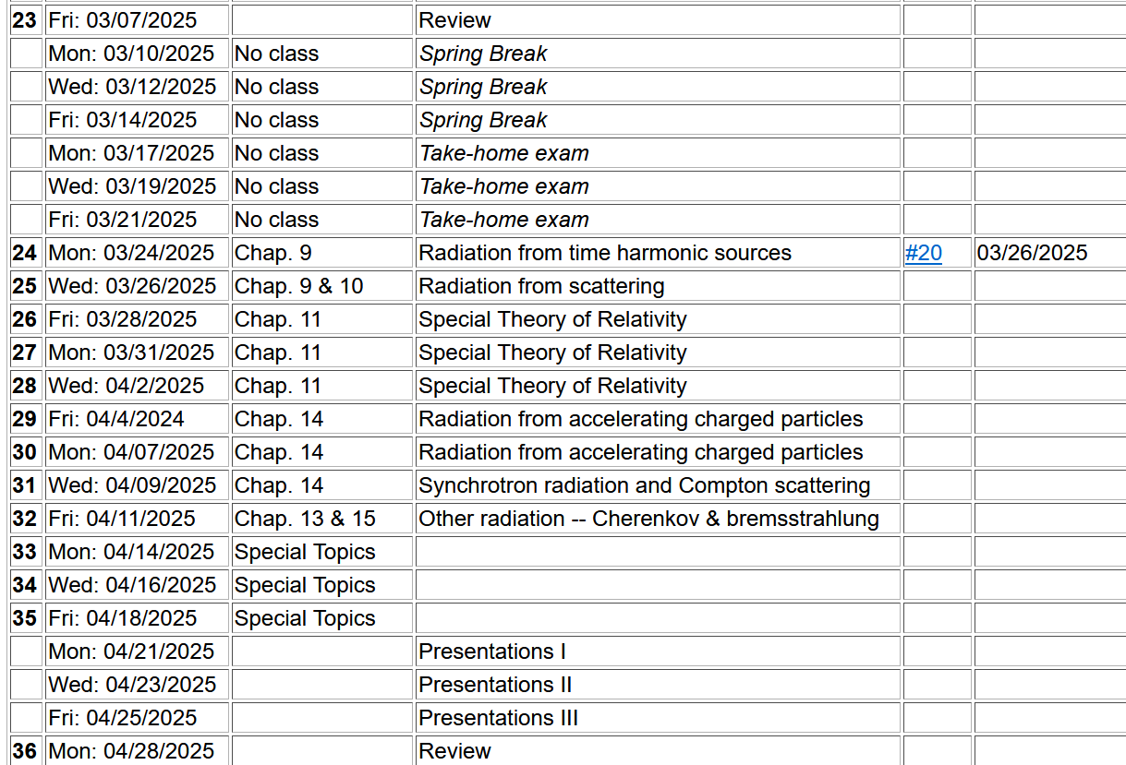
Tentative schedule for PHY 712

Slide 3
Questions for discussion –
Preferences for presentations
3 presentations/day for 2 days
2 presentations/day for 3 days
Timing of presentations
Last full week of classes
Earlier?
Other?

Slide 4
Homework assignment from this lecture

Slide 5
Review --
Maxwell’s equations
Notes:
Since Maxwell’s equations were introduced and used in Chapters 6-8, we have focused on the properties of the fields themselves. Now we will begin to study how these fields are produced by particular sources. The sources that we will consider are harmonic in time and their spatial form (considered to be localized in space) is represented by a multiplicative factor. More generally, we are considering one component in the Fourier transform for the source function. The results are quite different from the Liénard-Wiechert potentials discussed a few weeks ago. In this slide, Maxwell’s equations are presented for the case that the sources are completely represented by the charge and current densities.

Slide 6
Formulation of Maxwell’s equations in terms of vector and scalar potentials
Notes:
It is convenient to express the coupled vector fields in terms of the scalar and vector potentials as we have discussed previously.

Slide 7
Formulation of Maxwell’s equations in terms of vector and scalar potentials -- continued
Complicated coupled mess!

Slide 8
Formulation of Maxwell’s equations in terms of vector and scalar potentials -- continued
This choice decouples the equations for the scalar and vector potentials.
Notes:
We will focus our attention on the Lorentz Gauge representations. In this case, the scalar potential and each of the three Cartesian components of the vector potential have an inhomogeneous differential equation to solve.

Slide 9
Solution of Maxwell’s equations in the Lorenz gauge -- continued
Notes:
For a spatially localized source, the physically meaningful solution can be written as an integral over the source time t’ and space r’ as discussed previously before.

Slide 10
Electromagnetic waves from time harmonic sources
Note that this is a very different situation from that considered in for Liénard-Wiechert radiation.
Notes:
Now we specialize to the pure harmonic time dependence. Mathematically, we will evaluate the sources with the complex function exp(-iωt), taking the real part at the end of the analysis. Note that because we need to conserve charge, the continuity equation must be satisfied which consequently means that the current and charge densities are functionally related.

Slide 11
Electromagnetic waves from time harmonic sources – continued:
After evaluating time integral.
Notes:
Putting the form of the source term in the integral, we can first perform the integral over the source time t’, resulting in the last equation of the slide. Notice that the full solution of the differential equation also may have a solution to the homogeneous equation as represented the f=0 contribution.

Slide 13
Example radiation source -- exact results for r>>R:

Slide 14
Example radiation source – continued --
Note that the continuity of charge and current must be satisfied. For the Fourier amplitudes, the relations are as below:

Slide 15
Example of radiation source
From the analysis valid for kr>>1 and kR<<1:

Slide 16
More details --
Correct when this term is negligible.
For dipole approximation:
Notes:
An example of using the spherical harmonic expansion to analyze “exact” expressions for the scalar and vector potentials.

Slide 17
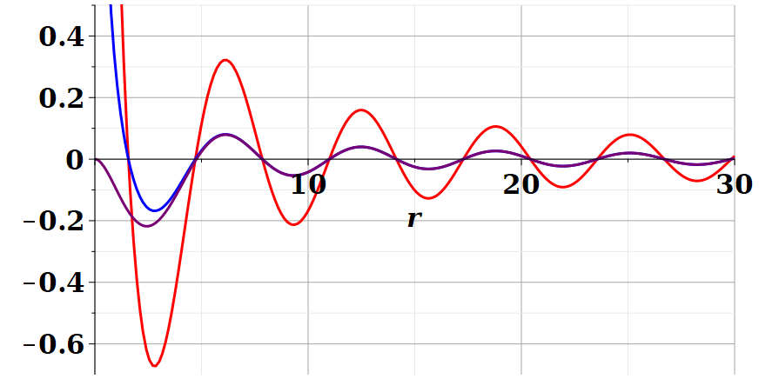
Example continued
For kR=1
Dipole approximation
Re(Ã(r,ω))
/R
exact
Blue curves represent long range part of exact expression
For kR=0.1
Dipole approximation
Re(Ã(r,ω))
exact
/R
Notes:
Comparing the values of the vector potential calculated using the asymptotic expansion (r→infinity) with the exact evaluation. You see that the difference occurs only within the source extent.

Slide 18
Electromagnetic waves from time harmonic sources – continued:
Note: in this case we have assumed a restricted extent of the source such that kr’<<1 for all r’ with significant charge/current density.
Notes:
In the long wavelength limit, the dipole approximation is numerically close to the physical situation.

Slide 19
Electromagnetic waves from time harmonic sources –
considering the dipole approximation:
Notes:
Continued analysis of vector and scalar potential fields following Jackson Section 9.2.

Slide 20
Relating dipole radiation results to notation in Jackson --

Slide 21
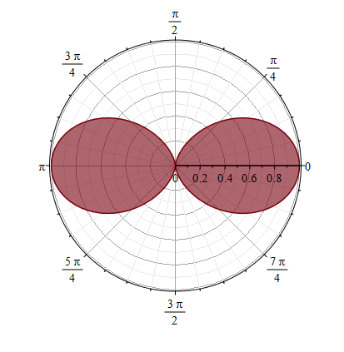
Properties of dipole radiation field for kr >>1:
z
Example:
r
θ
p
E
Note that vectors r, E, B are mutually orthogonal
y
x
B
Notes:
Geometric properties of dipolar fields.

Slide 22
Now consider an alternative approach to the spherical Bessel function expansion (neglecting the homogeneous solutions --
Notes:
Up to now, we have worked with the exact spherical harmonic expansion, evaluating the results in certain limits. Now consider analyzing the Green’s function integral directly without use of Bessel functions. You may recognize this treatment as the Born approximation encountered in quantum mechanical scattering theory.

Slide 23
For our example:
➔Results equivalent to Bessel function expansion in the limit kr → ∞.
Notes:
This approach is similar to the Bessel function expansion if more terms were used.

Slide 24
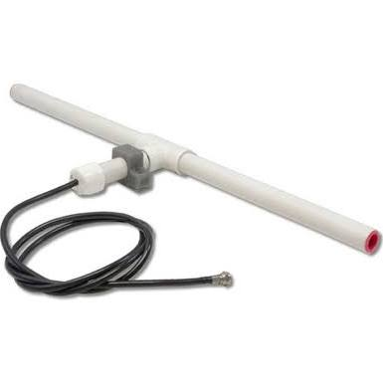
r
Other time harmonic
radiation sources analyzed using the
``alternative approach’’
Linear center-fed antenna
z
θ
d/2
Notes:
Up to now, we have been thinking about sources on the atomic scale. The analysis also works for macroscopic sources such as antennas. This example which follows your textbook is called a center fed antenna.

Slide 25
Consider antenna source (center-fed)
r
z
d/2
θ
φ
y
d/2
x
25
Notes:
Specifically, consider an antenna. For convenience, we are using a slightly different notation from the previous lecture as noted at the top of the slide.

Slide 26
Alternative approach – linear center-fed antenna continued
Notes:
Analyzing the vector potential in this “Born” approximation, we obtain an analytic result for the radiation distribution.

Slide 28
Alternative approach – linear center-fed antenna continued
Notes:
The radiation pattern is quite sensitive to the relationship between the antenna length d and the wavelength of the radiation.

Slide 29
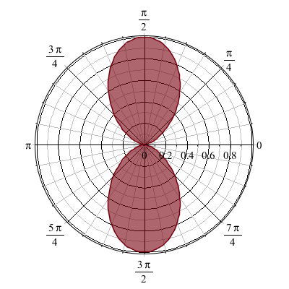
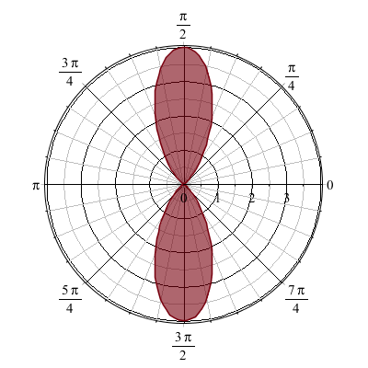
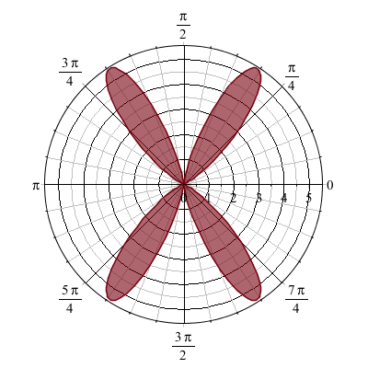
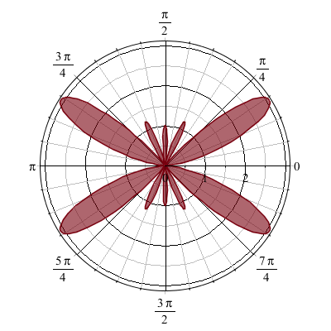
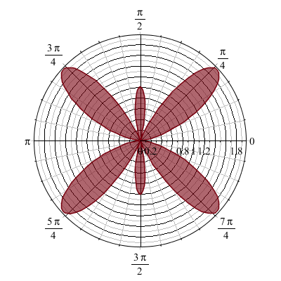
Alternative approach – linear center-fed antenna continued
kd=π 2π 3π 4π 5π
Interesting patterns for special values of kd
Notes:
Here are some polar plots of the radiation patterns for various cases.

Slide 30
Some details --
kd=π 2π 3π 4π 5π
Polar plot:
Angle indicates values of theta
Radius indicates value scaled to 1.
θ

