Slide 1
PHY 712 Electrodynamics
10-10:50 AM MWF Olin 103
Notes for Lecture 27: Theory of Special Relativity
    Chap. 11 – Sec. 11.1-11.7,11.9 in JDJ)
      Lorentz transformation relations
      Electromagnetic field transformations
      Connection to Liénard-Wiechert potentials for constant velocity sources
Notes:
In this lecture, we will continue our discussion of Special Relativity. In particular, we will discuss how the E and B fields transform between two relatively moving reference frame. Using a particular example, we will be able to show that our results for transformed fields are consistent with the results we obtain using the analysis using the Lienard-Wiechert potentials discussed earlier.

Slide 2
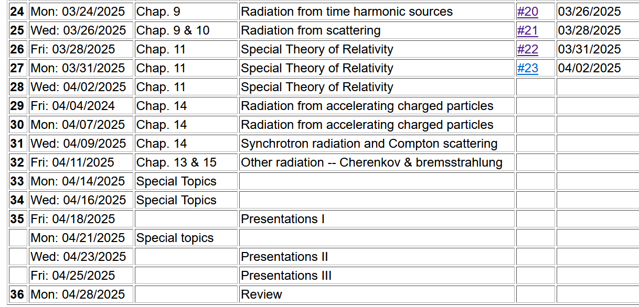
Class time shifted to
9 AM

Slide 3
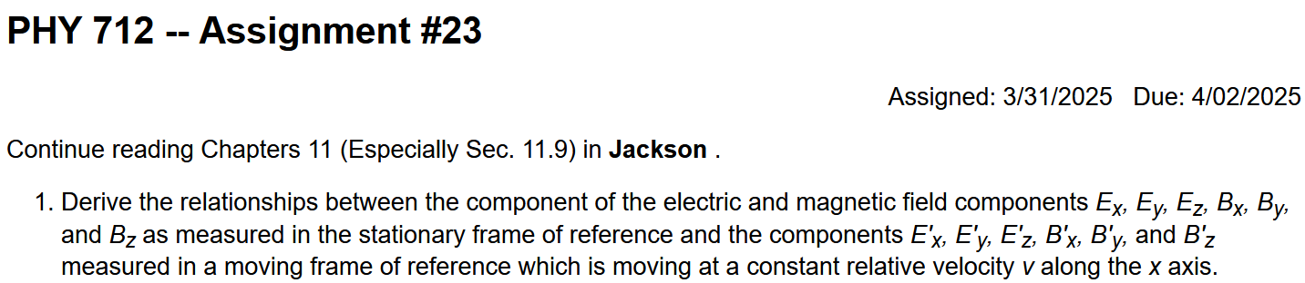

Slide 4

Crazy colloquium schedule for this week

Slide 5
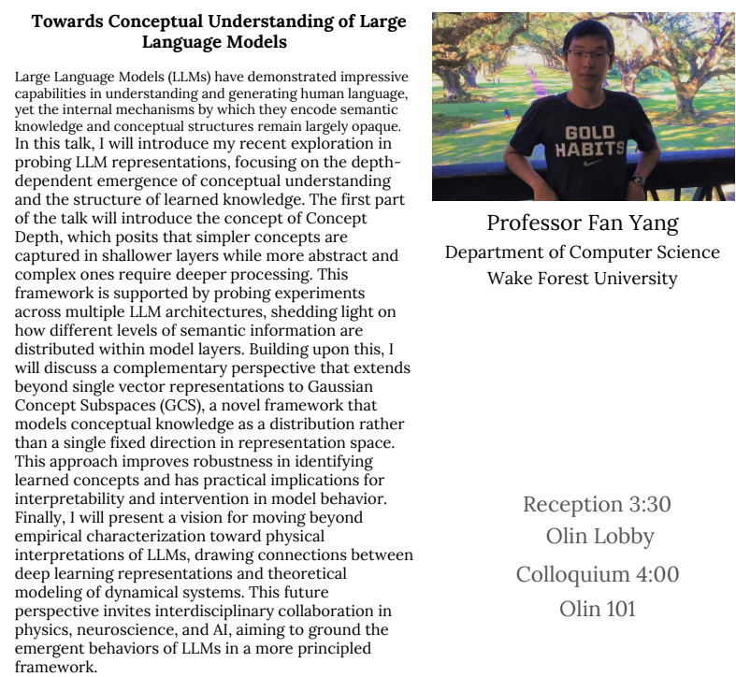
Wednesday
4/2/2025

Slide 6
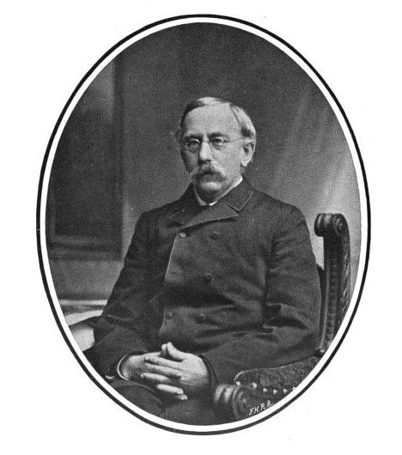
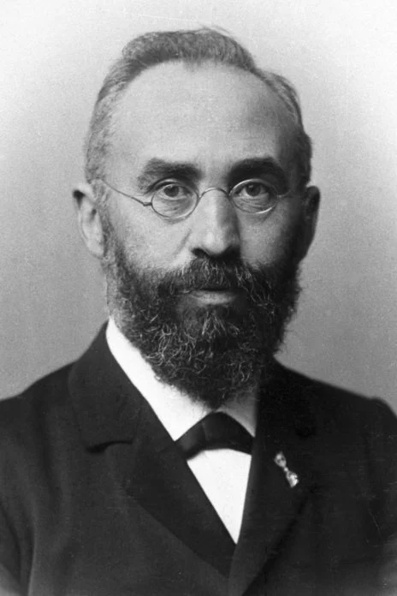
Reminder – L. V. Lorenz and H. A. Lorentz
Ludvig Valentin Lorenz
1829-1891
➔Lorenz gauge
Hendrik Antoon Lorentz
1853-1928
➔Lorentz transformation

Slide 7
Lorentz transformations
y
y’
v
x
x’
y’
y
x’
x
Notes:
We will continue to use the stationary and moving reference frames introduced in the previous lecture. In this case, the relative motion is along the x-axis. Of course, there is nothing special about this choice, but we will use it throughout this lecture.

Slide 8
Lorentz transformations -- continued
Notes:
This slide reviews the transformations of the time and position 4-vector.

Slide 9
Velocity relationships
➔

Slide 10
Special theory of relativity and Maxwell’s equations
Maxwell’s equations in any inertial reference frame:
Notes:
This slide reviews the relevant equations for the continuity of our sources, and for Maxwell’s equations in terms of the scalar and vector potentials, and for the relationship of the E and B fields to the scalar and vector potentials.

Slide 11
More 4-vectors:
Notes:
Here we identify 4-vectors of time-position, charge and current sources, and scalar and vector potentials.

Slide 12
Lorentz transformations
Repeated index summation convention
Notes:
It is reasonable to postulate that each of these three 4-vectors transform from one reference frame to another with the Lorentz transformation.

Slide 13
4-vector relationships
Notes:
In addition to the 4-vectors we have defined up to now, which are written with an upper index alpha, we will also need to define a lower index version of the 4-vector which just means that the space part is taken with a minus sign. We also need a notation for derivatives with respect to time and space given with the partial symbol. It turns out that for consistency, the upper and lower signs needed for the derivative operator, the upper and lower signs must be given as indicated. While Jackson’s conventions are consistent throughout his text, other textbooks may use other sign conventions.

Slide 14
Special theory of relativity and Maxwell’s equations
➔
➔
➔ ??
Notes:
Here we exercise our new notation to write the important equations. I have to admit that the new notation looks quite compact, (pretty, intriguing?) But what about the E and B fields, how does the new notation work for them?

Slide 15
From the scalar and vector potentials, we can determine the E and B fields and then relate them to 4-vectors, finding --
Notes:
Writing out the 6 equations for all of the E and B field components, we see that the new notation has a very nice pattern, but each field component has two indices!!! We can thus conclude that the 6 E and B field components are part of a 4x4 matrix or tensor.

Slide 16
Field strength tensor
For stationary frame
For moving frame
Notes:
Therefore we can define the field strength tensor and assign each of the 6 field components and their negative values to an entry in the 4x4 field strength tensor. From this logic, we can then deduce that the field strength tensor transforms as a tensor with a Lorentz transformation sandwich. Evaluating the multiplication of the three matrices, we obtain the result given on the last line.

Slide 17
Summary --
Field strength tensor

Slide 18
➔ This analysis shows that the E and B fields must be treated as components of the field strength tensor and that in order to transform between inertial frames, we need to use the tensor transformation relationships:
Transformation of field strength tensor
Notes:
Therefore we can define the field strength tensor and assign each of the 6 field components and their negative values to an entry in the 4x4 field strength tensor. From this logic, we can then deduce that the field strength tensor transforms as a tensor with a Lorentz transformation sandwich. Evaluating the multiplication of the three matrices, we obtain the result given on the last line.

Slide 19
Inverse transformation of field strength tensor
Notes:
Using the same logic, it is possible to evaluate the inverse transformation. The last result is the same as given in Jackson Eq. 11.148.

Slide 20
Comparison of the two transformations
Notes:
Comparing the various transformations.

Slide 21
Example:
y
y’
v
b
q
x
x’
z
z’
Notes:
Now, consider a particular example discussed in Section 11.10 of Jackson. A particle sits at the origin of the moving frame. The E and B fields are measured at the point b along the y axis in the stationary frame. What are the values of the fields measured in the stationary frame?

Slide 22
Example:
y
y’
v
b
q
x
x’
z
z’
Notes:
It is easy to write the fields in the moving frame, since the particle is stationary in that frame. Then we use the transformation equations to find the fields in the stationary frame. We are not quite done, because the expressions involve the time measured in the moving frame.

Slide 23
Example:
y
y’
v
b
q
x
x’
z
z’
Expression in terms of consistent coordinates
Notes:
Using the time-coordinate transformation we can then write the fields measured in the stationary frame in terms of the time appropriate to that frame.

Slide 24
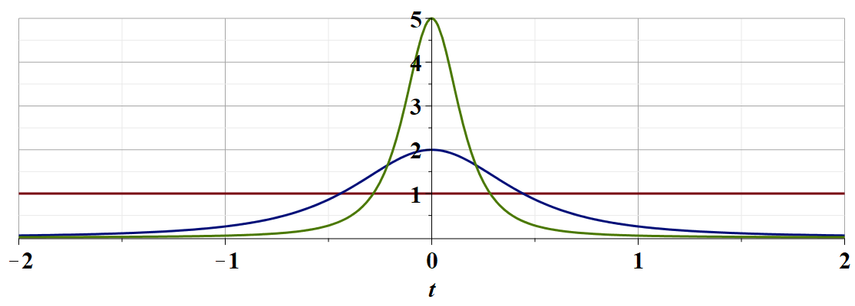
γ_{v}=5
γ_{v}=2
γ_{v}=1
c
Notes:
This plot shows the y component of the electric field as measured in the stationary frame plotted as a function of time. For large gamma, there is a large peak at t=0.

Slide 25
Examination of this system from the viewpoint of the
the Liènard-Wiechert potentials (temporarily keeping SI units)
Notes:
Do these results make sense? In order to check the results, we can calculate the fields directly in the stationary frame using the methods we discussed several lectures ago using the Lienard-Wiechert potentials. Here we review some of those equations.

Slide 26
Examination of this system from the viewpoint of the
the Liènard-Wiechert potentials – continued (SI units)
Notes:
More equations.

Slide 27
Examination of this system from the viewpoint of the
the Liènard-Wiechert potentials – continued (SI units)
Notes:
Finally the E and B fields obtained from that analysis.

Slide 28
Examination of this system from the viewpoint of the
the Liènard-Wiechert potentials – (Gaussian units)
Notes:
Here are the equations in cgs Gaussian units that we are now using.

Slide 29
Examination of this system from the viewpoint of the
the Liènard-Wiechert potentials – continued (Gaussian units)
Notes:
Now to evaluate the equations, we need to consider the constant velocity trajectory of our example. We will continue this discussion on Wednesday.

Slide 30
Summary --
y
y’
v
b
q
x
x’
z
z’
Is this result consistent with the the Liènard-Wiechert analysis?

