Slide 1
PHY 712 Electrodynamics
10-10:50 AM MWF Olin 103
Class notes for Lecture 2:
Reading: Chapter 1 (especially 1.11) in JDJ;
More comments on the electrostatic potential energy
Calculation of the electrostatic energy for a finite system
Electrostatic energy in terms of electrostatic fields
Electrostatic energy of extended systems -- introduction to Ewald summation methods
Notes:
This lecture details some special properties of the electrostatic energy of finite and extended systems. It illustrates some special properties of the long range nature of the Coulomb interaction. Ewald summation methods may or may not be important for your particular field of study. However, it is at least important to be aware of the ideas.

Slide 2
Reminder:
4 PM Olin 101

Slide 3
Your questions –
From Edoardo – "When computing the electrostatic energy of a discrete distribution of point-like charged particles we take into account only the electrostatic interactions. Thus, for some configurations, the value can be < 0. In the case of a continuous distribution, we also include the self-interaction energies, and the total electrostatic energy is always > 0 (it is proportional to the square of the electric field). Can we think about the self-interaction terms as the energy to generate the sources of the electric field?“
From Pablo – “Why shouldn't there be a self interaction considered in the energy of a discrete system? How is the energy density defined in this case?”

Slide 4
Notes:
The homework problem assigned this time exercises the ideas presented in this lecture.

Slide 5
Example in HW2

Slide 6
Calculation of the electrostatic energy of a system of charges --

Slide 7
Example finite charge system for which electrostatic energy W can be calculated in a straightforward way
2
3
Charge -e
1
5
4
Charge +e
6
(particles moves off to infinity)
Notes:
Summation for a finite number of particles is straightforward, but extension to an infinite system runs into difficulty.

Slide 8
Summary --

Slide 9
Slight digression:
Comment on electrostatic energy evaluation --
When the discrete charge distribution becomes a continuous charge density: the electrostatic energy
becomes
Notice, in this case, it is not possible to exclude the ``self-interaction''.
Previous expression can be rewritten in terms of the electrostatic potential or field:
Notes:
We will see and use these expressions throughout the course. However, the so-called self energy often leads to difficulties….

Slide 10
Some details --

Slide 11
Summary for continuum --
Electrostatic energy
Note that, because of the inclusion of the self-interaction energies, there may be mathematical divergences involved in evaluating these quantities.

Slide 12
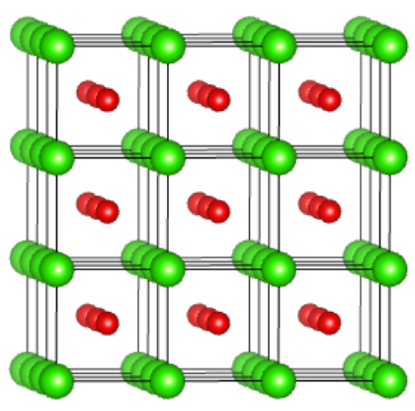
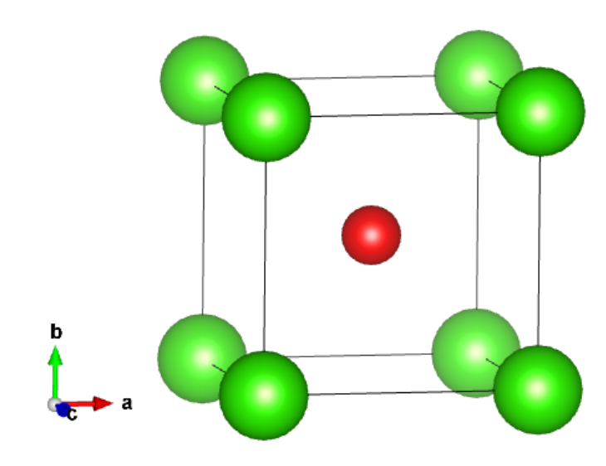
In general, the evaluation of the electrostatic energy of an extended system can be numerically tricky because of the long range nature of the Coulombic forces.
Now consider the electrostatic energy of a periodic crystal of CsCl
Cl
Cs
Single cell
Multiple cells

Slide 13
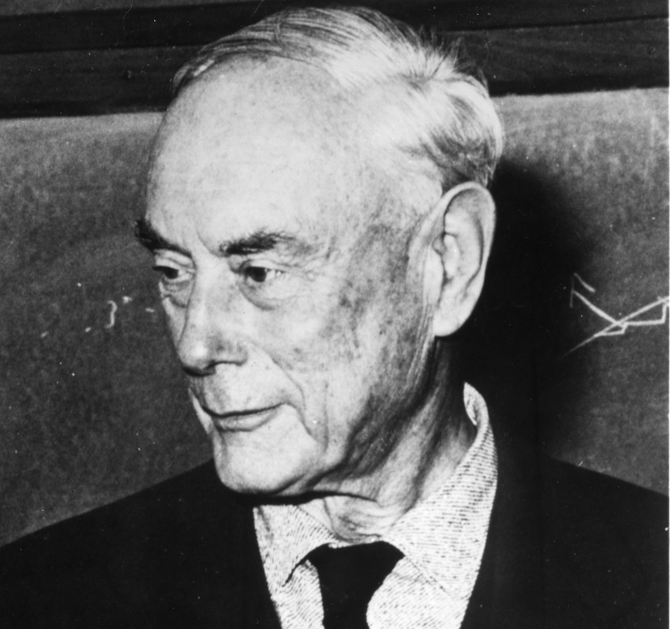
In general, the evaluation of the electrostatic energy of an extended system can be numerically tricky because of the long range nature of the Coulombic forces.
However, thanks to very clever mathematicians, it is possible to perform this sort of calculation for periodic systems.
Ewald, Paul Peter, 1888-1985
American crystallographer, emigrated from Germany

Slide 14
The direct summation of the electrostatic terms of an infinite ionic system diverges, however using Ewald’s ideas the single divergent summation can be represented by two converging summations (plus a few corrections).
The formula that we will derive and use for a lattice with periodic real space translations T and reciprocal space translations G is:
➔See Ewaldnotes.pdf

