Slide 1
PHY 712 Electrodynamics
10-10:50 AM MWF Olin 103
Class notes for Lecture 3:
    Reading: Chapter 1 (especially 1.11) in JDJ;
      Continued discussion/derivation of Ewald summation methods
      Example for CsCl

Slide 2
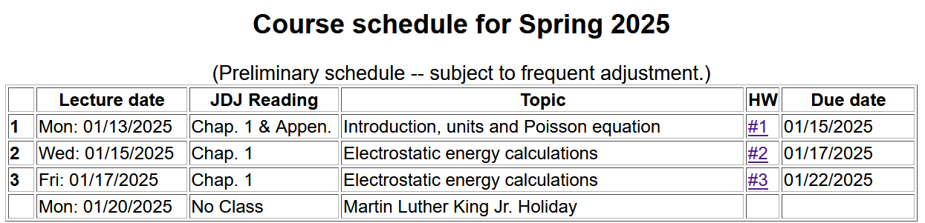

Slide 3
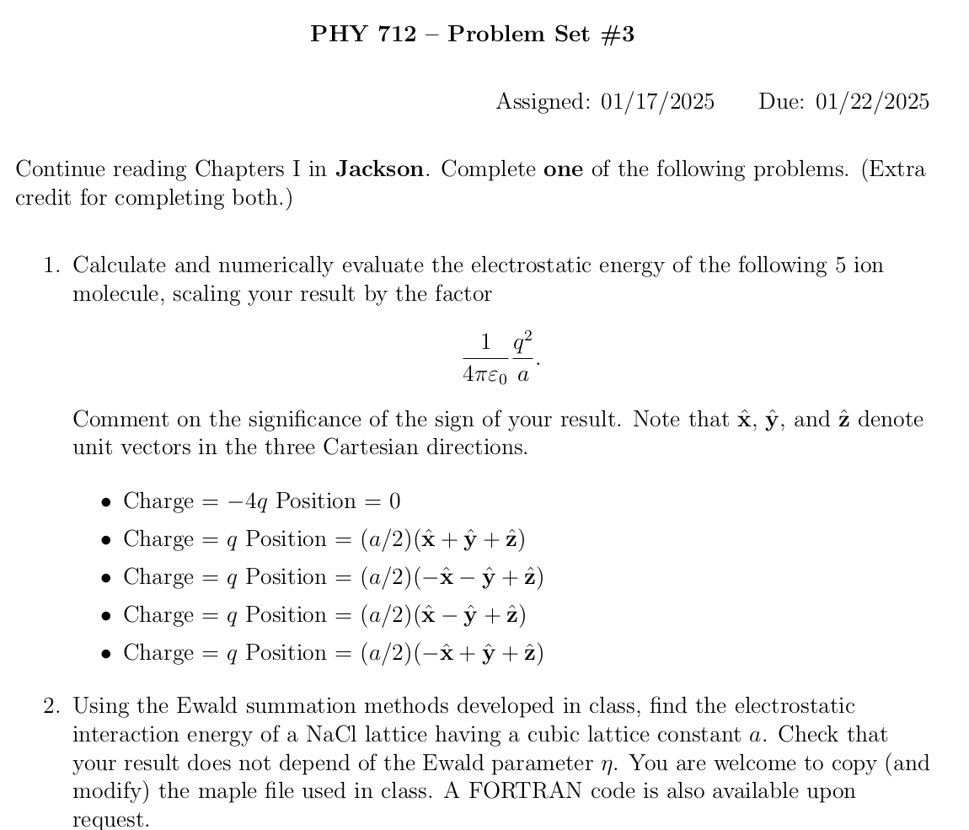

Slide 4
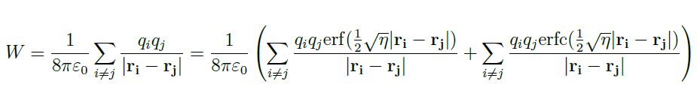
Last time, we argued that we need to carry out the following summation of all pairs of ions using Ewald’s very clever trick with the erf and erfc functions:
Must be evaluated in “reciprocal” space
Can be converged as is (in real space)
In order to make progress, we need to systematically enumerate all of the ion positions in the system

Slide 5
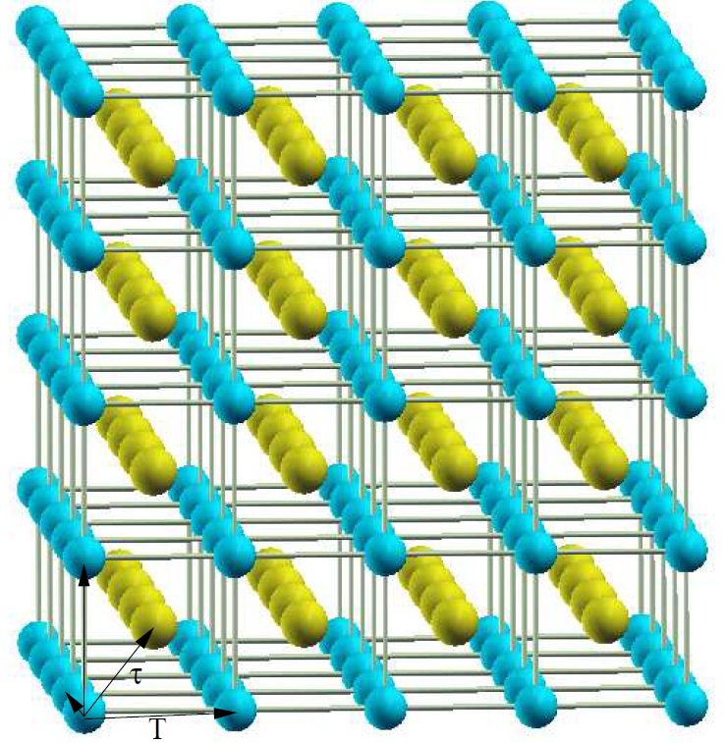
Using CsCl as our example system
Cs
Cl
Notice that a unit cell contains one Cl and one Cs

Slide 6
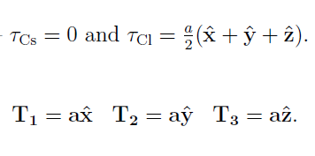

For CsCl --
a
Note that in general --

Slide 7
Note – this works for CsCl and more generally

Slide 8
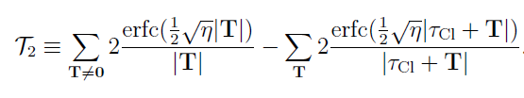
For CsCl:
q_{Cs}=e
q_{Cl}=-e

Slide 9

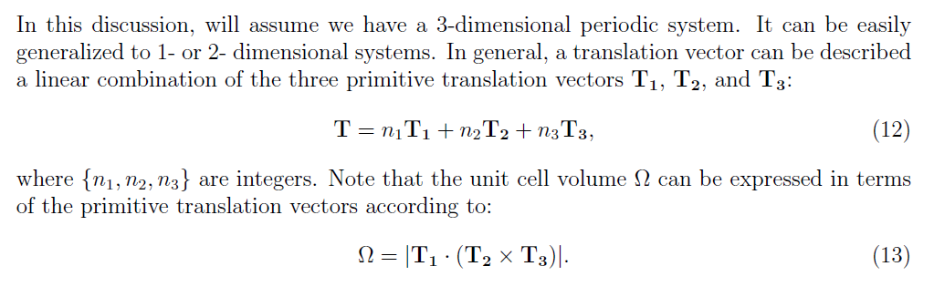
For evaluating w₁ which needs to be evaluated in reciprocal space, additional considerations are needed --
It can be shown that --
Volume of unit cell
in real space

Slide 10
Preview – what happens if
is true?
Subtract out self-energy contribution

Slide 11
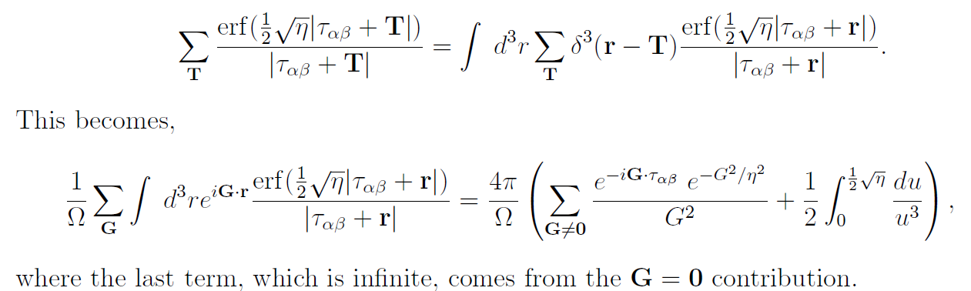
Continued --
Preview – what happens if
is true?

Slide 12
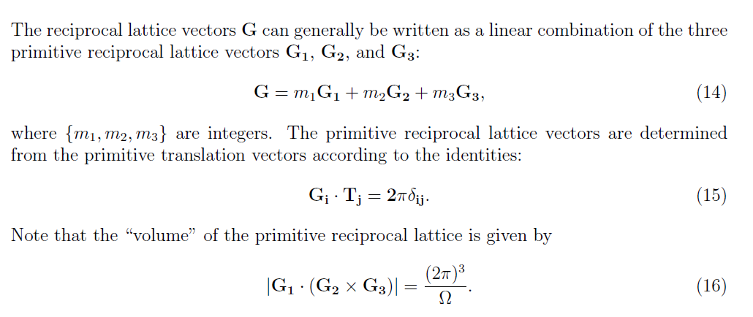
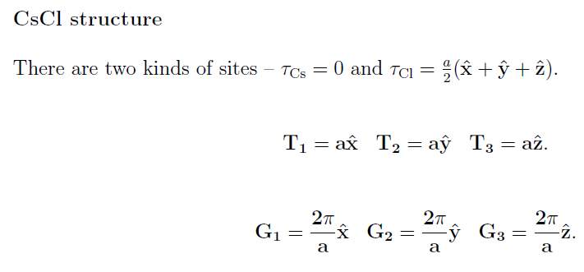
Back to “proof” --
Example --

Slide 13
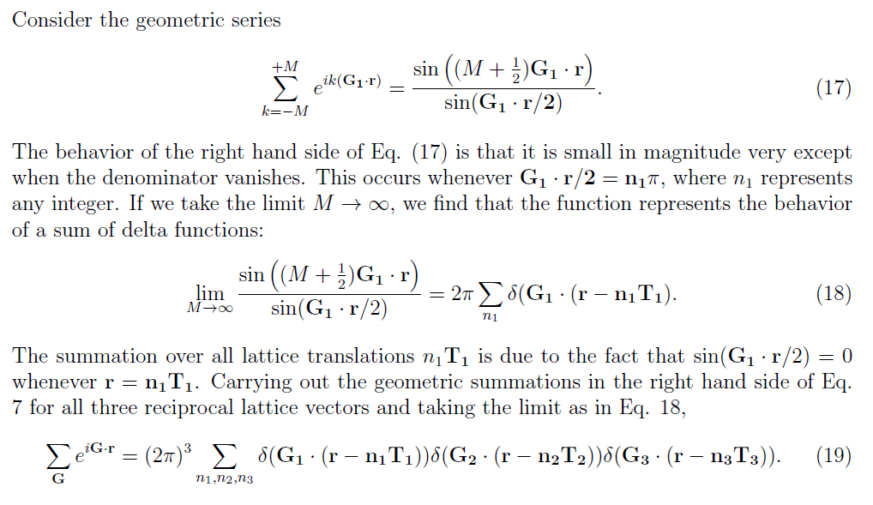
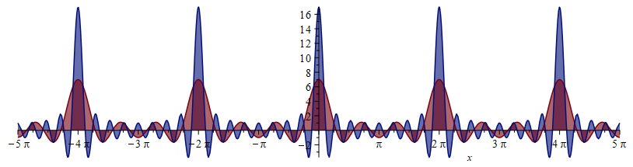
Consider the summation;
Behavior of function for various values of M:
M=8
M=3

Slide 14
“Proof” of identity --

Slide 15
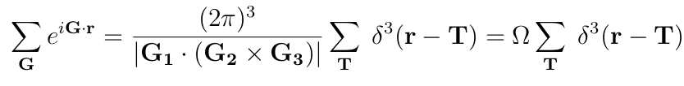
Final result --

Slide 17


divergent results
+ appropriate changes of variables and order of integration

Slide 18
Divergent term

Slide 19
Problem – Electrostatic energy of a periodic non-neutral system is not defined!
Solution -- Add uniform compensating charge and find the electrostatic energy of periodic neutral system, carefully analyzing diverging terms to determine a convergent expression.

Slide 20
Some details
Cancels divergence
Extra contribution

Slide 21
For CsCl --
a

Slide 22
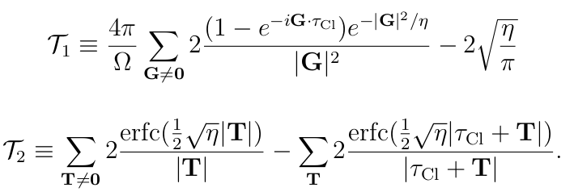
➔Can be evaluated using Maple or Mathematica or other programming language

Slide 23
The Madelung constant is referenced in many textbooks as:
From Kittel’s textbook:
For NaCl α= 1.747565
CsCl α= 1.762675
ZnS α= 1.6381

